Slide 1
Deep Learning in Spatial Transcriptomics Intro to Neural Networks - Backward Pass
Caleb Hallinan
09/29/2025
10x Xenium Breast Cancer Data

Slide 2
Today’s class
Brief refresher on forward pass of a neural network
What is a backward pass entail? How does it work to train a neural network?
Next class:
Commonly used NN modifications (ex. Dropout) and intro to convolutional neural networks
Future class:
How to code in Pytorch

Slide 3
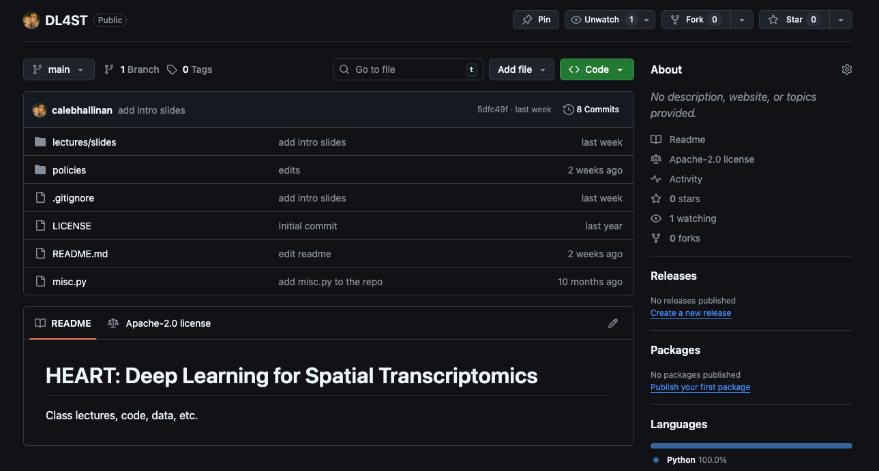
GitHub for class
Now public, recommend connecting to local folder as we will begin using code today

Slide 4
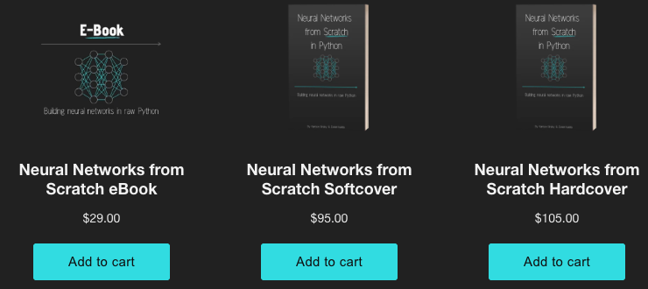
Neural Networks from Scratch in Python
https://nnfs.io/order
https://github.com/Sentdex/nnfs_book/tree/main

Slide 5
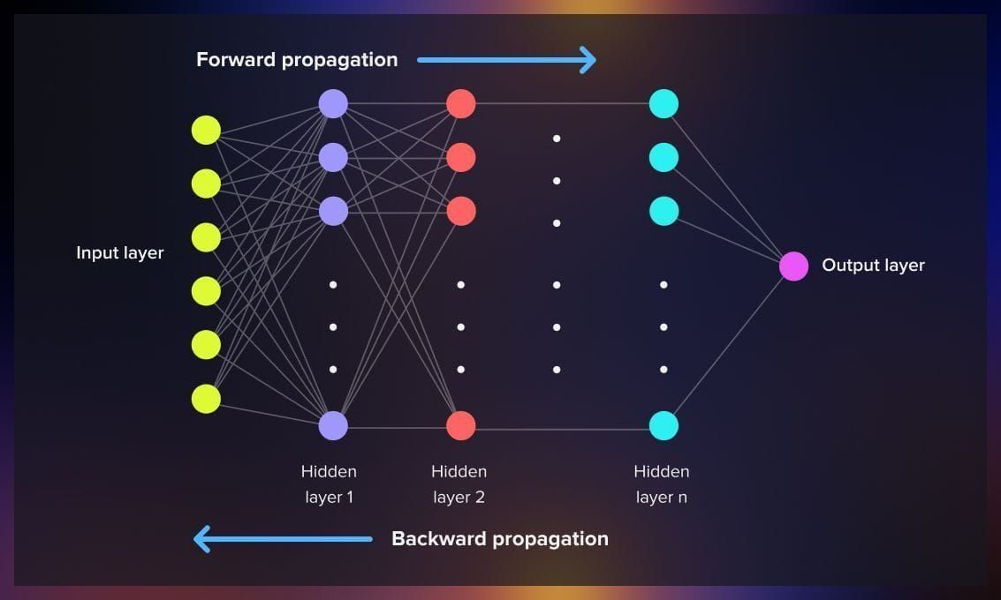
Today’s coding
Brief Review: How do NN do forward propagation?
How do NN do backward propagation?

Slide 6
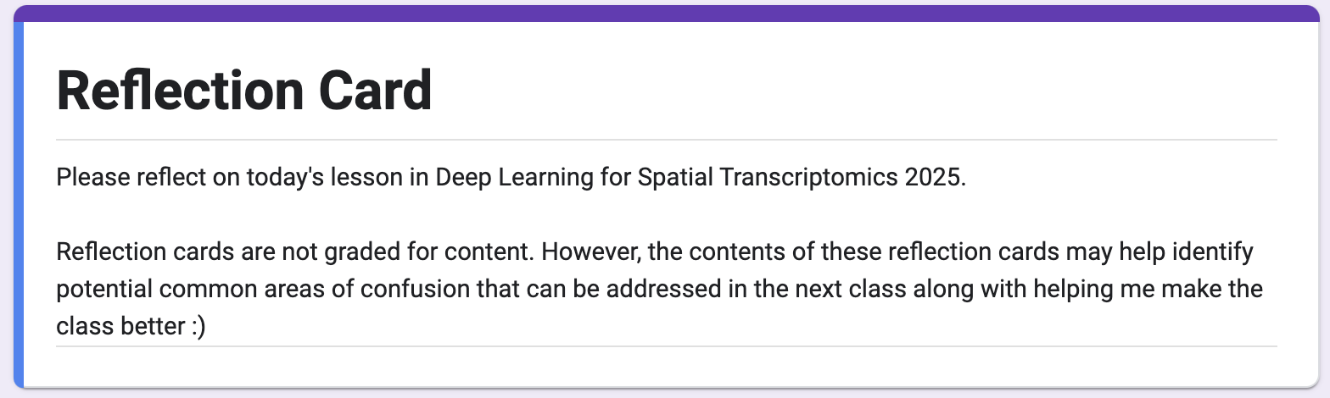
Reflection Cards
Essentially a means to help me make this class better!
What is something that you learned in today's lecture?
What is something that you are still confused about from today's lecture?
Do you have any other comments/feedback/thoughts/suggestions/concerns?
https://forms.gle/zHEEmRuEByVjHFDa9

