Slide 1
Deep Learning for Spatial Transcriptomics Introduction to Pytorch
Caleb Hallinan
10/??/2025
10x Xenium Breast Cancer Data
Notes:
Data

Slide 2
Today’s class
Review on Convolutional Neural Networks
https://medium.com/thedeephub/convolutional-neural-networks-a-comprehensive-guide-5cc0b5eae175
Introduction to Pytorch

Slide 3
Convolutional Neural Networks

Slide 4
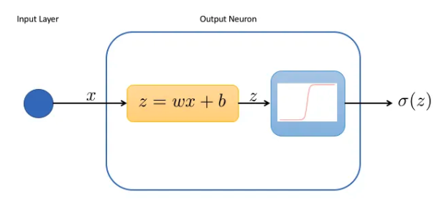
We know about the basic NN

Slide 5
NN example on an image
Doesn’t always capture the features we want… why?

Slide 6

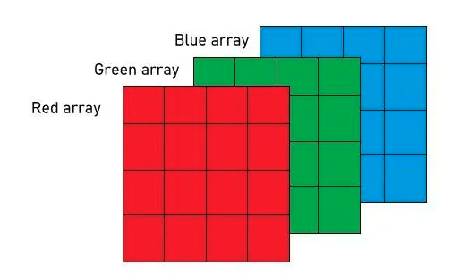
What is an image?
=
Three channels (matrices) stacked on top of each other
So how can we preserve spatial information in the image for a NN?

Slide 7
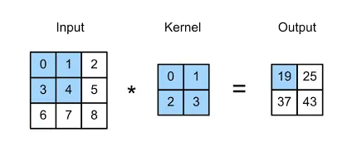
Convolutional Operation
Output matrix is known as a feature map!

Slide 8
Kernels

Slide 9
There are typically separate kernels for each channel

Slide 10
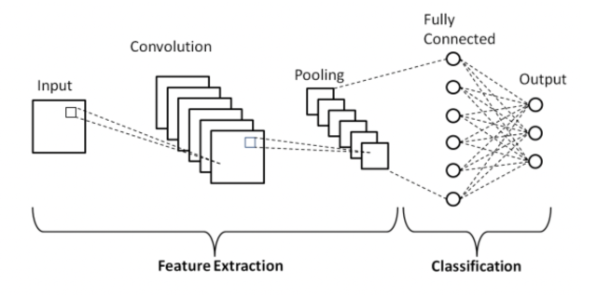
Depth
The ‘depth’ of a layer refers to the number of kernels it contains. Each filter produces a separate feature map, and the collection of these feature maps forms the complete output of the layer
DEPTH

Slide 11
Why would we want more kernels/feature maps?

Slide 12
Stride
Stride refers to the number of pixels by which a kernel moves across the input image.
Stride 1
Stride 2

Slide 13
Why would we want a smaller or bigger stride?
Notes:
Increasing the stride will allow the filter to cover a larger area of the input image, which can be useful for capturing more global features.
In contrast, lowering the stride will capture finer and more local details.
In addition, increasing the stride will control overfitting and reduce computational efficiency as it will reduce the spatial dimensions of the feature map.

Slide 14
Padding
Padding refers to the addition of extra pixels around the edge of the input image.
Padding = 1

Slide 15
Why would we want to add padding?
Notes:
Mainly when the edges of the image contain useful information that you want to capture.

Slide 16
What is Pooling?

Slide 17
Pooling
Main objective is dimensionality reduction
Pooling layers do not reduce the number of channels
Each pooling operation is applied independently to each channel of the input data

Slide 18
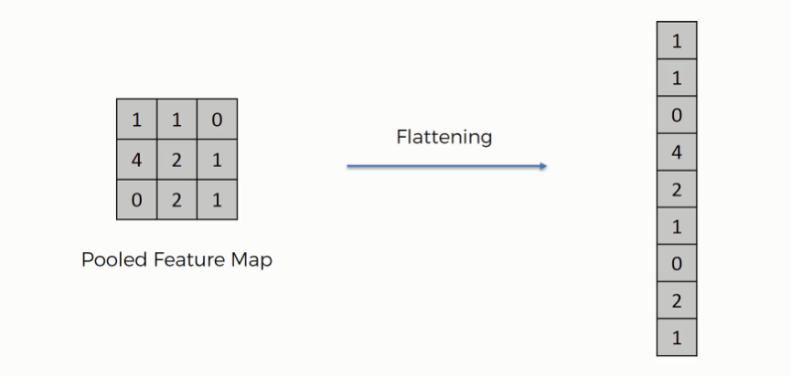
Flattening layer (last layer)

Slide 19
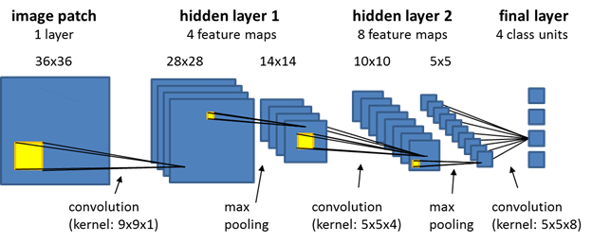
All together so far

Slide 20
Why do we need Dense Layers in a CNN?
Notes:
While convolutional layers are good at detecting features in input data, dense layers are essential for integrating these features into predictions.
For example, if we design a convolutional neural network for facial recognition, early layers might detect edges and textures, while dense layers might interpret these to recognize specific facial features.

Slide 21
But what are we missing here? 🤔

Slide 22
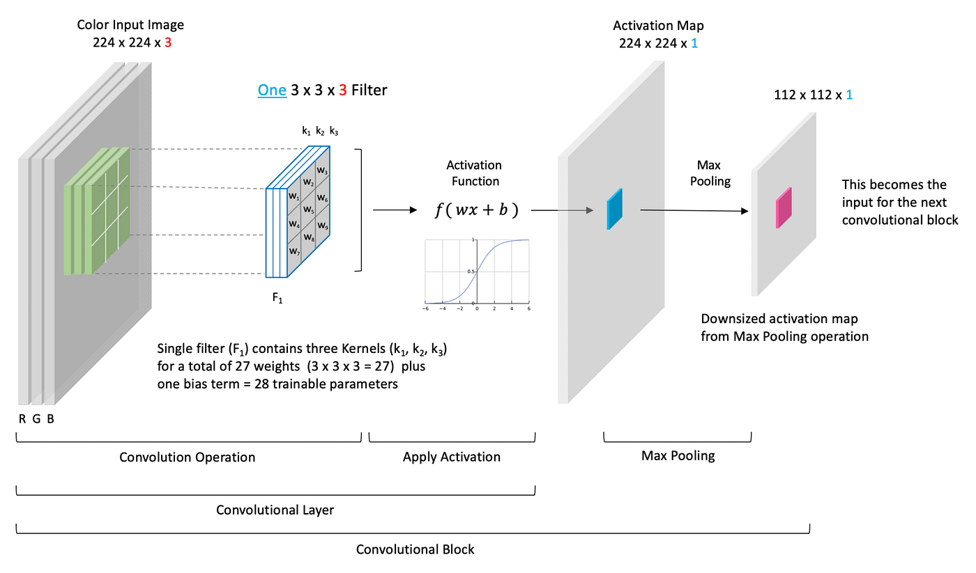
Activation Functions!

Slide 23

Full CNN

Slide 24
Intro to Pytorch

Slide 25
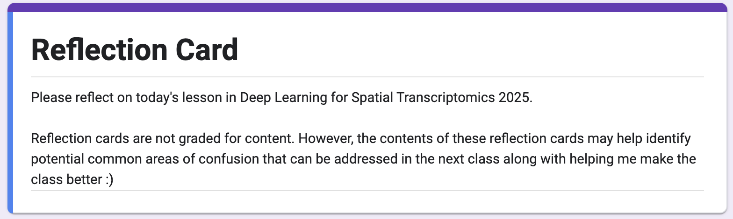
Reflection Cards
Essentially a means to help me make this class better!
What is something that you learned in today's lecture?
What is something that you are still confused about from today's lecture?
Do you have any other comments/feedback/thoughts/suggestions/concerns?
https://forms.gle/QwjjUPFD8YFThhyL9

