Slide 1

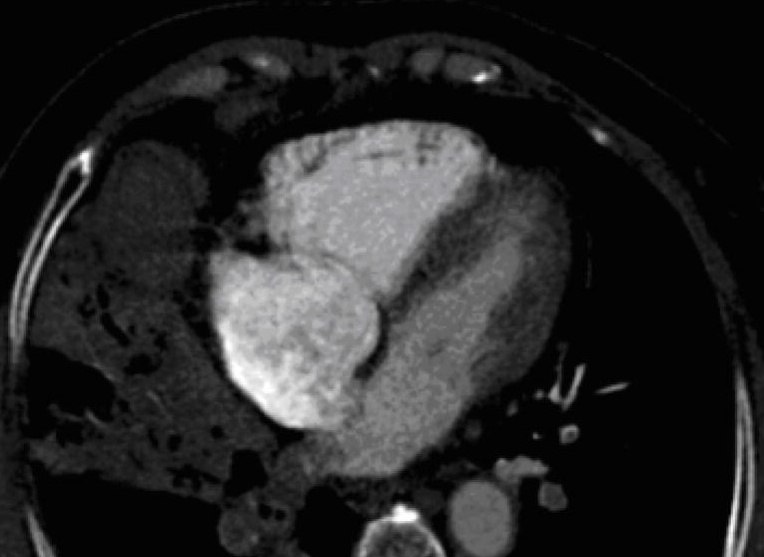
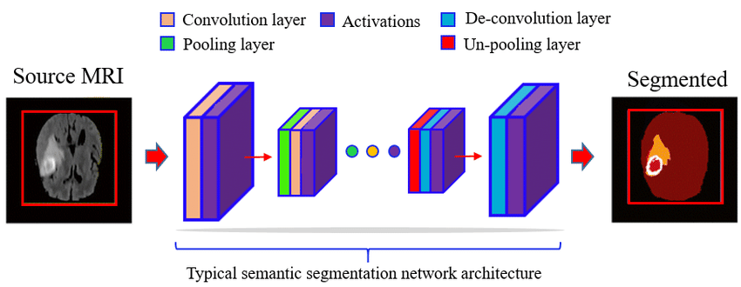
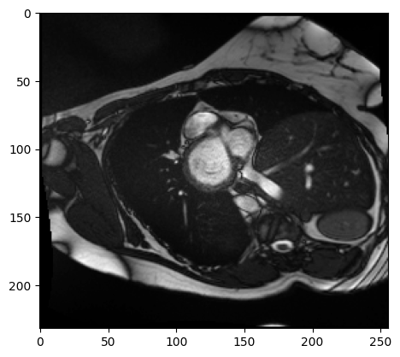
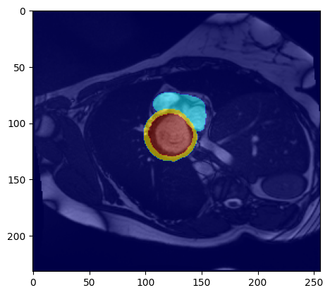
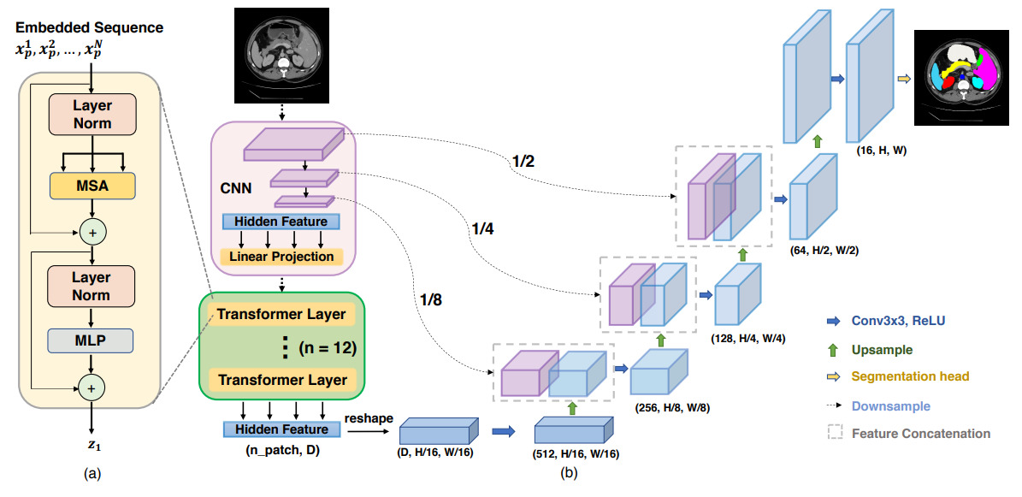
Evaluating Deep Learning Techniques for Segmenting and Classifying Cardiac MRI Images
Nidhi Soley, Marcus Rhodehamel, and Caleb Hallinan
Problem Statement
Overall Approach
Cardiac MRI serves as a gold standard for determining patient cardiac function: stroke volume, left and right ventricle ejection fraction, myocardial wall thickness, and left ventricle mass (Miller et al., 2013).
Automated cardiac MRI segmentation is a key challenge in the clinical cardiology community as the process is time consuming for doctors requiring need for fully automated characterization.
Cardiac MRI requires multiple planes of view for complete interpretation, is highly noisy due to dynamic movement of the heart, and highly subjective.
Leverage cutting-edge deep learning methodologies for segmentation of the left and right ventricular endocardium and epicardium, facilitating a comparative analysis with traditional techniques and outcomes.
- Traditional UNet, UNet++, TransUNet, ResNet, etc.
Assess the accuracy of deep learning classification models in distinguishing between the five specific heart conditions using relevant features.
- KNN, Perceptron, Multi-layered perceptron, etc.
Example of cardiac MRI in 4-chamber plane (Lu et al., 2007)
Dilated Cardiomyopathy
Patient 101 frame 1
Dilated Cardiomyopathy
Patient 101 frame 1
Figure adapted from Altaf et al., 2019
Solution
Milestones
Try to outperform previous users/methods in segmentation and classification
- Last and final leaderboard update was November 2022
Measure how far state-of-the-art deep learning methods can go at assessing multi-planar CMRI images:
- Segmenting the left and right ventricles
- Classifying disease state based on tissue morphology
- Analyzing cardiac wall thickness and spatial orientation of tissue.
- Determining model performance via DSC, F1-score, and classification accuracy
Segmentation of Ventricles & Myocardium:
Traditional UNet Analysis
- Evaluate the performance of the Traditional
UNet model.
UNet++ & TransUNet Evaluation
- Assess how different UNet variations compare in terms of accuracy and efficiency.
III. Exploration of Various DL Models
- Investigate additional cutting-edge deep learning models for potential improvements (ex. ResNet).
Classification of Pathologies:
Perceptron Testing
- Analyze the feasibility of using a single-layer perceptron.
MLP Performance
- Test the Multi-Layer Perceptron (MLP) to gauge its effectiveness over the perceptron.
More Advanced Methods
- Examine other state-of-the-art deep learning methods to enhance classification results.
Overview of TransUNet (Chen et al., 2021)
Dataset from the Automated Cardiac Diagnosis Challenge (ACDC) https://www.creatis.insa-lyon.fr/Challenge/acdc/index.html
(Bernard et al., 2018)
Note: We have access to a GPU
Notes:
look into segmamba or normal mamba for this project
May need to use pretrained weights
1. run mamba
2. test segmentation and classification at the same time
3. traditional UNET, maybe others

Slide 2
References
O. Bernard, A. Lalande, C. Zotti, F. Cervenansky, et al. "Deep Learning Techniques for Automatic MRI Cardiac Multi-structures Segmentation and Diagnosis: Is the Problem Solved ?" in IEEE Transactions on Medical Imaging, vol. 37, no. 11, pp. 2514-2525, Nov. 2018
C. A. Miller et al., "Quantification of left ventricular indices from SSFP cine imaging: Impact of real-world variability in analysis methodology and utility of geometric modeling", J. Magn. Reson. Imag., vol. 37, no. 5, pp. 1213-1222, 2013.
Lu MT, Ersoy H, Whitmore AG, Lipton MJ, Rybicki FJ. Reformatted Four-Chamber and Short-Axis Views of the Heart Using Thin Section (</=2 mm) MDCT Images. Acad Radiol. 2007 Sep;14(9):1108-12. doi: 10.1016/j.acra.2007.05.019. PMID: 17707319; PMCID: PMC2706116.
Altaf, Fouzia & Islam, Syed & Akhtar, Naveed & Janjua, Naeem. (2019). Going Deep in Medical Image Analysis: Concepts, Methods, Challenges and Future Directions. IEEE Access. PP. 1-1. 10.1109/ACCESS.2019.2929365.
Chen, J., Lu, Y., Yu, Q., Luo, X., Adeli, E., Wang, Y., ... & Zhou, Y. (2021). Transunet: Transformers make strong encoders for medical image segmentation. arXiv preprint arXiv:2102.04306.

