Slide 2
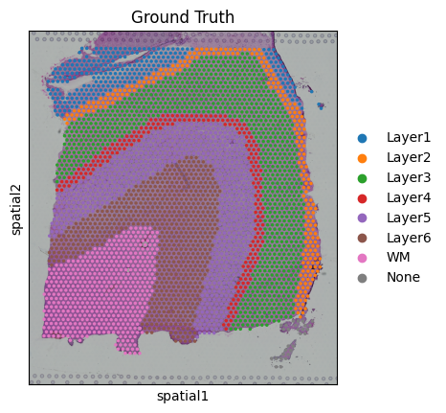
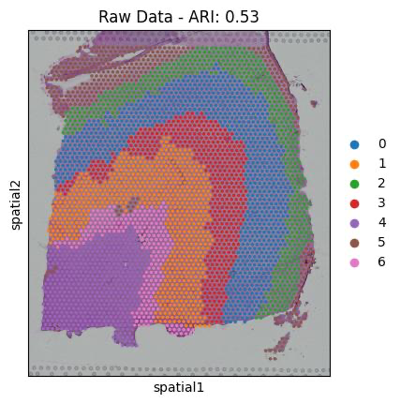
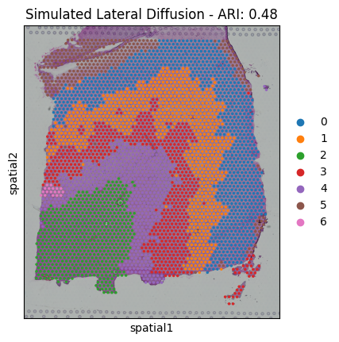
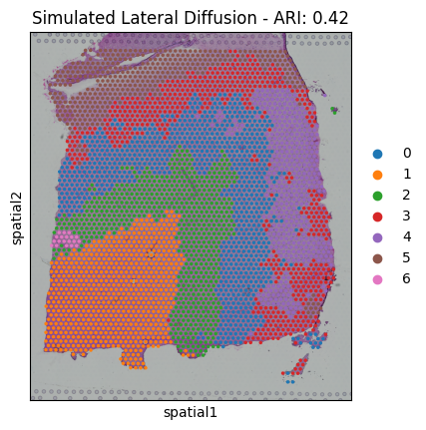
Here we see the effects of DeepST clustering when increasing the lateral diffusion of the top 100 SVGs. The third figure is giving 1 transcript count to the 6 nearest neighbors from each cell while the last is giving 2 transcript counts

Slide 3

