Slide 1


Inversion of Control
Matt Hinze
Senior Consultant, Headspring
matt@headspring.com
@mhinze
http://mhinze.com

Slide 2

?

Slide 3
EmailSender

Slide 4
WorkflowStepper

Slide 5
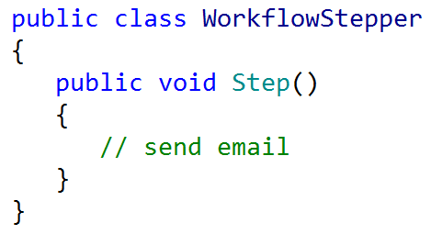

Slide 6
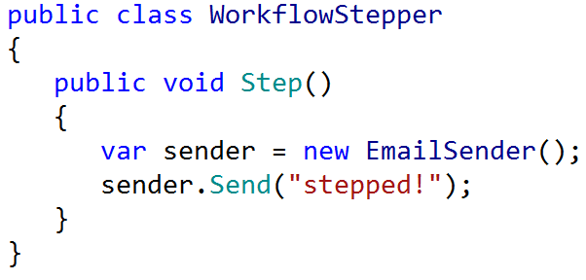

Slide 7
new

Slide 8
Relationship is set at compile time.

Slide 9
new isn’t always viable.

Slide 10
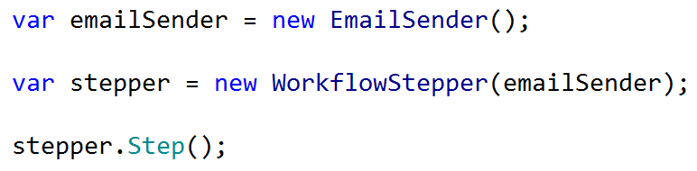

Slide 11
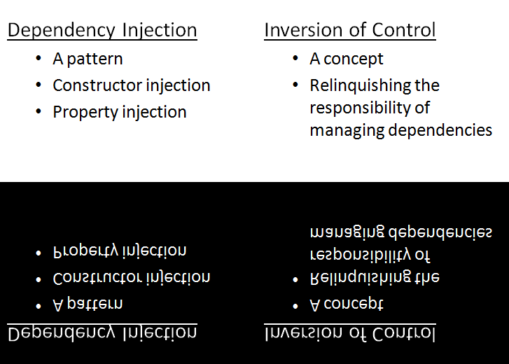

Slide 12
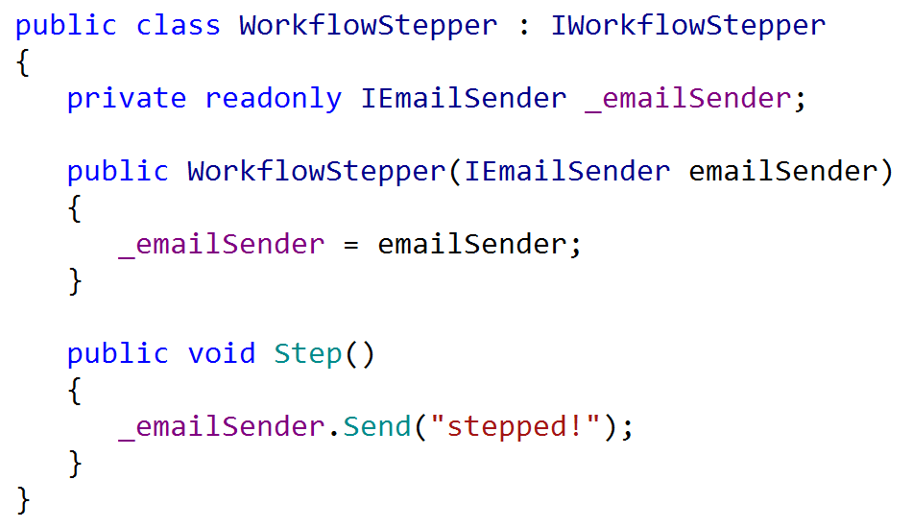

Slide 13
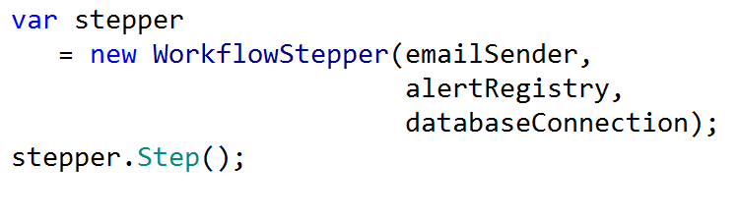

Slide 14
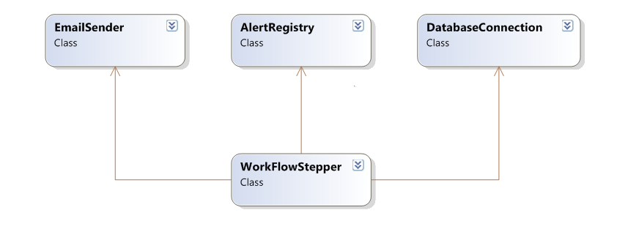

Slide 15
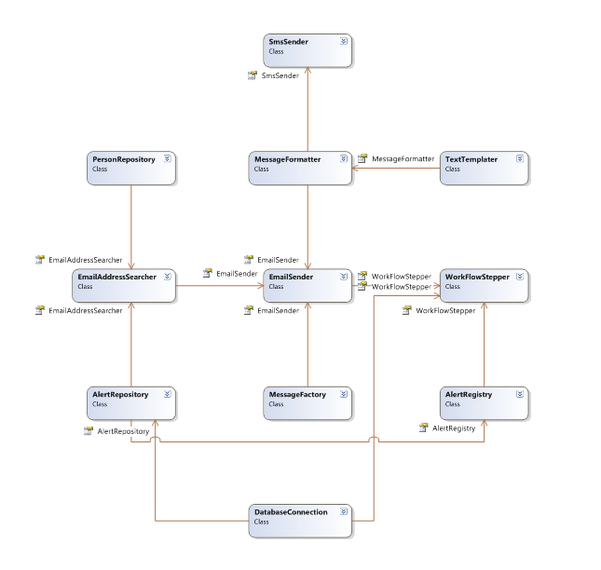

Slide 16
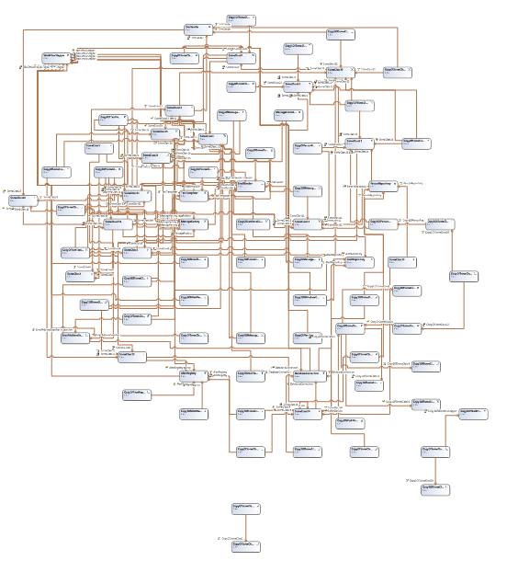

Slide 18
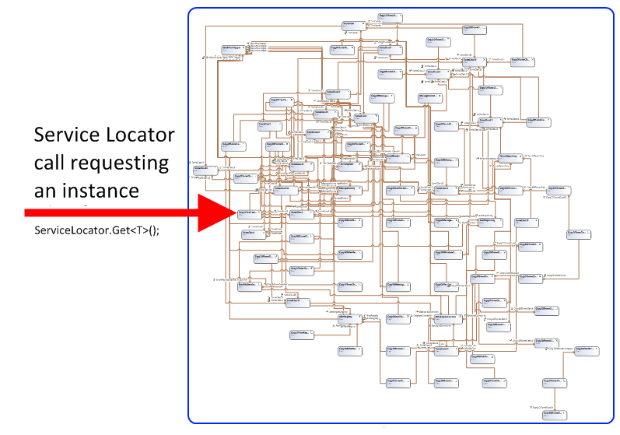

Slide 19
There is no new
Notes:
Finish demo here.

Slide 20
Some Benefits Enumerated
Testing
Reuse
Simplicity
Construction velocity
Fun

Slide 21
Don’t use the tool where you don’t need it, in unit tests for example.
Think of the tool as a “composer” instead of a “container”; minimize entry points.
Prefer constructor injection.
Avoid magic strings; favor convention over configuration.
Keep configuration off to the side

Slide 22
Useful Resources
StructureMap documentation
Autofac documentation
Jeremy Miller
Tool-specific mailing lists

Slide 23
Faster, Better, Stronger
http://headspringsystems.com/training

