Slide 1


Inversion of Control
Matt Hinze
Senior Consultant, Headspring
matt@headspring.com
@mhinze
http://mhinze.com

Slide 2

?
Notes:
What is inversion of control?
What is an IOC tool?
Delivers objects with pre-built and pre-wired dependencies right in there. An entire object graph created via configuration and reflection rather than the new operator.
Imagine you have an email sending class.. Let’s call it..

Slide 3
EmailSender

Slide 4
WorkflowStepper

Slide 5
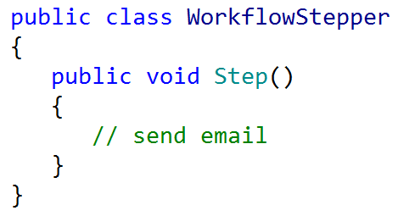

Slide 6
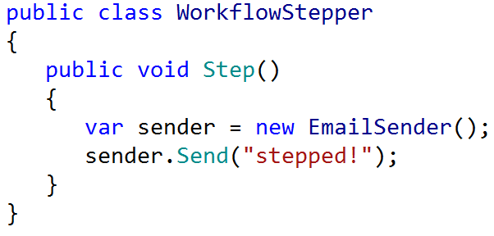

Slide 7
new
Notes:
But this – the use of the ‘new’ keyword – creates a tight coupling that is hard to change.

Slide 8
Relationship is set at compile time.
Notes:
Between objects, but also between the other dependencies of those objects. Think UI vs. Data access!

Slide 9
new isn’t always viable.
Notes:
Sometimes it’s difficult or impossible to instantiate a class.

Slide 10
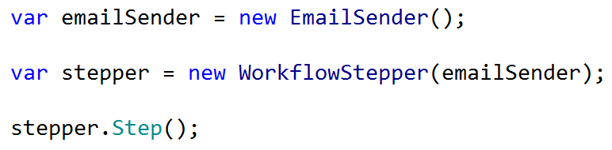
Notes:
Dependency injection

Slide 11
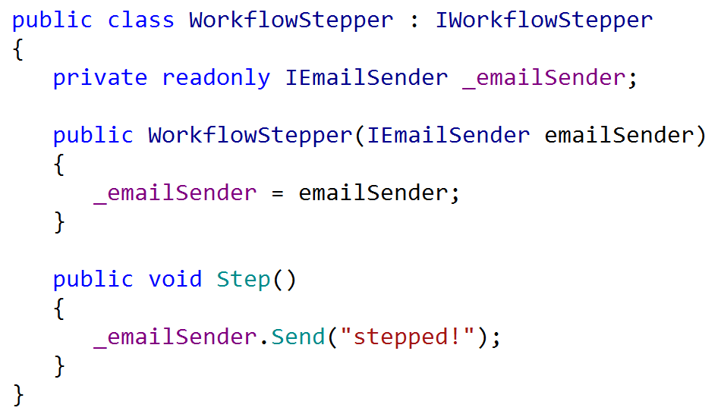
Notes:
Here is dependency injection in action.
Demo without service locator.

Slide 12
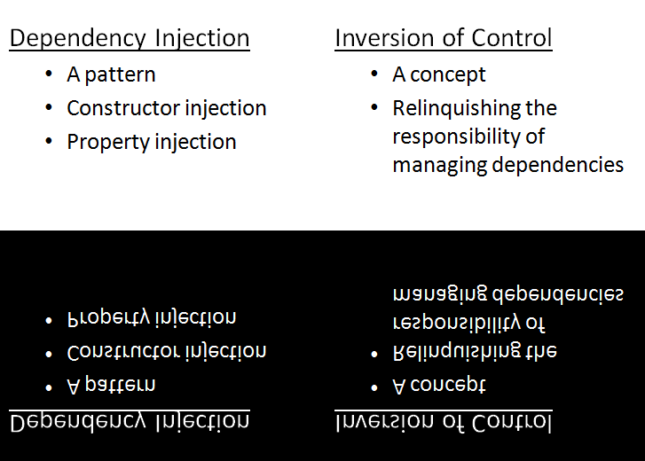
Notes:
But imagine a number of classes, a number of dependencies, a million components, each with one job, one responsibility, one easily-tested role to play, all composed together to form an application:

Slide 13
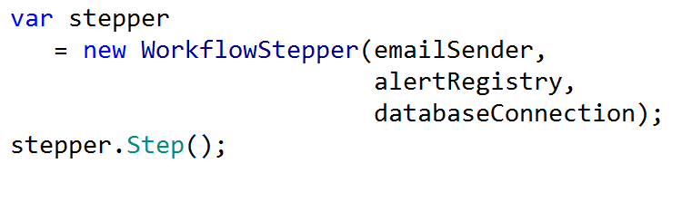

Slide 14
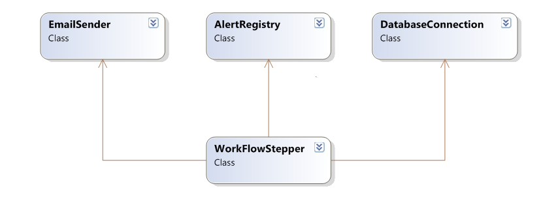

Slide 15
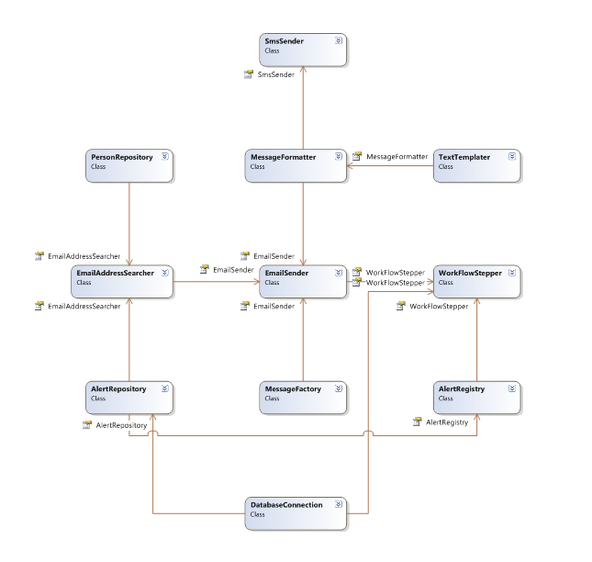

Slide 16
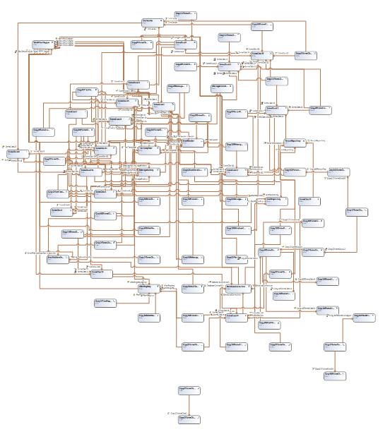

Slide 18
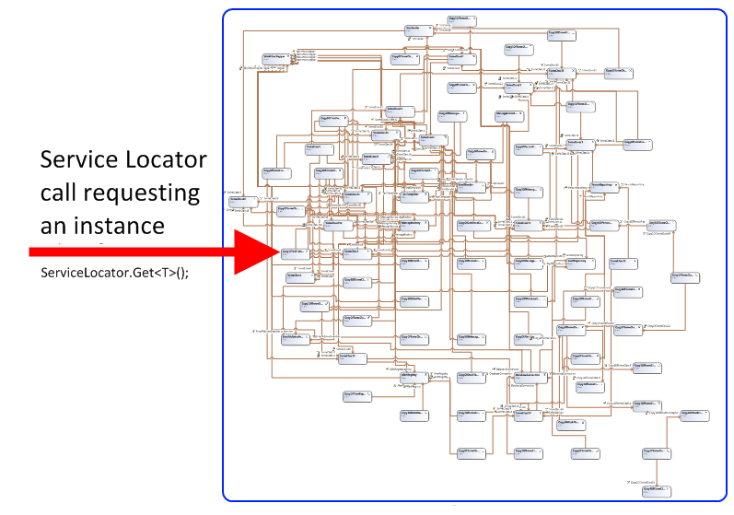

Slide 19
There is no new
Notes:
Finish demo here.

Slide 20
Some Benefits Enumerated
Testing
Reuse
Simplicity
Construction velocity
Fun

Slide 21
Don’t use the tool where you don’t need it, in unit tests for example.
Think of the tool as a “composer” instead of a “container”; minimize entry points.
Prefer constructor injection.
Avoid magic strings; favor convention over configuration.
Keep configuration off to the side

Slide 22
Useful Resources
StructureMap documentation
Autofac documentation
Jeremy Miller
Tool-specific mailing lists

Slide 23
Faster, Better, Stronger
http://headspringsystems.com/training

