Slide 1


Inversion of Control
Matt Hinze
Principal Consultant, Headspring
matt@headspring.com
@mhinze
http://mhinze.com

Slide 2

?
Notes:
What is inversion of control?
What is an IOC tool?
Delivers objects with pre-built and pre-wired dependencies right in there. An entire object graph created via configuration and reflection rather than the new operator.
Imagine you have an email sending class.. Let’s call it..

Slide 3
EmailSender

Slide 4
WorkflowStepper

Slide 5
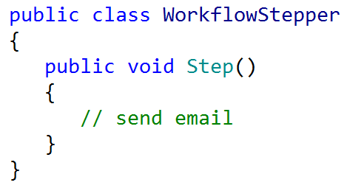

Slide 6
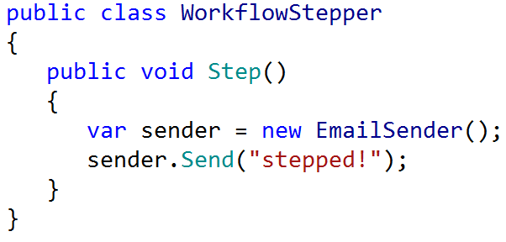

Slide 7
new
Notes:
But this – the use of the ‘new’ keyword – creates a tight coupling that is hard to change.

Slide 8
Relationship is set at compile time.
Notes:
Between objects, but also between the other dependencies of those objects. Think UI vs. Data access!

Slide 9
new isn’t always viable.
Notes:
Sometimes it’s difficult or impossible to instantiate a class.

Slide 10
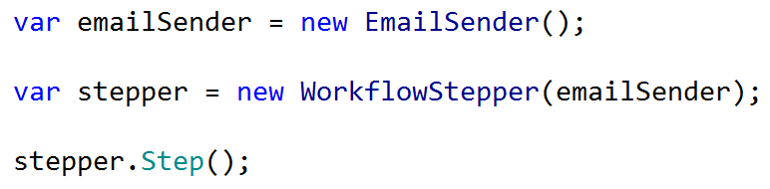
Notes:
Dependency injection

Slide 11
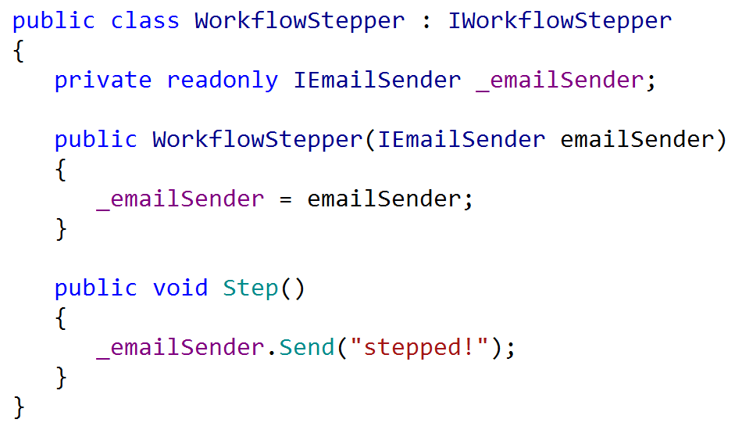
Notes:
Here is dependency injection in action.
Demo without service locator.

Slide 12
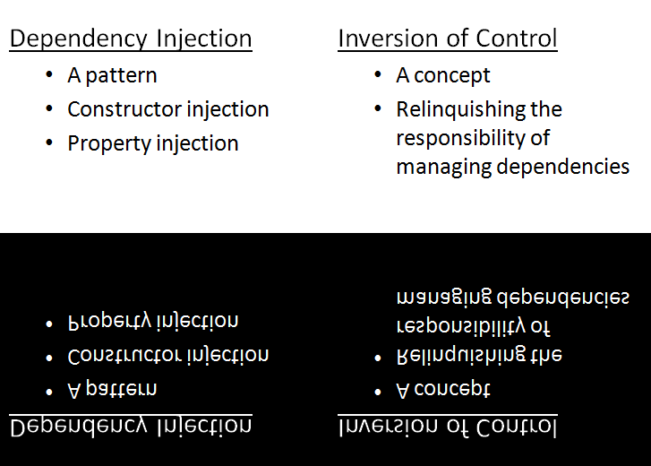
Notes:
But imagine a number of classes, a number of dependencies, a million components, each with one job, one responsibility, one easily-tested role to play, all composed together to form an application:

Slide 13
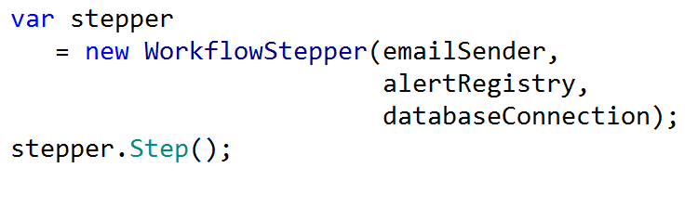

Slide 14
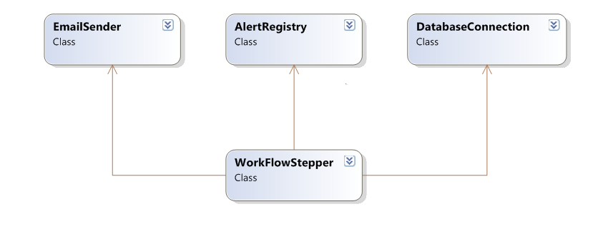

Slide 15
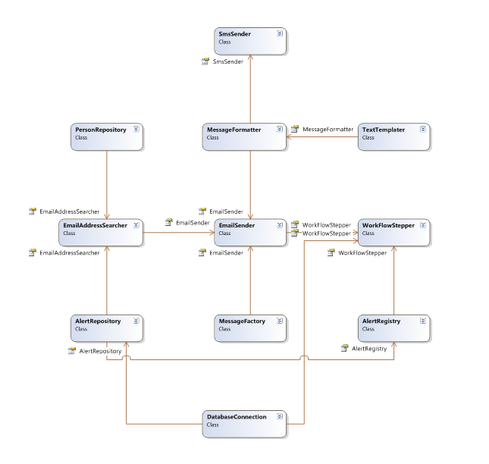

Slide 16
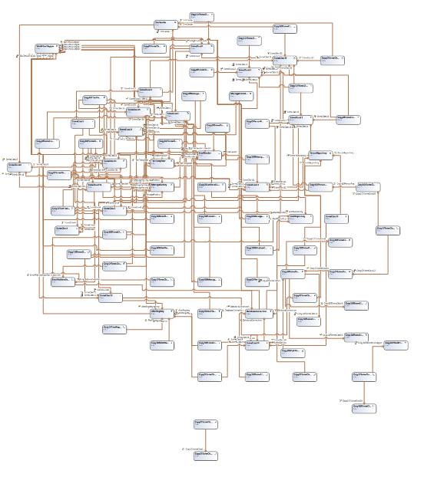

Slide 18
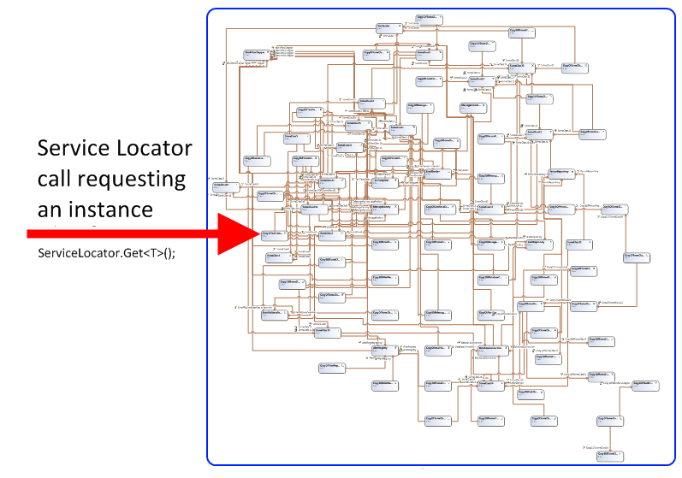

Slide 19
There is no new
Notes:
Finish demo here.

Slide 20
Some Benefits Enumerated
Testable & TDD-friendly
Simplicity
Reuse & DRY
All roads lead to construction velocity

Slide 21
Don’t use the tool where you don’t need it, in unit tests for example.
Think of the tool as a “composer” instead of a “container”; minimize entry points.
Prefer constructor injection.
Avoid magic strings; favor convention over configuration.
Keep configuration off to the side

Slide 22
Useful Resources
StructureMap documentation
Autofac documentation
Jeremy Miller
Tool-specific mailing lists

Slide 23
Faster, Better, Stronger
http://headspringsystems.com/training

