Slide 1
Live Imaging Gene Expression Dynamics
Caleb Lareau

Slide 2
Overview
Authors
Hematopoietic lineage
PU1/GATA1
Methods
Hoppe et al.
Discussion

Slide 3
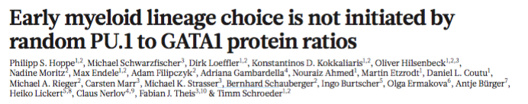

Slide 4
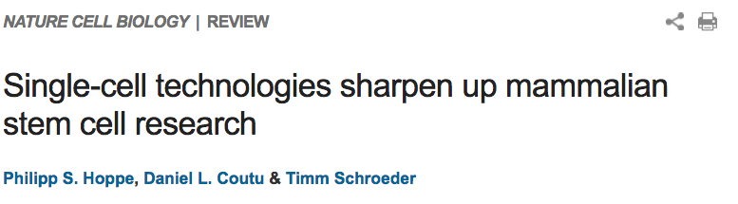
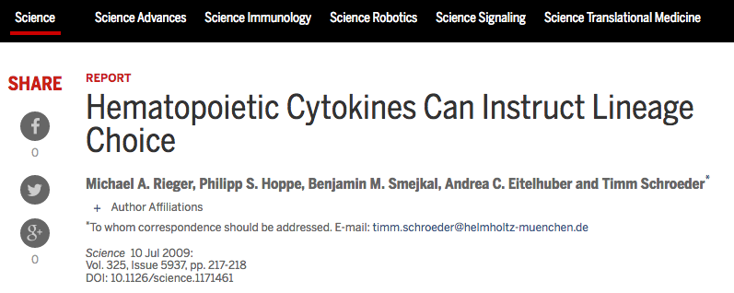

Slide 5
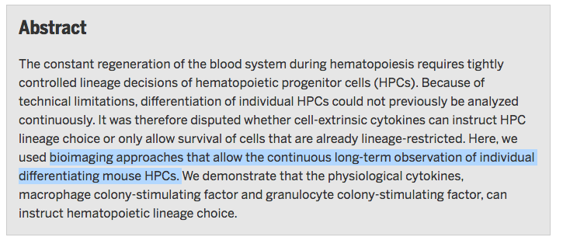

Slide 6


Slide 7
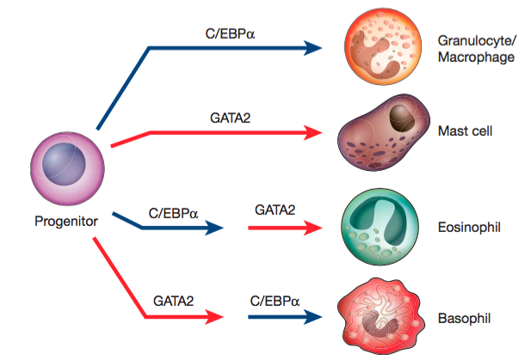

Slide 8
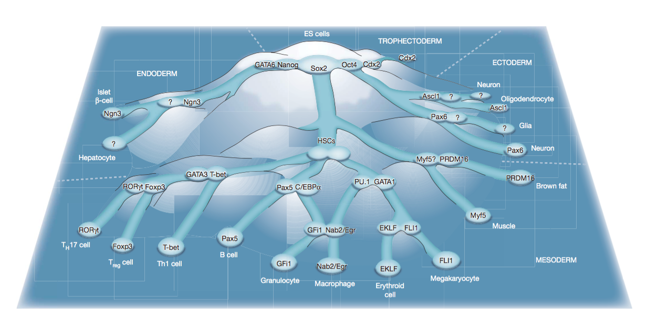

Slide 10
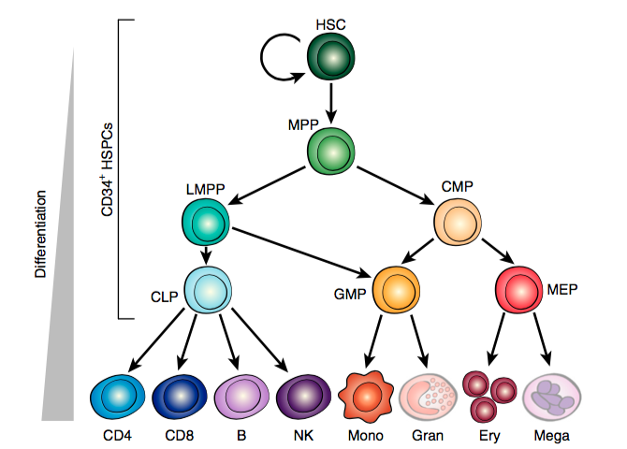
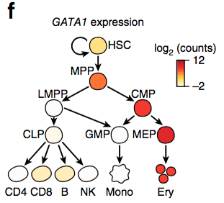

Slide 11
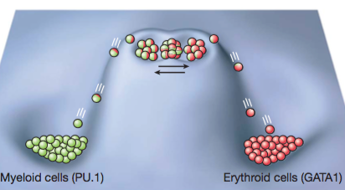

Slide 12
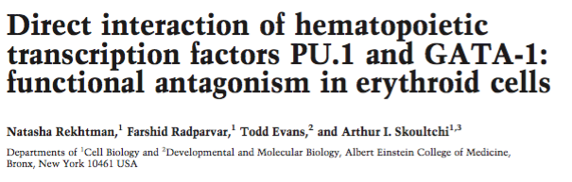
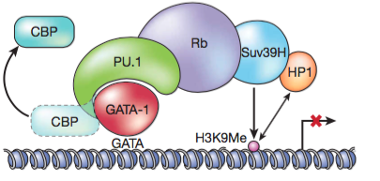

Slide 13
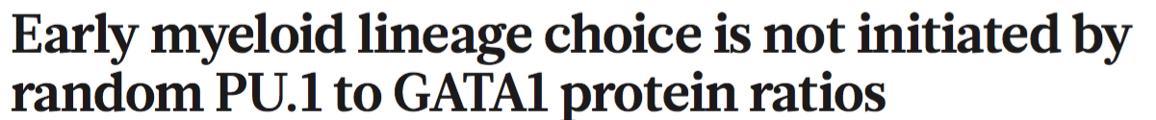
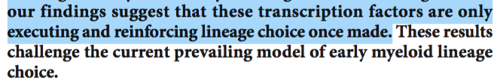

Slide 14
Previous GATA1/PU.1 Inferences
Bulk Cell populations
Averages
Cells may be dead
How valid are the protein dynamics?

Slide 15
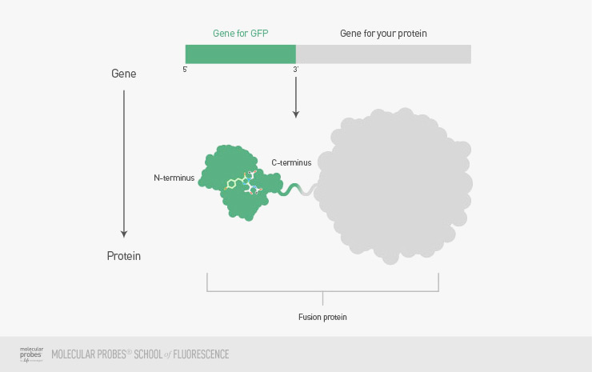
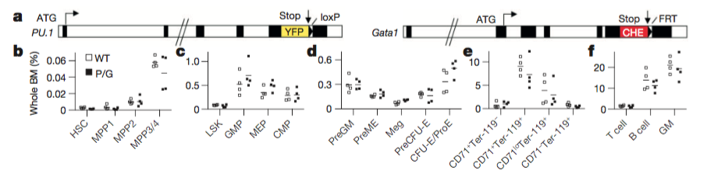
This study

Slide 16
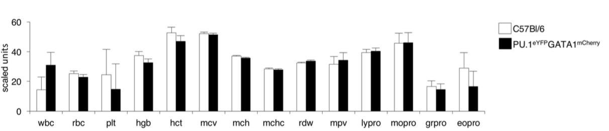

Slide 17
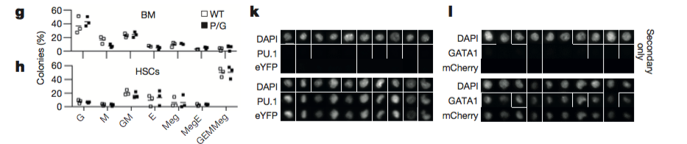
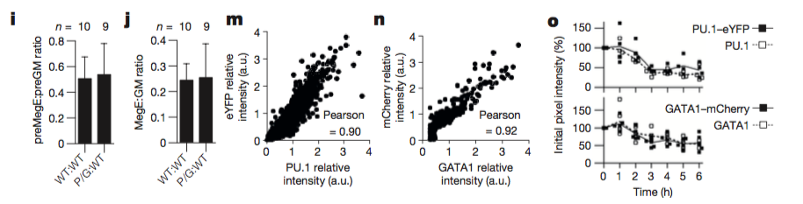

Slide 18
Figure 1 Takeaways
Gene fusion knock-ins don’t alter normal cell proportions
Gene fusion knock-ins don’t alter normal TF expression
Fluorescence (via mCherry/YFP) are good surrogates for protein expression values

Slide 19
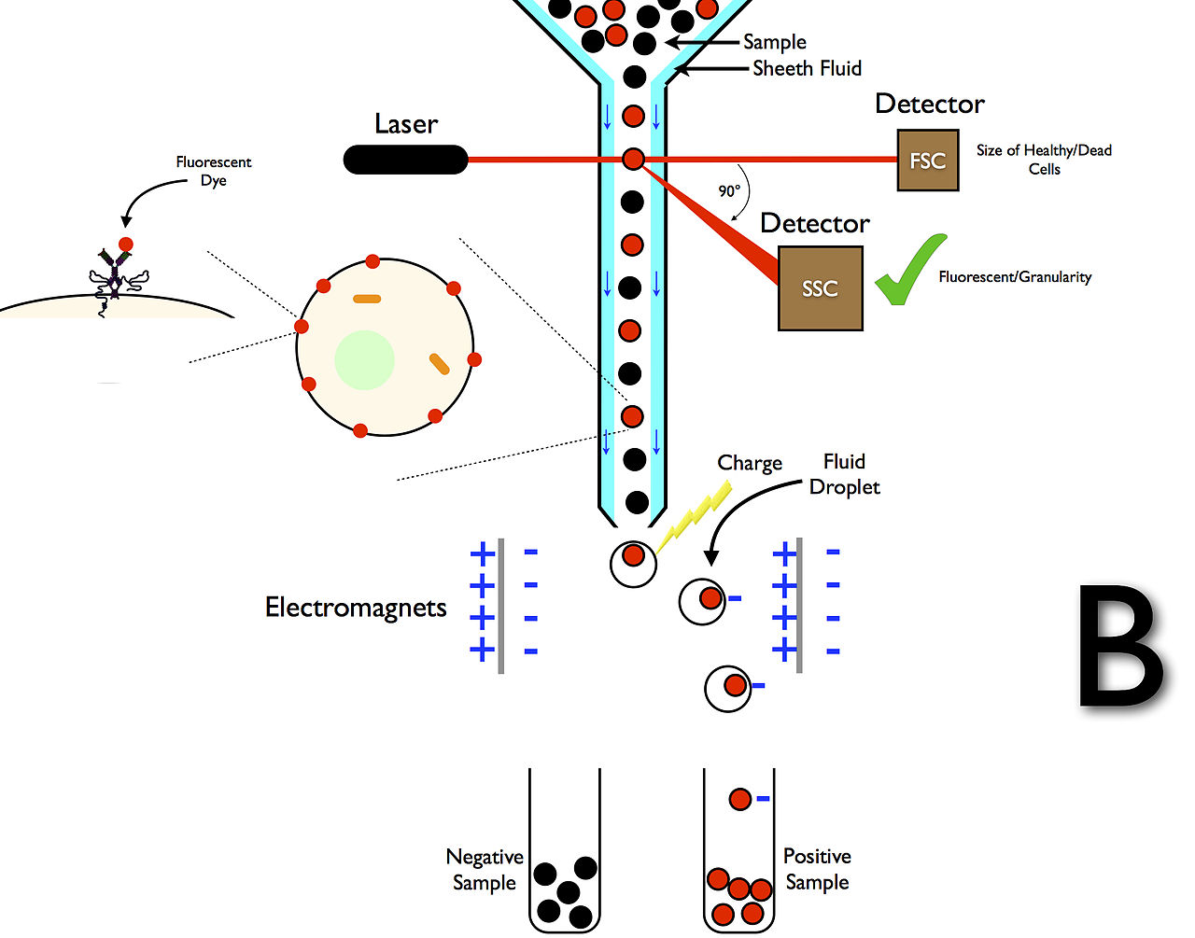
Fluorescence activated cell sorting

Slide 20
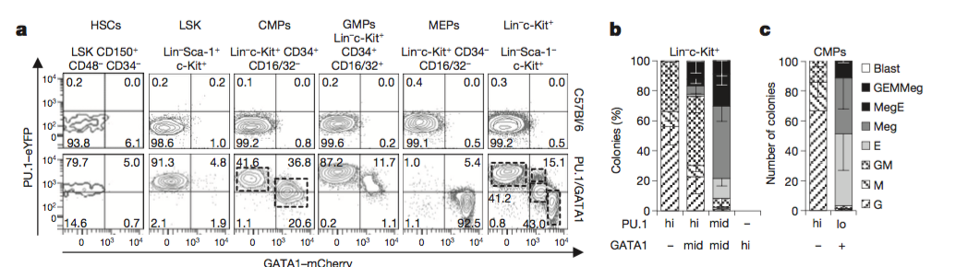
Figure 2

Slide 21
Takeaways from Figure 2
Reporter mouse construct works for delineating cell types
CMPs are just a mixture of MEPs and GMPs with different cell surface markers
Taken at a single timepoint

Slide 22
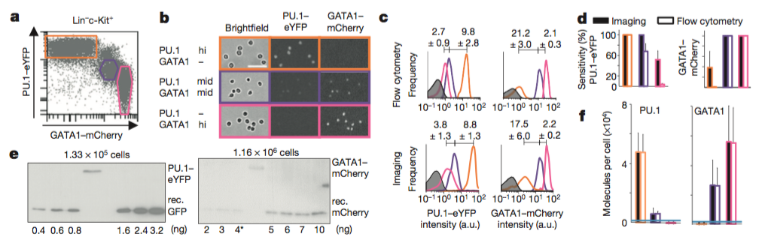

Slide 23
Takeaways from Figure 3
Fluorescence intensity of mCherry (GATA1) and eYFP (PU.1) are roughly the same as flow cytometry values
Better sensitivity in imaging

Slide 24
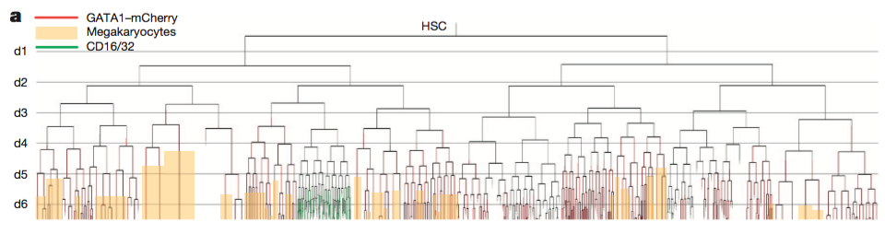

Slide 25
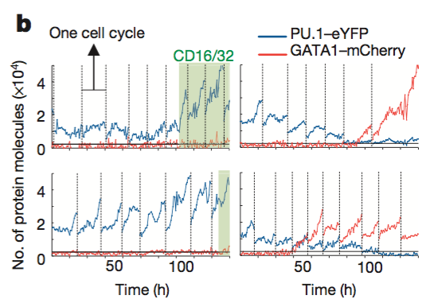
GM MegE

Slide 26

Evidence Presented
Figure 1 verifies mouse knock-in model
Figure 2 verifies flow cytometry/knock-in protein expression in different cell types
Figure 3 verifies flow cytometry = fluorescence imaging
Figure 4 shows single cell trajectory

Slide 27
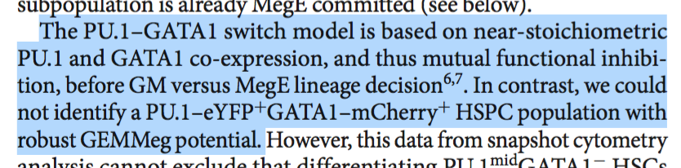
What if the alternative was true?
Would want 50%/50%

Slide 28
What if the alternative was true?
Equivalent ratios early; one line starts to dominate
Higher levels of GATA1 earlier

Slide 30
Thanks!!

