Slide 1
Live Imaging Gene Expression Dynamics
Caleb Lareau

Slide 2
Overview
Authors
Hematopoietic lineage
PU1/GATA1
Methods
Hoppe et al.
Discussion

Slide 3
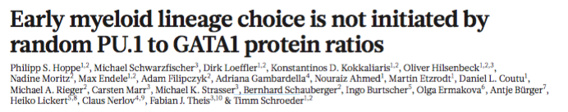

Slide 4
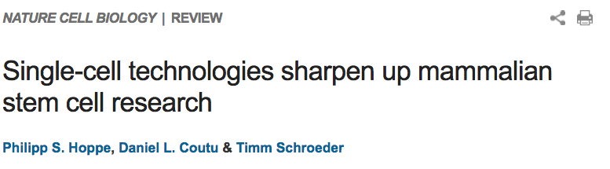
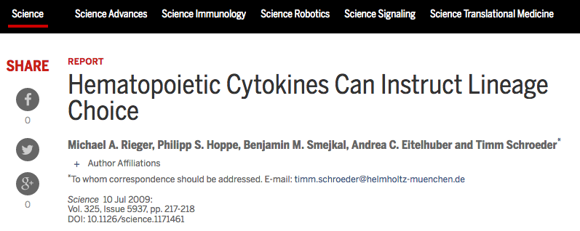

Slide 5
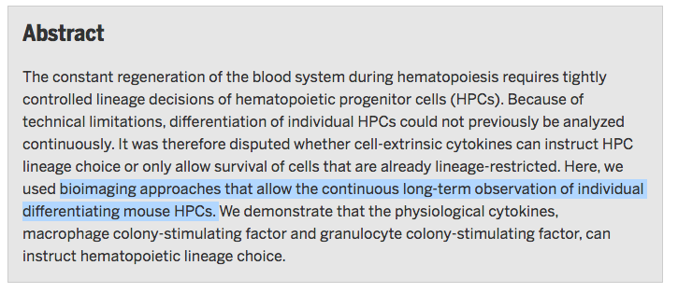

Slide 6


Slide 7
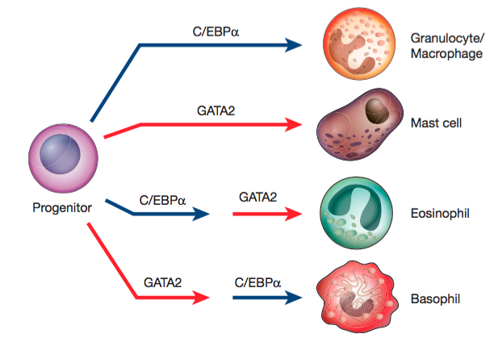

Slide 8
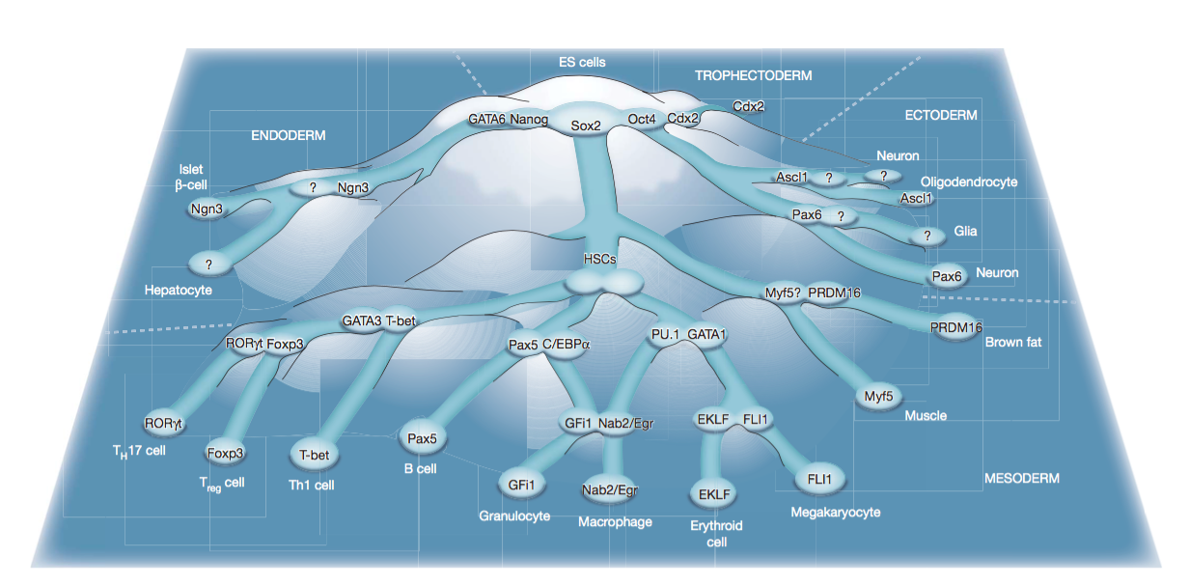

Slide 9
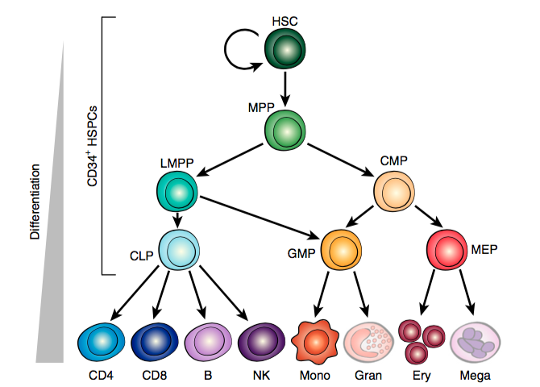
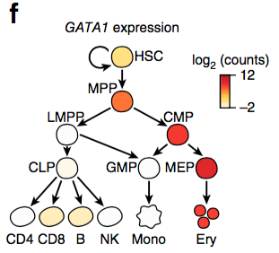

Slide 10
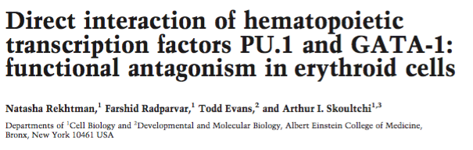
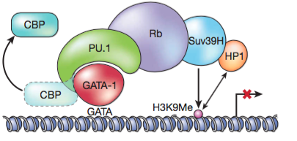

Slide 11
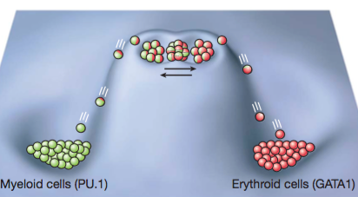

Slide 12
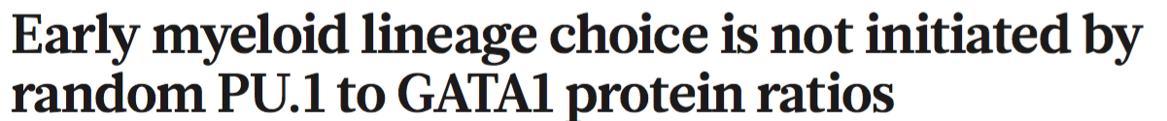
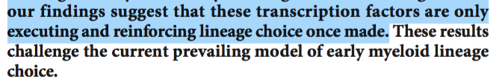

Slide 13
Previous GATA1/PU.1 Inferences
Bulk Cell populations
Averages
Cells may be dead
How valid are the protein dynamics?

Slide 14
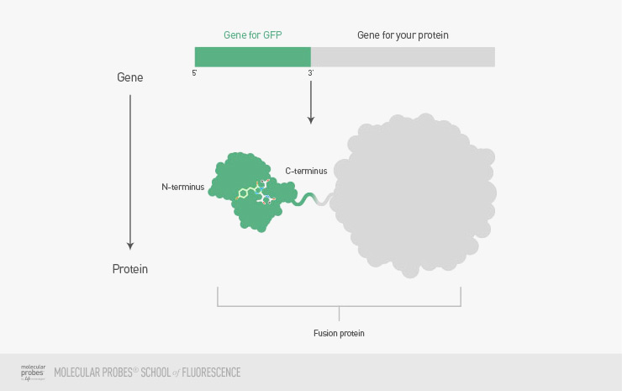
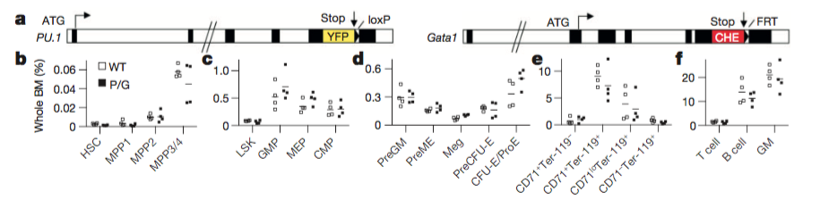
This study

Slide 15
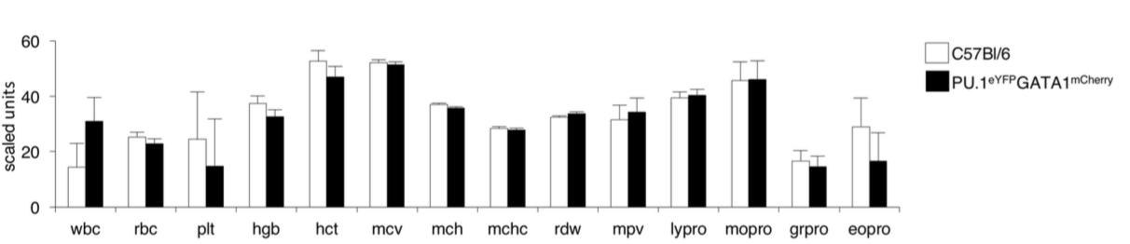

Slide 16
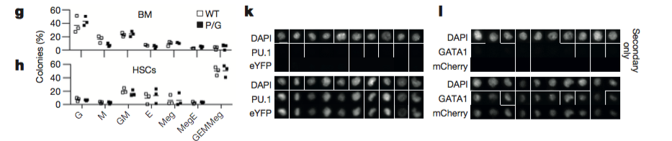
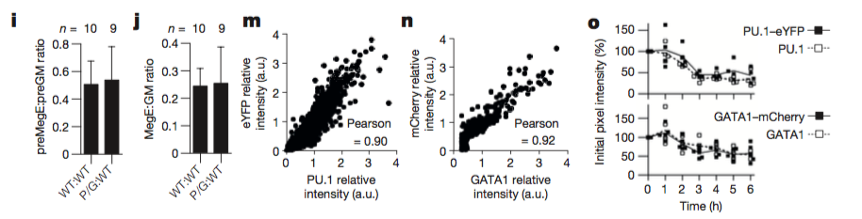

Slide 17
Figure 1 Takeaways
Gene fusion knock-ins don’t alter normal cell proportions
Gene fusion knock-ins don’t alter normal TF expression
Fluorescence (via mCherry/YFP) are good surrogates for protein expression values

Slide 18
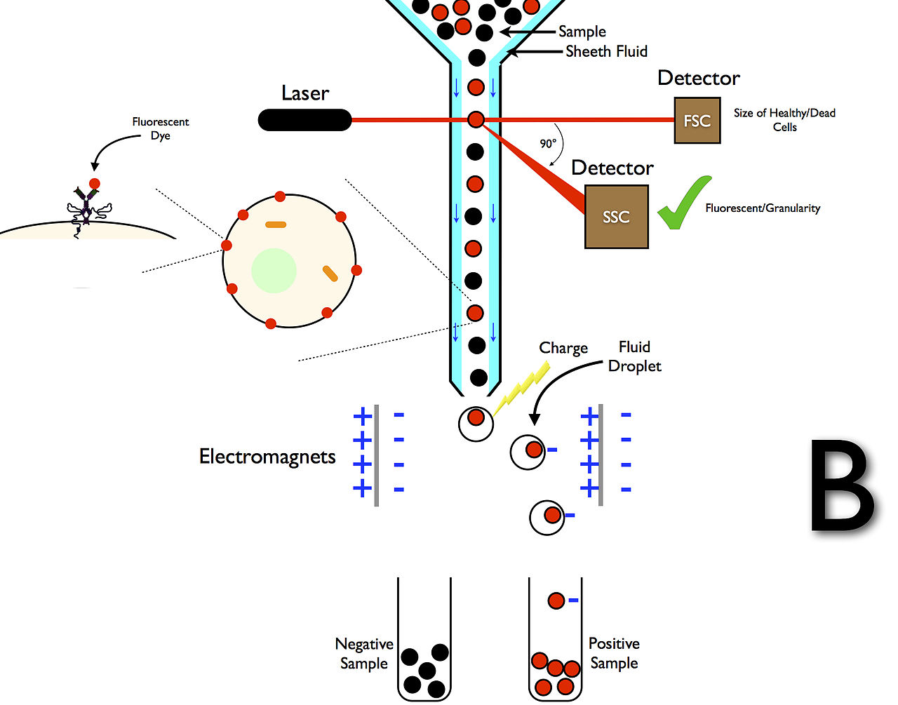
Fluorescence activated cell sorting

Slide 19
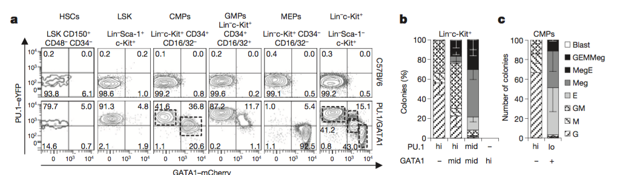
Figure 2

Slide 20
Takeaways from Figure 2
Reporter mouse construct works for delineating cell types
CMPs are just a mixture of MEPs and GMPs with different cell surface markers
Taken at a single timepoint

Slide 21
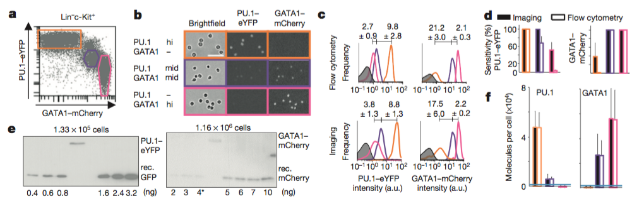

Slide 22
Takeaways from Figure 3
Fluorescence intensity of mCherry (GATA1) and eYFP (PU.1) are roughly the same as flow cytometry values
Better sensitivity in imaging

Slide 23
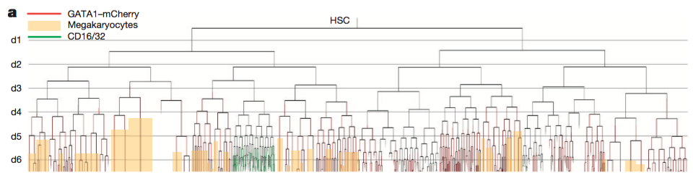

Slide 24
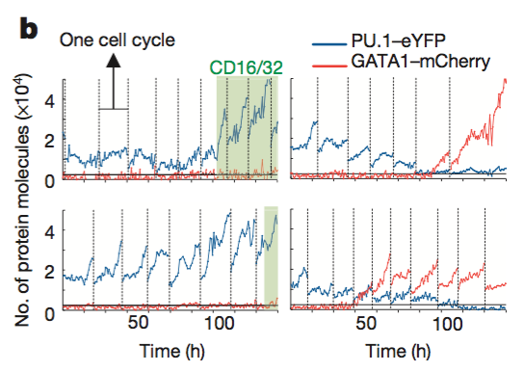

Slide 25

Evidence Presented
Figure 1 verifies mouse knock-in model
Figure 2 verifies flow cytometry/knock-in protein expression in different cell types
Figure 3 verifies flow cytometry = flourescence imaging
Figure 4 shows single cell trajectory

