Slide 1
Accessing Functional Consequences of the 3D Genome
Caleb Lareau

Slide 2
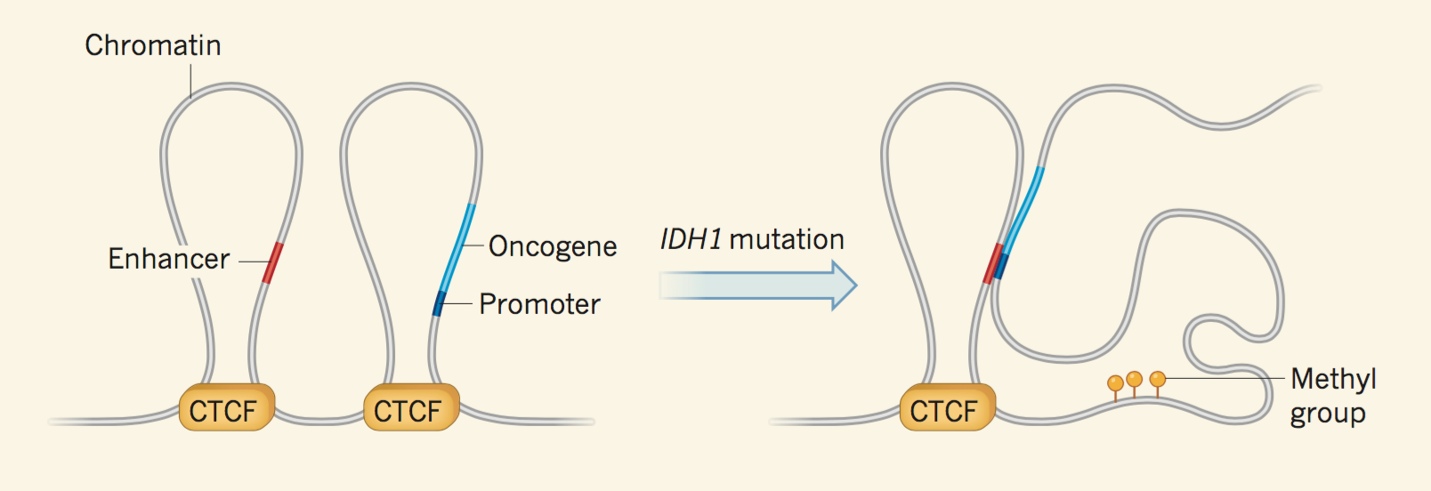

Slide 3
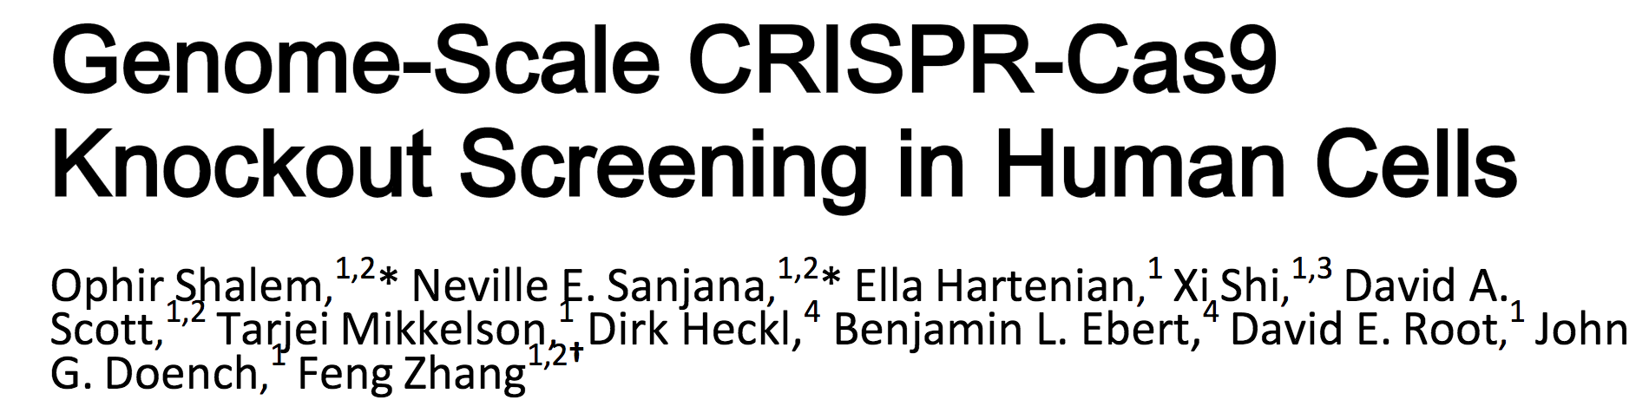
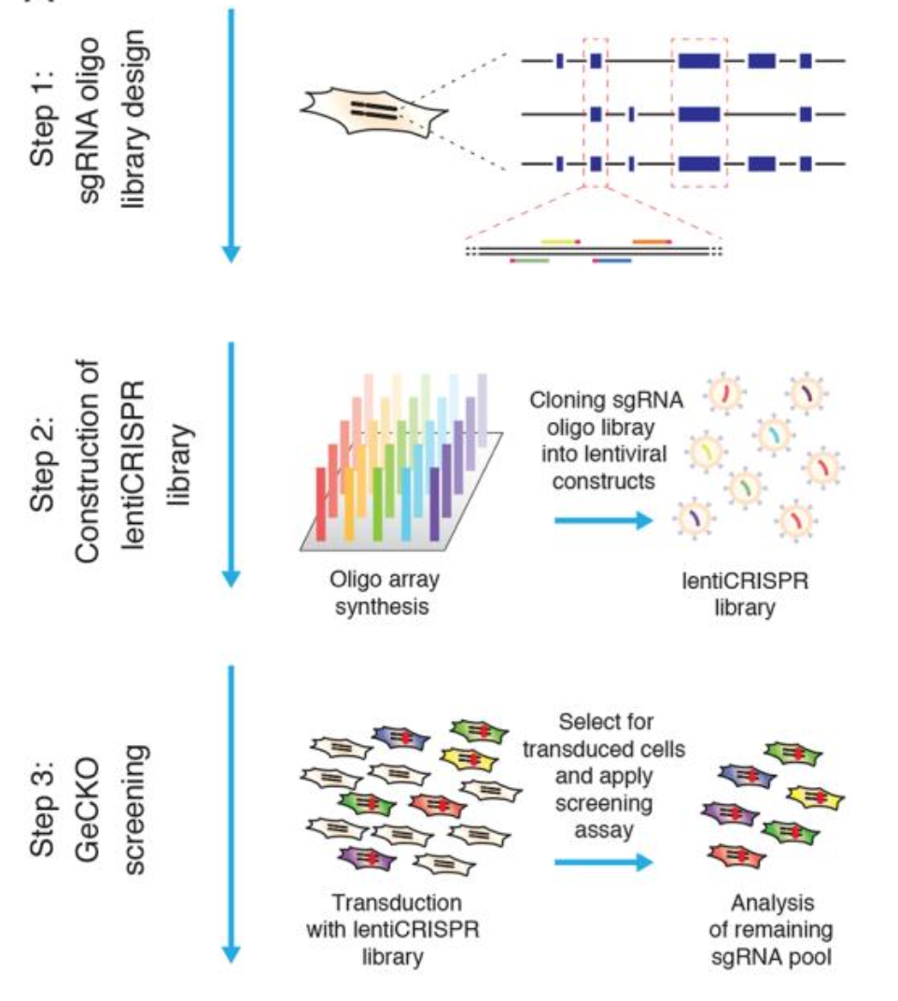

Slide 4
Question
Previous studies have identified vital genes for maintenance of cancer phenotypes…
Can we identify vital loops that maintain a similar phenotype?

Slide 5
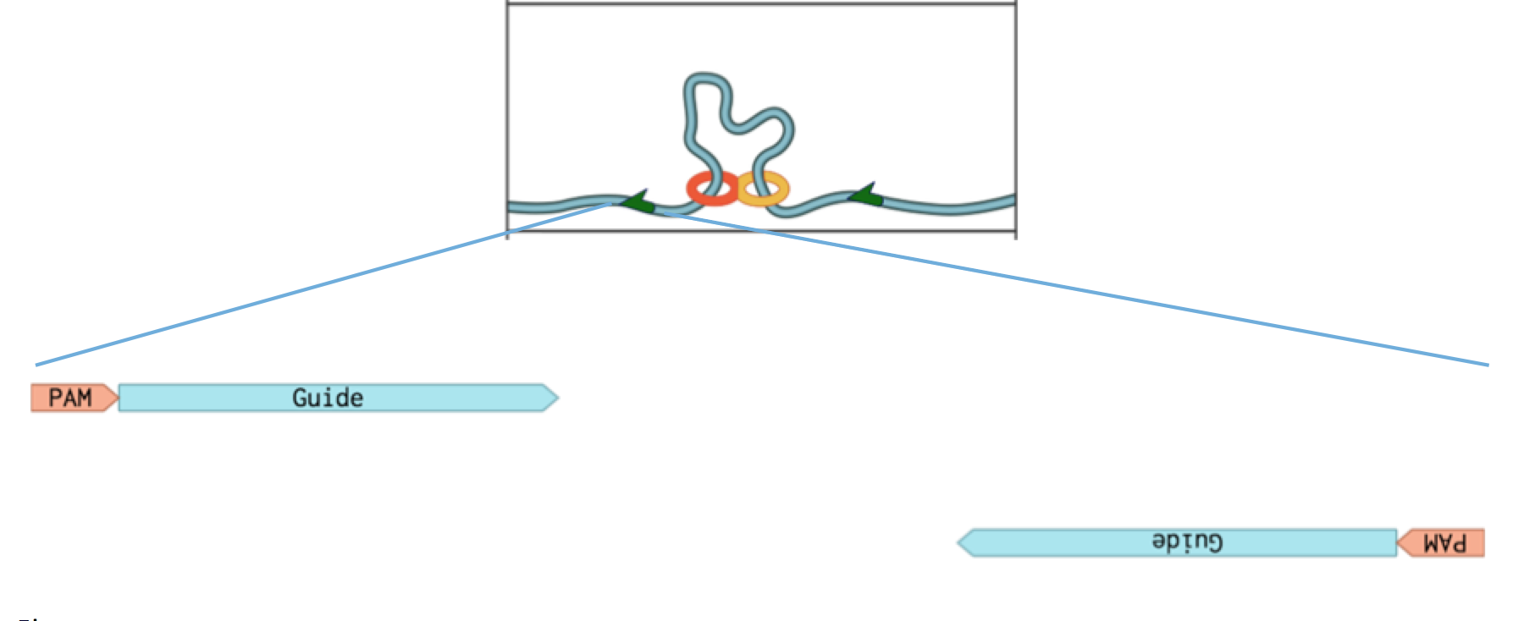
Gene(s)

Slide 6
Data Generation
Perform ChIA-PET on cell line
Determine ~40,000 loop anchors
Build oligo library against each loop anchor
Perform CRISPR screen

Slide 7
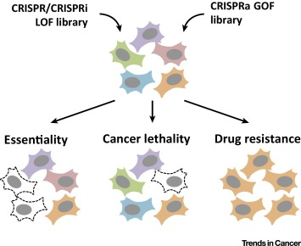

Slide 8
Example
Drug tolerant cancer cell line X
Introduce ~40,000 loop alterations
Take vital cells
Apply drug
Identify samples with induced drug resistance from loop alteration

Slide 9
Interpretation
Altered loop that leads to variable phenotype would be considered vital for phenotype
Genes near loop -> related?

Slide 10
Validation
ChIP-Seq to validate loss of loop boundary
Off-target analysis to assess modification efficacy
“Normal” CRISPR screen to cross previously vital genes with genes near vital loops

Slide 11
Discussion

