Slide 1
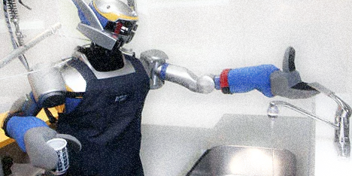

Team #3
Made by: Caleb Nwokocha Fe- lixe Tanha Patel

Slide 2
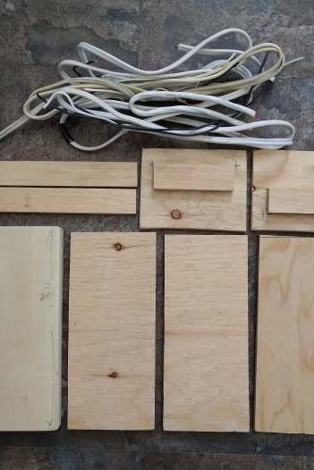
PROJECT- ROBOT BUTLER
Our team Project is to make a Robot Software.
A software that can help to perform bunch of household chores such as clearing dishes from a table, putting them in dishwasher, cleaning and much more little household chores.

Slide 3
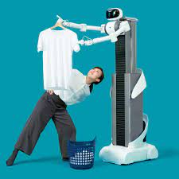
Economic Value
Save you time
Save you money

Slide 4
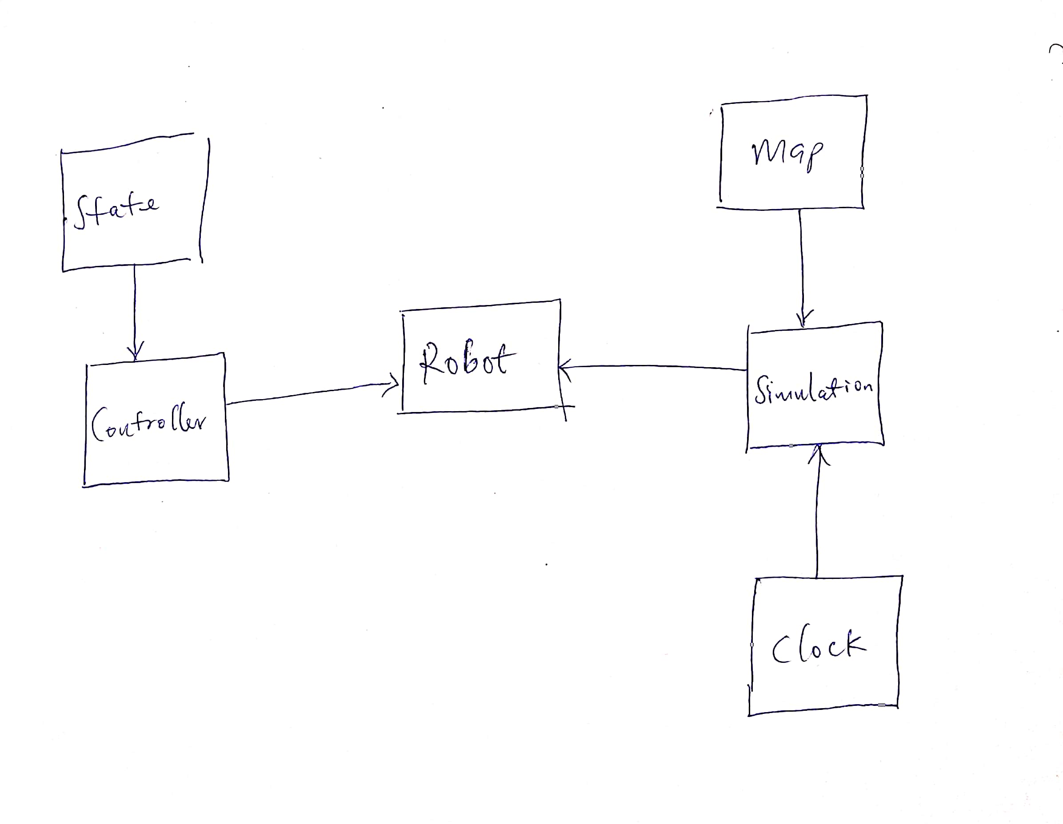
Robot Software Architecture

Slide 5
How is it related to the theme.
The theme is Chaotic Good, which means being free soul and doing something good without caring about the thing was performed.
Similarly in our project our Robot is doing household chores for us to make our lives easier but also without caring much about breaking the dishes, or cleaning without caring much about the dusty corners in the room.

Slide 6
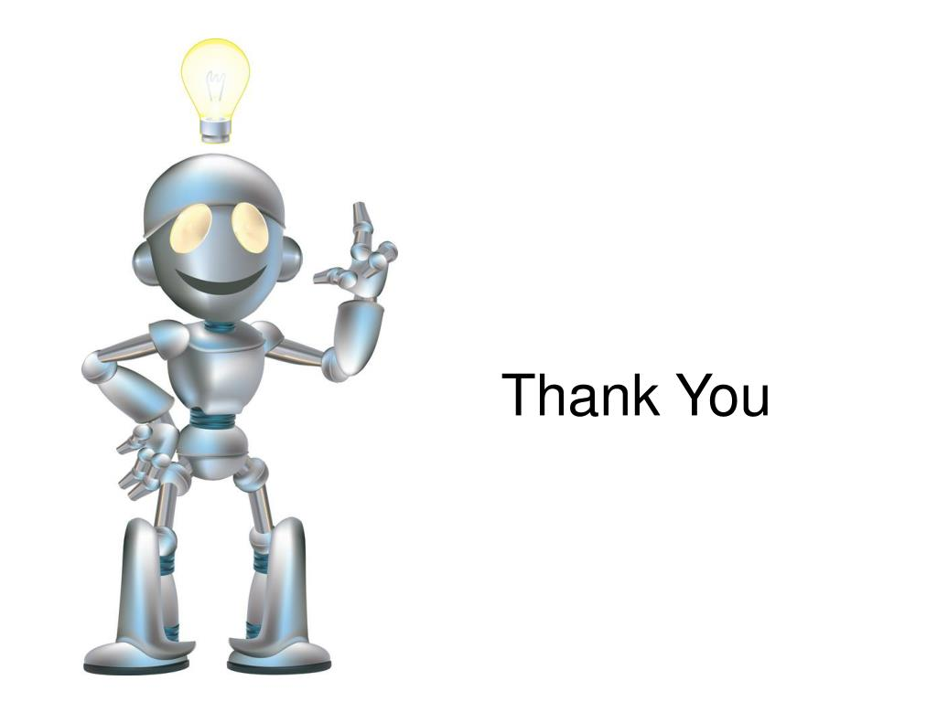
Thank you so much Hope you all enjoyed our Robot Butler.

