Slide 1
Good afternoon,
Welcome to Harstad Builders

Slide 2
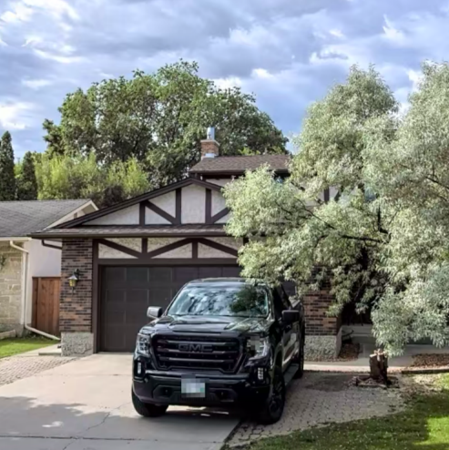
Construction company in Winnipeg, MB
76 Sweetwater Bay
Garage ≡ Shop

Slide 3
Contact information
Telephone: 2049799618, 2044301220
Email: hello@harstadbuilders.com, darrell@harstadbuilders.com
Website: https://www.harstadbuilders.com/

Slide 4
Q&A

Slide 5
Software Team
Name | Discord Username
Caleb Nwokocha | Caleb Nwokocha#5446
Jayed Rafi | coffee#0545
Harkeerat Singh Mayall | itsbazooka#1346
Victor Eze | N/A
Yash Vyas | Razer#9927
Vrushil Patel | Vrushil#93
Omar | OmarE#4373
Da Dan | Da Tan#9518

Slide 6
Process Architecture
Database
project
Area
Home
User profile
Services
Review & submit
About

Slide 7
Q&A

