Slide 1

Django Data Importing

Slide 2
Make better models
We still need a little more data about the class and to add the Students model.

Slide 3
Enter Env and Start Server
You should know this command by now.

Slide 4
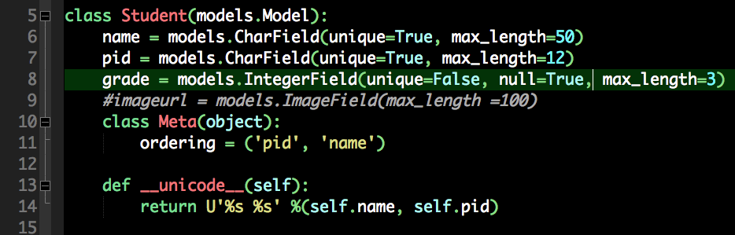
Students model

Slide 5
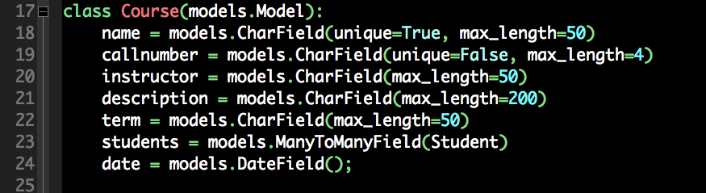
Course Model

Slide 6
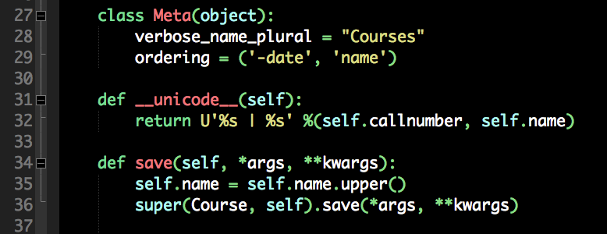
model.py extras

Slide 7
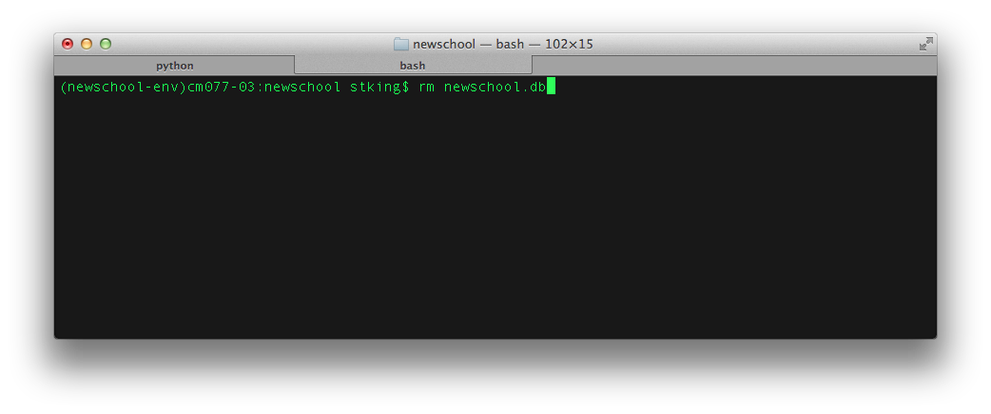
Load or Import some data
For development, delete the database

Slide 8
JSON
JavaScript Object Notation
A simple structured data format.
Similar in concept to XML and used for similar purposes
Lighter and Smaller than XML* (sometimes)
JS Object is a complex array

Slide 9
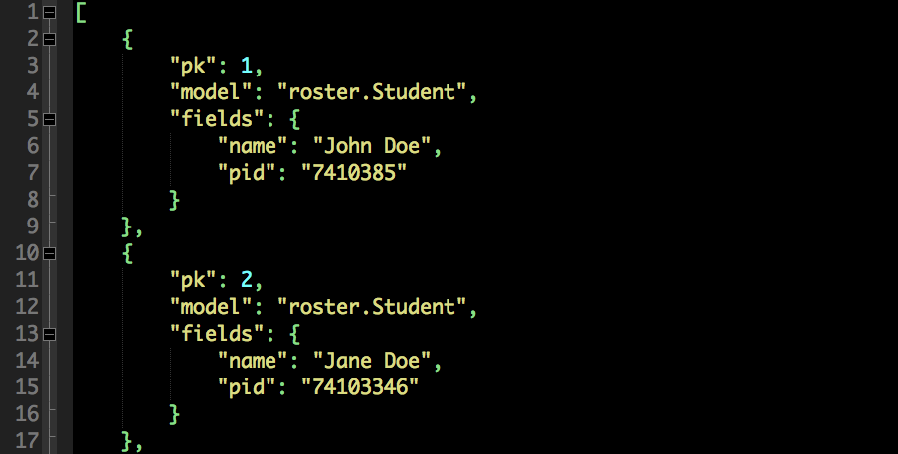
JSON

Slide 10
Create a JSON file
touch data_class.json

Slide 11
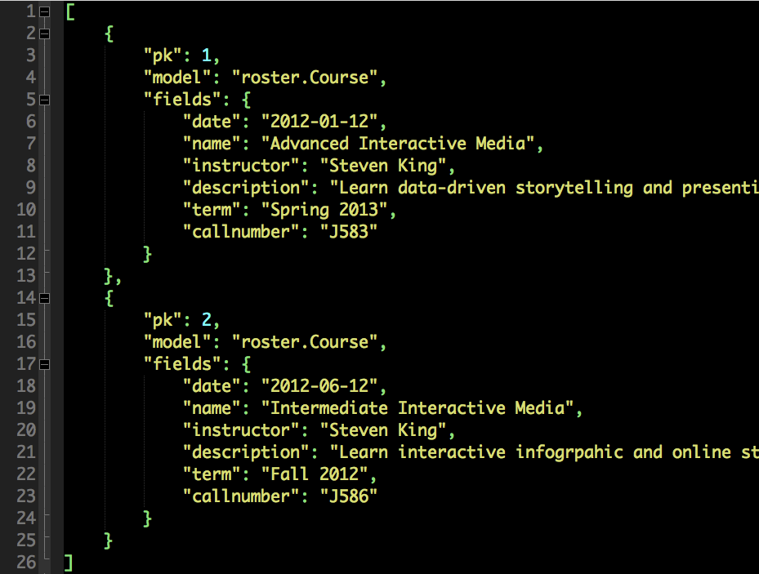

Slide 12
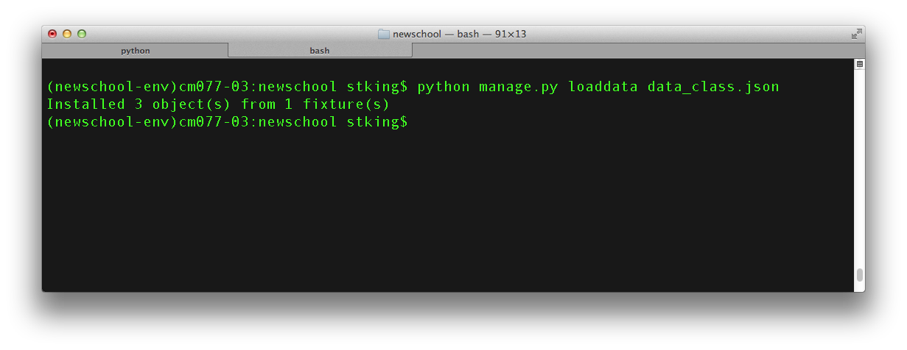
Import JSON

Slide 13
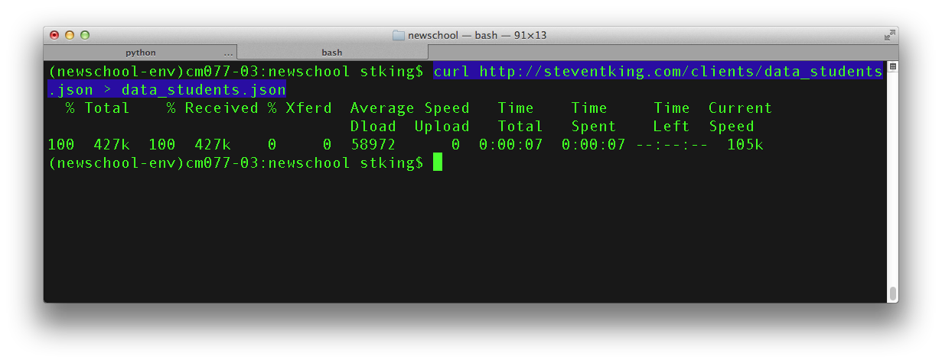
Let’s get BIG JSON
First, we need some data.
Curl is used for grabbing a file via HTTP
Save the output to a file called data_students.json
Curl URL > filename

Slide 14
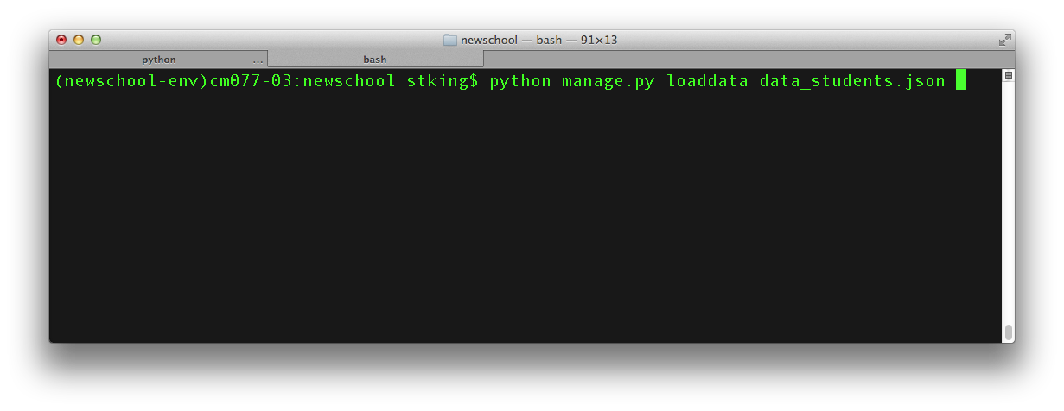
Load the JSON file you just saved

Slide 15
What?
Bad data or bad model?

Slide 16
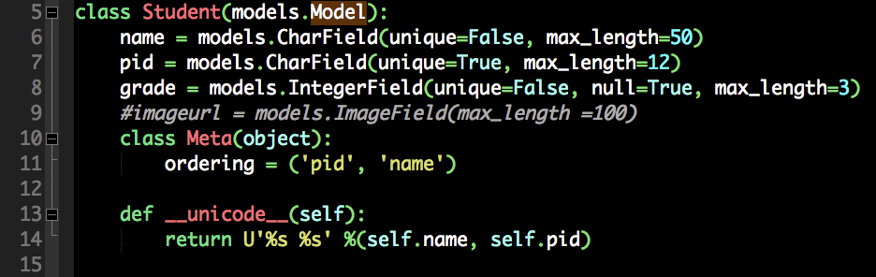
Fix the model

Slide 17
When Changing Models, Kill db!
Delete the DB
Sync DB
Re-import both data files

Slide 18
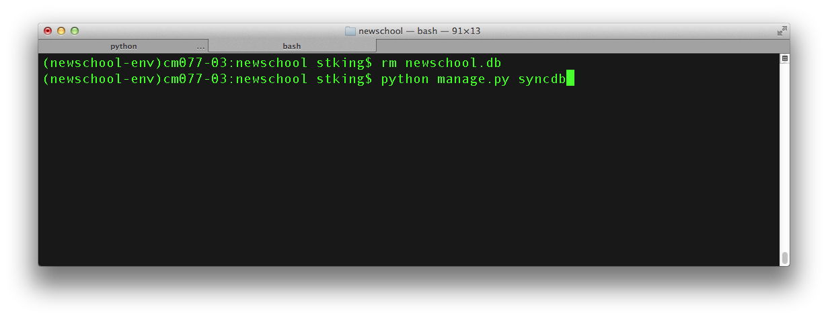
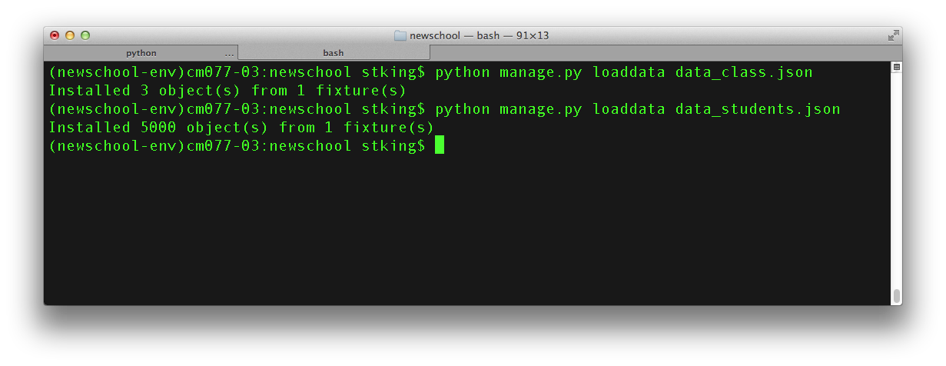
Dump and Import (both)

Slide 19
Oops, we left out the grades
Download an updated JSON file and replace the exsisting data with the new data.
http://steventking.com/clients/data_students_withgrade.json

Slide 20
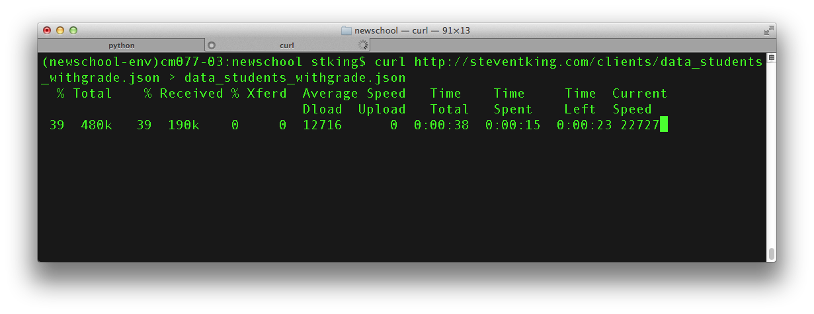
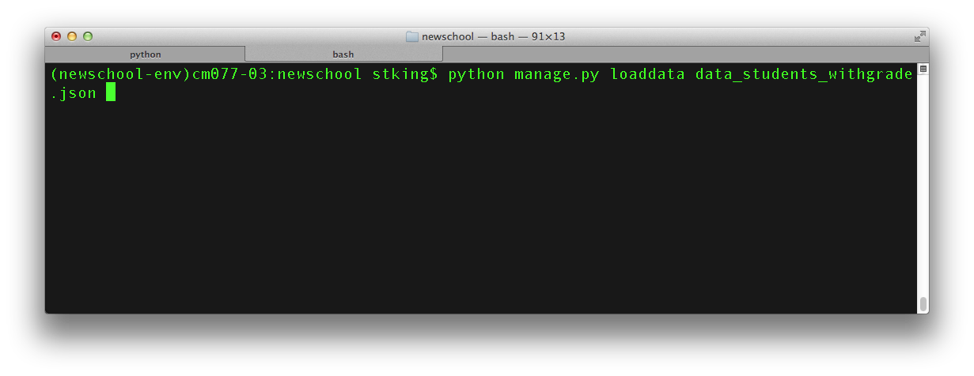
Incase you need help

Slide 21
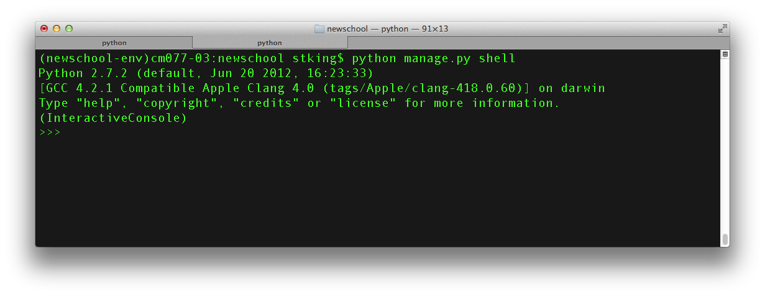
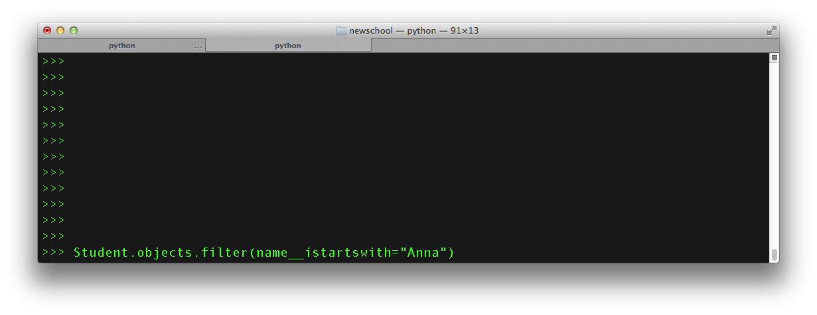
Python Data Magic

Slide 22
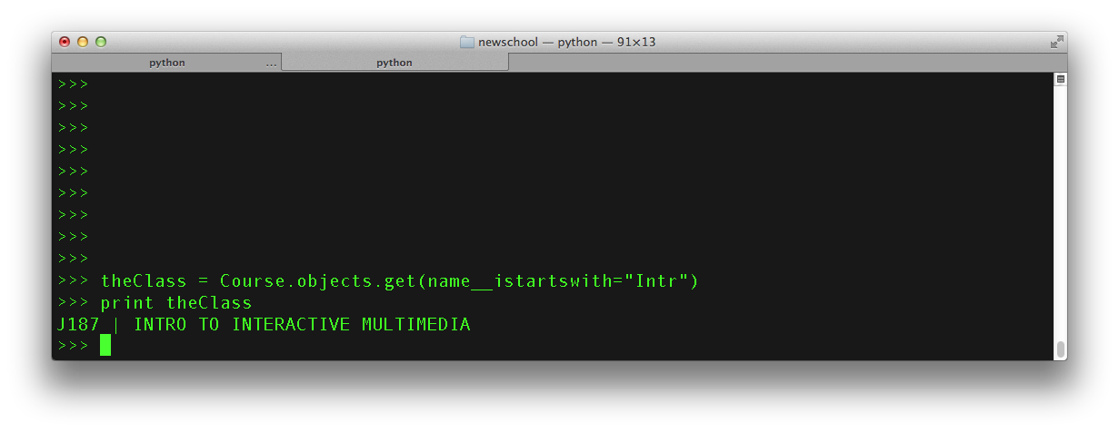
Using Python Shell

Slide 23
Front End Fun (Views and Templates

