Slide 1
Django Templates
Making it public and pretty

Slide 2
Steps Creating Pages
Check URL
Make a View
Make a Template

Slide 3
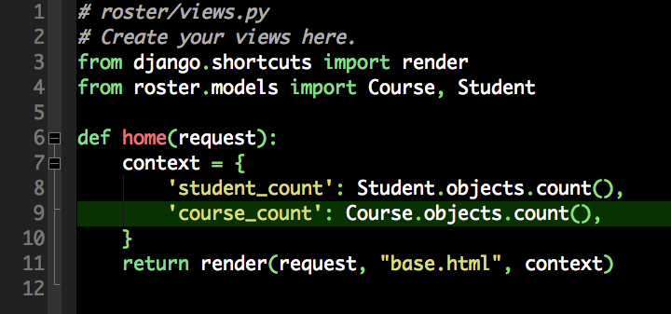
views.py

Slide 4
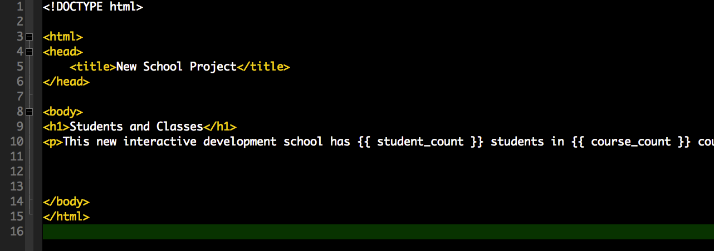
base.html

Slide 5
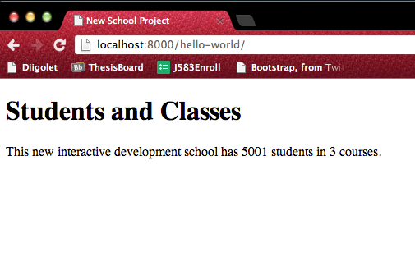
Check the homepage in browser

Slide 6
Template Locations
App templates (roster)
Project Templates (newschool)

Slide 7
App Templates
Specific Templates only used for a single app
Stored within the app dir
roster/templates/roster/home.html

Slide 8
Project Templates
Global Templates for the project
ideal for Boilerplate templates and HTML
Overriding App templates
Stored within the project dir
newschool/templates/base.html

Slide 9
Define Template Loader
Edit the TEMPLATE_LOADERS var in the settings file
Django loads templates in this order
projectname/templates/appname/home.html
appname/templates/appname/home.html

Slide 10
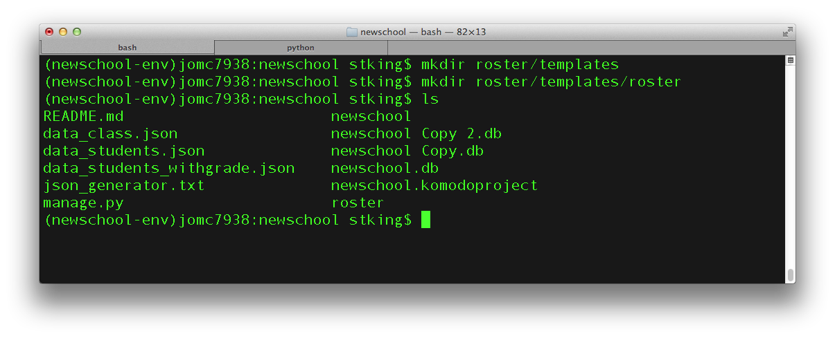
Make Template Dirs

Slide 11
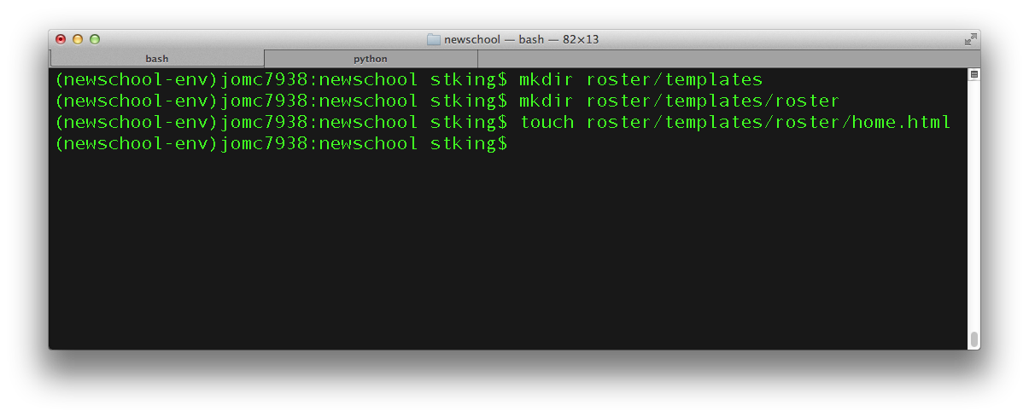
Set up Templates for New Homepage

Slide 12
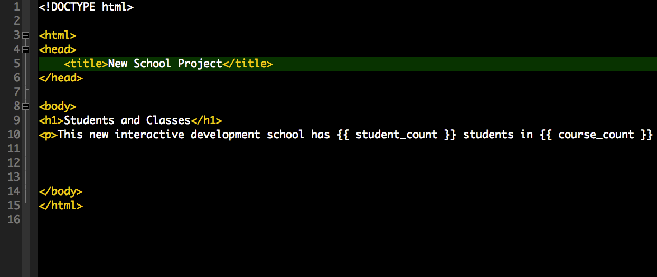
New Homepage

Slide 13
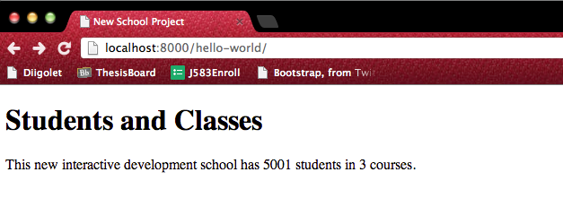
New Homepage Test

Slide 14
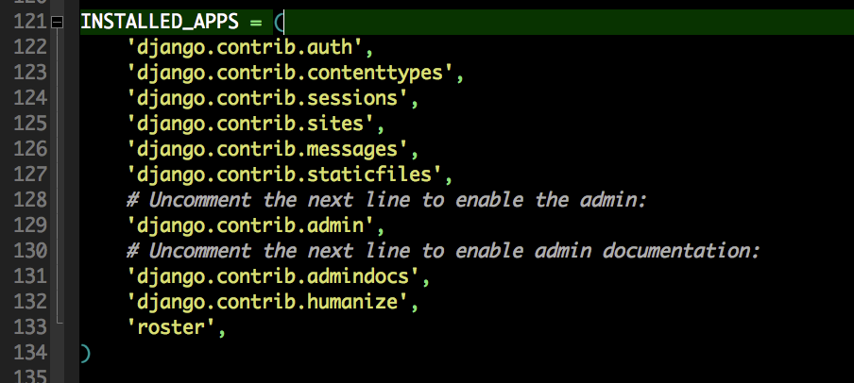
Humanize!

Slide 15
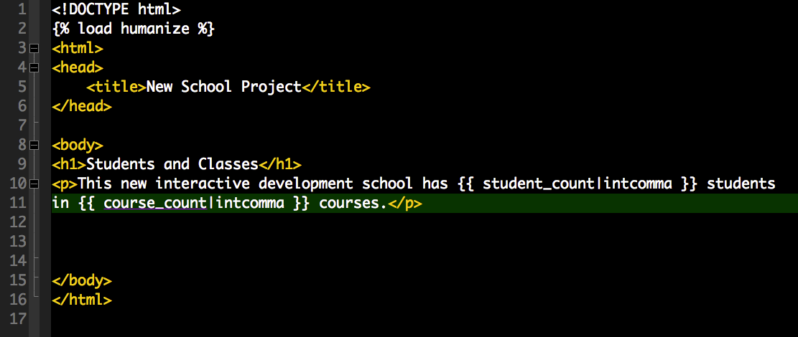
{{ var|intcoma }}
Don’t miss line 2.

Slide 16
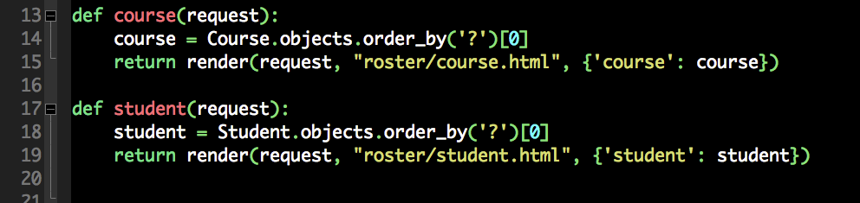
Now some more view
add this to views.py

Slide 17
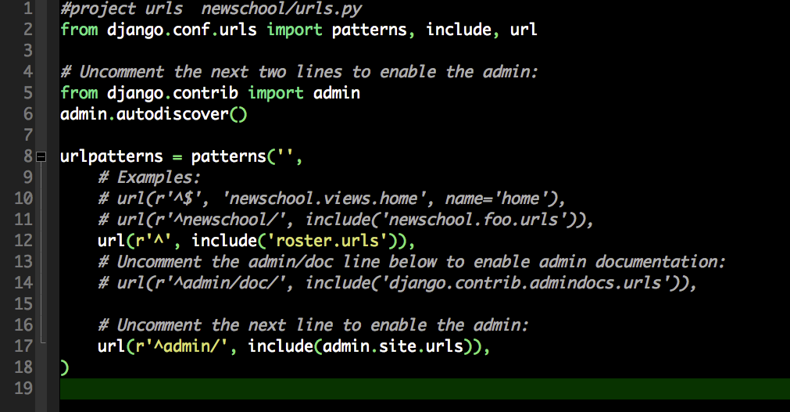
Need URLs
Change hello-world to include all roster urls.

Slide 18
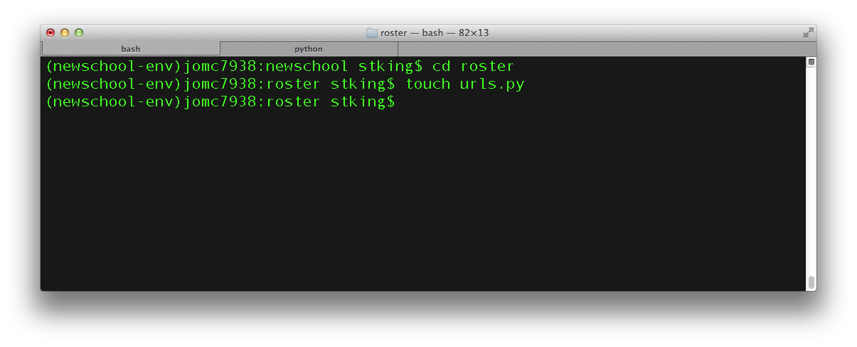
Add a new urls.py to the app
Create urls.py INSIDE ROSTER

Slide 19
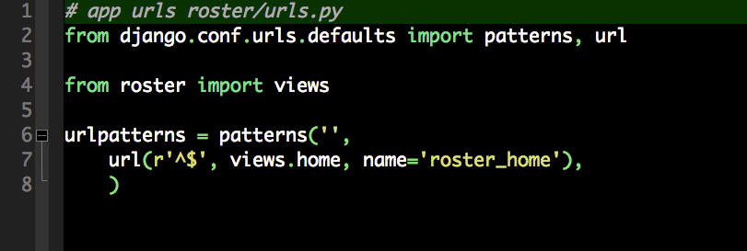
roster/urls.py

Slide 20
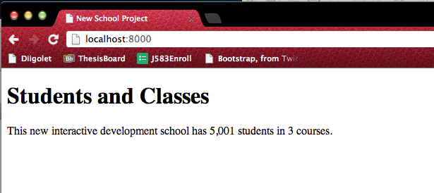
Test it main home page

Slide 21
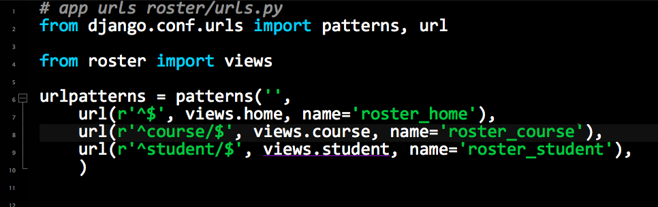
Open some more URLS
We need urls for /course/ and /student/

Slide 22
Templates
Keeping your templates DRY
DONT REPEAT YOURSELF
Create a Base Template
Defines high-level site layout/navigation
Includes site-wide CSS
Includes site-wide JS
Create blocks for things we want to change in sub-templates

Slide 23
Template Inheritance
base.html
Title Block
Content Block
home.html
“Home”
<h1>Hello World</h1>

Slide 24
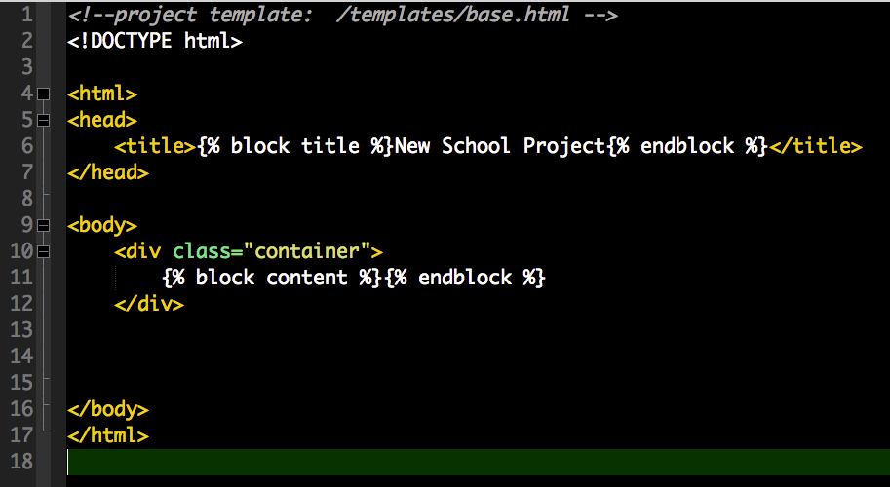
Base Template

Slide 25
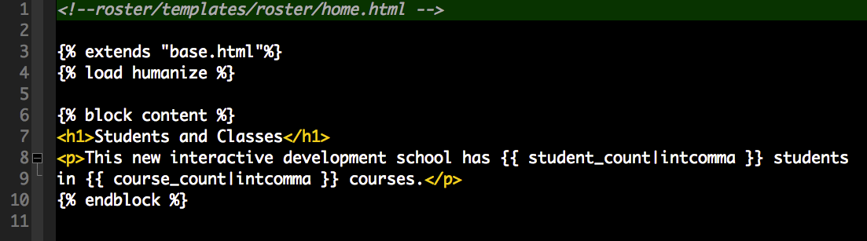
Home Template

Slide 26
Reversing URLs
You can use {% ‘roster_course’ %}
makes /course/

Slide 27
Use it for a link

