Slide 1

Deploy to Heroku
Heroku is a Python Django-Friendly Hosting Provider

Slide 2
Sign up
heroku.com

Slide 3
Create a New App
Name it and save copy the git info.

Slide 4
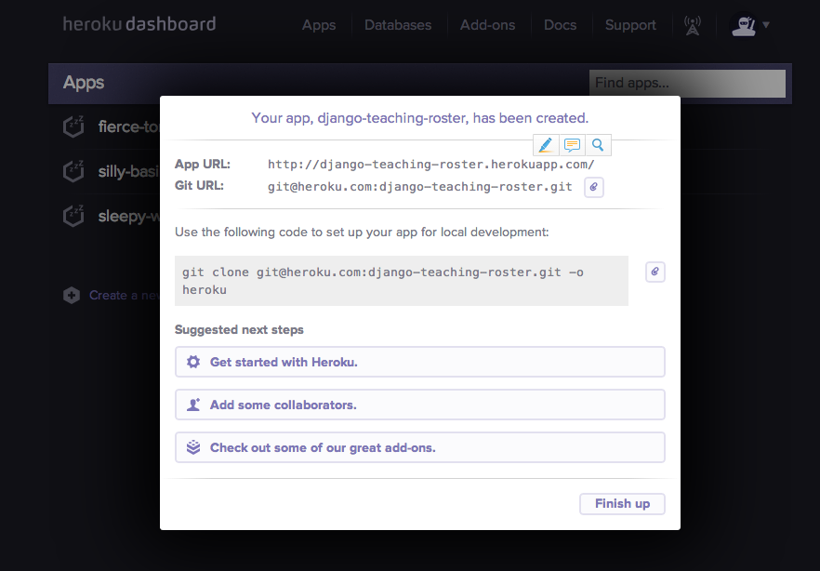

Slide 5
Virtual Env and CD to project folder
Run Virtual Env
Navigate to your project folder (not the apps)

Slide 6
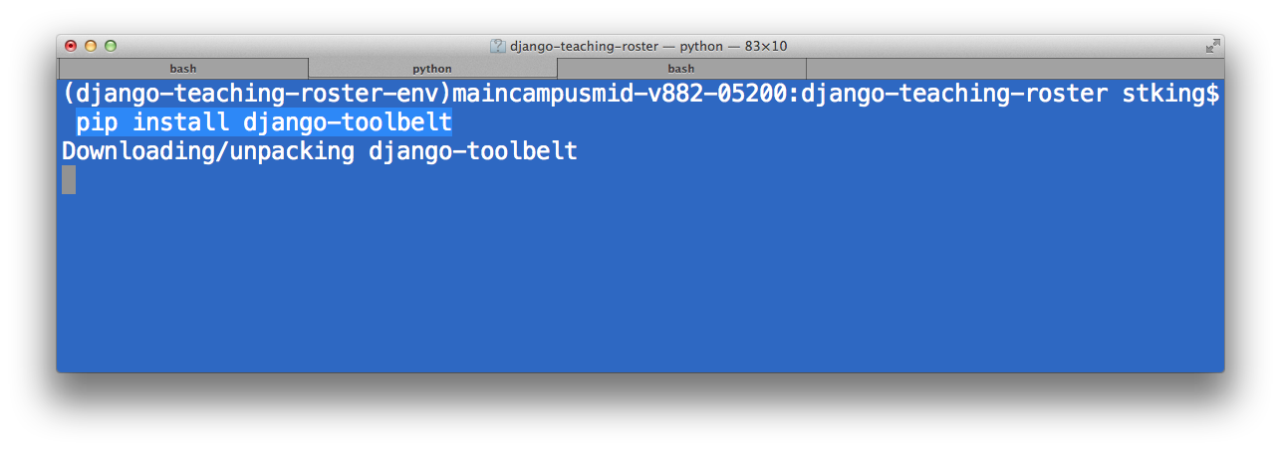
Install Toolbelt

Slide 7
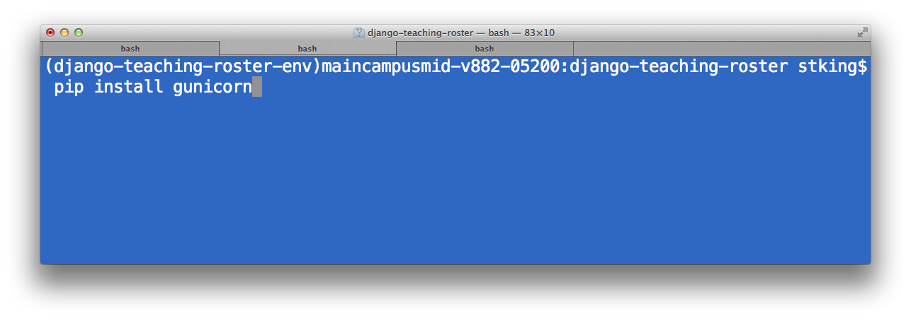
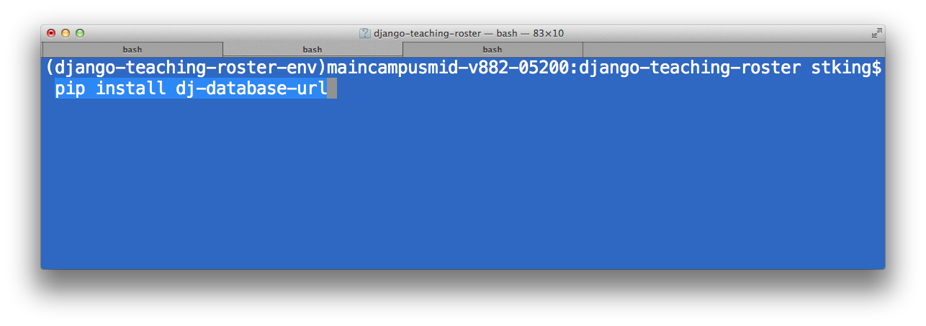
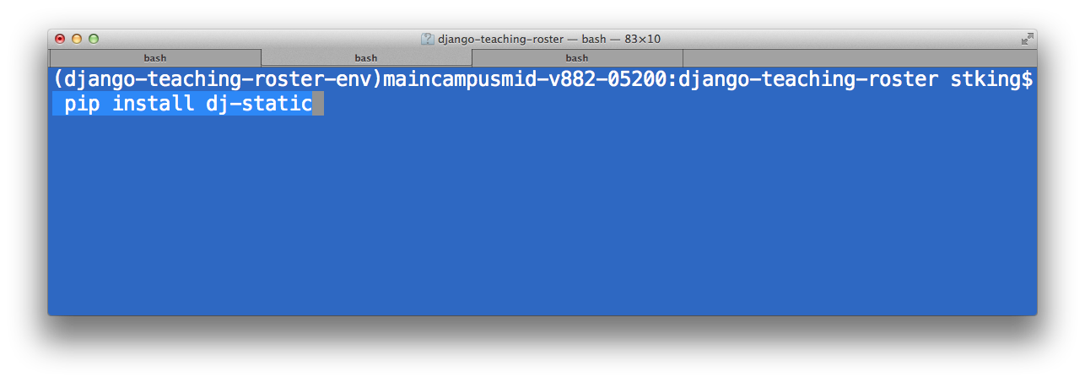
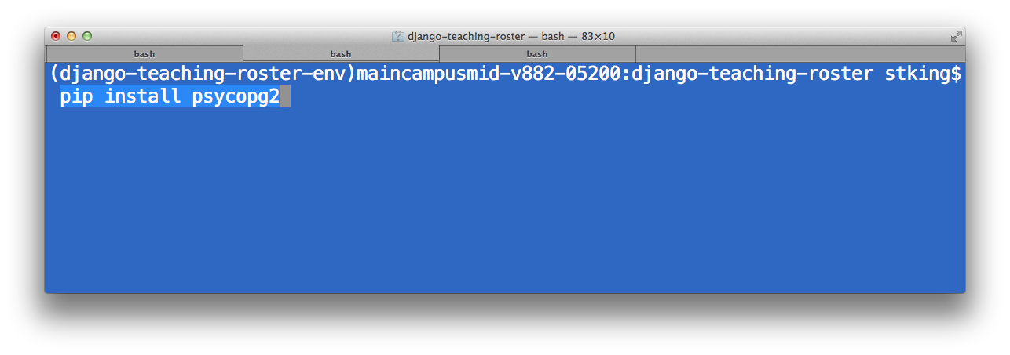
Install dependencies

Slide 8
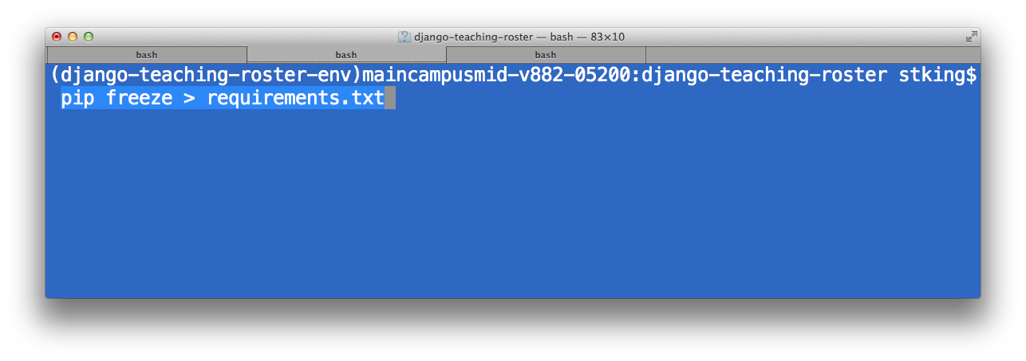
Pip Freeze!
This creates a text file of everything in your virtual env.
TIME SAVER! Why you use Virtual Env

Slide 9
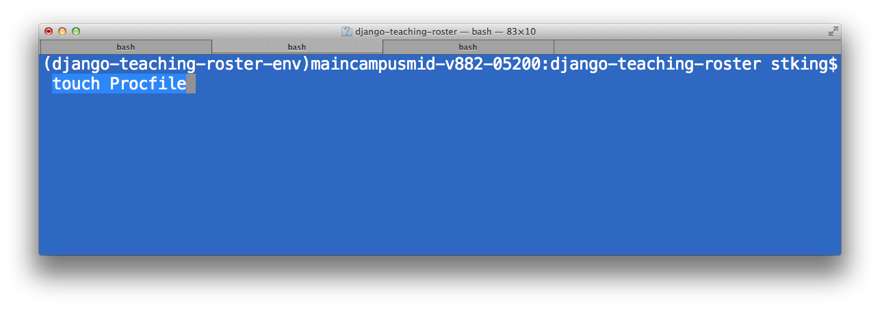
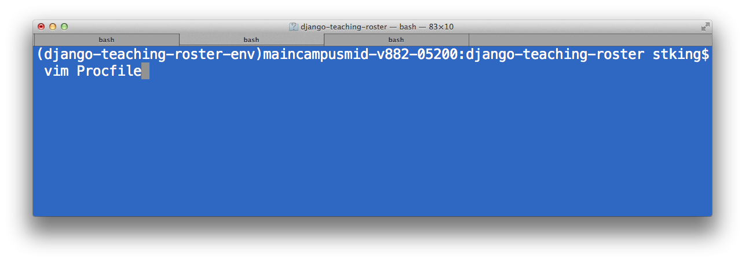
Create a Procfile

Slide 10
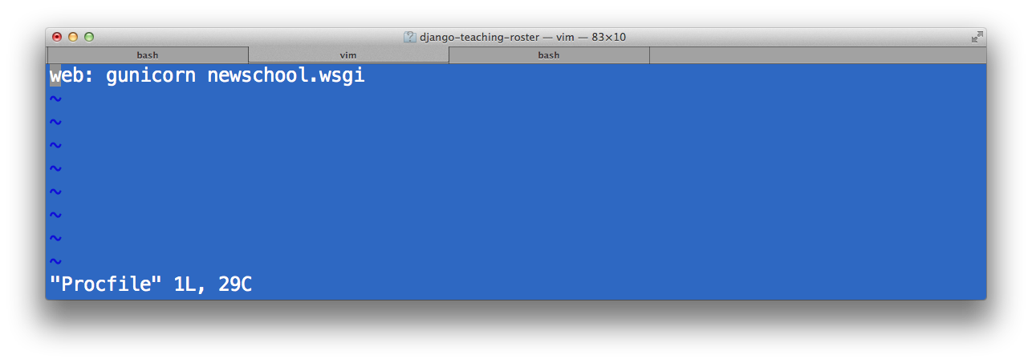
Edit Procfile
Procfile is a mechanism for declaring what commands are run by your application's dynos on the Heroku platform. It follows the process model. You can use a Procfile to declare various process types, such as multiple types of workers, a singleton process like a clock, or a consumer of the Twitter streaming API.

Slide 11
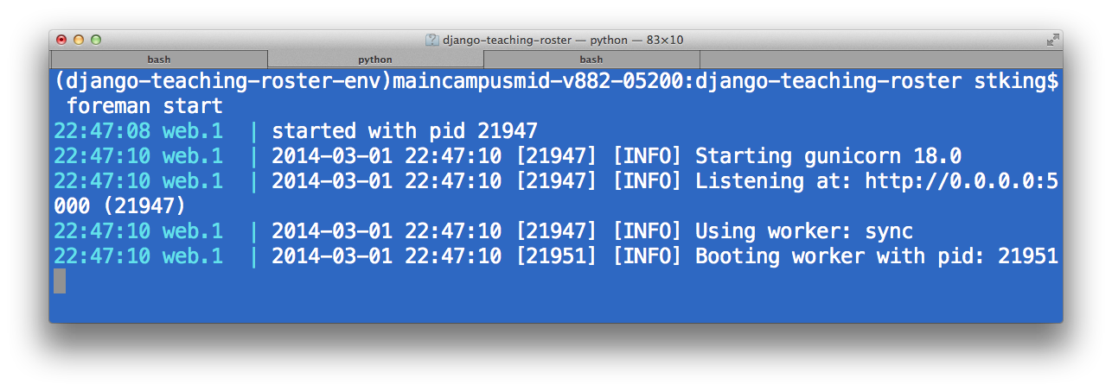
Start the Foreman

Slide 12
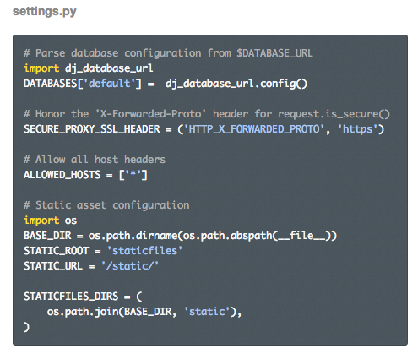
Add Heroko to Django Setting
https://devcenter.heroku.com/articles/getting-started-with-django

Slide 13
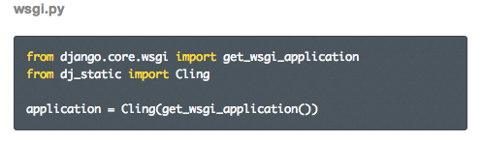
Serving Static Files

Slide 14
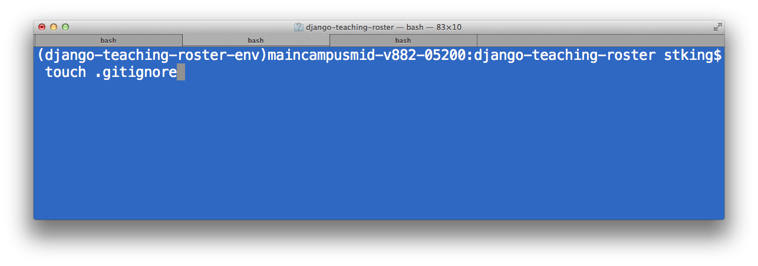
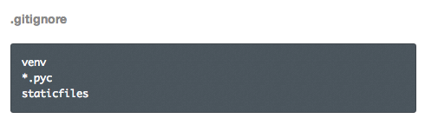
Set Git Ignore File

Slide 15

Login to Heroku

Slide 16
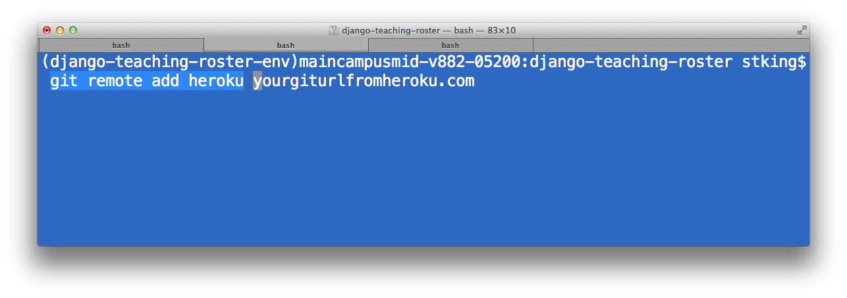
Add a new Git remote for heroku

Slide 17

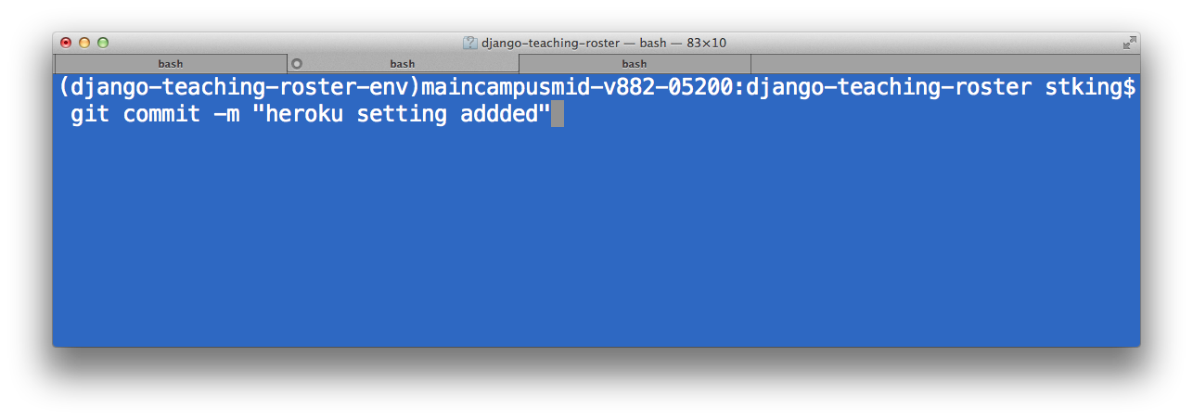
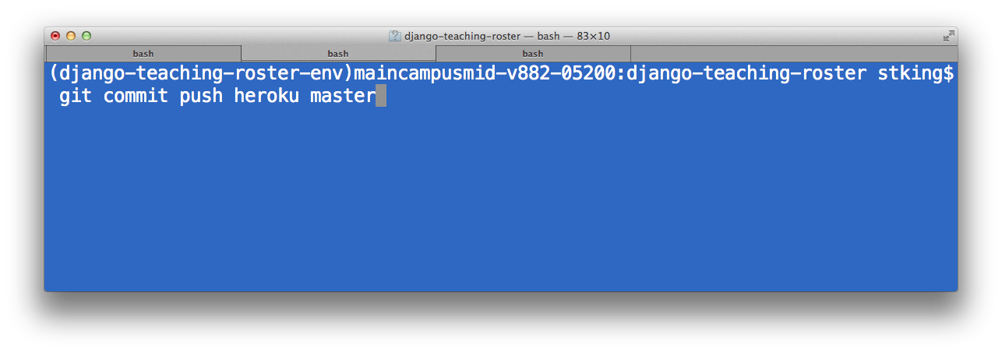
Using Git to Push to Heroku

Slide 18
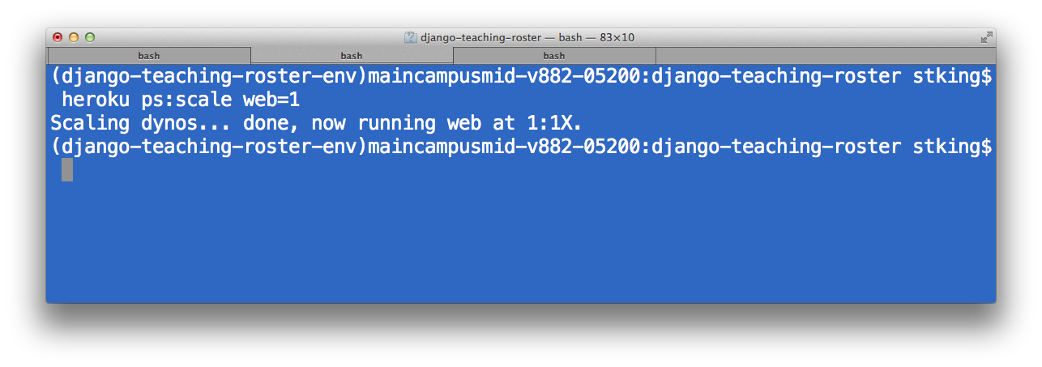
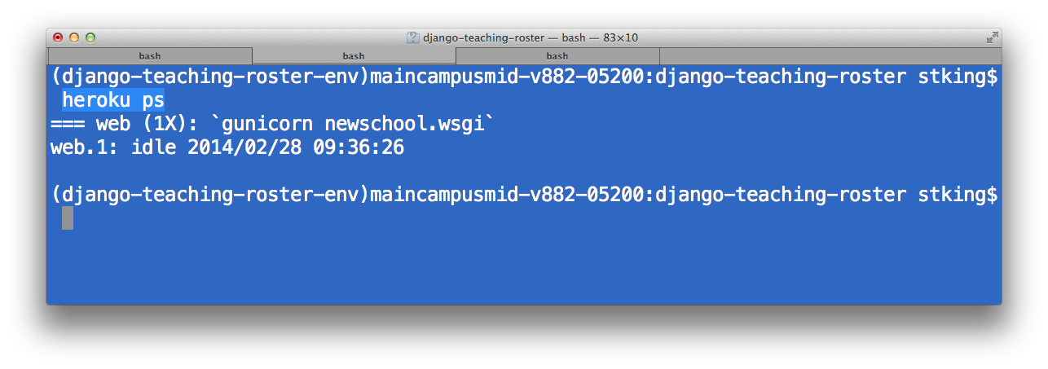
Start Servers

Slide 19
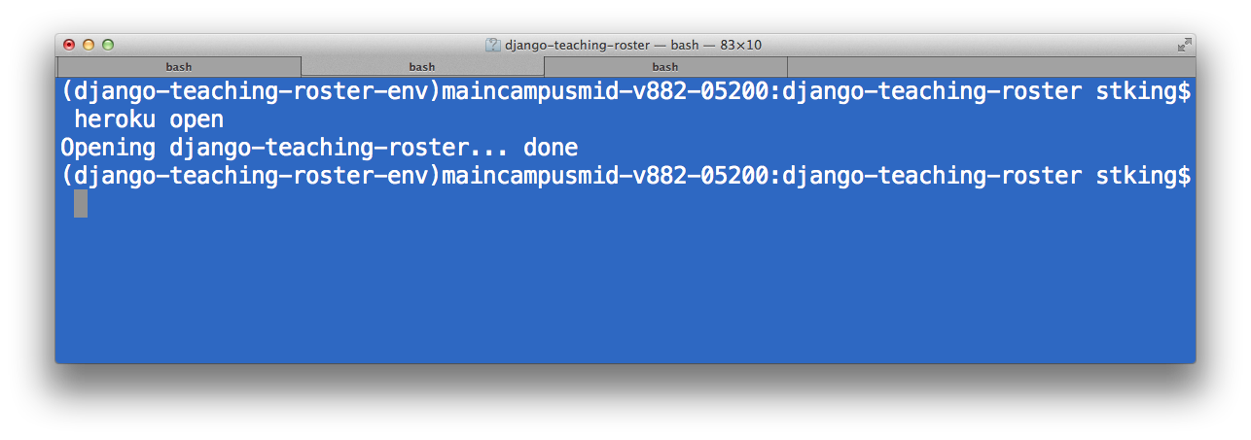
Open URL

Slide 20

If problems, view logs

Slide 21
Is it working?

Slide 22
About the Database
Right now you are running off of your SQLite3 static file you actually uploaded.
This is fine for development but not for production.
Security
Stability under load
Not as useful.

Slide 23
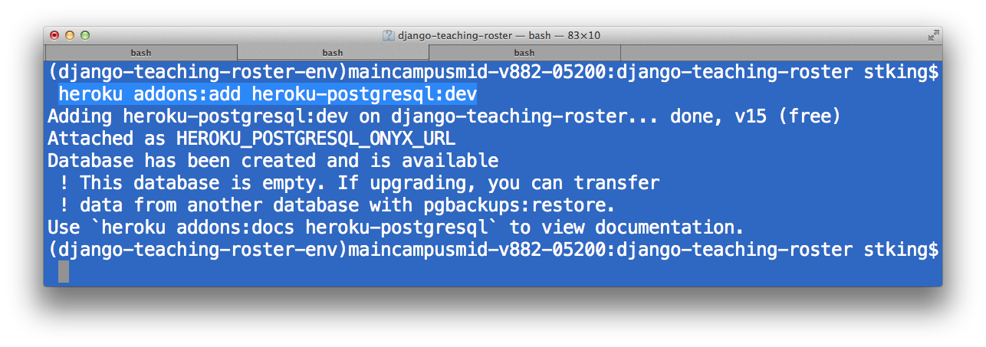
Lets Create a Postgres db

Slide 24
What just happened?
Heroku create a slice of a db you can use. You share with others but that is fine for what we are doing.
Use the color rather than complicated urls.

Slide 25
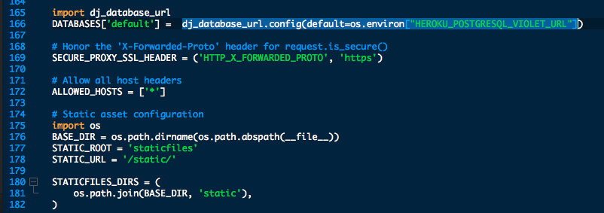
Connect the DB with settings.py
Scroll to the bottom.

Slide 26
Best part...
This method works with sqlite3 locally and Postgris remotely.

Slide 27
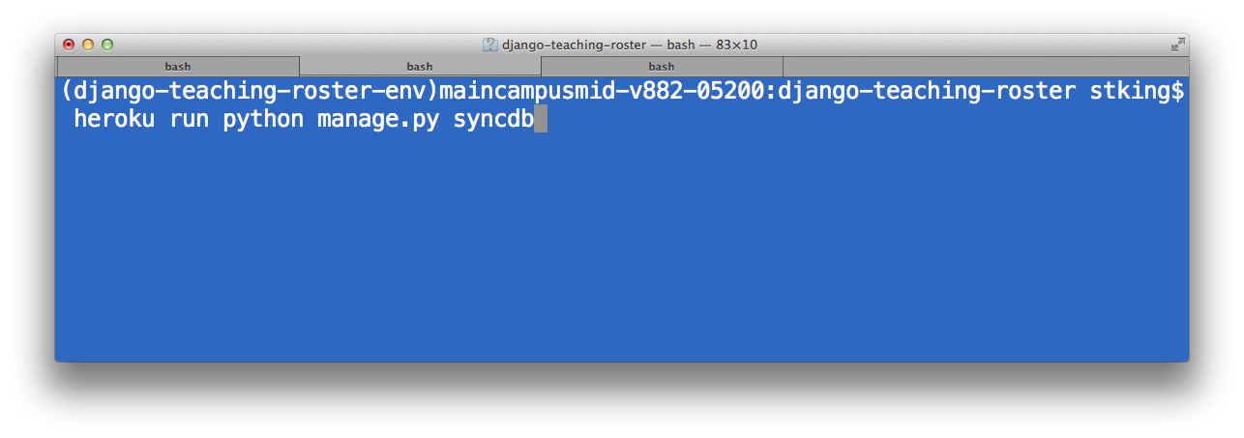
Run Heroku, Run!

Slide 28
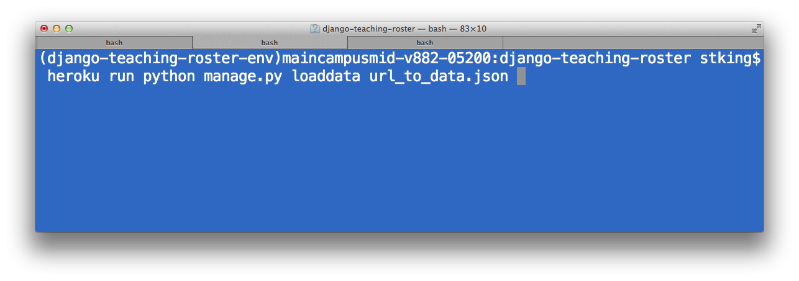
Load Data

Slide 29
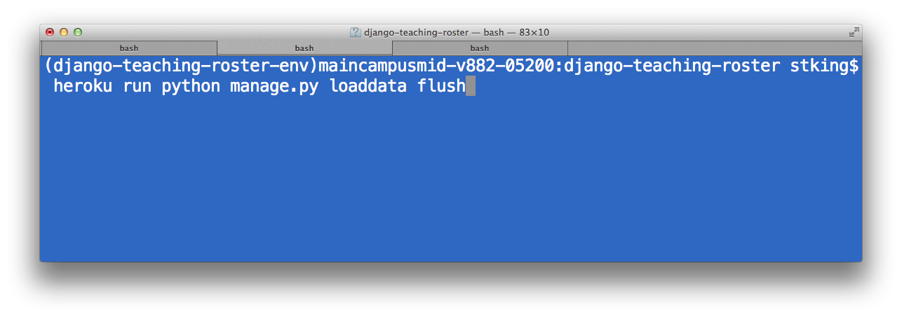
What if you need to delete db?
Removes data, then runs syncdb.

Slide 30
You are now a Heroku Master

