Slide 1
Screen Scraping
Using Python Beautiful Soup 4

Slide 2
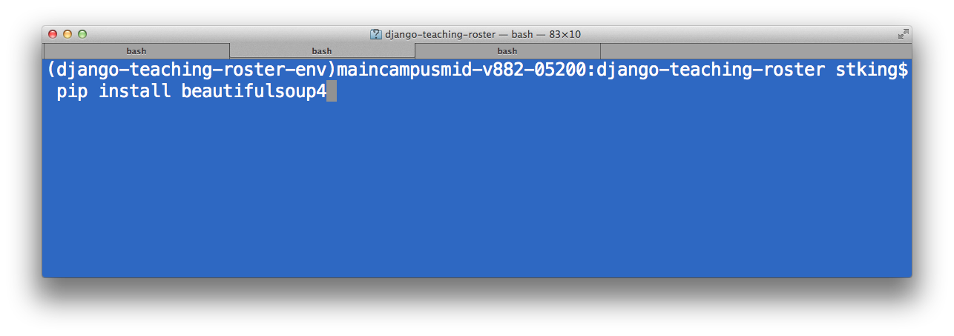
Install the Beautiful Soup Library

Slide 3
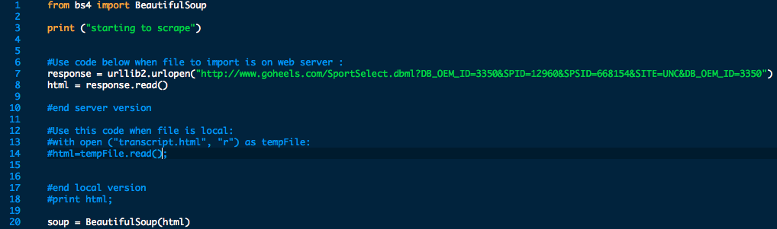
Simple Script

Slide 4

Finding The Data in the Document
soup.find(‘tag’)
soup.find_all(‘tag’)
soup.find(‘tag’, {‘element’ : ‘name’})

Slide 5

Getting Data from links
link.get(‘attribute’)

Slide 6
Getting data in tag
.text
.strip()

Slide 7
Integrate into manage.py
Step 1: Folder Structure
Step 2: Import commands
Step 3: Format Script
Step 4: run script from manage.py

Slide 8
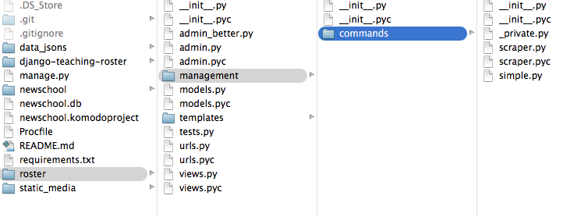
Folder Structure (App—management—commands—script)

Slide 9
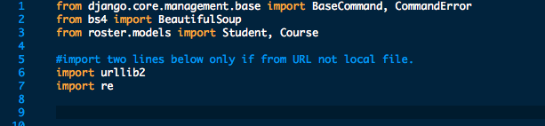
Imports

Slide 10
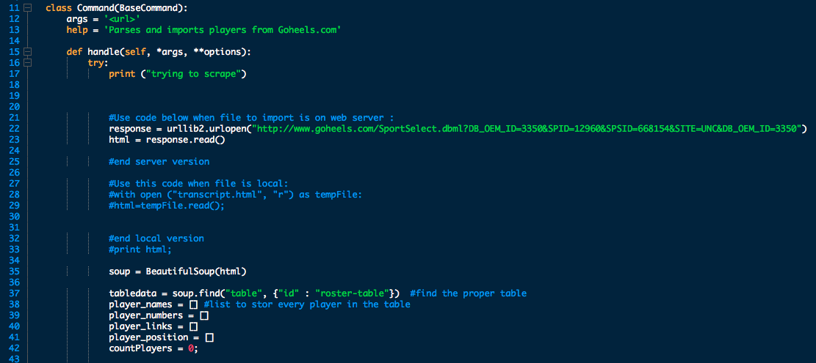
Formating

Slide 11
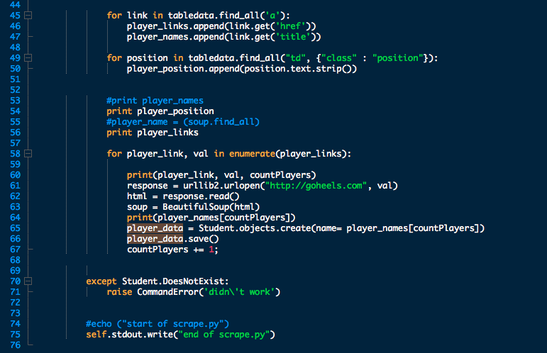
Formating

Slide 12
Run command
python manage.py scriptname

