Slide 1
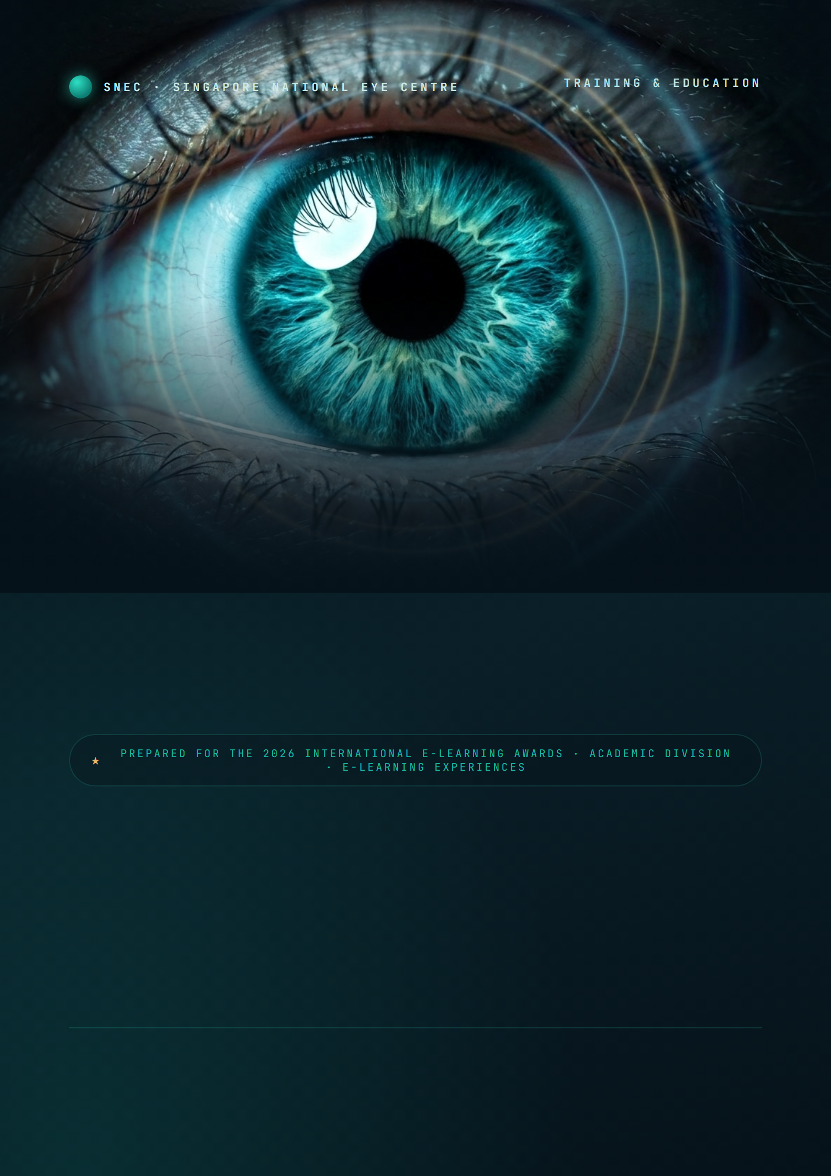
EyeBot
An AI training companion for the whole of ophthalmic education — grounding every learner, from first-year student to practising clinician, in faithful, adaptive, measurable practice.
Prepared for
Prepared by
Document
Dr JB · Director, SNEC Training & Education
Caleb Teo · SNEC Training & Education
June 2026 · Confidential Draft v3.0

Slide 2
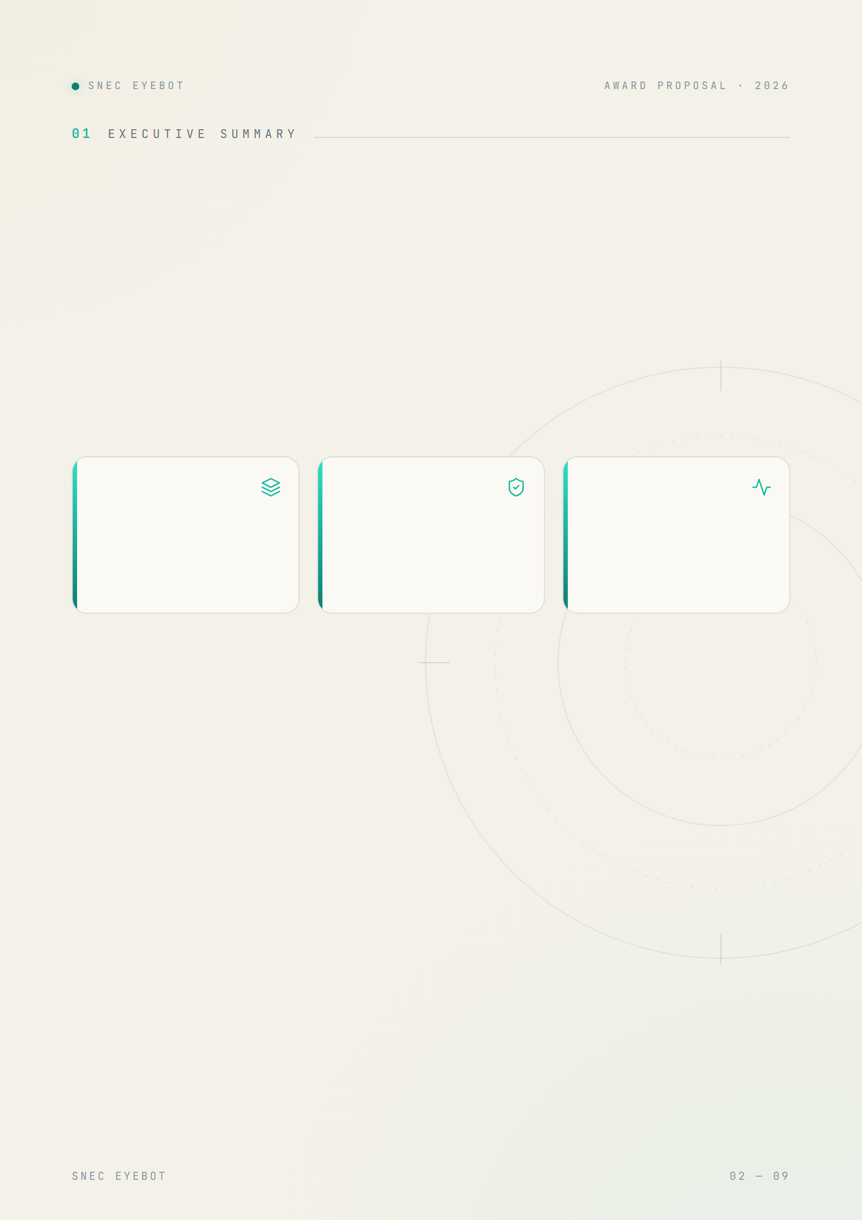
Imagine every ophthalmic trainee — whatever their role — with a tutor who never sleeps, a patient who is always available, and a curriculum that adapts to exactly what they keep forgetting.
3-in-1
Grounded
Cohort
Tutor, clinical simulator and memory engine working as a single adaptive loop.
Every answer drawn from validated clinical material — faithful, not the open internet.
Live at-risk detection, retention scoring and weekly digests for educators.
SNEC EyeBot is an AI learning companion that transforms a clinical curriculum into three evidence-based experiences — a Socratic tutor, inexhaustible virtual-patient simulations, and a self-optimising memory engine — woven into one adaptive loop. Grounded today in SNEC’s clinical curriculum and architected to serve the full spectrum of eye-care learners, it also gives educators a live, cohort-wide view of mastery for the first time. The platform is built, demonstrable, and ready to pilot.
A fixed curriculum becomes a living, personalised, measurable learning experience — and positions SNEC at the front of AI-enabled clinical education.

Slide 3
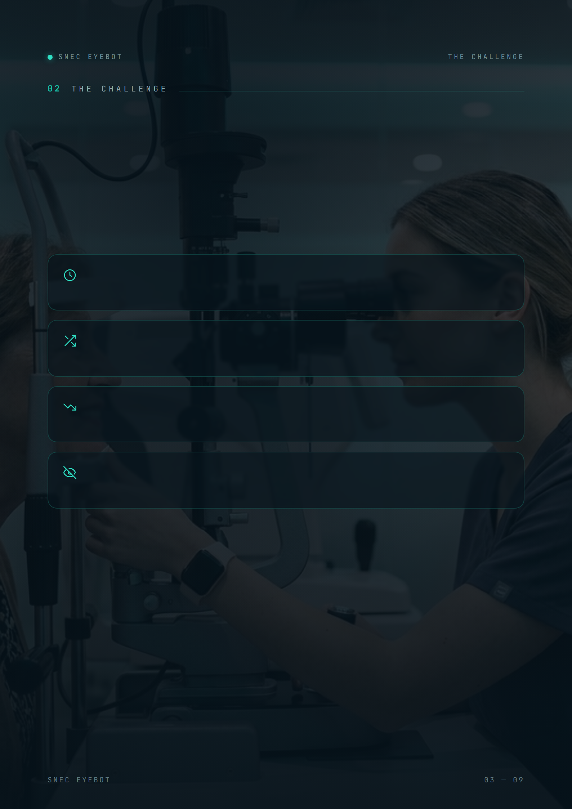
Training the eyes
behind the eye care.
Across the eye-care continuum — medical students on rotation, optometry students, ophthalmology residents, nurses and allied-health technicians — training is rigorous, yet it meets four structural limits that no amount of dedication can fully solve.
Expert time is scarce
One educator cannot give every trainee unlimited one-to-one tutoring or on-demand case practice.
Case exposure is uneven
Which conditions a trainee actually meets is left to the luck of the clinical roster.
Knowledge decays
Without deliberate reinforcement, much of what is taught is forgotten within weeks of the lesson.
Cohort gaps are invisible
Educators often discover weaknesses at assessment time — when it is already late to intervene.
EyeBot is engineered to dissolve all four — at once.

Slide 4
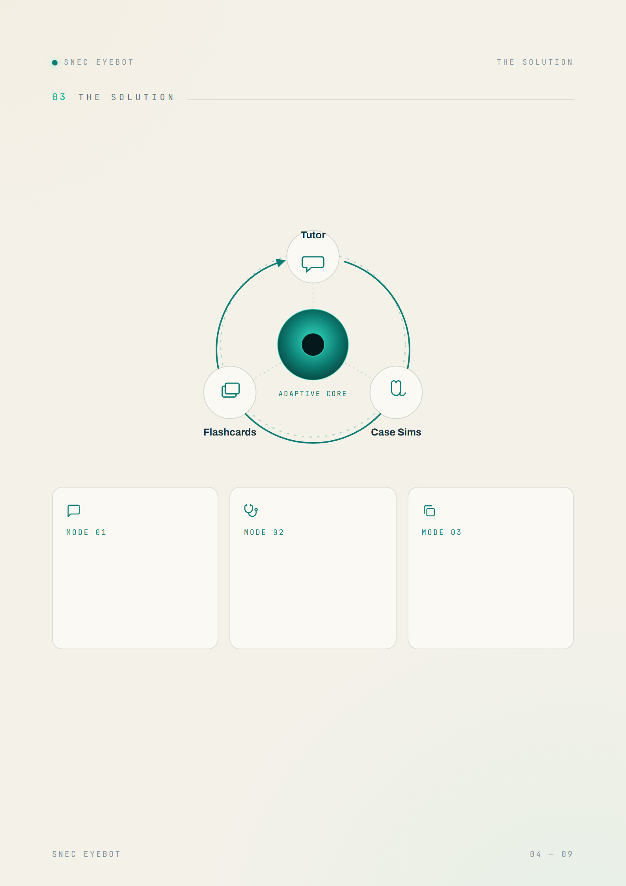
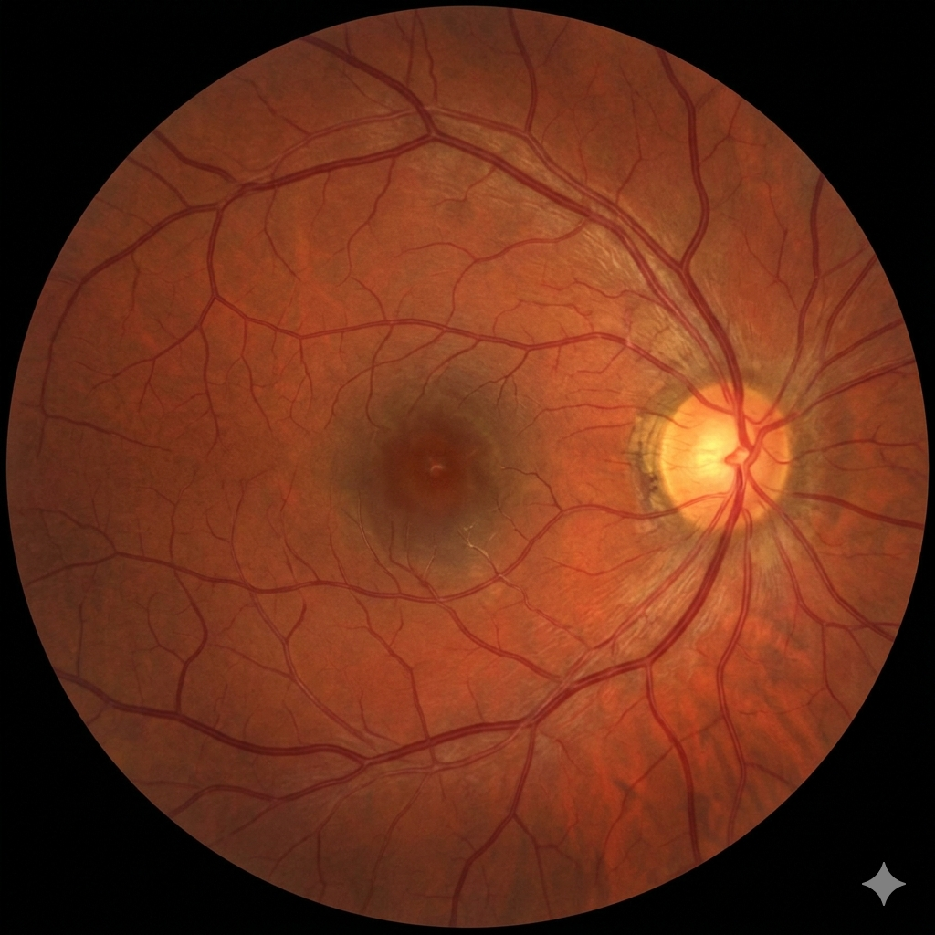
One companion. Three modes.
A single adaptive loop.
AI Socratic Tutor
Case Simulations
Spaced Flashcards
Plain-language questions met with Explanation → Mechanism → Clinical Pearl → a check for understanding, always grounded in the clinical knowledge base.
Interview a virtual patient, order investigations, commit to a diagnosis and plan — graded on a four-domain rubric out of 40 with instant feedback.
High-yield cards auto-generated from each session and every missed clinical point, scheduled by the SM-2 algorithm for durable recall.
…and quietly, an analytics layer watches the whole cohort — turning individual practice into institutional insight.

Slide 5
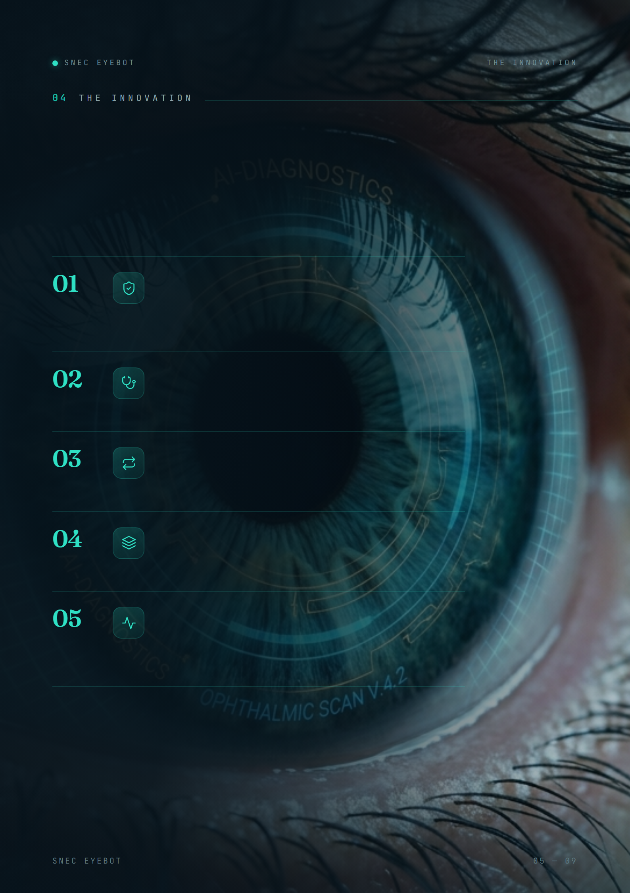
An innovation —
not an integration.
EyeBot is not a chatbot bolted onto a syllabus. Five deliberate advances make it genuinely new for clinical education.
Curriculum-grounded clinical AI
Answers are retrieved from the institution’s own validated material — faithful and auditable, never the untraceable guesswork of a generic model.
Inexhaustible virtual patients
The AI plays both patient and examiner: unlimited, standardised case exposure with rubric-graded feedback — independent of roster luck.
A self-optimising loop
Each learner’s weak points automatically become their next flashcards and tougher cases — genuine personalisation, at scale.
Reliable by architecture
A Workflows–Agents–Tools design separates AI judgement from deterministic execution — trustworthy enough for clinical training.
Cohort intelligence
Learning analytics purpose-built for clinical education: at-risk detection, retention scoring and learning-velocity — live, not at term’s end.
Together: the first AI companion built for how eye care is actually taught.

Slide 6
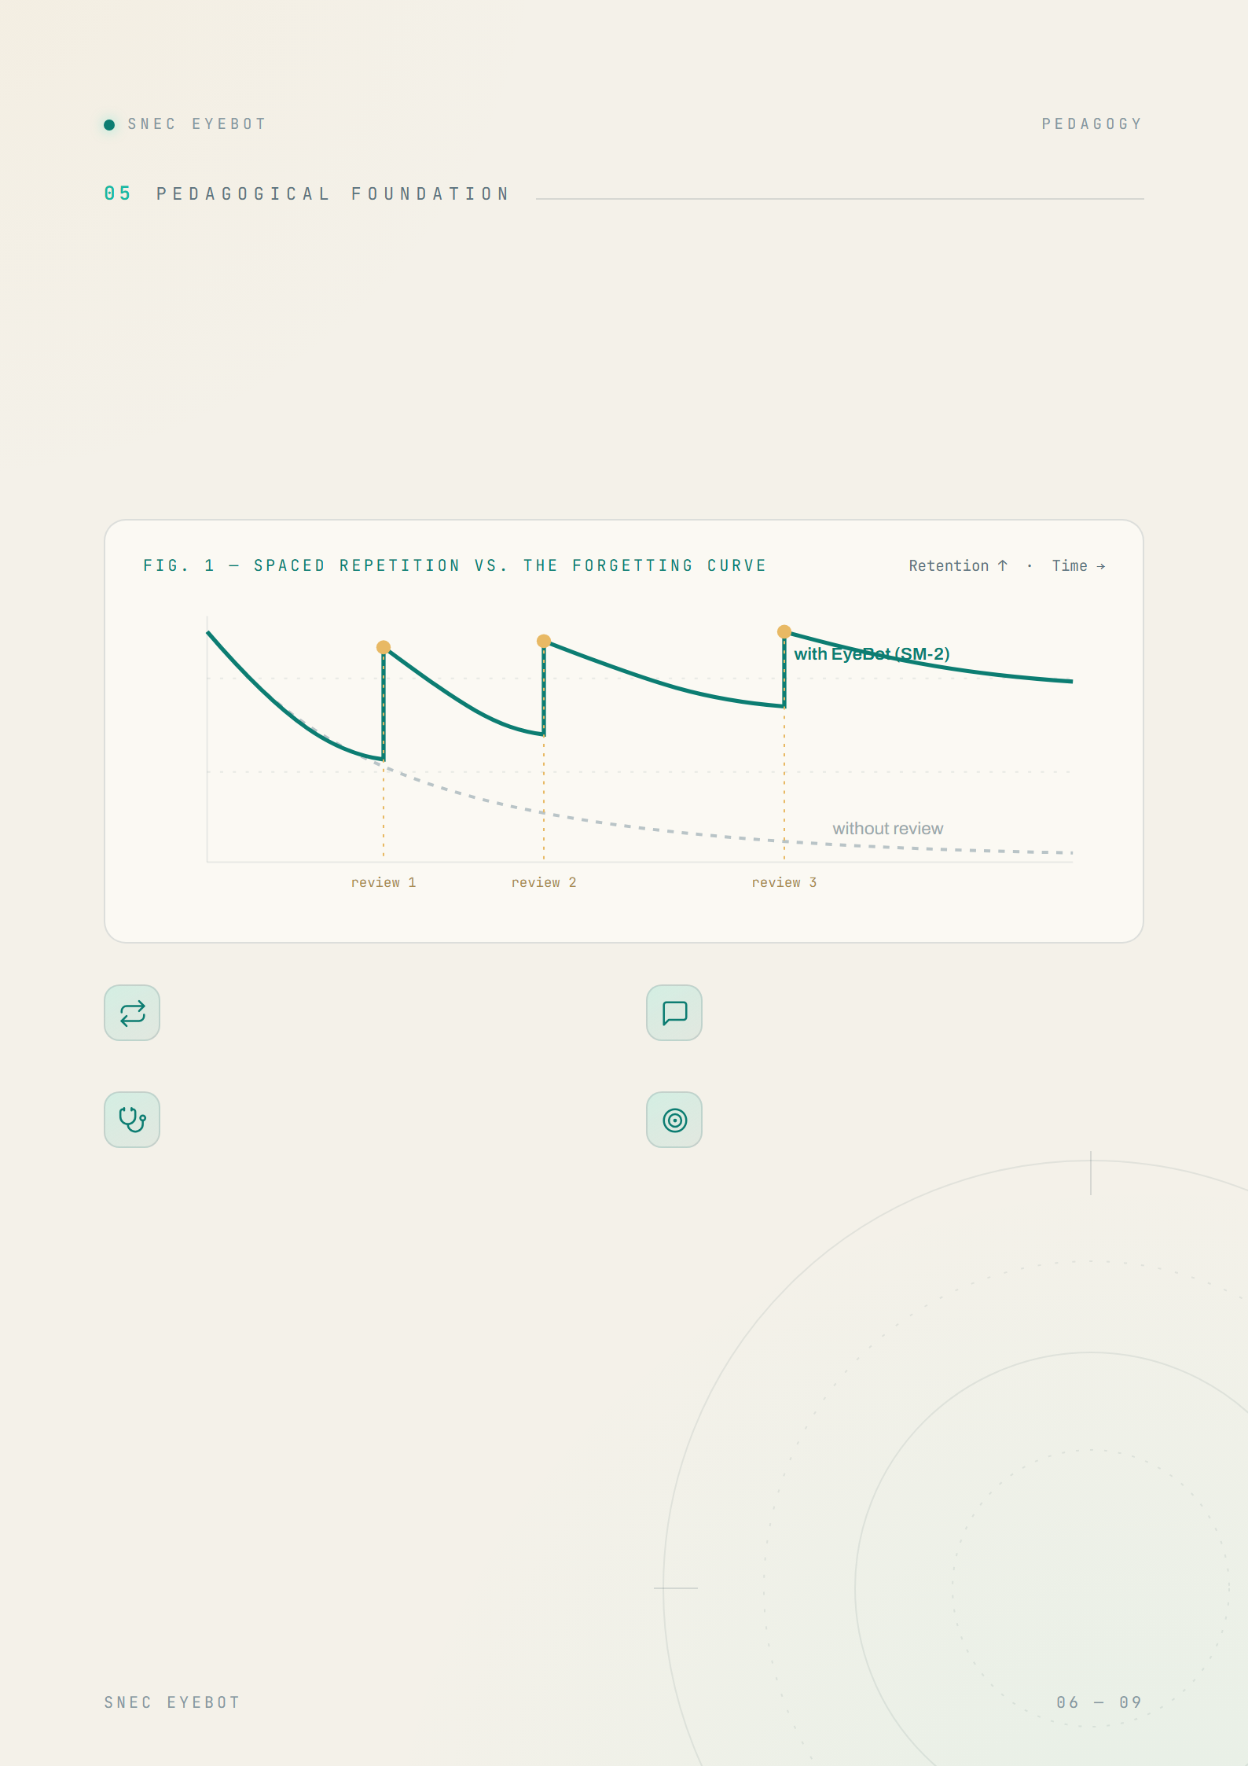
Grounded in learning
science, not novelty.
Every design decision in EyeBot maps to an established principle of how clinicians actually learn and retain.
Retrieval & spacing
Socratic scaffolding
SM-2 spaced repetition fights the forgetting curve — each review lengthens durable retention.
The tutor explains mechanism, then checks understanding — active recall over passive reading.
Case-based reasoning
Formative feedback
Simulations rehearse the full clinical chain: history, investigation, diagnosis, management.
Rubric scores and targeted cards turn every mistake into the learner’s next rep.

Slide 7
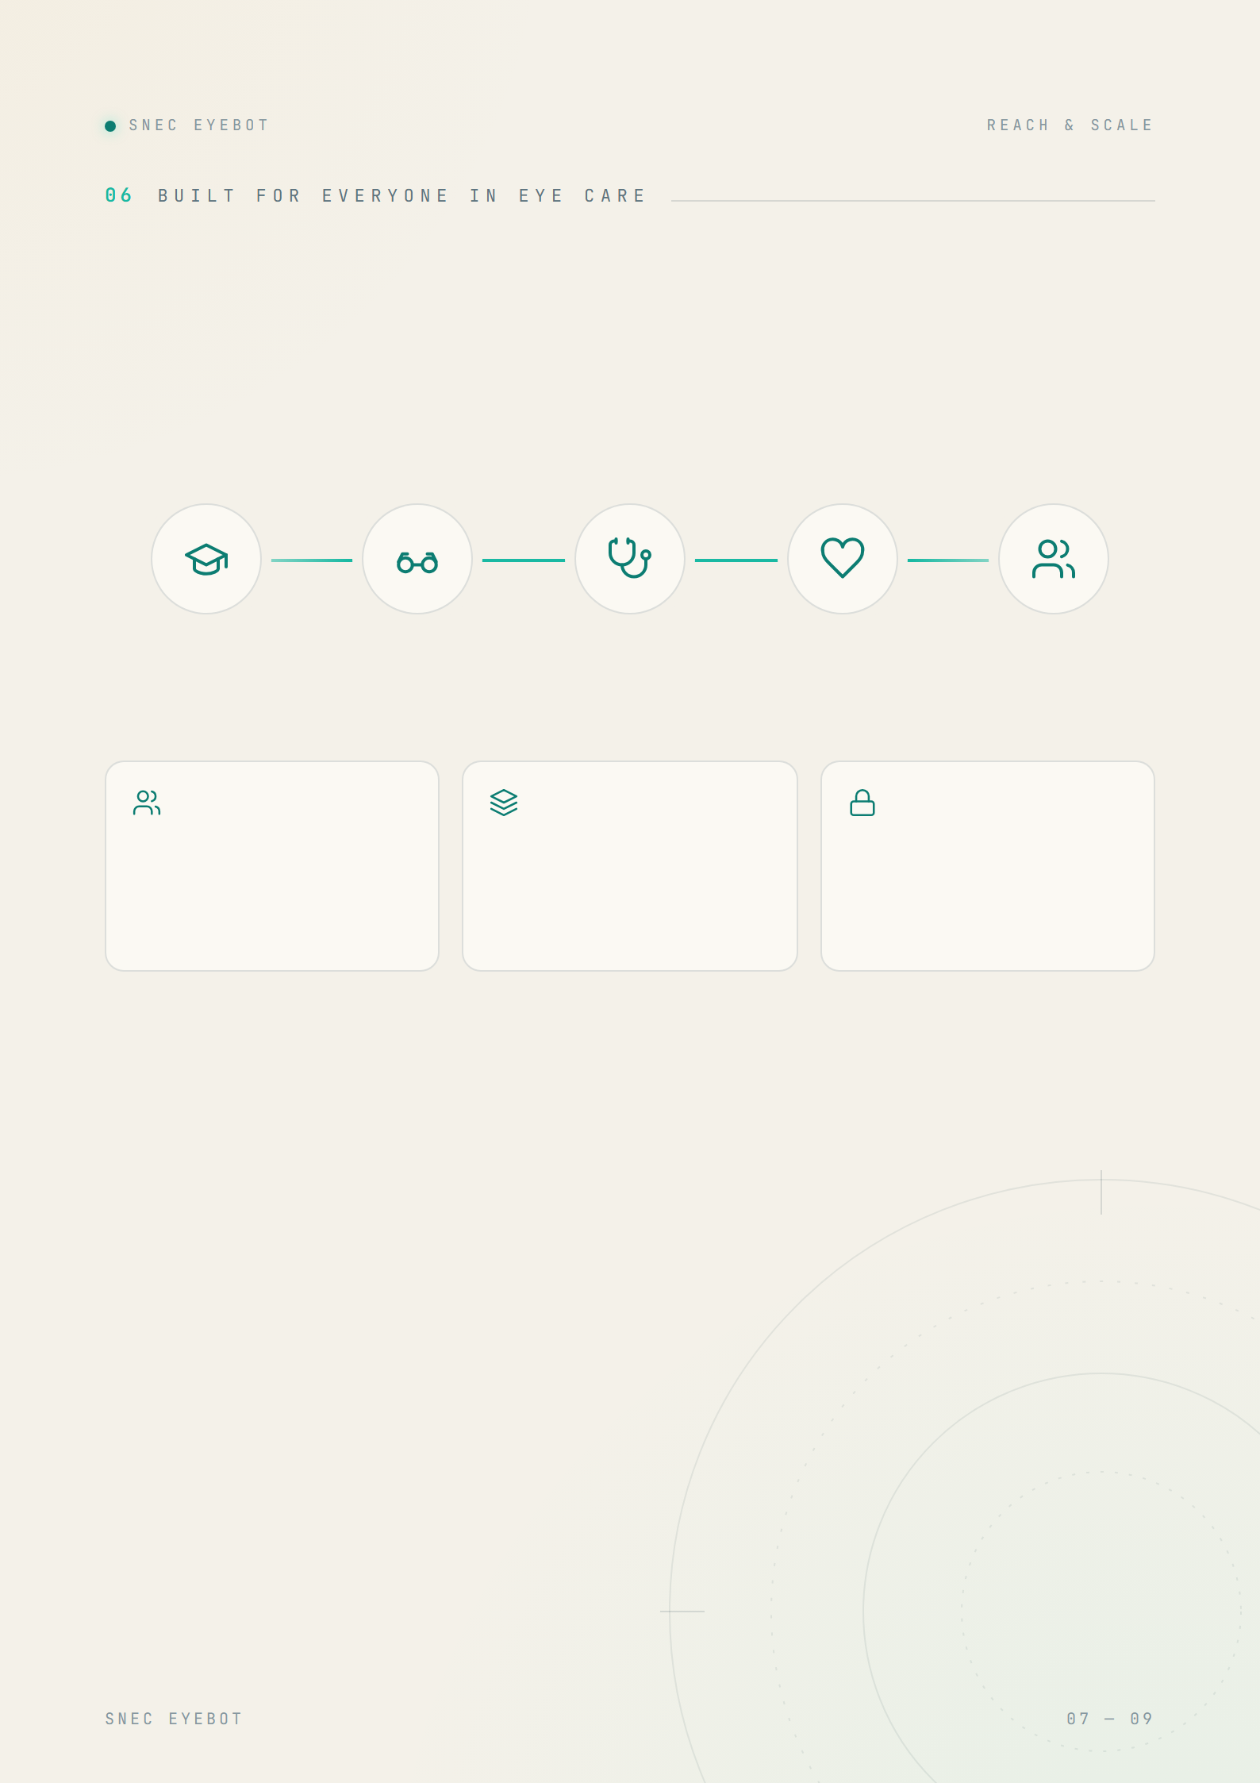
One engine. Every learner.
EyeBot adapts its content, cases and rubric to each role — and the same engine extends across specialties and institutions. What begins with SNEC’s programme scales to the whole of ophthalmic education.
Medical Students
Optometry Students
Ophthalmology Residents
Ophthalmic Nurses
Allied Health · OA / OT / PSA
Eye-rotation foundations
Refraction & primary care
Clinical decision-making
Peri-operative & patient care
Technical & assisting skills
Role-aware
Specialty-extensible
Institution-ready
Content, case libraries and rubrics tuned to each learner’s scope of practice.
The same engine accepts new curricula — glaucoma, retina, paediatrics and beyond.
PDPA-compliant consent, bcrypt credentials and role-based access — privacy by design.
From a single programme to an institution-wide standard for how eye-care professionals are trained.

Slide 8
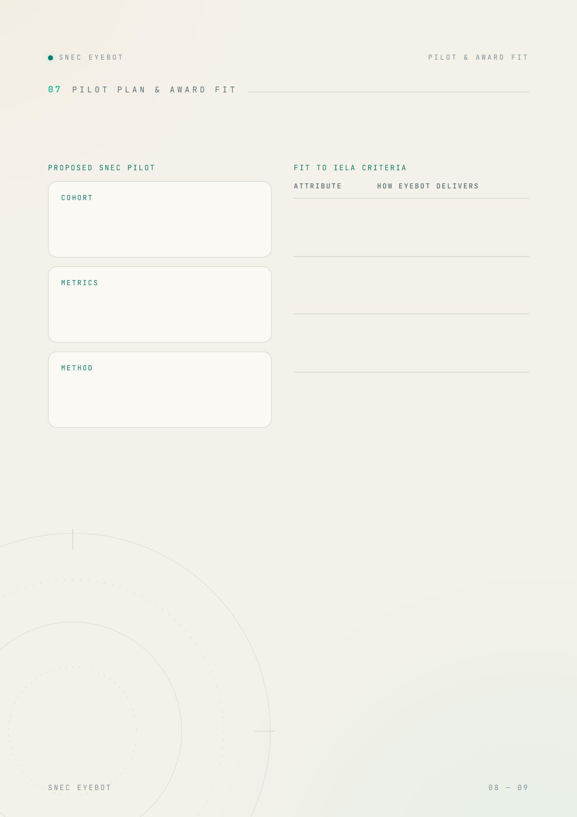
From prototype to proof.
A representative intake of ophthalmic trainees over an 8–12 week module, benchmarked against a prior cohort as historical control.
Educational soundness
PEDAGOGY
Curriculum-grounded; SM-2 spacing; Socratic + case-based design rooted in learning science.
Effectiveness
OUTCOMES
Closes gaps in a measured loop; analytics quantify uplift at learner and cohort level.
Pre/post knowledge test · case-rubric progression · flashcard retention · engagement (active days & streaks) · educator time saved · learner satisfaction.
User experience
ENGAGEMENT
Polished, gamified and mobile-friendly, with daily check-ins that build habit.
Baseline → guided daily use → measured uplift, with the analytics layer capturing evidence automatically throughout.
Significance
IMPACT
First AI companion spanning the ophthalmic learning continuum; scalable across SingHealth.
Because impact is measured, not asserted, the pilot doubles as the evidence base for the award submission itself.

Slide 9
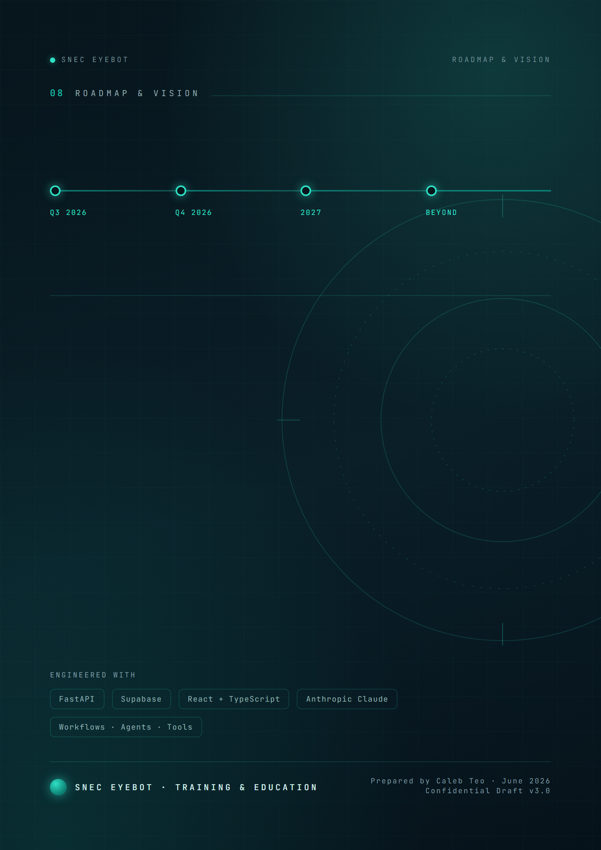
Where this goes next.
SNEC Pilot
Multi-role rollout
Specialty expansion
SingHealth-wide
Run with a live intake; capture the outcome evidence.
Extend across every eye-care learner type.
New curricula, richer simulation media, UI refresh.
Other institutions on the same engine.
SNEC EyeBot turns a fixed curriculum into a living, personalised and measurable learning experience — and positions SNEC at the forefront of AI-enabled clinical education.

