Slide 1
Fantasy Forest Adventure: A Web-Based Text Adventure Game
Group Project Presentation
Team Members: Caleb Thang, Ammar Abbkar, Abdinur Hussein
Visionary Designers

Slide 2
Problem Statement & General Requirements
Problem: Creating an immersive text-based adventure game using HTML, CSS, and CSS animations.

Slide 3
Problem Statement & General Requirements
Problem: Creating an immersive text-based adventure game using HTML, CSS, and CSS animations.
Requirements:
- Input: User interaction (clicks on buttons to make story choices)
- Output: Screen transitions, storyline updates, CSS-based effects

Slide 4
Project Overview
Objective: Develop an interactive, text-based adventure game set in a mystical forest.
• Focus on:
- Visual effects (CSS animations, transitions)
- Story-driven user choices that shape the gameplay
- Interactive animations

Slide 5
Design Overview
Wireframe Overview:
Key screens:
Main Menu, Story Screen, Instructions, Settings.
• Main Menu: Navigation buttons for game options.
• Story Screen: Narrative area and player choice buttons.
• Settings: Adjust audio, theme color.

Slide 6
User Interface & Experience (UI/UX)
Clean layout using Flexbox for responsive design.
Magical font and color scheme for fantasy theme.
Hover animations for interactive feedback.
Smooth transitions for storytelling.

Slide 7
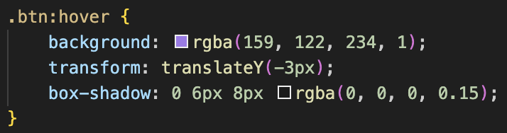
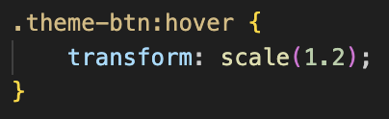
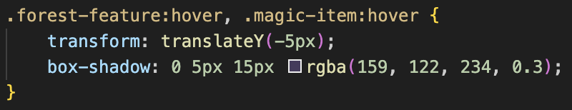
CSS Transformations
Transformations:
- Hover effects for interactive buttons.
- Button animations: Glow and scaling effects.
Button hover lift effect
Hover scale effect
Forest feature and magic item hover effect

Slide 8
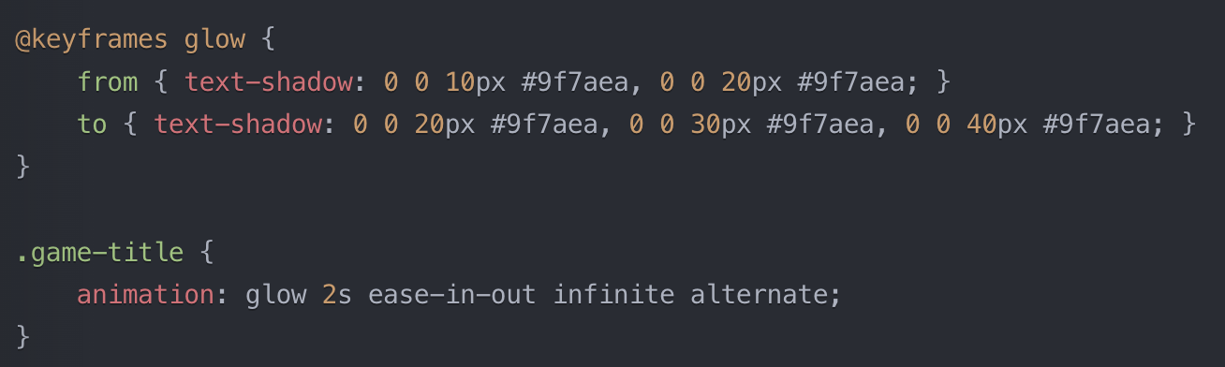
CSS Animations
Animations:
- Continuous animations (e.g., glowing effects).
- Animated forest environment (`background.gif`) sets the scene.

Slide 9
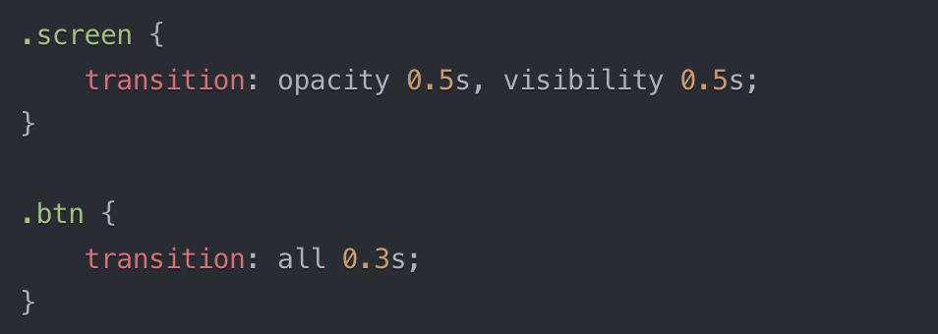
Transitions
Screen Transitions: Smooth fade-in/out between screens.
Button Hover Effects: Visual feedback when hovering over buttons.

Slide 10
Testing Plan
Test Plan: Testing user navigation, creature interaction, and visual effects.
Bug Reporting: Track glitches in transitions, incorrect animations, or broken links between sections.
Test Data: Checking visual consistency, animation fluidity, and interaction responsiveness.

Slide 11
Conclusion and Next Steps
We focused on creating an immersive user experience with smooth transitions, interactive elements, and CSS-based animations that enhance the storytelling.
Our next step is to create more interactive story where user interact with the forest endlessly.
Since JavaScript is not allowed, we are limited to our creativity. So in our next step we will improve our game with javascript.

