Slide 1
HANKAMER
SCHOOL OF
BUSINESS
249
389
117
~1,600
38
Fall 2025
Students
Spring 2026
Students
Info Sessions
Held
Est. Total
Visitors
States
Represented
OVERVIEW
638 students attended Hankamer info sessions across AY 2025–2026 — 249 in fall, 389 in spring.
117 sessions hosted across the year averaged just ~5 students each — a high-touch, personalized experience rarely found at scale.
Spring 2026 outpaced Fall 2025 by 56%, driven by senior application timelines and growing program interest.
Most students brought 1–2 family members, generating an estimated ~1,600 total campus visitors across the year.
38 states represented across both semesters — visitors came from coast to coast, including VT, OR, NY, and NH.
Class of 2026 and 2027 together made up 92% of all visitors, with a healthy mix of near-term and imminent prospects.
Information Session
Attendance Brief
Academic Year 2025–2026
RECOMMENDATIONS
Scale spring capacity — March and April are peak months; additional session dates or a larger venue may be needed.
Target high-potential out-of-state clusters: Kansas, Colorado, Illinois, Arkansas, and Oklahoma show strong interest.
Design for the family — ~40% of visits included both parents; messaging should address ROI, outcomes, and campus culture.
BAYLOR UNIVERSITY

Slide 2
ATTENDANCE TRENDS
AY 2025–2026
GRADUATION YEAR
Class of 2026 & 2027 = 92% of students
Both semesters shown. Fall 2025: 249 students (Aug–Dec). Spring 2026: 389 students (Jan–Apr). Total: 638.

Slide 3
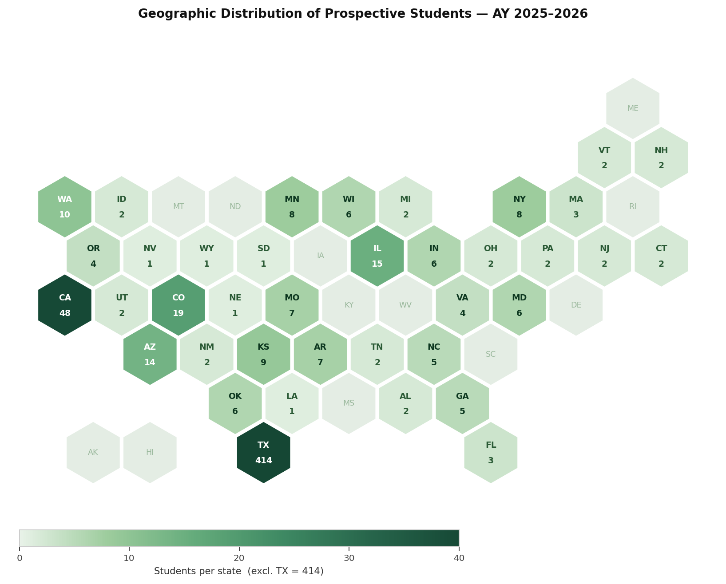
GEOGRAPHIC REACH — AY 2025–2026
38 States Represented
STUDENTS BY REGION
Region | Students | Share
Texas | 414 | 65%
West / SW | 103 | 16%
Midwest | 57 | 9%
South / Southeast | 41 | 6%
Northeast | 21 | 3%
International | 1 | <1%
65%
35%
1
from Texas
out-of-state
international
CA (#2, 48), CO (19), IL (15), AZ (14), WA (10), KS (9) are top non-TX states.
One student listed Torreón, Mexico — nascent international reach.
AY 2025–2026 combined. Some records had missing/ambiguous state data. Regional counts sum to 637 of 638 total students; 1 student had an unresolvable state entry.

Slide 4
VISITOR & FAMILY BREAKDOWN
TOP 10 STATES
WHO JOINS STUDENTS?
Companion | Frequency
Mother (solo) | Very common
Father (solo) | Common
Both parents | Very common
Sibling(s) | Occasional
Extended family | Rare
Friends / classmates | Rare
Student alone | Uncommon
FAMILY ENGAGEMENT INSIGHTS
~1,600 total campus visitors estimated across AY 2025–2026 — nearly 2.5× the student headcount.
~40% of visits included both parents, making this as much a family event as a student one.
Younger siblings (Class of 2028–2029+) are forming early impressions — a long-lead pipeline.
Visitor estimate based on ~2.5× the student headcount; companion data is self-reported at time of registration. Companion frequency reflects qualitative patterns, not exact counts.
Hankamer School of Business · Baylor University · Information Session Registration Log, AY 2025–2026

