Slide 1
Predicting Crash Severity in New Zealand Using Machine Learning
Crash Analysis System (CAS) — Kaggle Dataset
Notes:
This project uses machine learning to predict whether a crash will be severe based on road, environmental, and participant‑related features.

Slide 2
The Problem
Road crashes impose major social and economic costs in NZ.
Agencies need to understand which conditions lead to severe crashes.
Machine learning can uncover patterns not obvious from raw data.
Notes:
Severe crashes are rare, but when they happen, the consequences are huge. The challenge is that severity isn’t driven by a single factor - it’s the interaction of factors such as environment, road users, and conditions. This project uses the Crash Analysis System dataset to untangle those interactions and show which combinations lead to the worst outcomes.”

Slide 3
Dataset Overview
~705,000 crash records
79 columns
Includes road conditions, lighting, weather, speed limits
Includes participant involvement (vehicles, pedestrians, cyclists)
Includes injury counts
No date/time fields
No driver behaviour data
https://www.kaggle.com/datasets/neonninja/nzta-crash-analysis-system-cas/data
Notes:
This is a big dataset for me – over 705K records and 79 columns
The dataset includes features such as:
numbers of buses, cars, pedestrians, moped
number of injuries – fatal, minor,
There are no date and time fields. Without time‑of‑day, day‑of‑week, or seasonal information, we can’t analyse temporal patterns, which are often crucial in crash modelling.
There are also no driver behaviour data such as distraction, impairment, fatigue, or speeding behaviour. These are often the strongest predictors of crash severity, but they’re not included in this Kaggle version of the Crash Analysis System dataset.
The models are trained on historical data, which may not fully reflect emerging risks/patterns such as new vehicle technologies, changing road layouts, or evolving driver behaviour.

Slide 4
Data Cleaning & Preparation
Dropped irrelevant columns (IDs, coordinates, high‑missingness fields)
Filled missing values
Renamed columns to consistent snake_case
Engineered features:
effective_speed_limit
num_participant_types
weather_pair
severity_binary
Converted severity to binary target
Notes:
This project uses machine learning to predict whether a crash will be severe based on road, environmental, and participant‑related features.
I have cleaned up the names of the columns and created some engineered features such as
effective_speed_limit
num_participant_types
weather_pair
severity_binary
to help the model

Slide 5
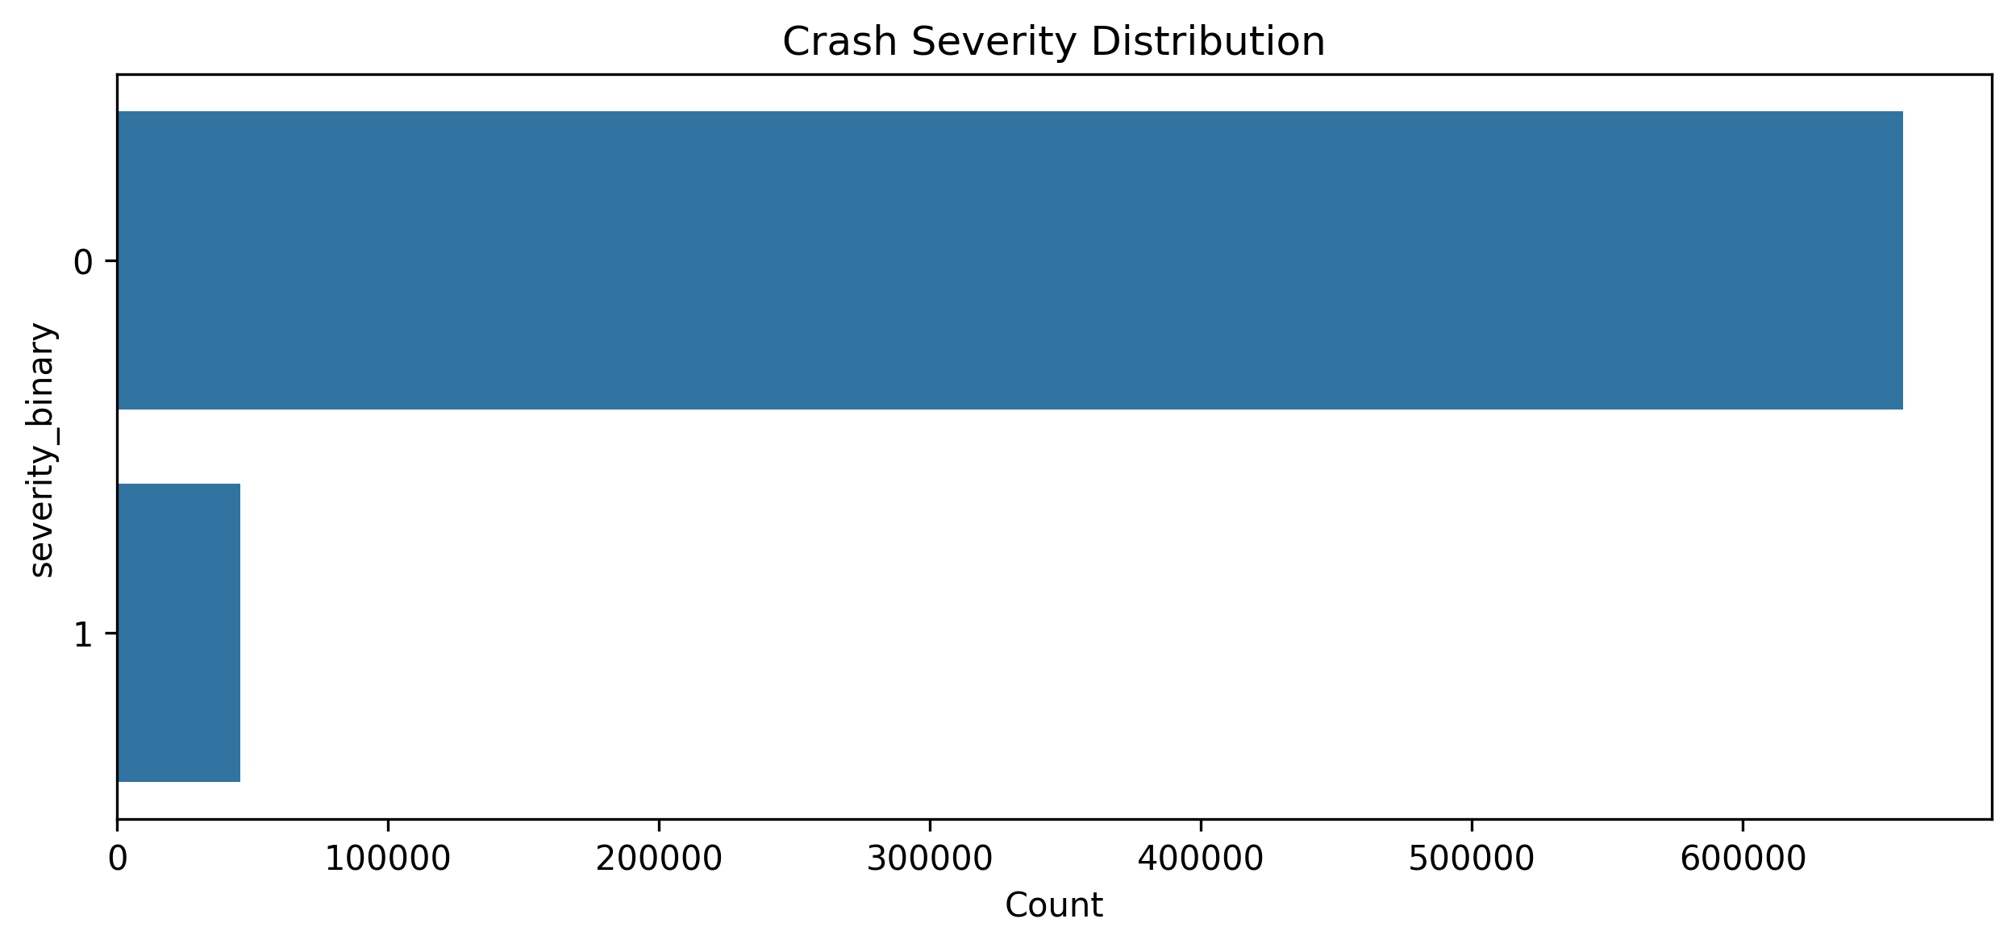
Severity Distribution
Notes:
Severe crashes are rare, and that imbalance means a model could ignore them and still look accurate. That’s why, in machine learning, we use class_weight='balanced' — it forces the model to treat severe crashes as equally important and stops the minority class from being drowned out.

Slide 6
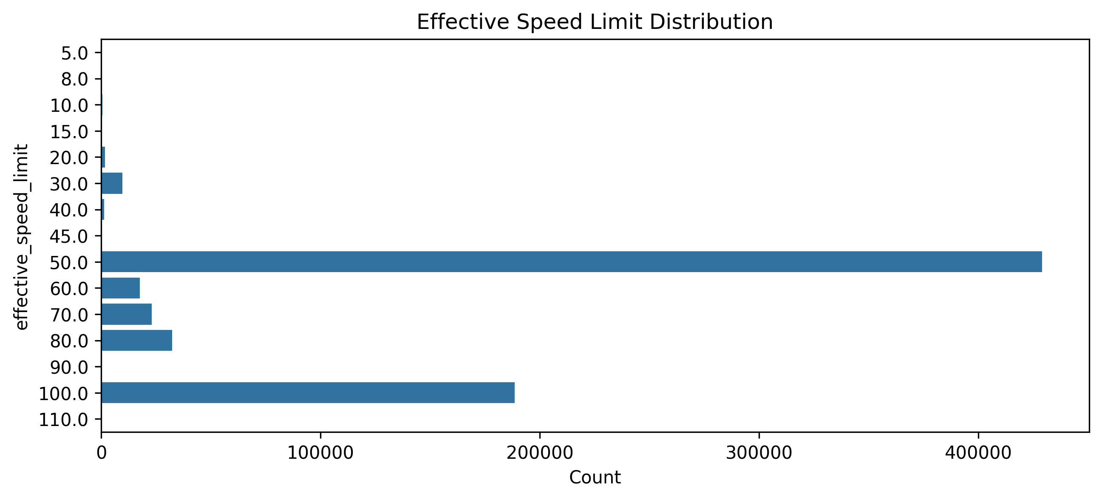
Speed Limit Distribution
Notes:
Clear peaks at 50, 80, 100 km/h
Higher limits correlate with more severe crashes
Speed is a key predictor

Slide 7
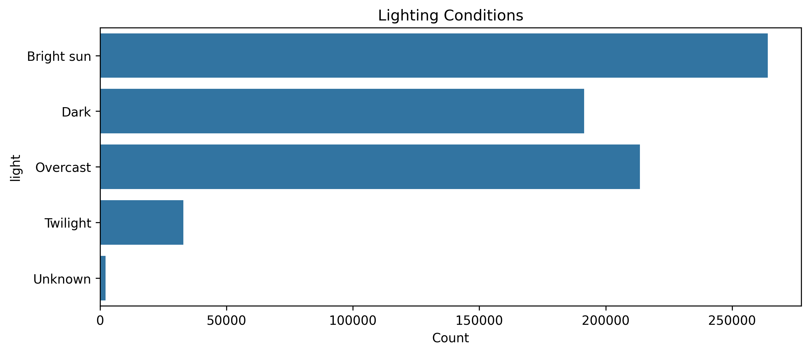
Lighting Conditions
Notes:
Emphasise that this chart shows raw crash counts, not severity
The dominance of “Bright sun” and “Overcast” is expected because these conditions represent the majority of driving time

Slide 8
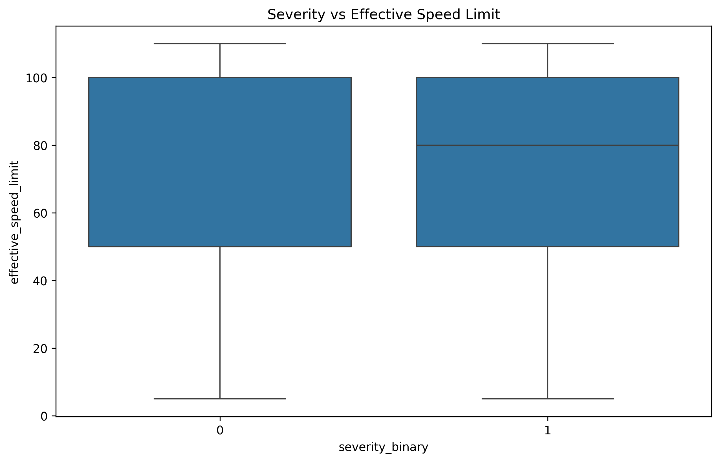
Severity vs Speed Limit
Speed limit distributions for severe and non‑severe crashes are surprisingly similar
Median and IQR overlap heavily
Speed limit alone is not a strong discriminator of severity
Notes:
This plot compares the effective speed limit for non‑severe crashes (0) and severe crashes (1).
At first glance, we might expect severe crashes to cluster at higher speed limits — but the boxplots show something more subtle.
the median speed limit is almost identical for both severity groups.
the interquartile ranges overlap heavily, meaning most crashes — severe or not — occur across a similar band of speed limits.
This suggests that speed limit alone is not a strong discriminator of severity in this dataset.
However, this doesn’t mean speed is unimportant. Instead, it implies that:
Speed interacts with other factors (lighting, road type, participant types).
The speed limit may not reflect the actual travel speed at the time of the crash.
Severity may depend more on impact speed, which we don’t have.
Speed is still a meaningful factor, but not in isolation.

Slide 9
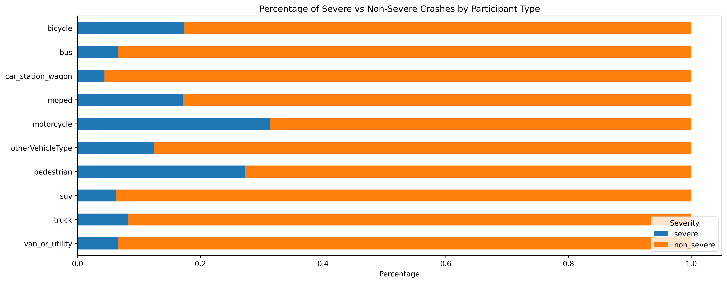
Participant Type Severity %s
Motorcycles and pedestrians show the highest proportions of severe crashes
Cyclists and moped riders also have higher severity percentages
Larger vehicles (trucks, vans, buses, SUVs) show lower severity proportions
Car and station wagon crashes dominate in volume but have lower severe‑crash percentages
Highlights the vulnerability of unprotected or lightly protected road users
Notes:
This chart shows relative severity, not raw counts — it focuses on risk per crash, not frequency.
Motorcyclists and pedestrians stand out clearly as the most vulnerable groups, with a much higher share of severe outcomes.
Cyclists and moped riders also show elevated severity, reinforcing the vulnerability of two‑wheeled and unprotected road users.
Heavier vehicles tend to protect occupants better, which explains their lower severe‑crash proportions.
Cars and station wagons dominate the dataset in absolute numbers, but their severity percentage is comparatively low.

Slide 10
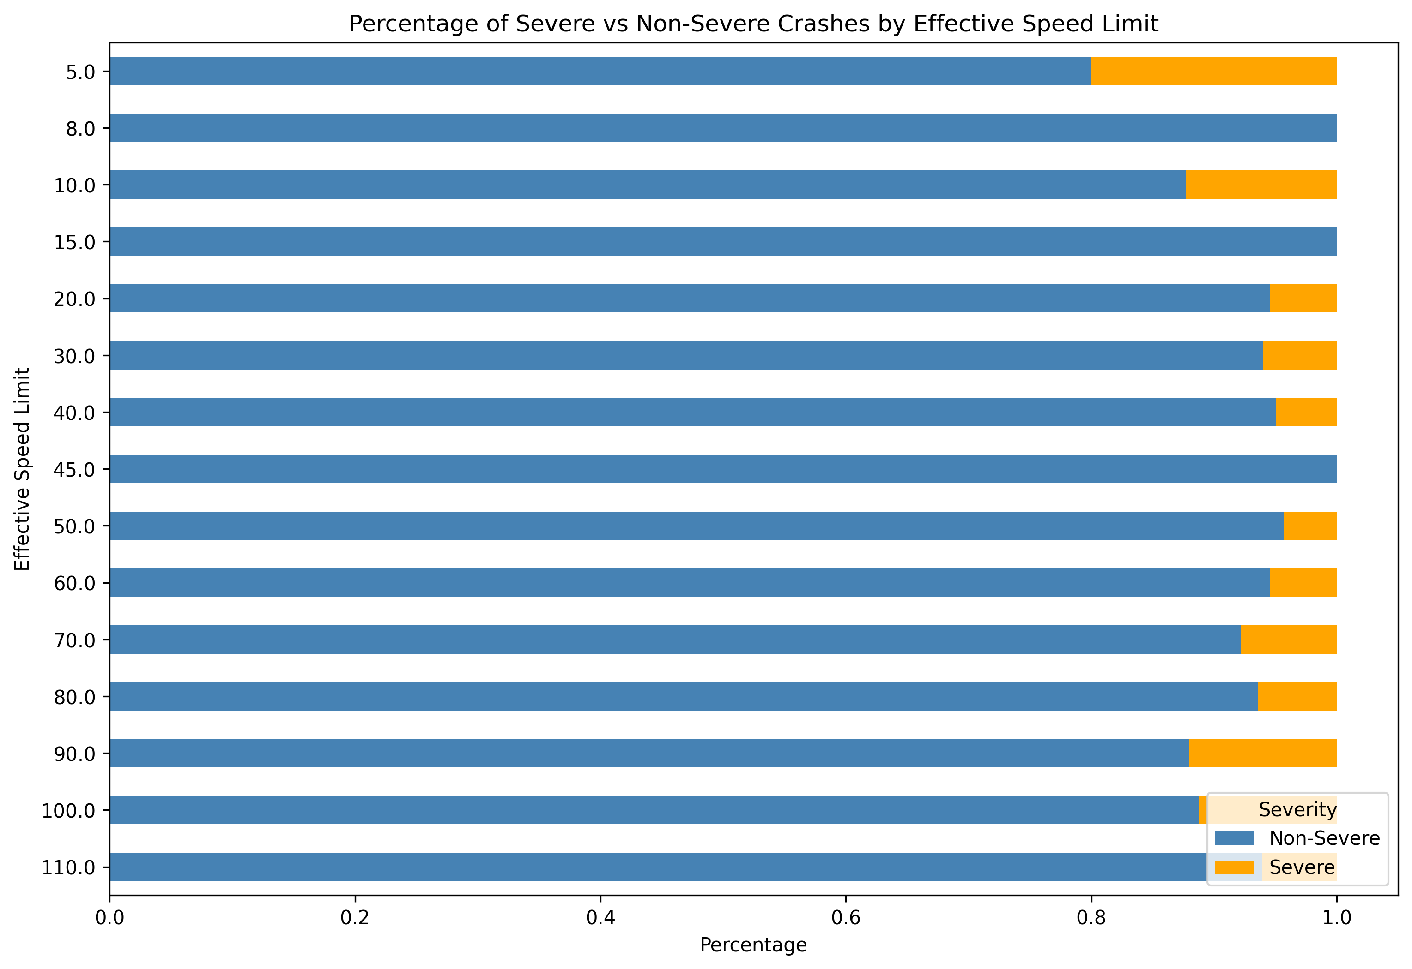
Effective Speed Limit %s
Notes:
This chart looks at severity as a percentage of crashes of each effective speed limit.
At very low effective speeds, severe crashes are rare which is exactly what we’d expect.
As we move into the mid‑range speed limits (40–70 km/h), the pattern becomes more mixed.
But once we reach the higher speed limits - 80km/h and above - the proportion of severe crashes rises sharply. Even small increases in speed can dramatically increase injury severity.
This slide complements the earlier boxplot:
The boxplot showed that speed limit alone doesn’t separate severe from non‑severe crashes.
But this percentage‑based view shows that higher‑speed environments do carry higher severity risk, even if the distributions overlap.

Slide 11
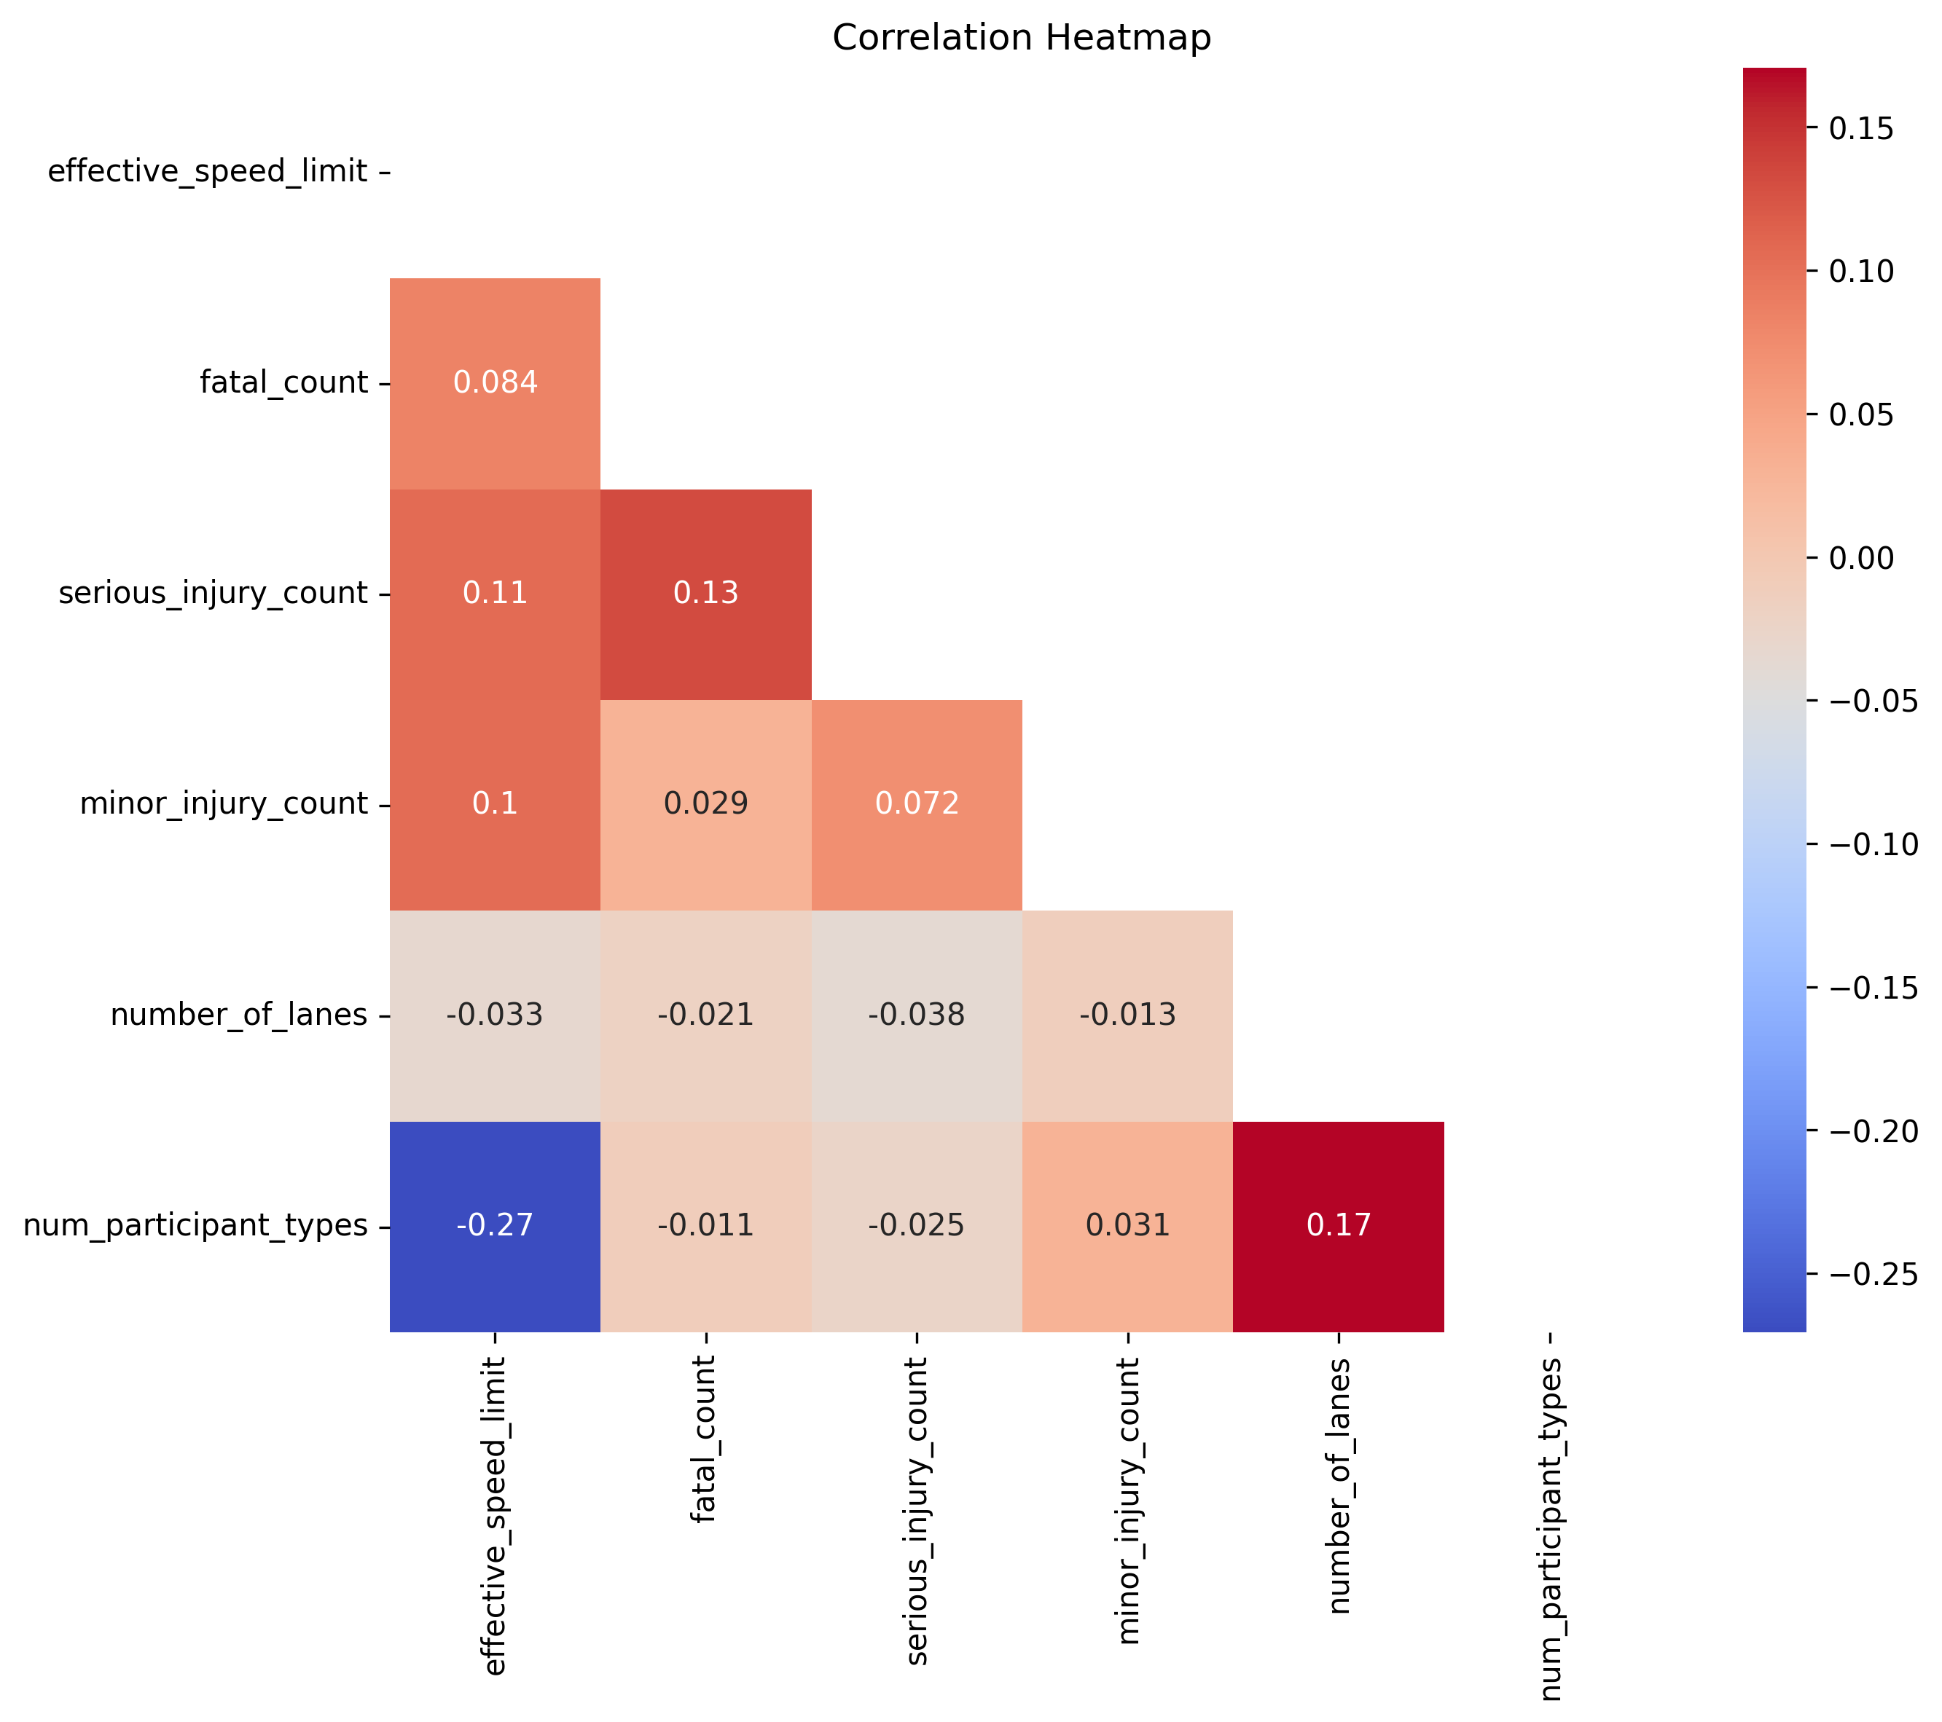
Correlation Heatmap
Notes:
Main point: no strong correlations - low multicollinearity
Injury counts show weak positive correlations with each other
effective_speed_limit has small positive correlations with injury counts
num_participant_types shows:
Moderate negative correlation with effective_speed_limit
Moderate positive correlation with number_of_lanes
Emphasise that the numeric features are not redundant.
Engineered features behave sensibly and add value.

Slide 12
Modelling Approach
Three models evaluated: Logistic Regression, SVM, Gaussian Naïve Bayes
Two preprocessing pipelines:
Sparse pipeline for LR and SVM
Dense pipeline for GaussianNB
Class balancing applied to address minority severe‑crash class
Hyperparameter tuning avoided due to runtime constraints
Final models prioritised speed, stability, and interpretability
Notes:
The modelling process didn’t follow a straight line — it evolved as I tested what was practical at this dataset’s scale.
I initially planned to use GridSearchCV, but with lots of rows and a heavy preprocessing pipeline, it became clear that GridSearchCV was far too slow to be practical.
I also went down a bit of a rabbit hole with Bernoulli Naïve Bayes. It seemed like the right choice at the time, but in practice it didn’t perform well and required awkward preprocessing adjustments.
I switched back Gaussian Naïve Bayes. This forced me to split the preprocessing into two separate pipelines:
A sparse pipeline for Logistic Regression and SVM (efficient and memory‑friendly)
A dense pipeline for GaussianNB (because it can’t handle sparse matrices)
Once the pipelines were sorted out, I focused on models that were fast, robust, and interpretable, rather than chasing marginal gains through expensive tuning.
The final modelling suite reflects a balance between theoretical and practical constraints

Slide 13
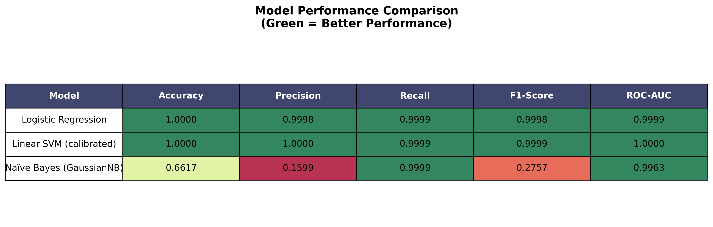
Model Performance
Logistic Regression and Linear SVM deliver near‑perfect performance across all metrics
GaussianNB achieves very high recall and ROC‑AUC, but precision and F1 collapse
Naïve Bayes struggles due to strong feature‑distribution assumptions
Final model choice prioritises balanced performance and interpretability
Notes:
Both Logistic Regression and Linear SVM are essentially perfect on this dataset — accuracy, precision, recall, F1, and ROC‑AUC are all at or extremely close to 1.0. SVM edges ahead slightly, but the difference is negligible.
GaussianNB, on the other hand, is a mixed bag:
It achieves excellent recall (almost identical to the linear models)
And a very high ROC‑AUC, meaning it ranks severe vs non‑severe cases well
But its precision collapses, which drags F1 down
This happens because GaussianNB assumes each feature follows a normal distribution, which is not true for one‑hot encoded categorical data. The model ends up predicting “severe” more often, which inflates recall but reduces precision.
This reinforces why the dense vs sparse preprocessing split was necessary — GaussianNB needed dense numeric input, while LR and SVM thrived on sparse matrices.
The takeaway for the audience:
Linear models dominate this dataset

Slide 14
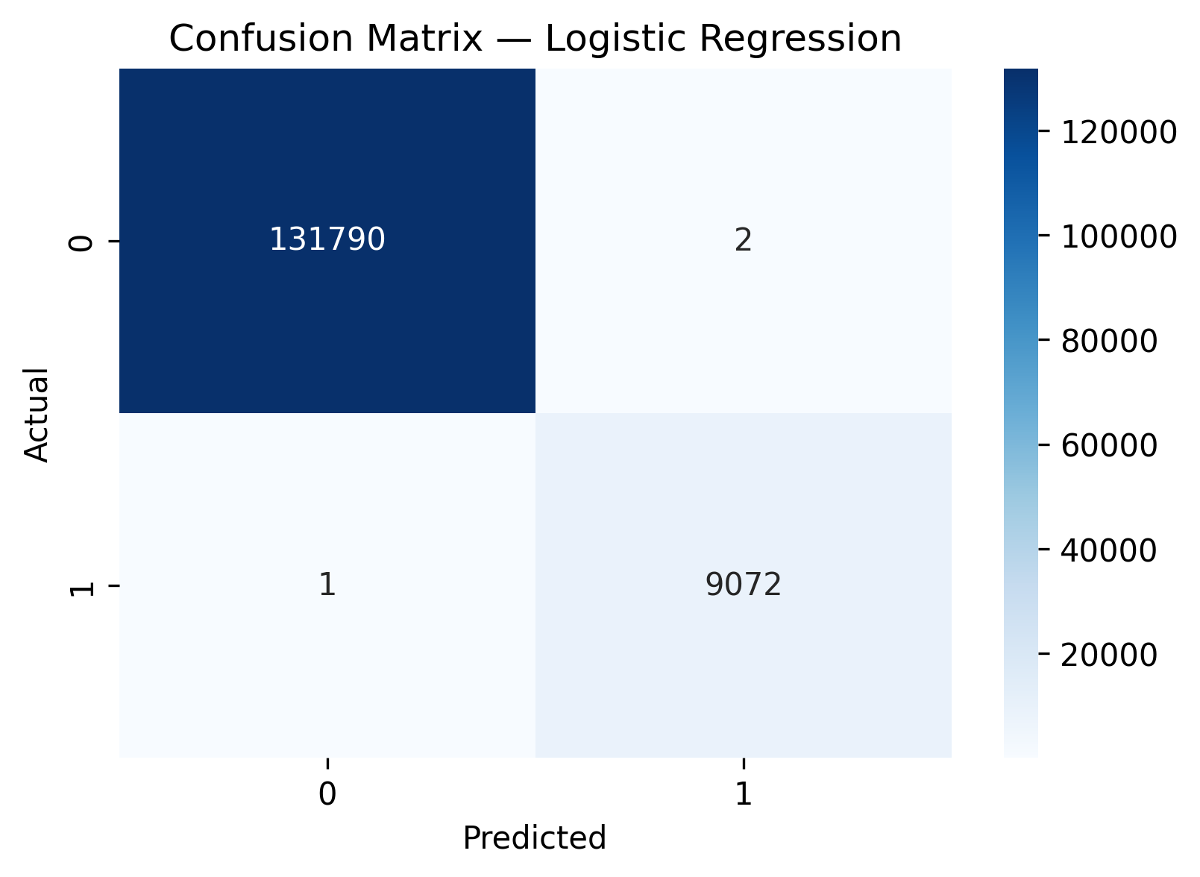
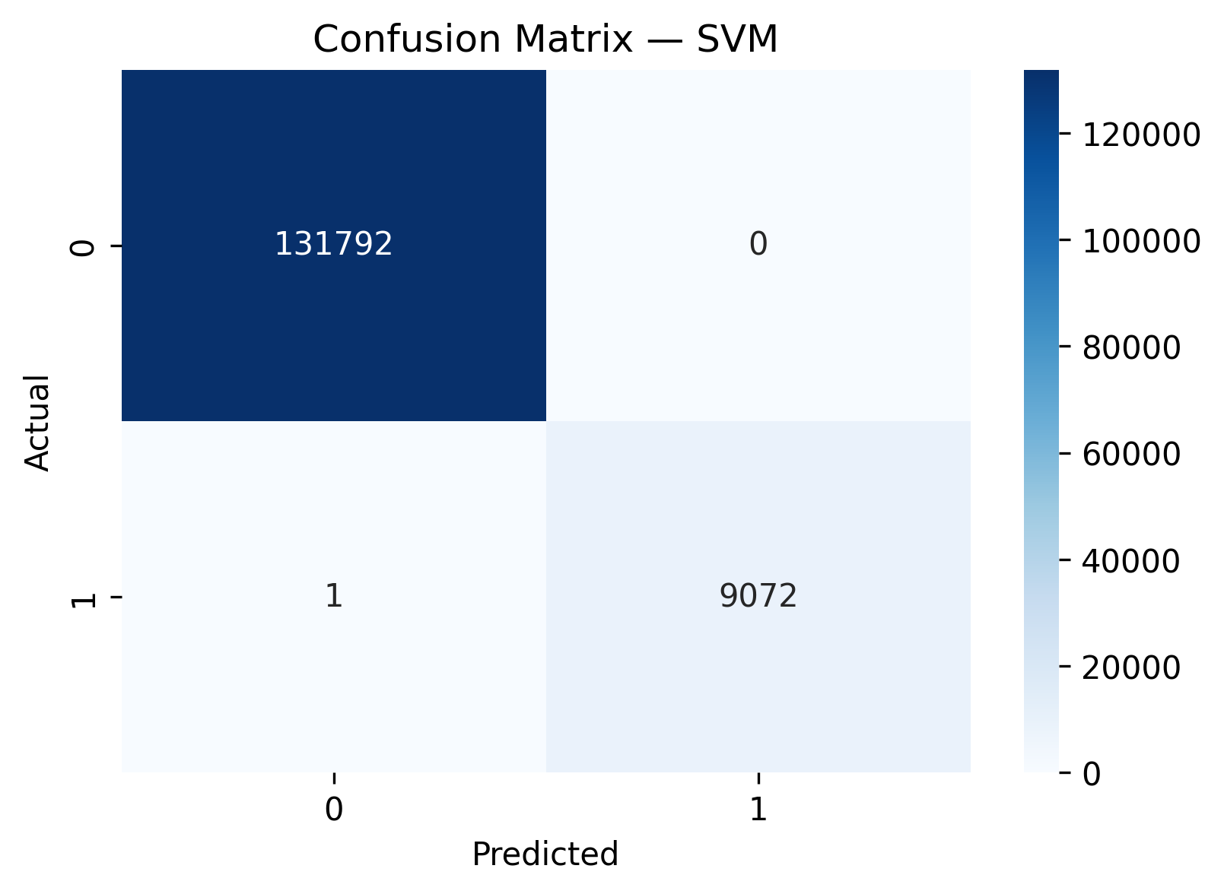
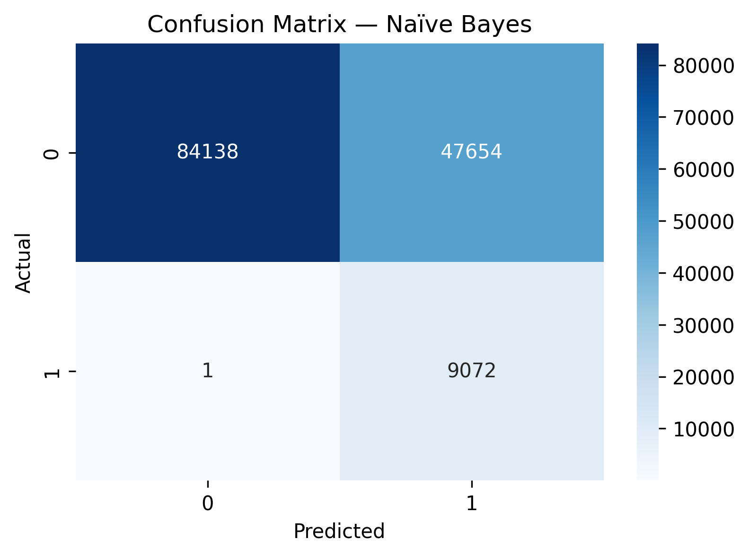
Confusion Matrices
Logistic Regression and SVM both achieve near‑perfect classification
Logistic Regression is almost identical, with only two false positives
SVM produces zero false positives and only one false negative
GaussianNB misclassifies tens of thousands of non‑severe crashes as severe
Confirms linear models as winners
Notes:
These confusion matrices tell the story even more clearly than the performance table.
Starting with the linear models:
SVM is great! It predicts every non‑severe crash correctly and misses only one severe crash.
Logistic Regression is almost identical, with only two false positives and one false negative.
For a dataset of this size, these numbers are very strong (and, if I am honest, this makes me suspicious).
Now compare that to Gaussian Naïve Bayes:
It correctly identifies almost all severe crashes (only one false negative).
But it produces 47,654 false positives: predicting “severe” when the crash was actually non‑severe.
Naïve Bayes fails here because:
It assumes each feature is independent and normally distributed.
This is untrue for one‑hot encoded categorical data.
As a result, it becomes overconfident and predicts “severe” far too often.
Linear models are more reliable - the confusion matrices displayed make that difference undeniable

Slide 15
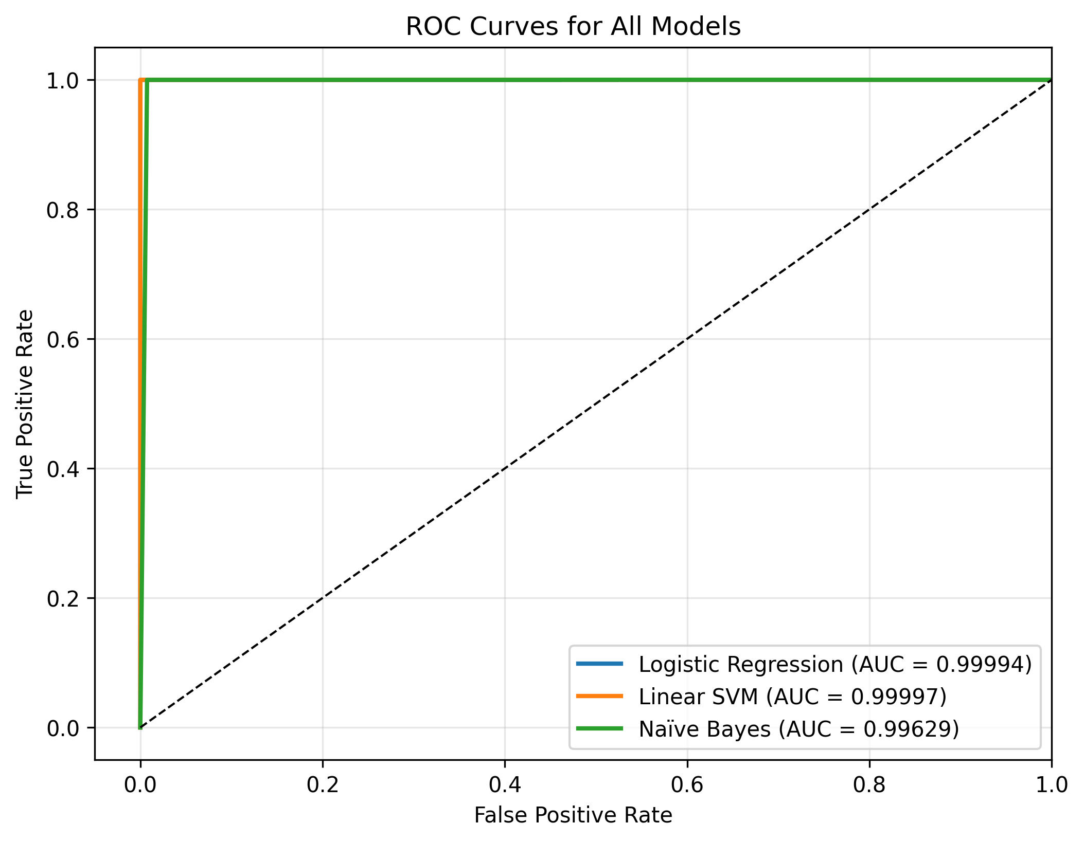
ROC Curves
All models achieve exceptionally high ROC‑AUC
Linear SVM has the highest AUC, followed closely by Logistic Regression
GaussianNB also performs strongly in ranking ability
ROC curves alone do not reveal precision issues
Confirms strong separability of the severe vs non‑severe classes
Notes:
Receiver Operating Characteristics - Measures how well a model can separate the positive class from the negative class
These ROC curves show how well each model can rank severe vs non‑severe crashes — and all three models perform extremely well.
The Linear SVM (in orange) has the highest AUC, but the difference between SVM and Logistic Regression is tiny. Both curves hug the top‑left corner.
Gaussian Naïve Bayes also shows a very high AUC, despite performing poorly on precision and F1.
This slide reinforces why we need to look at multiple metrics — accuracy, precision, recall, F1, confusion matrices, and ROC curves all tell different parts of the story.
This supports the final model choice and ties neatly into the next slide on key insights.

Slide 16
Key Insights
Speed limit alone is not a strong predictor: severe and non‑severe crashes share similar distributions
Vulnerable road users (motorcycles, pedestrians, cyclists) have the highest severe‑crash percentages
Engineered features (effective speed limit, participant counts) add meaningful structure
Linear models (LR, SVM) are extremely stable and high‑performing
Naïve Bayes fails due to unrealistic feature assumptions, despite high ROC‑AUC
Notes:
The first insight is that speed limit alone doesn’t separate severe from non‑severe crashes. The boxplot showed almost identical distributions meaning severity depends on interactions, not a single variable.
Participant type is another strong indicator. Motorcyclists, pedestrians, and cyclists are consistently over‑represented in severe outcomes, reinforcing their vulnerability.
The engineered features behaved as intended: they added structure without introducing multicollinearity, which helped the models learn more effectively.
On the modelling side, the linear models (Logistic Regression and SVM) were strong and stable.
Gaussian Naïve Bayes looked good on ROC‑AUC but failed on precision and F1 because its assumptions don’t match one‑hot encoded data.

