Slide 1

Amazon Delivery Analysis
Statistical Analysis & Geospatial Visualisation
Data Science Mini Project 1
Notes:
Welcome to my mini project on the analysis of Amazon delivery times

Slide 2
Data
kaggle.com/datasets/sujalsuthar/amazon-delivery-dataset
Amazon Delivery Records (43,740 observations)
Key Variables: Vehicle type, Weather, Traffic, Delivery time, Location
Problem statement
How do different vehicle types perform under varying environmental conditions?
Objectives
Apply Exploratory Data Analysis (EDA) techniques
Implement statistical visualisation methods
Practice multi-factor analysis
Create geospatial data analysis and mapping
Notes:
I am presenting today on my findings from an Amazon delivery dataset. There are over 43 thousand observations and we are going to delve into my exploratory data analysis and visualising some of the data on a map.
When I come to the Jupiter Notebook, I will discuss templates and keeping things simple.

Slide 3


6 steps to speedy delivery
Step 1: Data Preparation & Quality Assessment
Data cleaning, standardisation, outlier detection
Missing value analysis and treatment
Step 2: Baseline Vehicle Delivery Time Analysis
Descriptive statistics, distribution analysis
Box plots for central tendency comparison
Step 3: Weather Impact Analysis
Categorical variable analysis
Grouped statistical comparisons
Step 4: Traffic Impact Analysis
Multi-level categorical analysis
Traffic impact quantification
Step 5: Combined Conditions Analysis
Heatmap visualisation, correlation analysis
Multi-factor interaction effects
Step 6: Geospatial Analysis & Interactive Visualisation
Coordinate validation, spatial distribution mapping
Interactive web-based visualisation
Notes:
Jasprit Bumrah has very speedy deliveries but, to paraphrase Star Wars, “these are not the speedy deliveries that you are looking for”! I’m not sure how I worked cricket and Star Wars into this presentation but I feel a childish delight in doing so!
Step 1: Data Preparation & Quality Assessment
There was a fair bit of cleaning up the data. I:
made all the columns lower case
stripped whitespace from the beginning and end of strings
replaced the string ‘NaN’ with another string
There were minimal nulls in the dataset so I set their values to ‘Unknown’
I converted the feature columns to a type called ‘category’ – this was a new data type to me (in pandas, category is a special data type designed for columns that contain a limited set of repeated values). The Vehicle, weather and traffic features had up to 7 items, so they were natural fits.
Steps 2, 3, 4 and 5
I’ll show you my comparisons of vehicle types and delivery times.
I will also show you how weather impacted the delivery times, how traffic congestion effected the delivery times and a combination of these factors.
The last step
was to play with maps. You’ll see how I dropped the Amazon store location onto a map of the world. But which country will we be looking at?

Slide 4
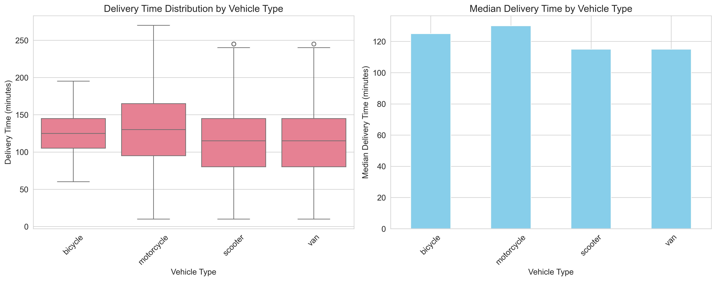
Vehicle Delivery Times
Notes:
Vehicle Delivery Times
You can see that there are 4 types of vehicle: bicycle, motorcycle, scooter and van.
1. Scooter and Van Are the Fastest (and Most Consistent)
Both scooters and vans have median delivery times around 115 minutes. Their box plots show tight interquartile ranges, meaning delivery times are more predictable.
2. Motorcycles Are Slower and More Variable
Motorcycles have a higher median delivery time (~130 minutes) and a much wider spread.
This might be because:
They encounter more variable conditions.
They may be used for longer-distance or more complex deliveries.
At this juncture I would suggest that I should have changed tack in my anaylysis and calculated the average speed of each vehicle type rather than delivery time – this would have been a better angle to attack things. We can use something called the Haversine Formula to calculate the distance travelled between two pairs of longitude and latitude. From that we can work out average speed for each delivery. Maybe next time.

Slide 5
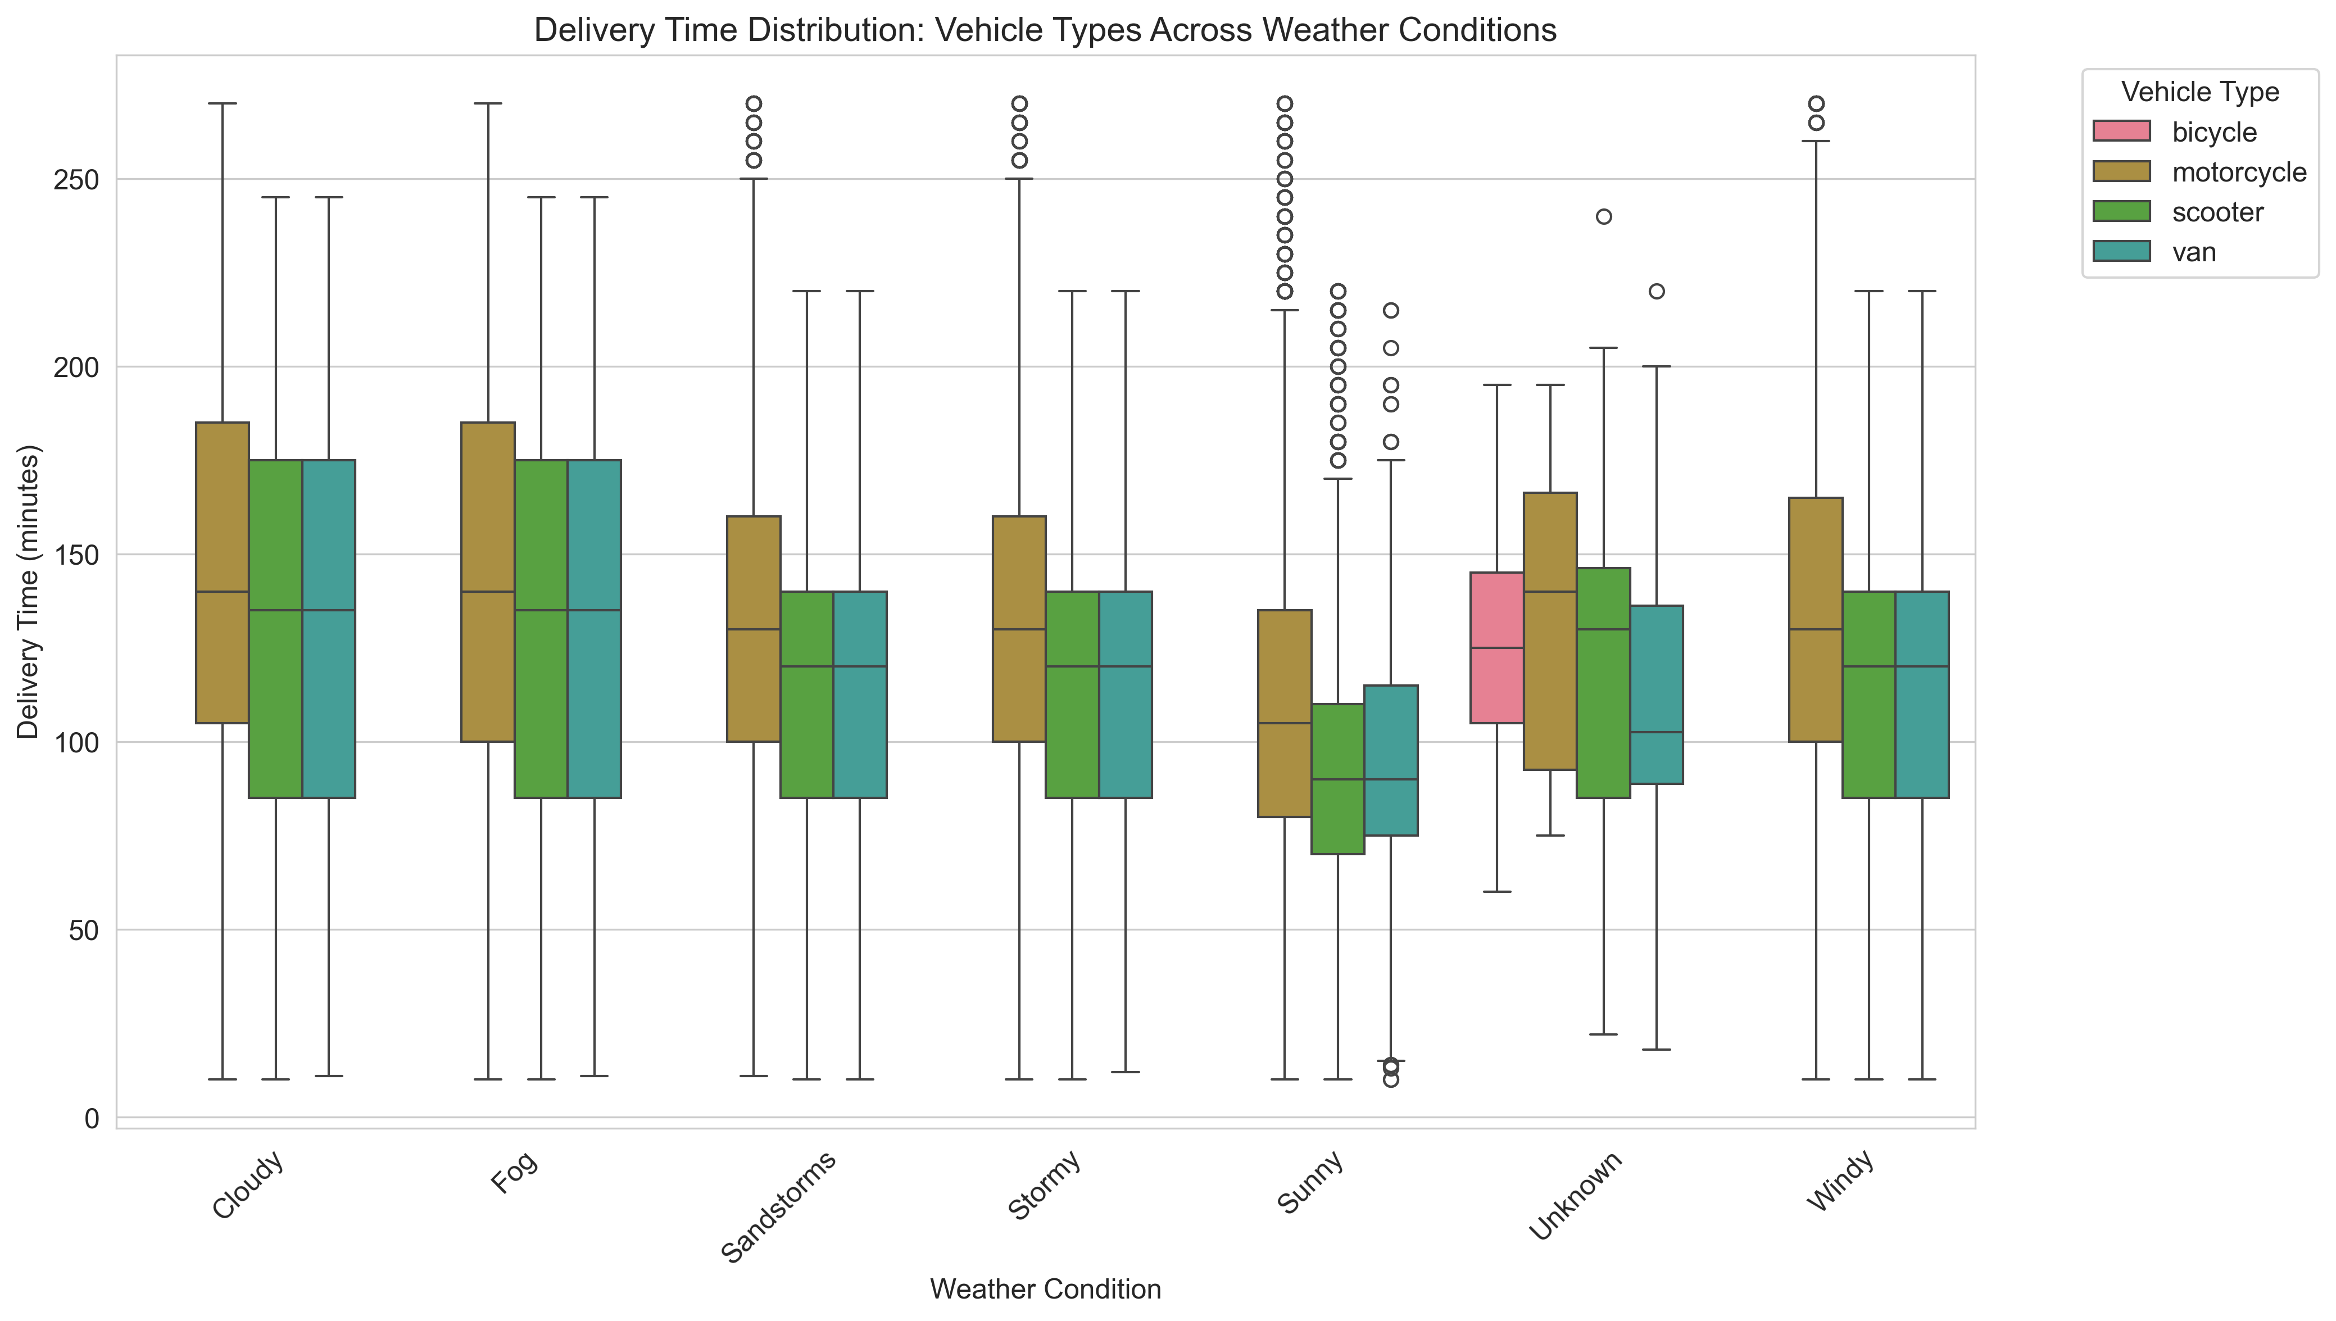
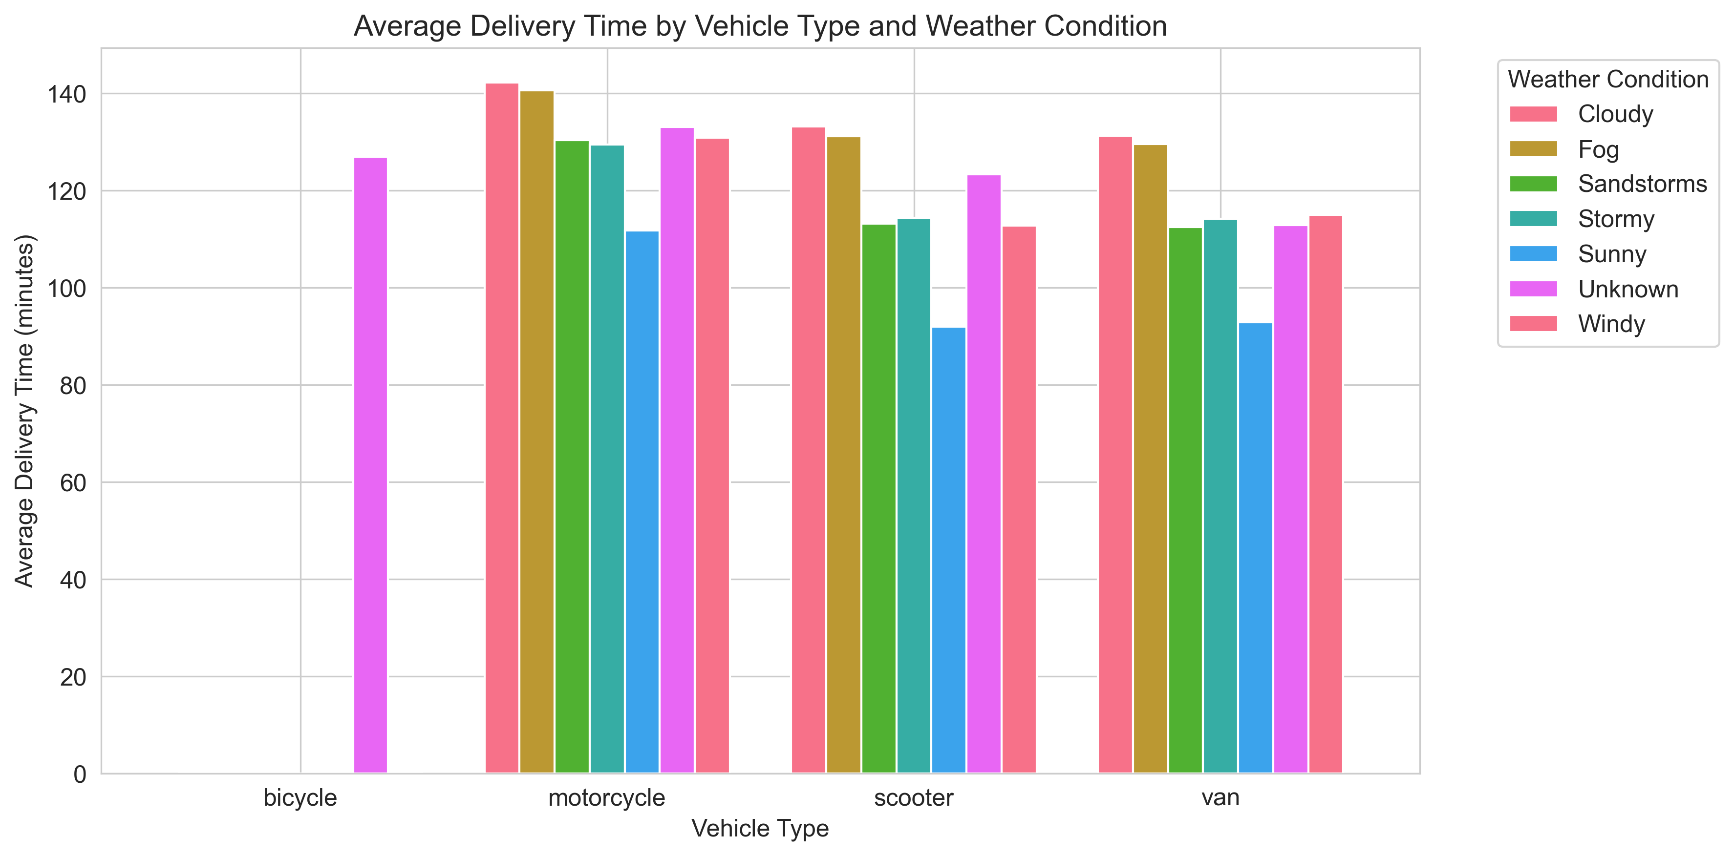
Weather Condition Impact Analysis
Notes:
Here we look at the impact of weather of vehicles.
Everyone loves sunny weather
Across motorcycles, scooters, and vans, sunny conditions consistently produce the lowest delivery times (≈ 90–105 minutes).
Cloudy and Foggy conditions slow all vehicles similarly
Motorcycles, scooters, and vans all show elevated medians around 130–140 minutes.
Fog reduces visibility → cautious driving → slower speeds.
Cloudy conditions likely correlate with higher congestion or moisture on roads.
These conditions affect all vehicle types similarly, so switching vehicles won’t meaningfully improve performance.
In the case of Sandstorms and Stormy weather: Two‑wheeled vehicles degrade more sharply
Both plots show a clear pattern:
Motorcycles and scooters jump from ~90–105 minutes (sunny) to ~120–130 minutes in sandstorms/stormy weather.
Vans degrade less severely, staying around ~112–120 minutes.
We can say that vans are the way to go in poor weather.
There are only 91 observations (0.2%) where the weather is unknown. It is a small proportion and it is the only weather category associated with bicycles.

Slide 6
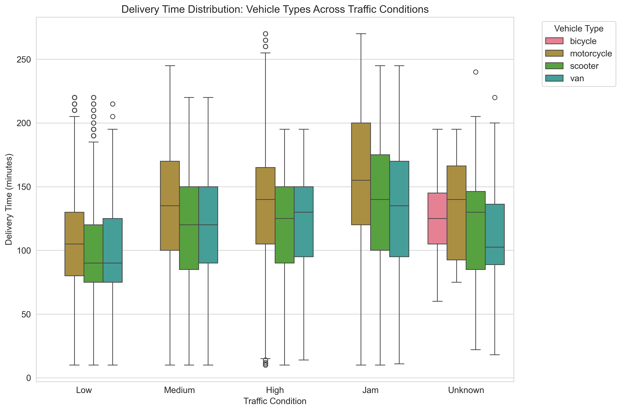
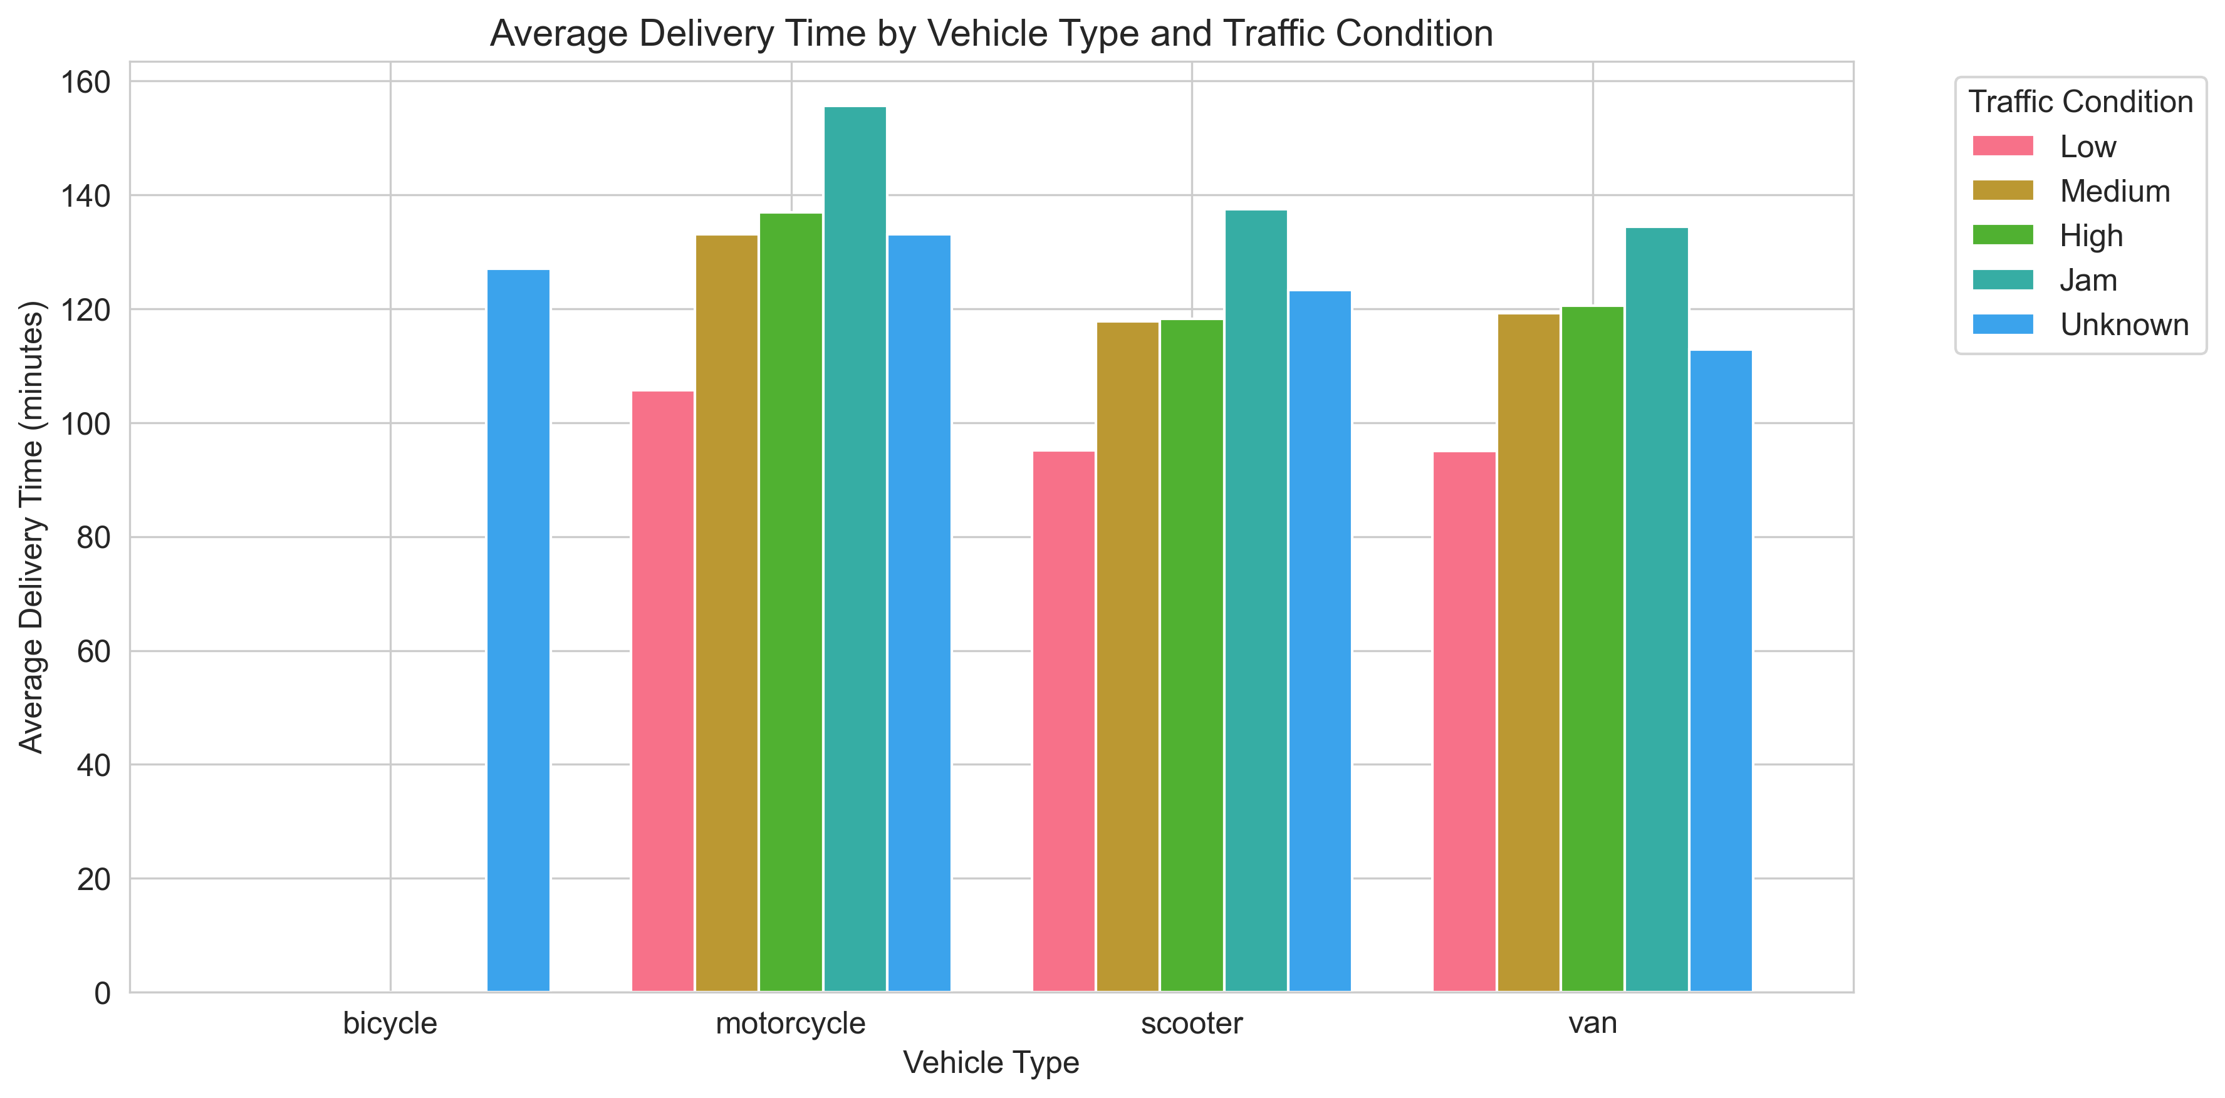
Traffic Condition Performance Analysis
Notes:
Here we look at how traffic effects the vehicles. The dataset only has observations for bicycles in “Unknown” traffic conditions so they can’t meaningfully contribute to any comparative insight.
Motorcycles are generally slower than scooters and vans
When you look across all traffic conditions, this is overwhelmingly true.
Scooters and vans are always faster than motorcycles
Scooters and vans are often tied or very close
This is reinforced by the boxplot, where motorcycles show:
Higher medians
Wider spreads
More variability
More outliers
Scooters and vans cluster lower and tighter
Motorcycles are similar to scooters so, I must ask the question: why are vans more effective than motorcycles?

Slide 7
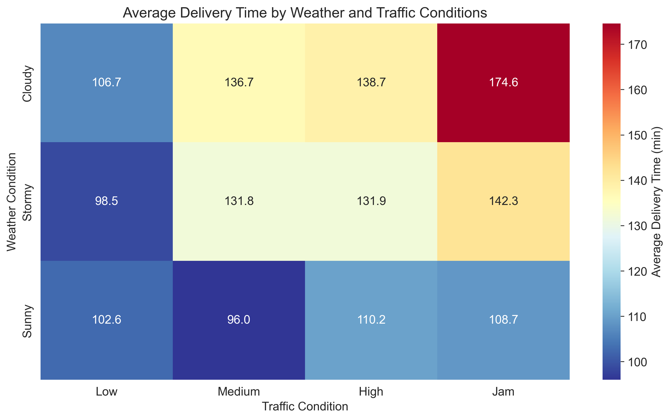
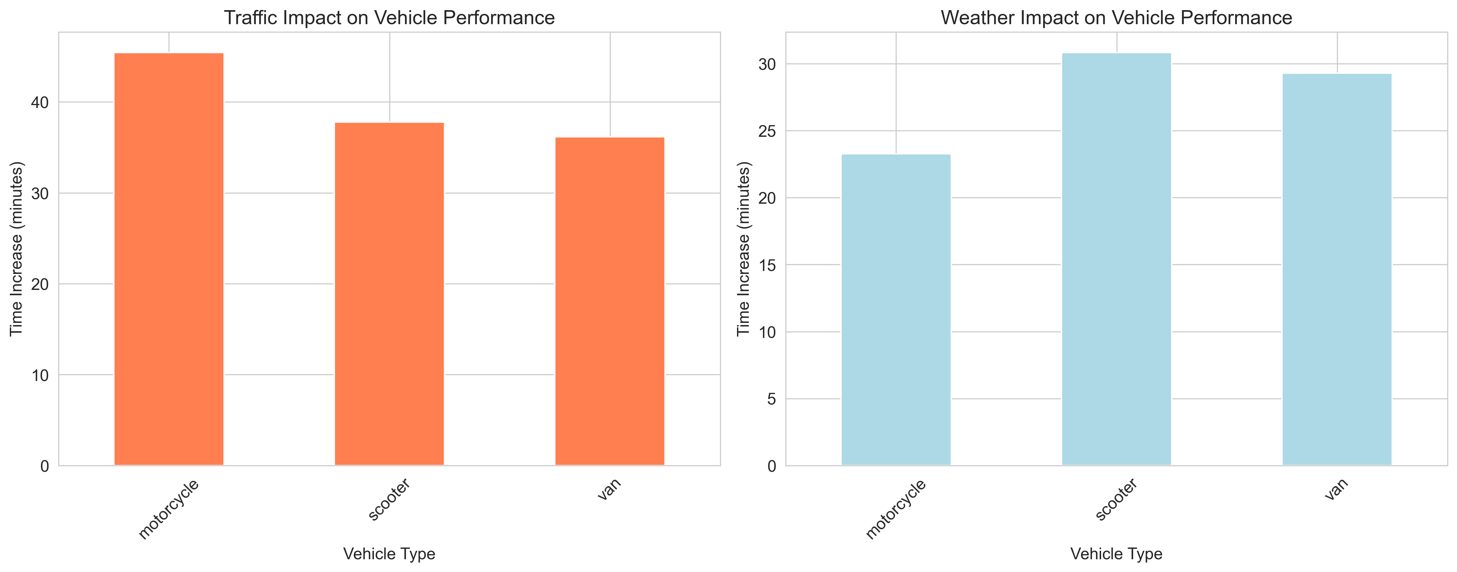
Multi-Factor Interaction Analysis
Notes:
We now look at the combined effects of weather and traffic on vehicles
As mentioned before the data for bicycles is not worth mentioning because we do not have substantive data combined with weather and traffic.
The heatmap shows how the environment behaves, and the two bar charts show how each vehicle reacts to traffic or weather.
Key insights from the heatmap
Traffic is the dominant driver of delay. Across all weather types, the jump from Low → Medium → High → Jam produces the steepest increases in delivery time.
Fog + Jam is the worst combination.
Sunny with Low/Medium traffic are consistently the fastest.
Key insights from the bar graphs show that
Motorcycles suffer the largest traffic penalty (+45.4 min). Despite being nimble, they slow down dramatically in heavy congestion.
Scooters & vans are quite similar with 37 and 36 minutes. Both degrade under traffic but not as severely as motorcycles.
Scooters are the most weather‑sensitive (+30.8 min).
Vans and motorcycles show moderate weather sensitivity (+29–23 min).

Slide 8
Conclusion
Motorcycles are most vulnerable to traffic
Scooters are most vulnerable to weather
Vans are the most balanced and predictable.
Notes:
✅ 1. Vehicle assignment should depend on the dominant constraint.
High‑traffic zones: Vans or scooters outperform motorcycles because they degrade less under congestion.
Bad‑weather periods (Fog/Stormy): Vans again are the safest bet; scooters degrade heavily.
✅ 2. Motorcycles excel only under optimal conditions.
Low traffic + decent weather → motorcycles are fast.
Anything else → they become the worst performer.
✅ 3. Scooters shine in good weather but collapse in bad weather.
Sunny + High traffic are their best combination (79.9 min), which is counterintuitive but supported by your data.
✅ 4. Vans are the most stable across all conditions.
They have the smallest combined penalty from traffic + weather.
They’re the most reliable choice for consistent delivery times.

Slide 9
Interactive Geospatial Visualisation
Interactive HTML Heatmap: 05_store_delivery_heatmap.html
Notes:
I removed the observations where latitude and longitude were both zero – this position is somewhere off the west coast of Africa in the Gulf of Guinea.

