Slide 1
Stable or long-lived beams for SOLARIS
(for Brad and Alexandra)

Slide 2
Species with a half-life >1d
(The assumption is made that the isotope could be acquired, this may not be the case)
Blue arrows point to some potentially high-profile cases
¹⁴⁶Gd
ReA6 energies useful for exploring new systems
ReA6 energies useful in select cases
¹²⁶Sn
¹⁰⁶Ru
ReA6 energies ideal for direct-reaction studies
⁵⁶Ni
⁶⁶Ni
⁴⁴Ti
³²Si
Z
^{59/60}Fe
³⁵S
N

Slide 3
Species with a half-life >1d
(The assumption is made that the isotope could be acquired, this may not be the case)
Blue arrows point to some potentially high-profile cases
Green arrows point to some other suggestions
¹⁴⁶Gd
²¹⁰Po, ²¹⁰Pb
ReA6 energies useful for exploring new systems
ReA6 energies useful in select cases
¹²⁶Sn
¹⁰⁶Ru
ReA6 energies ideal for direct-reaction studies
⁵⁶Ni
⁶⁶Ni
²⁶Al
⁴⁴Ti
²²Na
Z
³²Si
Z
^{59/60}Fe
¹⁴C
N
³⁵S
¹⁰Be
N

Slide 4
Structure and astrophysics
³²Si: single and two-nucleon transfer with reactions such as (d,p), (d,t) and (t,p) all possible, as well as (p,p). Main focus is to elucidate single-neutron energies of the d orbitals and connections to spin-orbit force, proton s-orbital depletion, bubble nuclei. Both AT-TPC and Si-array mode
Many groups interested in this, from Argonne, LBNL, Manchester UK, etc. Material potentially available.
³⁵S: focus would be identification and cross sections for key neutron excitations in ³⁶S for astrophysical purposes
Interest from the University of Surrey group, UK
⁴⁴Ti: much long term interest in reactions on this system. np-pairing properties can be determined from e.g. (d,α) or (³He,n) [possible in AT-TPC mode]. Potentially Coulomb excitation studies can be carried out with SOLARIS, using kist charged particles. Other studies would include (d,p) and so on.
Again, we are aware of interest from many groups, including LBNL
⁵⁶Ni, ⁶⁶Ni: a definitive measurement of the (d,p) reaction on the ⁵⁶Ni doubly-magic system remains to be done. With ReA6 and SOLARIS, we have the perfect approach. Knowledge of f and p neutron excitations important for a complete understanding of the region. Similarly with ⁶⁶Ni, here the f, p, and g excitations. Limited spectroscopy available in this region, following several very low-energy (d,p) and (t,p) measurements. Like with ⁵⁶Ni, ReA6 and SOLARIS could prove essential for definitive measurements.
Past, limited, studies at Argonne, would complement ⁵⁶Ni(p,d) work done at NSCL a few years ago, and several measurement done with ⁶⁶Ni beams at ISOLDE in recent years

Slide 5
Structure and astrophysics
^{59,60}Fe: interest to look at the surrogate reaction for (n,γ) via e.g. ⁵⁹Fe(d,p). Inverse kinematics technique has been developed for HELIOS, with photon detection available and transferrable to SOLARIS. No previous measurements
LANL group have expressed interest in this measurement
¹⁰⁶Ru: extend knowledge of the interplay between single-particle and collective modes, with reactions such as (d,p), (d,t), and most importantly (t,p) possible at ReA6 with SOLARIS
Topical, measurement, some groups looking at more neutron-rich systems, but only because these intermediary systems are not accessible
(possible people include the ORNL group and collaborators)
¹²⁶Sn: one of the longest accessible chains of isotopes over which the evolution of proton and neutron excitations can be studied. Groups have recently revisited the stable systems in anticipation of extended information of single-neutron excitations from ¹²⁴Sn to ¹³²Sn. A ¹²⁶Sn(d,p) reaction study would be of significant interest, and like above, something not easily accessible to date
Possible interest from the ORNL group and certainly from the ANL group
¹⁴⁶Gd: study of neutron excitations outside of N = 82 is the goal here, via (d,p). Much work has been done in the last 10 years to track how these states evolve from Sm to Sn, but a great deal of interest to move towards Gd, where the proton g_{7/2} and d_{5/2} should be full making the Z = 64 sub-shell closure
Interest from the Argonne group, and well established as a major goal by many groups and facilities. Isotope may not be possible to acquire. ReA6 energies should be enough to make for a useful measurement

Slide 6
Other possibilities
Various User may have interest in the following isotopes, though some may have been studies extensively due to them being quite readily available
¹⁰Be: almost continuous interest in the ¹⁰Be(d,p) reaction both for structure and reaction theory work, and weak binding
Work by the ORNL group and recent theory studies by NSCL, and I suspect more to come
¹⁴C: interest from various group to revisit this in the context of the quenching of single-particle cross sections
Substantial interest from the HELIOS group at Argonne
²²Na: possibly already studied in enough detail, but strong connections to nuclear astrophysics and N = Z physics
²⁶Al: many recent results from (d,p) studies on the ground and isomeric states, and their connection to the Galactic Al production mechanism. Perhaps more direct measurements could be done, e.g., (³He,d) with SOLARIS in the AT-TPC mode might be of significant value
Several groups from Surrey, to FSU, to ORNL, to ANL, have made many contributions to this Al-26 story in recent years
²¹⁰Po, Pb: two closed-shell systems where detailed measurements would be valuable. For ²¹⁰Po, previous (d,p) studies done with a long-lived target, but suffer from contaminants. For ²¹⁰Pb, much recent interest. The low energies would limit these measurements
I could imagine significant interest in these heavy systems, and follow recent measurement at CERN with the new solenoidal spectrometer ISS with a ²⁰⁶Hg, also at relatively low energy

Slide 7
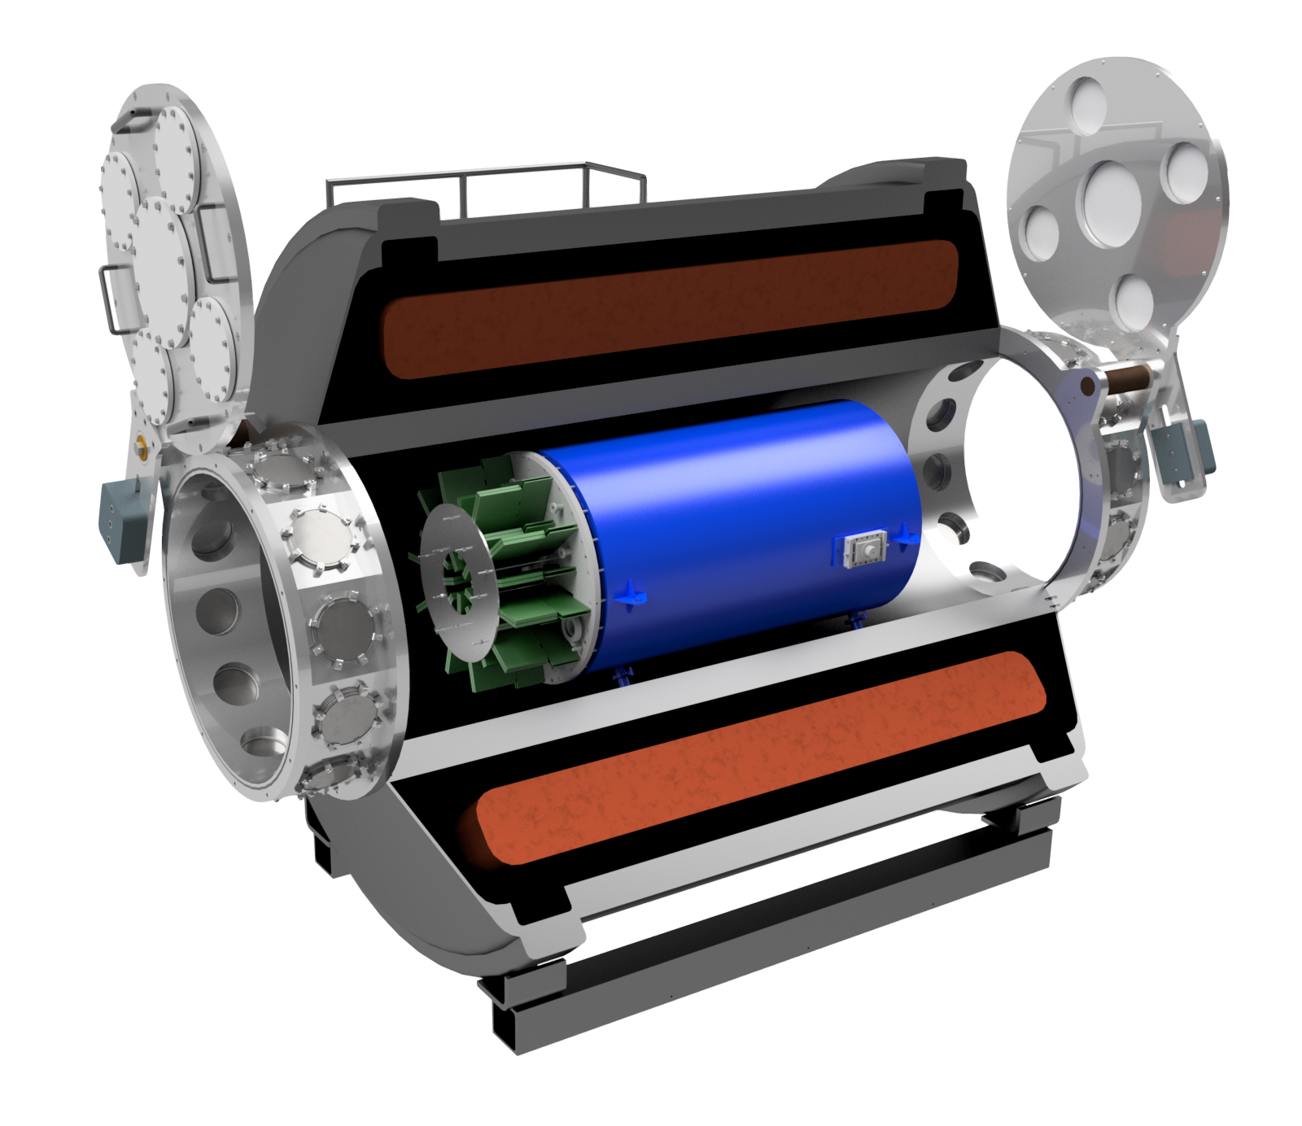
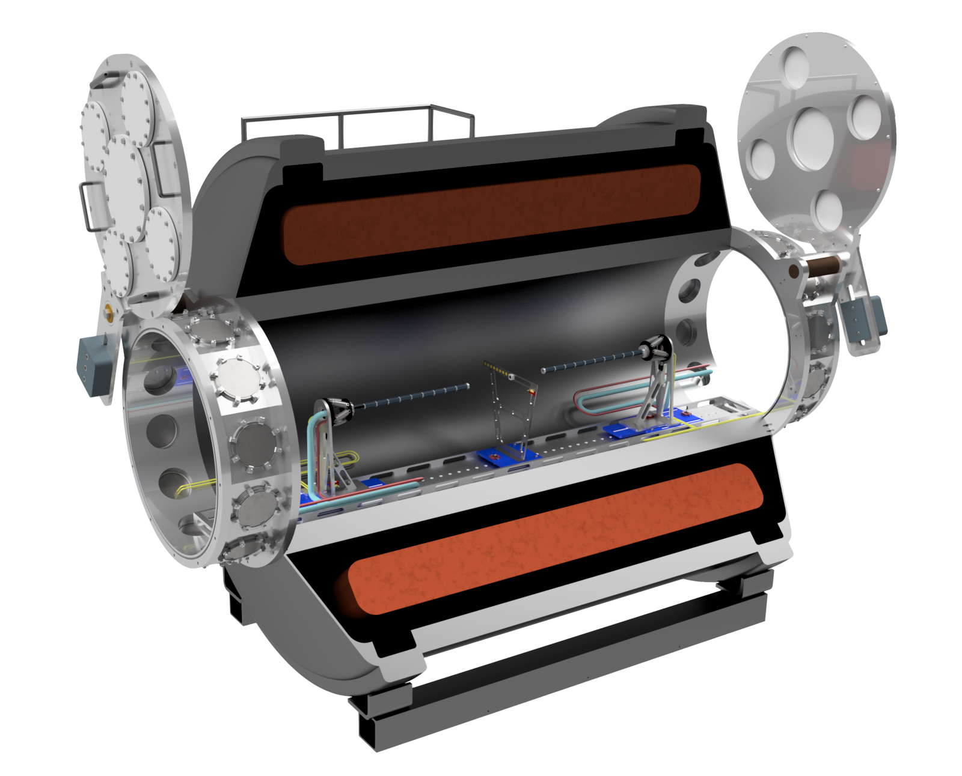
Opportunities for both modes
AT-TPC mode
Si-array mode

