Slide 1
COSC 361 Filesystem Functions
Stephen Marz

Slide 2
Topics
Filesystem Functions
create
open
read
write
getattr
readdir
opendir
mkdir
rmdir
chmod
chown
unlink
truncate
rename

Slide 3
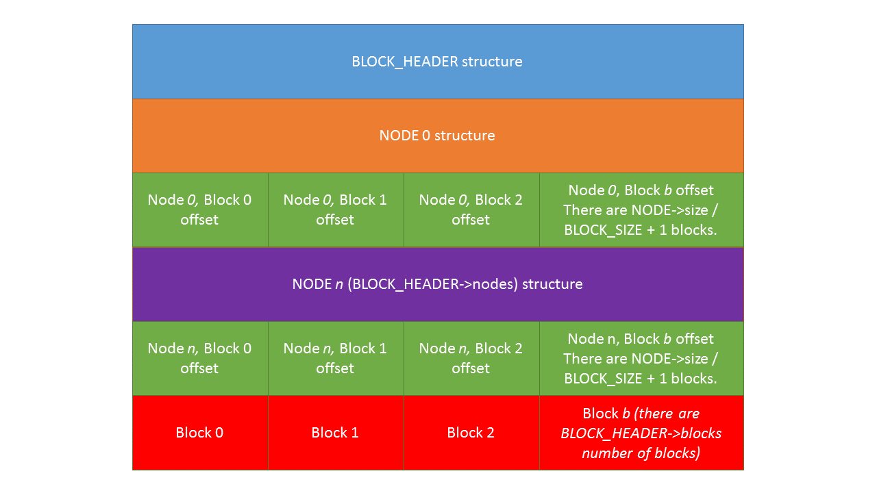
COSC 361 Project 4 File System

Slide 4
Create Function
Given: path and mode (permissions and type)
Make sure path and node do not already exist!
Allocates a new inode and block
Size will be 0 (increasing this will be done with write)
Everything else is "defaulted"
Default uid = getuid()
Default gid = getgid()
Default mode given by passed parameter (or this with S_IFREG)
Default time = time(NULL) // There are 3 of these!!

Slide 5
Open Function
For files only (not directories)
Checks to see if file exists
OS' job is to associate the file with a descriptor number
Openable? return 0
Not found? return –ENOENT

Slide 6
Read Function
Reads data up to “size” starting with “offset”
Step 1: Find the file given by the path
Step 2: Find the blocks associated with this file
Step 3: Move to “offset”
Step 4: Start writing the data into *buf
(you should write “size” bytes up to the size of the file)
Step 5: Return number of bytes you read into *buf

Slide 7
Write Function
Similar to read
Step 1: Find the file given by the path (should exist since if it doesn’t create is called)
Step 2: Find the blocks associated with the file
Step 3: Allocate new blocks or write the rest of current blocks (you will need at least size+offset blocks).
Step 4: Move to offset
Step 5: Write *data into the new blocks (may span more than 1 block!)
Step 6: Update the block offsets for this file
Step 7: Return number of bytes written
Do NOT truncate using write. If the current size is > size+offset, then don’t change the size. fs_write can only grow a file. fs_truncate is used to shrink them.

Slide 8
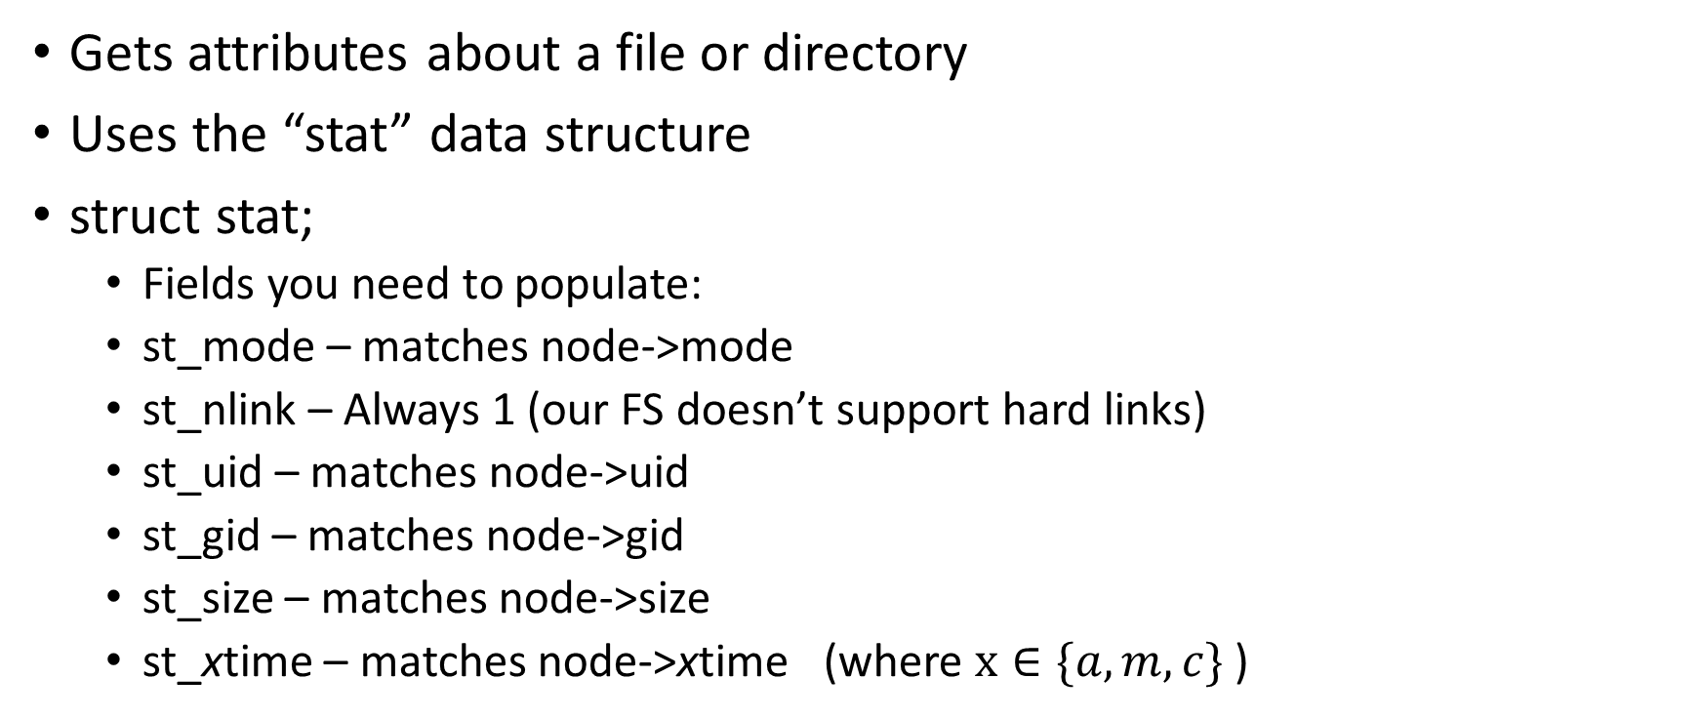
Getattr Function
Gets attributes about a file or directory
Uses the “stat” data structure
struct stat;
Fields you need to populate:
st_mode – matches node->mode
st_nlink – Always 1 (our FS doesn’t support hard links)
st_uid – matches node->uid
st_gid – matches node->gid
st_size – matches node->size
st_xtime – matches node->xtime (where $x∈\{a,m,c\}$)

Slide 9
Readdir Function
Reads the nodes that belong to a directory
Uses a function pointer “filler” to fill void *buf
filler(buf, “.”, 0, 0);
filler(buf, “..”, 0, 0);
You must ALWAYS have . and .. (current and parent)
Make sure you NEVER put any forward slashes in this!
filler(buf, file_name_without_slashes, 0, 0);
One filler call for each node inside of a directory

Slide 10
Opendir Function
Analogous to the Open function
Checks to see if the directory exists
If yes: return 0
If no: return –ENOENT (no entry)

Slide 11
Mkdir Function
Creates a new, empty directory at the given path
path contains the directory that needs to be created (it’ll be the last name)
Step 1: Allocate a new node
Step 2: Set default metadata (mode, uid, gid, size, etc.)
size must be 0 for all directories
Set the time by using time(NULL)
Set the uid and gid by using getuid() and getgid()
Set the mode by S_IFDIR | mode
Step 3: Add the new node to the node list.

Slide 12
Rmdir Function
Removes a directory node
Step 1: Find the node
Step 2: Make sure it is a directory (check for S_IFDIR bit)
Step 3: Remove the node
Step 4: Free resources used (if used)
Step 5: return 0 if successful

Slide 13
Chmod Function
Changes the mode of a node
Step 1: Search for the node given by path
Step 2: Change the mode to given mode
Step 3: return 0 if successful, error code if not

Slide 14
Chown Function
Changes the uid and/or the gid of a node (directory or file)
Step 1: Search for file or directory
Step 2: Set the uid to given uid and gid to given gid
Step 3: Return 0 if successful, error code if not

Slide 15
Unlink Function
Deletes a file only (not directories!)
Step 1: Find the node given by “path”
Step 2: Ensure it is NOT a directory (if it is, return –EISDIR)
Directories are removed by rmdir
Step 3: Delete the blocks associated with this node
Step 4: Delete the node
Step 5: Return 0 if successful, error code if not

Slide 16
Truncate Function
Step 1: Find the node given by the “path”
Step 2: End the file at the given size. Any block past the size must be deleted.
You may need to reduce the number of blocks in the node for this function.
Take care that you remove the block properly and update the # of blocks.

Slide 17
Rename Function
Renames “path” to “new_name”
The new name might contain a new path!!
Step 1: Search for “path” node (may be file or directory)
Step 2: Check to make sure “new_name” contains a valid path
Step 3: Rename the node to the new path (change node.name)
Step 4: Return 0 if successful, error code if not

Slide 18
fs_drive: Loading the Block Drive
You will load the entire drive into memory by implementing fs_drive function.
Keep track of nodes and blocks separately.
You may implement whatever data structures you need
You may even use globals
Create a fresh block drive by using "makeblock"

Slide 19
fs_destroy: Saving the Block Drive
This function is called when your program exits
It should write the new nodes/blocks back to the hard drive file
This saves anything I did with your file system
Refer to the format above
If you screw this up, use makeblock to create a fresh, new drive

Slide 20
Project Hints
Implement fs_drive
Implement getattr
Implement open and opendir
Implement readdir and read
These functions are all that are required to get a very basic file system going.

Slide 21
Potential Problems
The attached Makefile uses the libraries in my home folder
This will not work if you’re using your own system!
Must be on a Hydra machine
If you segfault or any other failure, you may have to manually unmount your filesystem
fusermount –u /path/to/your/mountpoint
-u means “unmount”

Slide 22
Interacting
Run ./fs
This will mount your file system into the “mnt” folder
Open a new terminal
cd into the mnt folder
You should see README.txt and README.too if you created a new hard_drive using makeblock.
To test you filesystem, interact with it much like you would a normal filesystem.

Slide 23
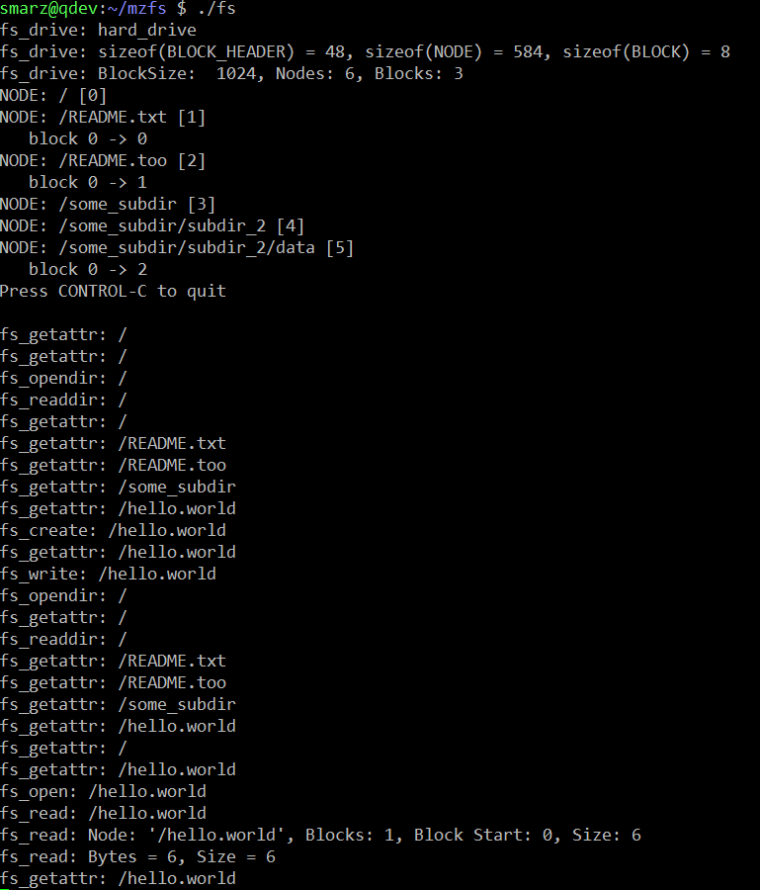
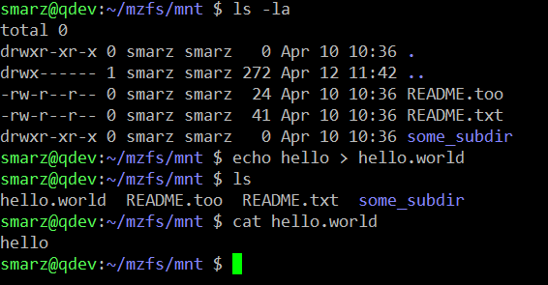
Views
Terminal 1
Terminal 2

