Slide 1
Crafter
Kingston
Join the Kingston Community!
Now for FREE!

Slide 2


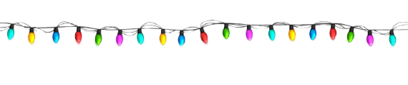
Crafter
Kingston
Join the Kingston Community!
Now for FREE!

