Slide 1

OpenDeeperSearch
By Carpal Tunnel Bros

Slide 2
Analysis of ODS-v2 FRAMES Benchmark Failures
Category Contributions
Incomplete Multi-Hop Reasoning: 25 wrong answers (9.51%)
Incorrect Answer Grounding: 127 wrong answers (48.29%)
Suboptimal Search Queries: 93 wrong answers (35.36%)
Misinterpretation or Logic Errors: 4 wrong answers (1.52%)
Code Execution / Parsing Issues: 14 wrong answers (5.32%)

Slide 3
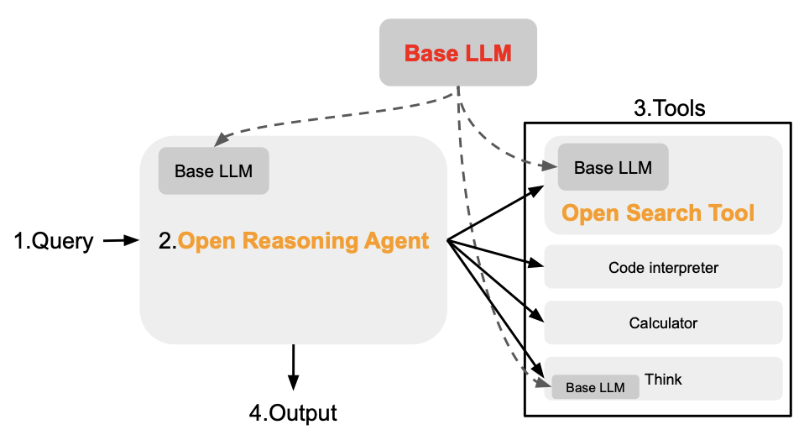
1.5 Reasoning guide

Slide 4
Main contributions
Experiments with reasoning guide for CodeAgent
Bug-fixes to ensure correct working pipeline in our given environment
Extensions to Open Search Tool

Slide 5
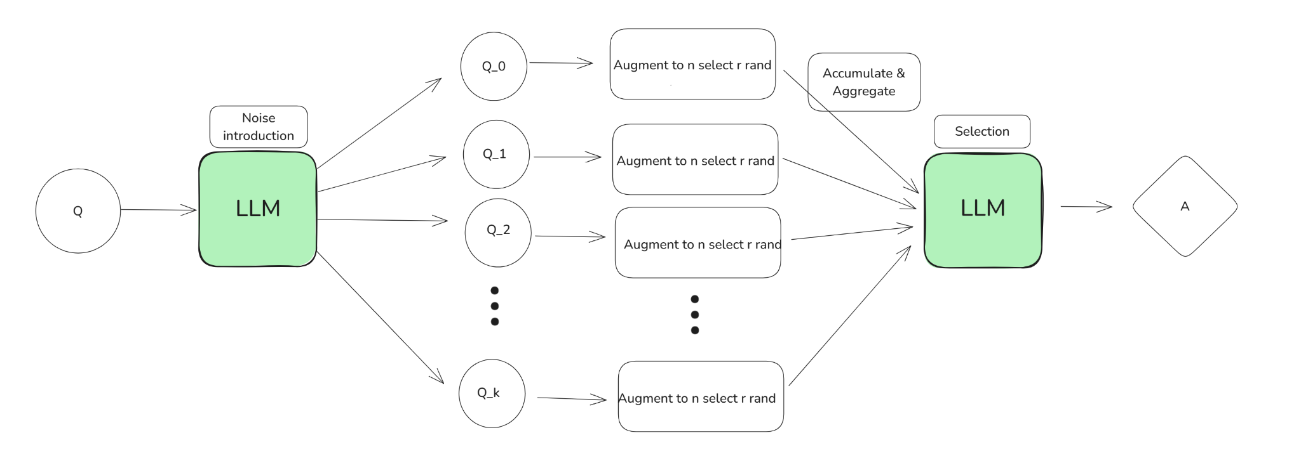
Changes to the Model and Future Directions

