Slide 1
Ray-Object Intersections

Slide 2
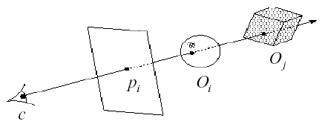
Mathematics
The heart of any ray tracer, or ray casting for hidden surface removal, is the intersection routines.
Each kind of primitive has different properties, so we have different intersection equations.
(d_{x},d_{y},d_{z})^{T}
(x₀, y₀, z₀)^{T}

Slide 3
Parametric Ray Equation
Let
  the COP be P₀ = ( x₀ , y₀ , z₀ ) ^{T} and
  the viewing direction be D = ( d_{x} , d_{y} , d_{z} ) ^{T}
Any point P lying on the eye ray is given by:
P = P₀ + D t
Or writing each coordinate separately:
x = x₀ + d_{x} t
y = y₀ + d_{y} t
z = z₀ + d_{z} t

Slide 4
Ray Parameterization
The parametric ray equation is given by:
P = P₀ + D t
Points along the line of sight is parametrized by t:
t = 0 , at COP (eye/viewpoint)
t < 0 , behind COP
t > 0 , in front of COP
Non-negative t
(d_{x},d_{y},d_{z})^{T}
(x₀, y₀, z₀)^{T}

Slide 5
Mathematics
Consider an implicit surface (i.e., spheres and other quadrics defined by an implicit equation)
F ( x , y , z ) = 0
In the following, all surface equations are assumed to be in the object space coordinate system. Therefore, we need to transform the ray before testing for intersection.

Slide 6
Intersecting Spheres
The (implicit) equation of a unit sphere is given by:
x² + y² + z² = 1
Assuming a unit sphere (radius is equal to one). Substituting the parametric ray equation yields the following:
(d_{x} ² + d_{y} ² + d_{z} ² ) t² + 2(d_{x} x₀ + d_{y} y₀ + d_{z} z₀) t
+ (x₀² + y₀² + z₀²) – 1 = 0
which is a quadratic equation in t.

Slide 7
Intersecting Spheres
Solving the quadratic equation in t gives the solution.
Ray misses the sphere if the discriminant is negative.
If the discriminant is non-negative, the smallest positive t is taken.
Then, the intersection point is given by:
x = x₀ + d_{x} t₁
y = y₀ + d_{y} t₁
z = z₀ + d_{z} t₁

Slide 8
Possible cases
1
1. Ray intersects sphere twice
with t>0
2. Ray tangent to sphere
3. Ray intersects sphere with t<0
4. Ray originates inside sphere
5. Ray does not intersect sphere
2
3
4
5

Slide 9
Intersecting Quadrilaterals
Solving a ray-plane equation determines if the ray hits the polygon plane. It is followed by an extent check to see if the ray hits the polygon.
Again, let’s write the ray equation as:
P = P₀ + D t
which defines a ray as:
P₀ = ( x₀ , y₀ , z₀ ) ^{T}
D = ( d_{x} , d_{y} , d_{z} ) ^{T}

Slide 10
Intersecting Quadrilaterals
Define the plane in terms of [A B C D ] as:
A x + B y + C z + D = 0
Note: the unit vector normal of the plane is defined by:
P_{normal} = P_{n} = [A B C ] ^{T}

Slide 11
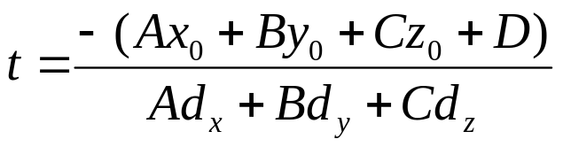
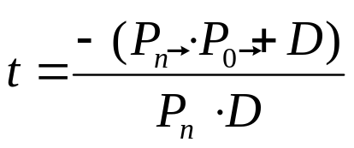
Intersecting Quadrilaterals
Substituting the ray equation into the plane equation yields:
A (x₀ + d_{x} t) + B (y₀ + d_{y} t) + C (z₀ + d_{z} t) + D = 0
Solving for t
In vector form, the equation becomes
The vector equation will have no solution if the dot product of P_{n} and
D is zero (ray direction exactly perpendicular to plane normal).

Slide 12
Intersecting Quadrilaterals
Define
  v_{d} = P_{n} • D
  v₀ = - (P_{n} • P₀ + D)
Hence,
t = v₀ / v_{d}
If t < 0, then the line defined by the ray intersects the plane behind the COP. Therefore, no intersection actually occurs.
Else, the intersection point is given by:
P = P₀ + D (v₀ / v_{d})

Slide 13
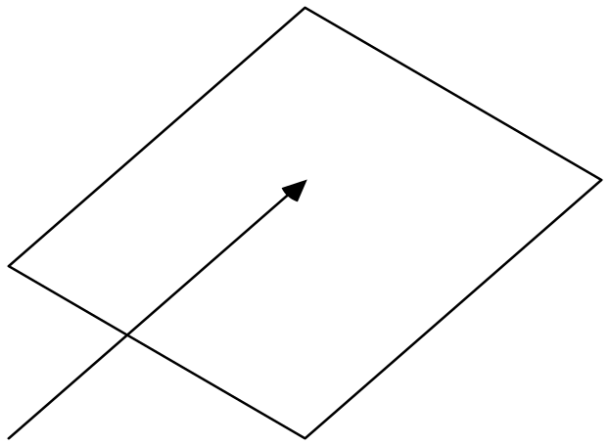
Possible Cases
P_{n} • D = 0
P_{n} • D > 0
t > 0
t < 0
P_{o}
P_{o}

Slide 14
Intersecting Quadrilaterals
Further extent check is required if the intersection point lies within the region bounded by the quadrilaterals
If dot product of 4 directed edges with vector to intersection point have same sign, it lies inside
Same method works for other convex polygons

Slide 15
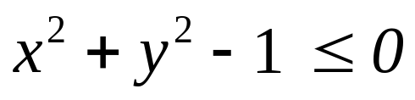
Intersecting a disk
Intersecting circles is similar to intersecting quadrilaterals
The extent check, after computing the intersection point, becomes one of using the circle equation
Consider a circle lying on the z=0 plane. If the ray intersects the z=0 plane, it also intersects the circle if:

Slide 16
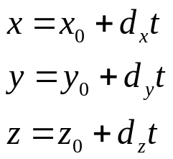

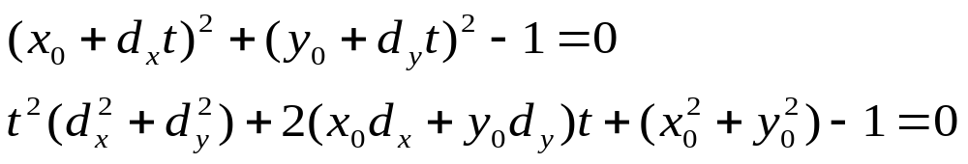
Intersecting Cylinders
Recall the parametric ray equation is:
The equation for an infinite cylinder (along Z-axis) is:
Substituting the ray equation yields a quadratic equation in t:
An extent check is applied for a finite cylinder.

Slide 17
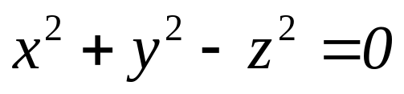
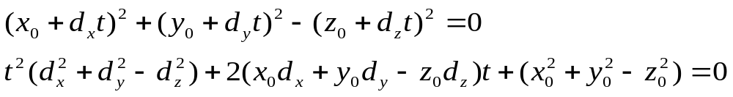
Intersecting Cones
The implicit equation for a cone is
Substituting the ray equation into the above yields a quadratic equation in t :
Compute the discriminant, and solve for t if the discriminant is non- negative.

