Slide 1
Texture Mapping

Slide 2
Reading
Required
Hearn & Baker 14.8-14.9
Angel, pages 373-386
Optional
Paul S. Heckbert. Survey of texture mapping. Computer Graphics and Applications 6(11): 56-67, November 1986
http://www.cs.cmu.edu/afs/cs/user/ph/www/texsurv.ps.gz

Slide 3
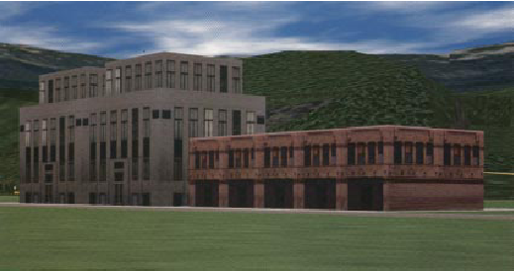
Texture Mapping
Texture mapping allows you to take a simple polygon and give it the appearance of something much more complex
  Due to Ed Catmull, PhD thesis, 1974
  ensures that “all the right things” happen as a texture polygon is transformed and rendered

Slide 4
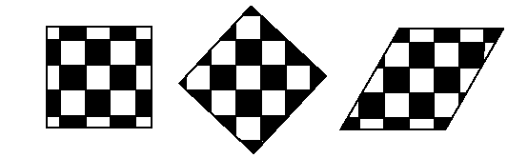
Non-Parametric Texture Mapping
With non parametric texture mapping:
  Texture size and orientation are fixed
  Unrelated to size and orientation of polygon
  Gives a cookie-cutter effect

Slide 5
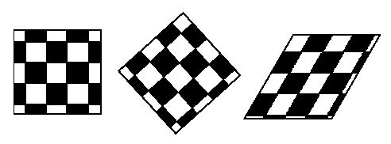
Parametric Texture Mapping
With parametric texture mapping, texture size and orientation are tied to the polygon:
  Separate texture space and screen space
  Texture the polygon as before but in texture space
  Deform (render) the textured polygon into screen space

Slide 6
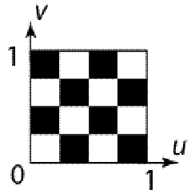
Implementing Texture Mapping
A texture lives in it own image coordinates paramaterized by (u,v):

Slide 7
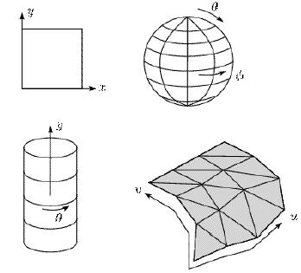
Implementing Texture Mapping
It can be wrapped around many different surfaces:

Slide 8
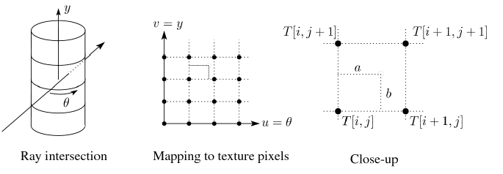
Texture Resampling
What do we do when the texture sample lands between texture pixels?
We resample. Common choice is bilinear resampling.

Slide 9
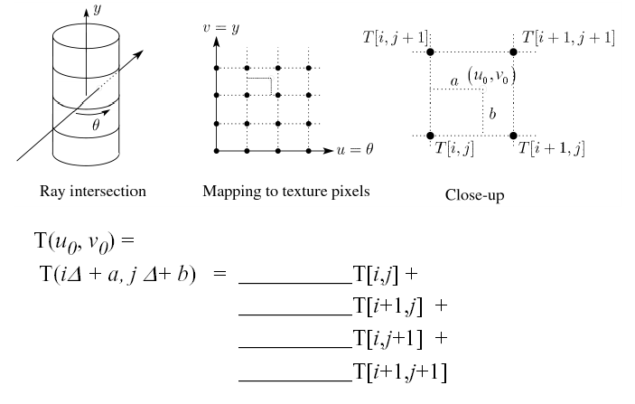
Bilinear Resampling

Slide 10
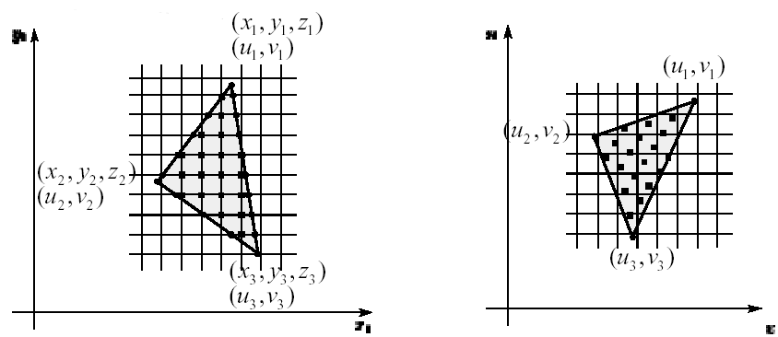
Implementing, cont’d
Texture mapping can also be handled in z-buffer algorithms
  Scan conversion is done in screen space, as usual
  Each pixel is colored according to the texture
  Texture coordinates are found by Gouraud-style interpolation
screen space
texture space

Slide 11
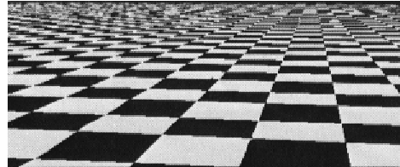
Antialiasing
If you point-sample the texture map, you get aliasing (stair-casing effect):

Slide 12
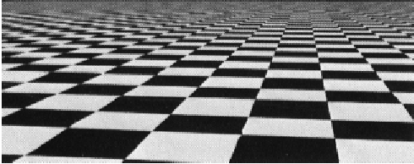
Antialiasing
Proper antialiasing requires area averaging in the texture:

Slide 13
What is Aliasing?
This is the phenomenon that occurs when we undersample a signal. It causes certain high frequency feature to appear as low frequencies.
To eliminate aliasing we have to either band limit (low pass filter) our input signal or sample it at a higher rate.
The first approach (i.e. prefiltering) is more efficient.

Slide 14
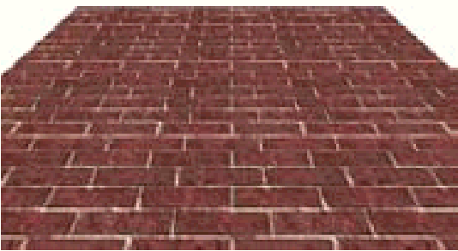
Spatial filtering
We prefilter the texture to remove the high frequencies that show up as artifacts in the final rendered image.
The prefiltering required in the undersampling case is basically a spatial integration (summing) over the extent of the sample.

Slide 15
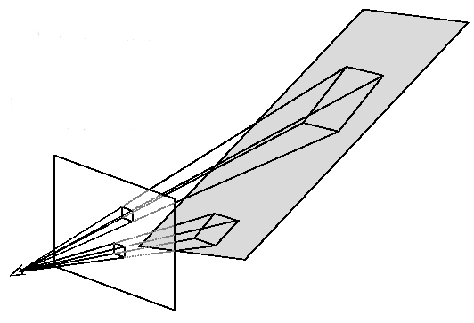
Computing Average Colors
Computationally difficult part is prefiltering (summing) over the covered pixels:
Several methods have been used:
1. Brute force
  Just sum (mean filter)
2. Mip maps
3. Summed Area Tables

Slide 16
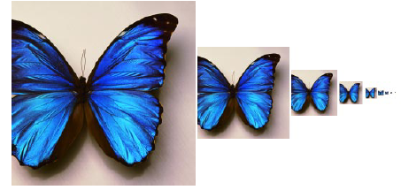
Mip Maps
Lance Williams, 1983
  “multum in parvo” – many things in a small place”
  Keep textures prefiltered at multiple resolutions
  Figure out two closest levels
  Linear interpolate between the two

Slide 17
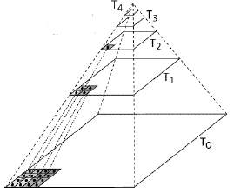
Mip Map Pyramid
The mip map hierarchy can be thought of as an image pyramid:
  Level 0 (T0[i,j]) is the original image.
  Level 1 (T1[i,j]) averages over 2x2 neighborhoods of original.
  Level 2 (T2[i,j]) averages over 4x4 neighborhoods of original
  Level 3 (T3[i,j]) averages over 8x8 neighborhoods of original

Slide 18
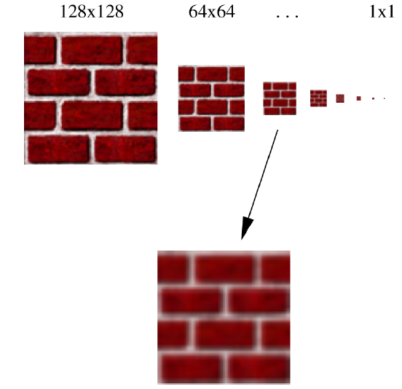
Mip Maps
1. Figure out two closest levels
2. Linear interpolate between the two

Slide 19
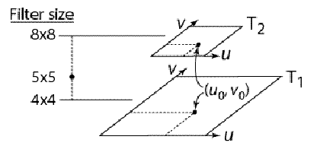
Mip Map Resampling
What would the mip-map return for an average over a 5x5 neighborhood at location (u₀,v₀)?
How do we measure the fractional distance between levels?
What if you need to average over a non-square region?

Slide 20
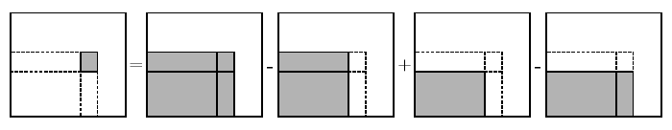
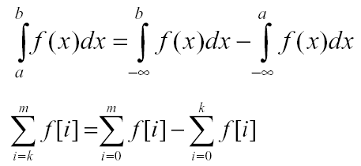
Summed Area Table (SAT)
Recall in Calculus (in continuous or discrete form):

Slide 21
What is a SAT?
5 0 9 9
4 7 8 8
0 0 3 7
1 6 8 3
10 23 51 78
5 18 37 55
1 7 18 28
1 7 15 18

Slide 22
Summed Area Table
Due to Frank Crow (1984).
Keep sum of everything below and to the left.
Use four table lookup.
Requires more memory (2-4 times the original)
Gives less blurry results.

Slide 23
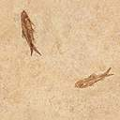
Summed Area Table (SAT)
Determining the rectangle:
  Find bounding box and calculate its aspect ratio
v
y_{s}
pixel
x_{s}
u

Slide 24
Summed Area Table (SAT)
Determine the rectangle with the same aspect ratio as the bounding box and the same area as the pixel mapping.
v
y_{s}
pixel
x_{s}
u

Slide 25
Summed Area Table (SAT)
Center this rectangle around the bounding box center.
Formula:
    Area = aspect_ratio*x*x
    Solve for x – the width of the rectangle
Other derivations are also possible using the aspects of the diagonals, …

Slide 26
Summed Area Table (SAT)
Calculating the color
  We want the average of the texture element colors within this rectangle
(u4,v4)
(u3,v3)
v
+
-
-
+
(u1,v1)
(u2,v2)
+
-
+
-
u

Slide 27
Summed Area Table (SAT)
To get the average, we need to divide by the number of texels falling in the rectangle.
  Color = SAT(u3,v3)-SAT(u4,v4)-SAT(u2,v2)+SAT(u1,v1)
  Color = Color / ( (u3-u1)*(v3-v1) )

Slide 28
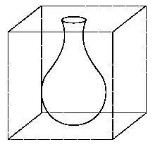
Solid Textures
Q: What kinds of artifacts might you see from using a marble wallpaper instead of a real marble?
  One solution is to use solid textures.
  Use model-space coordinates to index into a 3D texture.
  Like “carving” the object from the material
The mathematics is easy; but coming up with the solid texture is difficult…

Slide 29
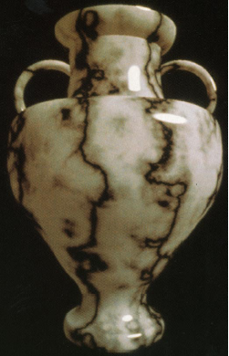
Solid Textures

Slide 30
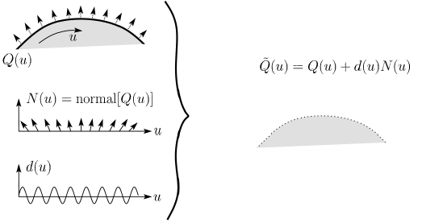
Displacement Mapping
In displacement mapping, a texture is used to perturb the surface geometry itself:
Silhouettes are correct.
Requires doing additional hidden surface calculations.

Slide 31
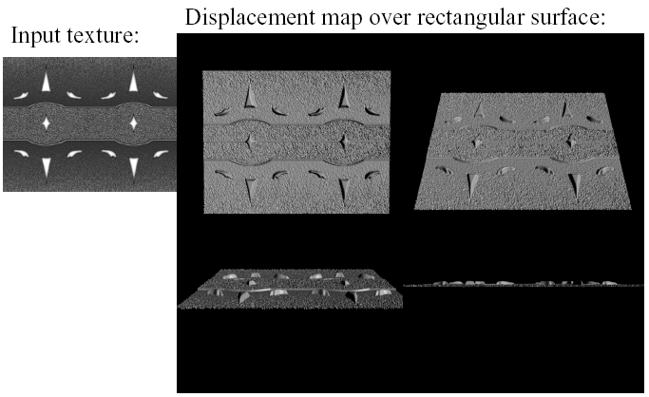
Displacement Mapping

Slide 32

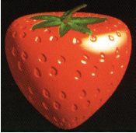
Bump Mapping
Textures can be used for more than just color
In bump mapping, a texture is used to perturb the normal:
  The normal is perturbed the normal according to the partial derivatives of the texture.
  These bumps ‘animate’ the surface.

Slide 33
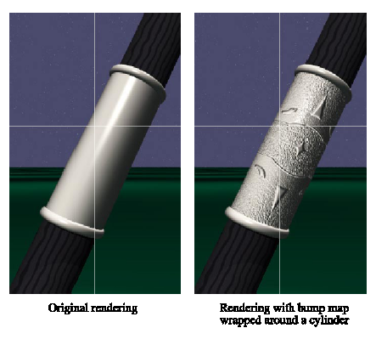
Bump Mapping Example

Slide 34
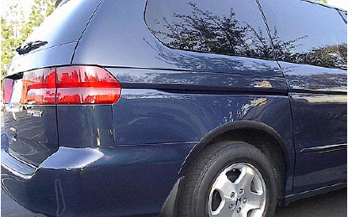
Environment Mapping

Slide 35
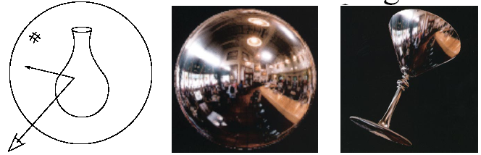
Environment Mapping
A.k.a. reflection mapping
Use texture to model object’s environment
Rays are bounced off objects into environment to determine color of illumination
Works well when there is just a single object
With some simplifications can be implemented in hardware
Ray tracer can be extended to handle refractions as well

Slide 36
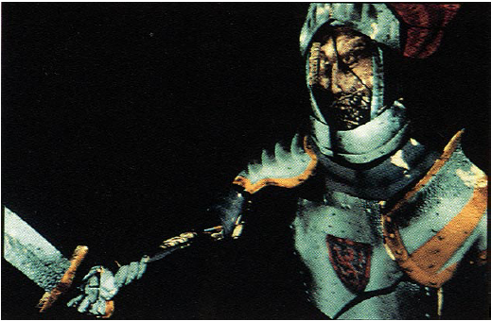
Combining Texture Maps
Using texture maps in combination to achieve better effects.

Slide 37
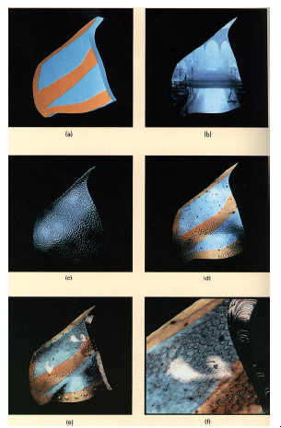
Combining Texture Maps

Slide 38
Summary
What to take from this lecture:
What texture mapping is and what is it good for
Understanding the various approaches to antialiased textured mapping
  Brute force
  Mipmaps
  Summed area tables
Additional effect with texture mapping techniques
  Bump mapping
  Displacement mapping
  Environment mapping

