Slide 1
Parametric Curves

Slide 2
Reading
Required
Hearn & Baker, 10.6 -10.9
Foley, 11.2
Optional
Bartels, Beatty, and Barsky. An Introduction to Splines for use in Computer Graphics and Geometric Modeling. 1987.
Farin. Curves and Surfaces CAGD: A Practical Guide. 4th ed. 1997.

Slide 3
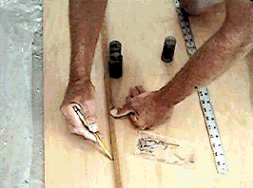
Curves Before Computers
The loftsman’s or carpenter’s spline:
  long, narrow strip of wood or metal
  shaped by lead weights called “ducks”
  gives curves with second-order continuity, usually
Used for designing cars, ships, airplanes etc.
But curves based on physical artifacts cannot be replicated well, since there is no exact definition of what the curve is.
Around 1960, a lot of industrial designers were working on this problem.

Slide 4
Motivation for curves
What do we use curves for?
  building models
  movement paths
  animation

Slide 5
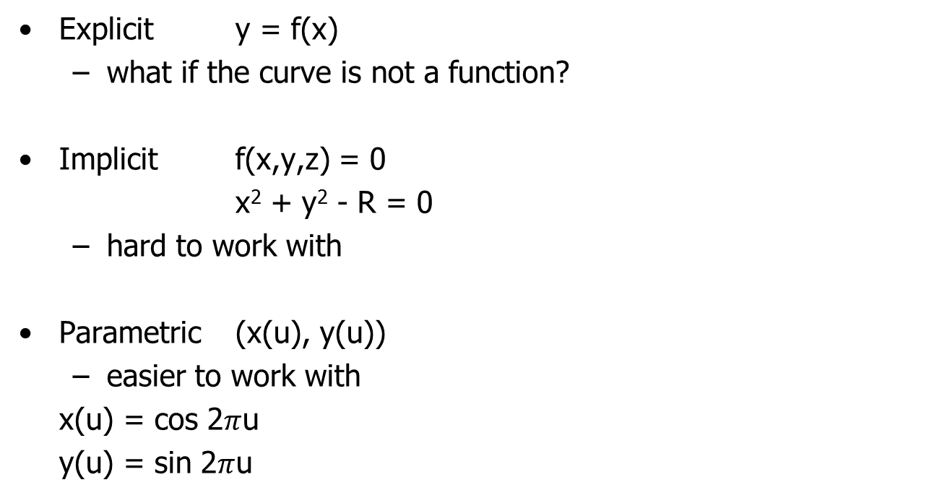
Mathematical Curve Representation

Slide 6
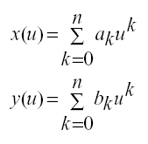
Parametric Polynomial Curves
We’ll use parametric curves where the functions are all polynomials in the parameter.
Advantages
  easy (and efficient) to compute
  infinitely differentiable

Slide 7
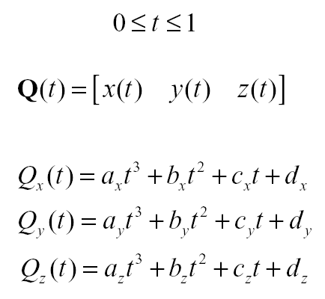
Cubic Curves
Fix n=3
For simplicity we define each cubic function with the range
x(t) =
y(t) =
z(t) =

Slide 8
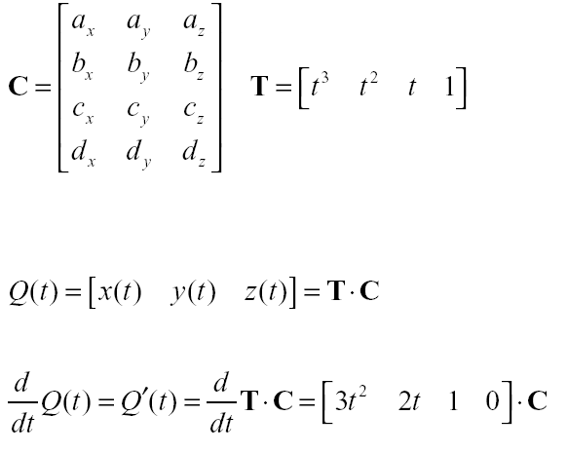
Compact Representation
Place all coefficients into a matrix:

Slide 9
Controlling the Cubic
Q: How many constraints do we need to specify fully to determine the cubic Q(t)?

Slide 10
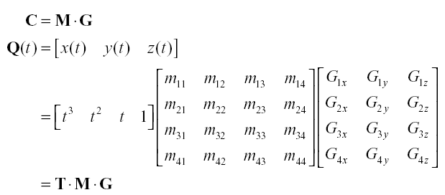
Constraining the Cubics
Redefine C as a product of the basis matrix M and the 4-element column vector of constraints or geometry vector G.

Slide 11
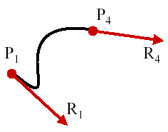
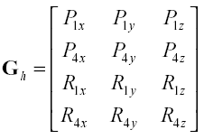
Hermite Curves
Determined by
  endpoints P₁ and P₄.
  tangent vectors at the endpoints R₁ and R₄.
So,
  Q(t) = T M_{h} G_{h}
where
P₁
P₄
R₁
R₄

Slide 12
Computing Hermite Basis Matrix
The constraints on Q(0) and Q(1) are found by direct substitution:
P₁= Q(0) = [ 0 0 0 1 ] M_{h} G_{h}
P₄= Q(1) = [ 1 1 1 1 ] M_{h} G_{h}
so constraints on tangents are
R₁= Q’(0) = [ 0 0 1 0 ] M_{h} G_{h}
R₄= Q’(1) = [ 3 2 1 0 ] M_{h} G_{h}
Note: tangents are defined by
Q’(t) = [ 3t² 2t 1 0 ] M_{h} G_{h}

Slide 13
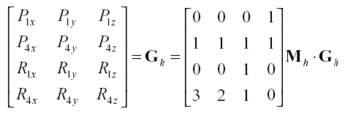
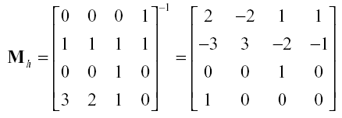
Computing Hermite Basis Matrix
Collecting all constraints we get
So

Slide 14
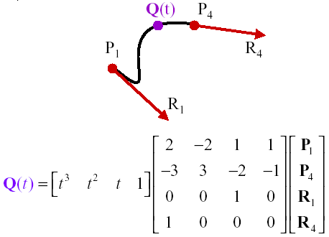
Computing a Point
Given two endpoints (P₁,P₄) and two endpoint tangents (R₁,R₄):

Slide 15
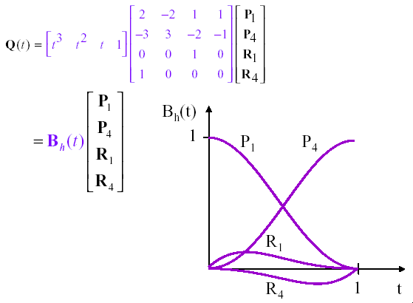
Blending Functions
Polynomials weighting each element of the geometry vector

Slide 16
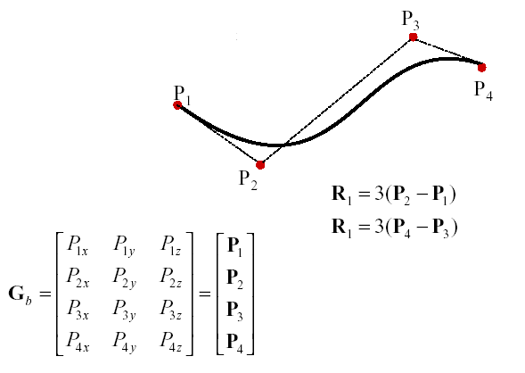
Bezier Curves
Indirectly specify the tangent vectors by specifying two intermediate points.
4

Slide 17
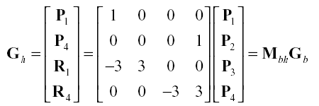
Bezier Basis Matrix
Establish the relation between the Hermite and the Bezier geometry vectors:
hb

Slide 18
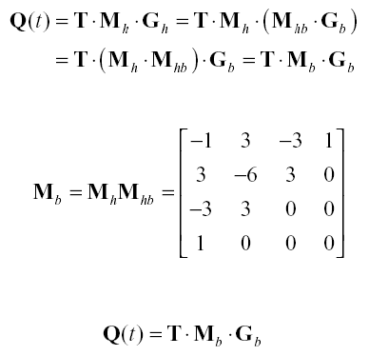
Bezier Basis Matrix

Slide 19
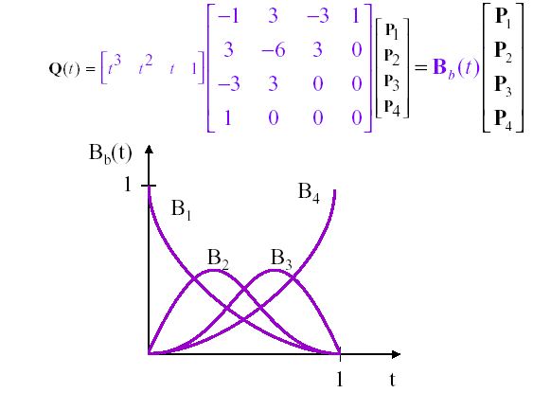
Bezier Blending Functions
A.k.a. Bernstein polynomials

Slide 20
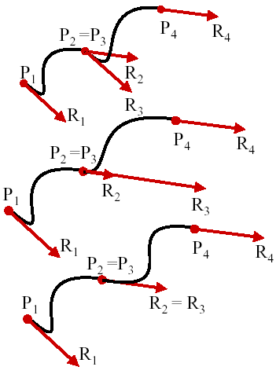
Continuity of Splines
Splines: 2 or more curves are concatentated together
C⁰: points coincide, velocity don’t
G¹: points coincide, velocities have the same direction.
C¹: points and velocities coincide.
Q: What’s C²?

Slide 21
Summary
Use of parametric functions for curve modeling
Enforcing constraints on cubic functions
The meaning of basis matrix and geometry vectors
General procedure for computing the basis matrix
Properties of Hermite and Bezier splines
The meaning of blending functions
Enforcing continuity across multiple curve segments

