Slide 1
Surfaces

Slide 2
Reading
Required
Hearn & Baker, sections 10.8, 10.9, 10.14
Foley, section 11.3
Recommended
Bartels, Beatty, and Barsky. An Introduction to Splines for use in Computer Graphics and Geometric Modeling, 1987.

Slide 3
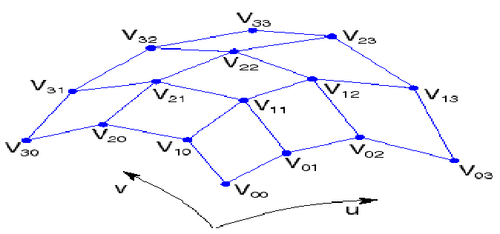
Tensor product Bézier surfaces
Given a grid of control point V_{ij}, forming a control net, construct a surface S(u,v) by:
  treating rows of V as control points for curves V₀(u), …, V_{n}(u).
  Treating V₀(u), …, V_{n}(u) as control points for curves parameterized by v.

Slide 4
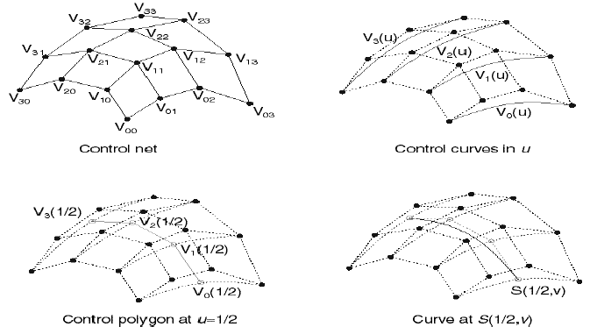
Tensor product surfaces, cont.
Let’s walk through the steps:
Which control points are interpolated by the surface?

Slide 5
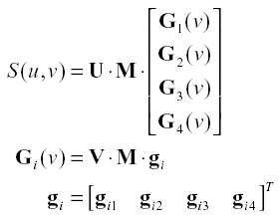
Building surfaces from curves
Let the geometry vector vary by a second parameter v:
[u³ u² u 1]
[v³ v² v 1]
g_{i1}
g_{i2}
g_{i3}
g_{i4}

Slide 6
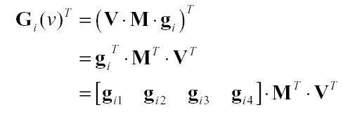
Geometry matrices
By transposing the geometry curve we get:
3x4 4x4 4x1
(3x1 vector)

Slide 7
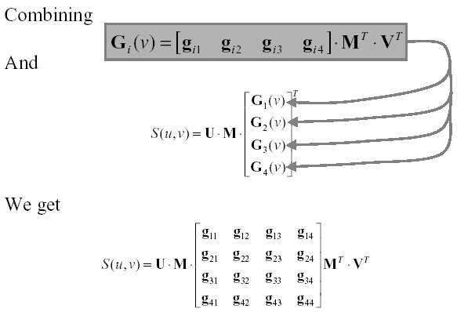
Geometry matrices
T
1x3 1x4 4x4 4x3
1x3 1x4 4x4 4x4x3 4x4 4x1

Slide 8
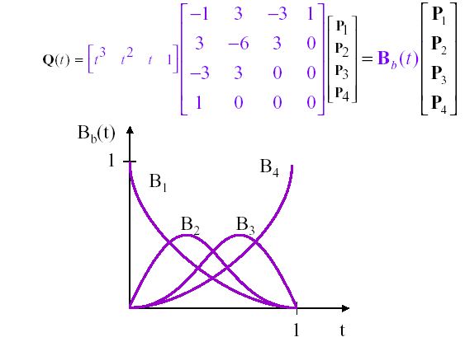
Bezier Blending Functions
A.k.a. Bernstein polynomials

Slide 9
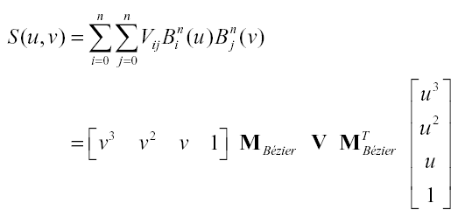
Matrix form
Tensor product surfaces can be written out explicitly:

Slide 10
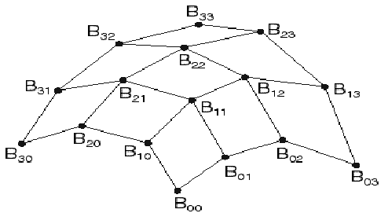
Tensor product B-spline surfaces
As with spline curves, we can piece together a sequence of Bezier surfaces to make a spline surface. If we enforce C² continuity and local control, we get B-spline curves:
treat rows of B as control points to generate Bezier control points in u.
treat Beizer control points in u as B-spline control points in v.
Treat B-spline control points in v to generate Bezier control points in u.

Slide 11
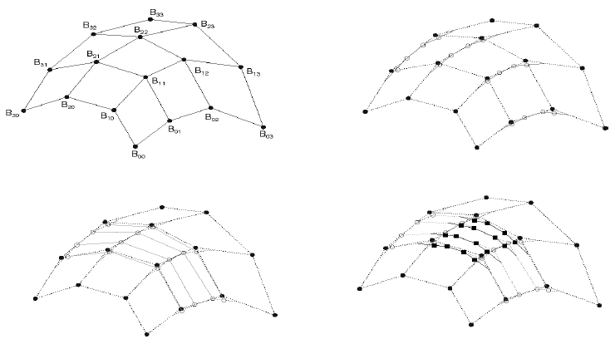
Tensor product B-spline surfaces
Which B-spline control points are interpolated by the surface?

Slide 12
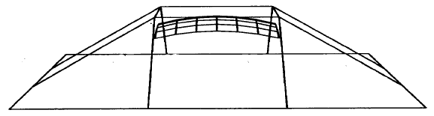
Tensor product B-spline surfaces

Slide 13
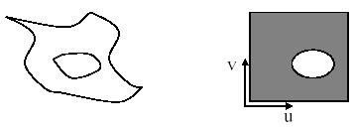
Trimmed surfaces
Sometimes, we want to have control points over which parts of a surface get drawn.
For example:
We can do this by trimming the u-v domain.
  Define a closed curve in the u-v domain (a trim curve)
  Do not draw the surface points inside this curve
It’s really hard to maintain continuity in these regions, especially while animating.

Slide 14
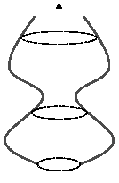
Surface of revolution
Ideal: rotate a 2D profile curve C(u) around an axis.
What kinds of shapes can you model this way?
  Vase, etc.
C(u)

Slide 15
Variations
Several variations are possible:
Scale C(u) as it moves.
Morph C(u) into some other curve C’(u) as it moves.

Slide 16
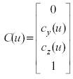

Constructing surfaces of revolution
Given: A curve C(u) in the yz-plane:
Let R_{x}(v) be a rotation matrix about the x-axis.
Find: A surface S(u,v) which is C(u) rotated about the x-axis.

Slide 17
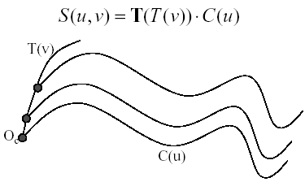
General sweep surfaces
The surface of revolution is a special case of a sweep surface.
Idea: Trace out surface S(u,v) by moving a profile curve C(u) along a trajectory curve T(v).
More specifically:
  Suppose that C(u) lies in a (x_{c},y_{c}) coordinate system with origin O_{c}.
  For every point along T(v), slide C(u) so that Oc coincides with T(v).
y_{c}
x_{c}

Slide 18
Orientation
The big issue:
  How to orient C(u) as it moves along T(v)?
Here are two options:
  Fixed (or static): Just translate Oc along T(v).
  Moving. Use the Frenet Frame of T(v).
    Allows smoothly varying orientation
    Permits surfaces of revolution, for example.

Slide 19
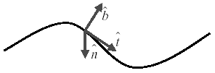
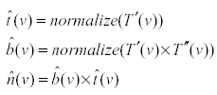
Frenet frames
Motivation: Given a curve T(v), we want to attach a smoothly varying coordinate system:
To get a 3D coordinate system, we need 3 independent direction vectors:
As we move along T(v), the Frenet frame (t,b,n) varies smoothly.

Slide 20
Frenet sweep surfaces
Orient the profile curve C(u) using the Frenet frame of the trajectory T(v):
  Put C(u) in the normal plane nb.
  Place O_{c} on T(v).
  Align x_{c} for C(u) with -n.
  Align y_{c} for C(u) with b.
C(u) in the normal plane nb
T(v)

Slide 21
Summary
What to take home:
How to construct tensor product Bezier surfaces
How to construct tensor product B-spline surfaces
Surfaces of revolution
Construction of sweep surfaces from a profile and trajectory curve
  with a fixed frame
  with a Frenet frame

