Slide 1
HW #2
Hints and clarification

Slide 2
Problem 1: Colors
Why is the sky blue?
Sunlight
  is made up of all colors
  passes through the atmosphere, which contains gas molecules, before reaching our eyes
Colors
  different wavelength
  different energies
When sunlight hits the gas molecules, it is scattered by these gas molecules.
Question: is the scattering equal for all wavelengths?

Slide 3
Problem 2: Shading
Why does the full moon look flat? It seems to be constantly lit. But why?
The moon is approximately spherical.
Question: What is the “configuration” of the solar system when you see a full moon?
APPARENTLY, if the moon is lambertian, then it should approximately follow the Phong shading equation:
  I = I_{l} a cos (N• L)
Hence, it should be brightest at the center. The intensity falls off as it is closer silhouette.
Now, it is NOT the case. So what happens? Can you somewhat guess the illumination equation for the full moon.

Slide 4
Problem 3: Orthographic Projection
Let’s move the image plane until it touches the corner.
For simplicity, we select this point as the origin. Take the unit vector along Ea and Eb and project them onto the plane using orthographic projection.
Remember the cosine law??
Ea
Eb

a
b
Lb
La
cos a

Slide 5
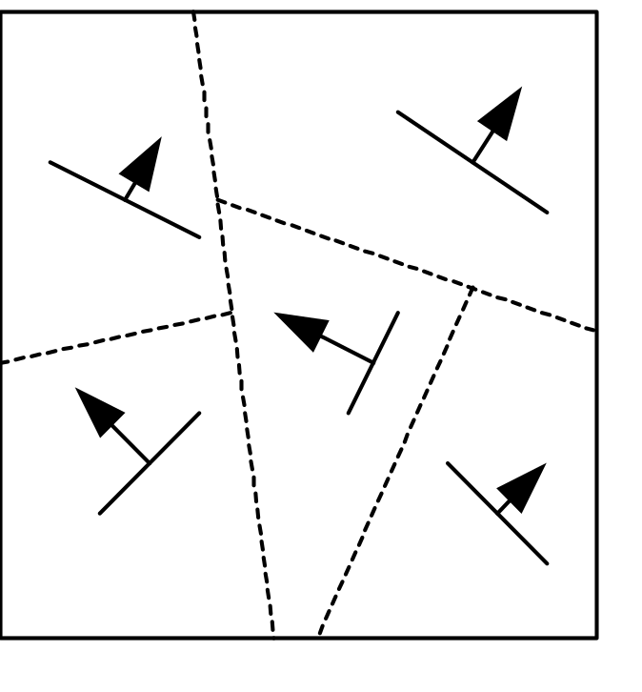
Problem 4a: BSP
Compare the proposed scheme with what we learned in class.
Advantages? Disadvantages?

Slide 6
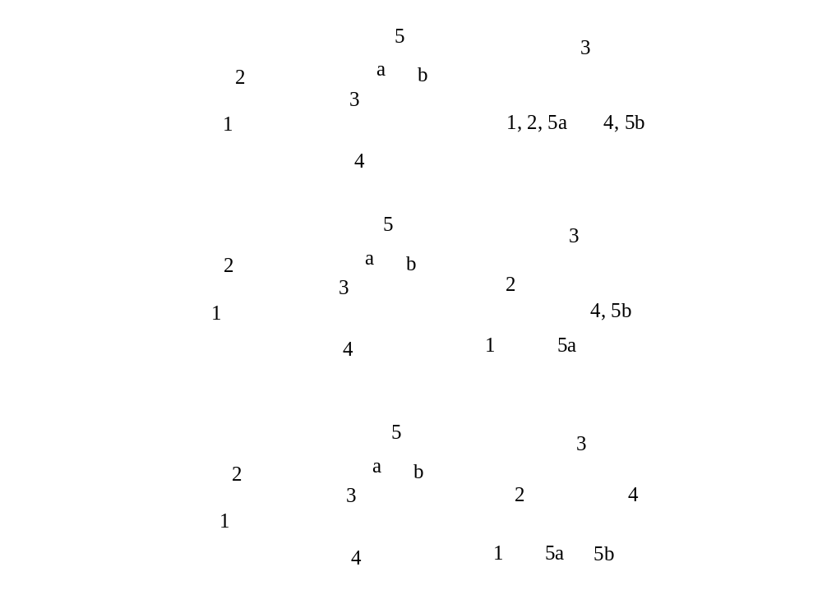

Slide 7
BSP Tree Display
showBSP( v: Viewer, T: BSPtree ) {
if T is empty then return
P := root of T
if viewer is in front of P {
showBSP( back subtree of T )
draw P
showBSP( front subtree of T )
} else {
showBSP( front subtree of T )
draw P
showBSP( back subtree of T )
}
}

Slide 8
Problem 4b: Displaying BSP
What information is needed at each internal node?
Question: What does each node store?
Answer: A plane!
Question: What characterizes a plane?
Answer: Normal!
Question: Given a viewing direction, how could you determine if the plane is visible or not?
Answer: dot product!
Question: So, what does a dot product call for resolving visibility?
Answer: Back face culling!
To answer this question, we also need to consider the viewing frustum (I will leave that to you!)

Slide 9
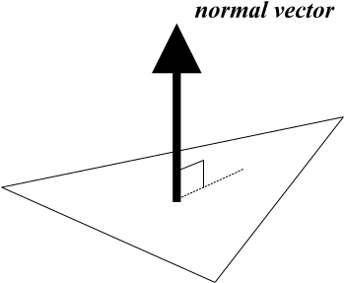
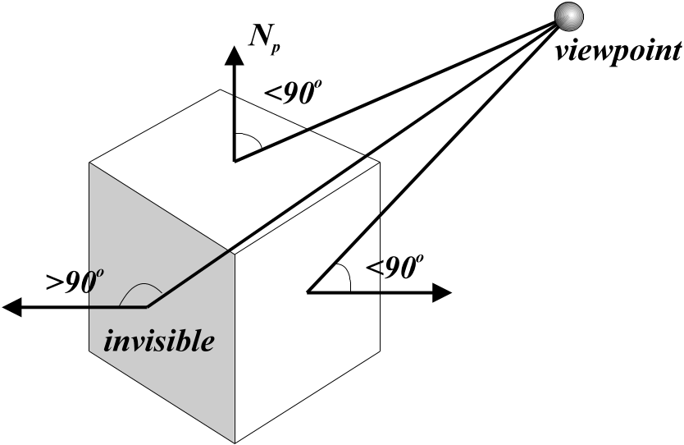
Back Face Culling
What is a normal vector?
It is a vector pointing in an orthogonal direction of a plane.
A polygon is front facing when θ, the angle between the viewer and the normal to the polygon, lies between -90º to + 90º or cos θ≥0

Slide 10
Problem 4c: BSP traversal
Front-to-back traversal?
You learned back-to-front traversal in class.
  Why back-to-front traversal? It’s a what a painter does! (Pseudo-painter’s algorithm)
  Disadvantage: a pixel may be shaded more than once. You know how expensive it is to shade one pixel after Project Trace!!

Slide 11
Problem 4d: BSP Traversal
What information is needed to avoid repetitive painting a pixel?
Answer: It should not be difficult. Please think!!

Slide 12
Problem 5: DRT
Discussion of (a) and (b).
Please handle the rest.

Slide 13
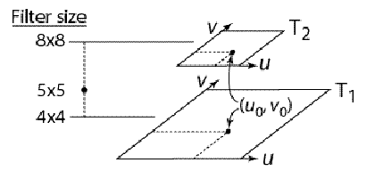
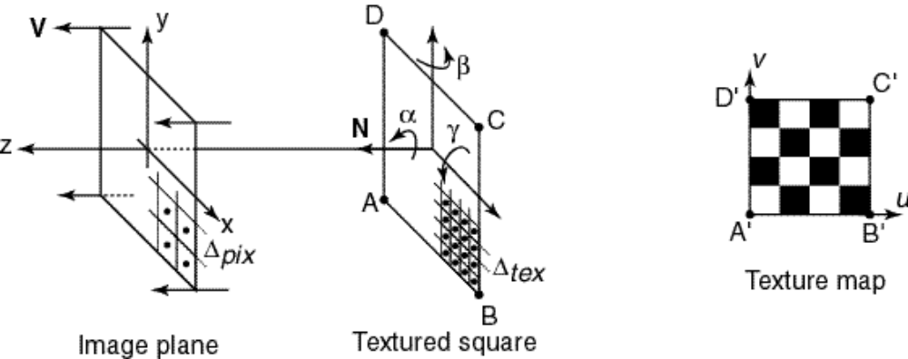
Problem 6a: Texture Sampling
    Assuming ∆_{pix} > ∆_{tex}, how must these sample spacings be related in order for mip mapping to yield the correct values without interpolating among mip map levels?
    We want a pixel to cover a square region in the texture map of a size that fits right into one of the pyramid levels.

Slide 14
Problem 6b: mip map rotation
What angles will produce accurate results?
What angles will produce inaccurate (blurry) results because you need to average
Will 0 deg produce accurate result?
Will 30 deg produce accurate result?

Slide 15
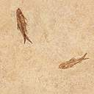
Summed Area Table (SAT)
Calculating the color
  We want the average of the texture element colors within this rectangle
(u4,v4)
(u3,v3)
v
+
-
-
+
(u1,v1)
(u2,v2)
+
-
+
-
u

Slide 16
Problem 6c: SAT
Assume no rotation.
Assume errors caused by linear interpolation is negligible.
Any restriction of the size of an image pixel and the size of a texture element (c.f. Problem 6a)?

Slide 17
Problem 7a: Bezier Curve
Perfect circle represented by a Bezier curve? Possible? Why?
What is the parametric form of a circle?
Q(t) = [ cos t sin t ]
Recall that Bezier curve is defined as a sum of cubic polynomial functions.
Is Q(t) a polynomial function?

Slide 18
Problem 7b: Comparison
Compare C2Draw, BezierDraw, CatmullRomDraw, BsplineDraw in terms of
  locality of control
  interpolation of control points
  continuity

Slide 19
Problem 8
Just run the algorithms we learned in class / use your Animate to draw the curves and screen capture…

Slide 20
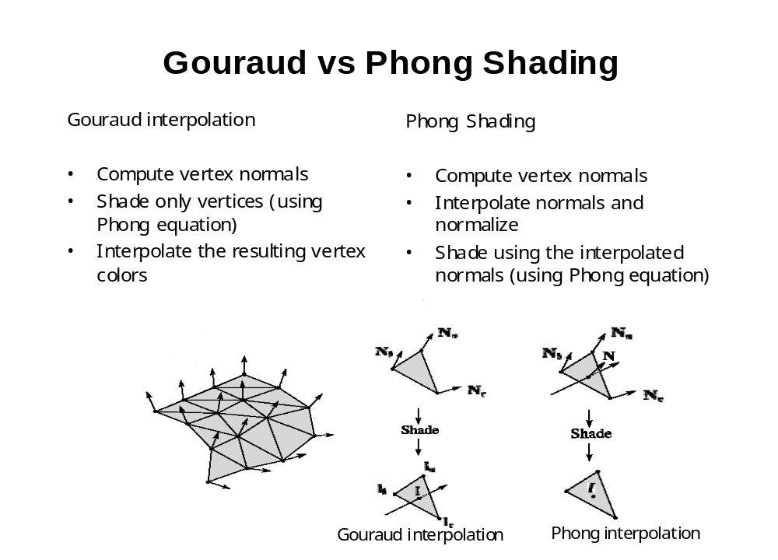
Problem 9: Phong vs Gourand Shading

