Slide 1
Introducing XMPP
For real-time communication

Slide 2
Agenda
Protocol
Market
Implementation

Slide 3
What is XMPP?
XMPP: Extensible Messaging and Presence Protocol
XML based protocol
TCP based transport
C/S Architecture
Push (Client / Server initiate) vs Pull (Client only)
Long-lived connection vs short-lived(http)

Slide 4
What XMPP can do?
IM
Collaborative Software
Game Server
System Control
Push Notification Service
PubSub Service
Notes:
http://xmpp.org/extensions/xep-0196.html

Slide 5
XMPP Strength
Open Standard (RFC)
Proven
Extensible
Community
Scalable
Channel encryption (TLS)
Authentication (Digest, SASL)

Slide 6
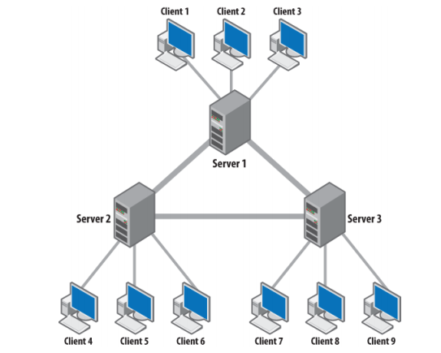
XMPP Architecture

Slide 7
XMPP Basics
Addressing
JabberID: username@domain/resource
IQ
get/set/result/error
Presence
Roster
Message

Slide 8
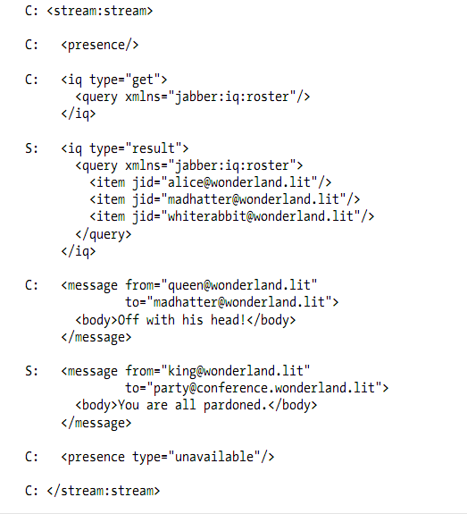
XMPP Stanza

Slide 9
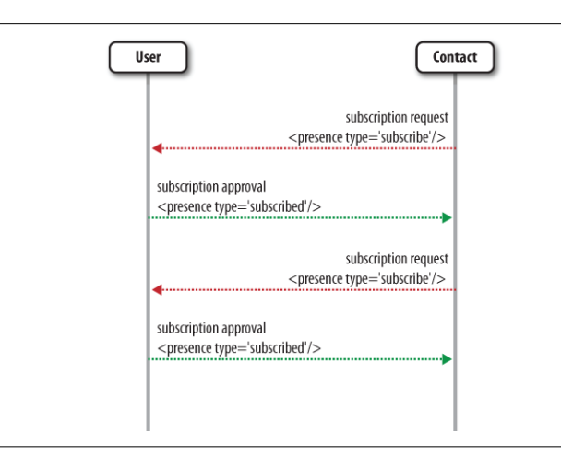
Presence Subscription

Slide 10
Famous Applications
Gtalk
Facebook Chat
WhatsApp
WebEx (acquired by Cisco for $3.2 billion in 2007, founded by min zhu)
MSN / Twitter /Google App Engine
IBM Sametime/Nokia Ovi
新浪微博
米聊，陌陌
人人网,网易泡泡,盛大KiKi
腾讯手机管家
如意通， IMO
Notes:
XMPP, 你值得拥有~

Slide 11
The Trend
For the first time ever, mobile phone users in 2012 sent more messages using messaging apps like WhatsApp, Kik and Line than they did using traditional SMS (text messages), according to Informa, a research firm. Messaging apps are expected to continue growing in 2013.
19 billion messages were sent with messaging apps in 2012.
17.6 billion messages were sent using SMS in 2012.

Slide 12
The Trend
Apple announced its iMessage service is transmitting more than 2 billion messages a day in 2013 Q1
WhatsApp announced it processed 18 billion messages in Dec 31st, 2012
Notes:
Why Whatsapp overpass iMessage

Slide 13
XMPP Implementations
Servers
Jabberd/Jabberd2 (C)
Ejabber( Erlang)
Openfire (JAVA)
Tigase (JAVA)
Clients
iChat
Spark
Libraries
xmpp.org/xmpp-software/

Slide 14
Openfire Overview
Full featured XMPP server
Based on Apache MINA
Easy install & management
Support dynamic plugin
Open source
Community support
Jetty based
Standalone
MySQL

Slide 15
AndroidPN
Stripped from Openfire
Notification service only
Support TLS encryption and authentication
Deployed with Tomcat
Integrated with Spring
Popular in Chinese developers
With Android client demo ( built on asmack)

Slide 16
PunchboxIM
Based on AndroidPN
Porting features and bugfixs from OF
Deployed with HAProxy
Clustering using Hazelcast
Switch MySQL to MongoDB
Support MUC
Support One-on-One chatting
Support contactlist
Improve heartbeat signaling for mobile
Image upload and download

Slide 17
PunchboxIM Architecture Overview
MongoDB
File Server
Hazelcast
IM1
IM2
IM3
IMn
Upload Server
API Server
Download Server
HAProxy(TCP)
Nginx(HTTP)
1
2
3
n
m
Clients
Notes:
The challenge of IM architecture

Slide 18
Resources
Sites
xmpp.org
www.igniterealtime.org
RFCs & XEPs
RFC 3920 RFC 3921
Source code
Books

Slide 19
Roadmap: 10M+ users
Table split
Redis support
Mina optimization
Account verification
Message history
Offline message
Image sharing
Voice chat
asmack optimization
C Client lib bring-up (security, test, multiplatform)
Http binding, Python support
XMPP protocol optimization, 2G/3G/Wifi optimization

Slide 20
XMPP Weakness
Verbose (inherited from xml)
Stateful (XML)
Unreliable Message (No ack for msg)
Inefficient for binary data transfer (XML)

Slide 21

Q&A
Google VS Apple
Gtalk, Google Wave, Google+, Google Hangouts (google IO 2013)
Notes:
Why google fails in IM market?

Slide 22
Heartbeat Signaling
Design to keep mobile devices connected
Default interval for AndroidPN is 30s
Default interval for WeChat is 300s
Default value for google native is 1680s
http://www.huxiu.com/article/11829/1.html
http://djt.qq.com/article/view/463
http://reteng.qq.com/info/17741.html

Slide 23
Play with XMPP
A Chat bot

