Slide 1
Course 2 Module 5 Programming Assignment Assignment is to ETL MIMIC data into the OMOP CONDITION_OCCURRENCE table
Detailed instructions with Slide Notes

Slide 2
ETL Steps
Assignment is to ETL MIMIC data into the OMOP CONDITION_OCCURRENCE table
Understand source/target data models
Profile source tables
Create ETL mappings
Write transformation code
Execute transformation
Perform data quality assessment
Package documentation
Notes:
This is an overview of the seven steps for ETL. The assignment focuses on Steps 1 thru 4 and Step 6
Place your finished deliverables into one or more slides. Add notes to provide additional information/context about what you have done

Slide 3
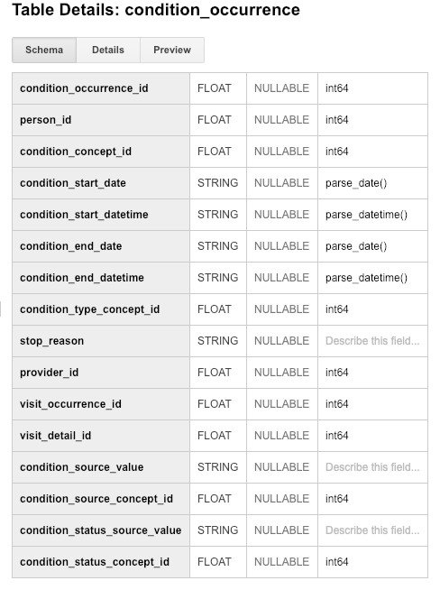
Step 1: Understand source/target data models
CONDITION_OCCURRENCE is the TARGET OMOP table.
Read the OMOP documentation about the type of data stored in CONDITION_OCCURRENCE and for three fields below that are in that table:
person_id
visit_occurrence_id
condition_source_value
A description of the CONDITION_OCCURRENCE table follows on the next 2 slides.
Notes:
Paste into one or more slides, the key table or tables from MIMIC that hold data that can be used to fill in the OMOP CONDITION_OCCURRENCE table.
Choose the MIMIC table screenshots from this slide to indicate which MIMIC table or tables would be used in the ETL process. Delete the MIMIC tables that you will not use.

Slide 4
3 fields in the CONDITION_OCCURRENCE table in OMOP
From https://github.com/OHDSI/CommonDataModel/wiki/CONDITION_OCCURRENCE
1.) Descriptions of the table for our work:
Suggesting the presence of a disease or medical condition stated as a diagnosis, a sign, or a symptom, which is either observed by a Provider or reported by the patient.
Medical claims data include diagnoses coded in Source Vocabularies such as ICD-9-CM that are submitted as part of a reimbursement claim for health services.
Condition records are typically inferred from diagnostic codes recorded in the source data. Such code systems, like ICD-9-CM, ICD-10-CM, Read etc., provide a comprehensive coverage of conditions. However, if the diagnostic code in the source does not define a condition, but rather an observation or a procedure, then such information is not stored in the CONDITION_OCCURRENCE table, but in the respective tables indicated by the domain.
Family history and past diagnoses ('history of') are not recorded in the CONDITION_OCCURRENCE table. Instead, they are listed in the OBSERVATION table.
Codes written in the process of establishing the diagnosis, such as 'question of' of and 'rule out', are not represented here. Instead, they are listed in the OBSERVATION table, if they are used for analyses.
We will map the ICD9_CODEs from MIMIC to OMOP for the condition_source_value.
2.) The 3 fields in the table that we are interested in:
person_id bigint A foreign key identifier to the Person who is experiencing the condition.
visit_occurrence_id integer A foreign key to the visit in the VISIT_OCCURRENCE table during which the Condition was determined (diagnosed).
condition_source_value varchar(50) The source code for the Condition as it appears in the source data. This code is mapped to a Standard Condition Concept in the Standardized Vocabularies and the original code is stored here for reference.
3.) Some of the rows from the OMOP CONDITION_OCCURRENCE table:
As you can see from the example output below from the OMOP CONDITION_OCCURRENCE table, a unique person may have multiple visits.
Row person_id visit_occurrence_id condition_source_value condition_concept_id concept_id concept_name
1 922876 4 8028 443458 443458 Closed fracture of facial bone
2 922940 106 43819 40481354 40481354 Speech and language deficit as late effect of cerebrovascular accident
3 922940 108 43819 40481354 40481354 Speech and language deficit as late effect of cerebrovascular accident
4 922940 110 43810 40481354 40481354 Speech and language deficit as late effect of cerebrovascular accident
5 922940 111 43810 40481354 40481354 Speech and language deficit as late effect of cerebrovascular accident
6 922918 53 03811 40489907 40489907 Sepsis due to Staphylococcus aureus
7 922971 69 03811 40489907 40489907 Sepsis due to Staphylococcus aureus

Slide 5
3 fields in the CONDITION_OCCURRENCE table in OMOP (continued)
4.)
As you can see from the following query on the OMOP CONDITION_OCCURRENCE table, a unique person with a unique visit may have multiple conditions assigned to them.
#standardSQL
SELECT co.person_id, co.visit_occurrence_id, count(co.visit_occurrence_id) as count_conditions
FROM mimic3_demo_omop.condition_occurrence co
group by co.visit_occurrence_id, co.person_id
Row person_id visit_occurrence_id count_conditions
1 922874 2 7
2 922883 11 5
3 922891 19 4
4 922895 24 5
5 922903 34 6
6 922907 39 6

Slide 6
Step 1: Understand source/target data models
CONDITION_OCCURRENCE is the TARGET OMOP table.
Select one or more MIMIC tables from the table screen shots on the next slides that you feel are most related to the three fields in CONDITION_OCCURRENCE.
Notes:
Paste into one or more slides, the key table or tables from MIMIC that hold data that can be used to fill in the OMOP CONDITION_OCCURRENCE table.
Choose the MIMIC table screenshots from this slide to indicate which MIMIC table or tables would be used in the ETL process. Delete the MIMIC tables that you will not use.

Slide 7
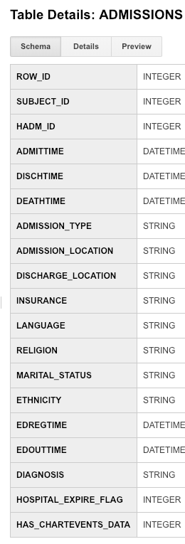
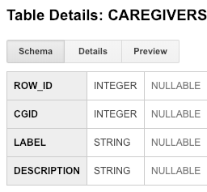
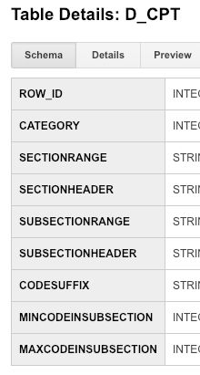
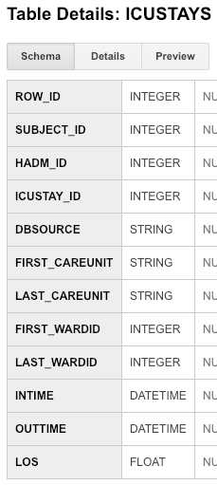
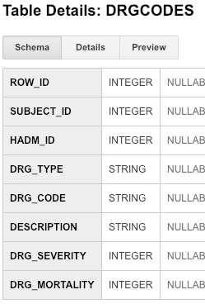
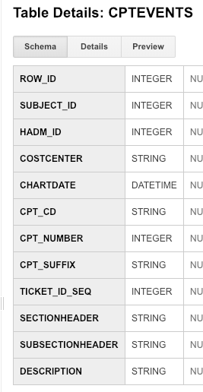
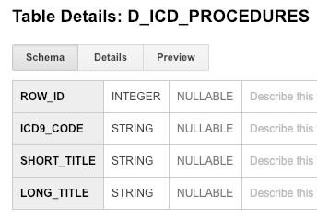
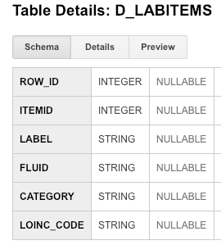
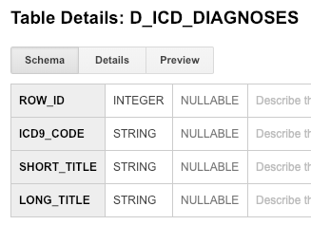
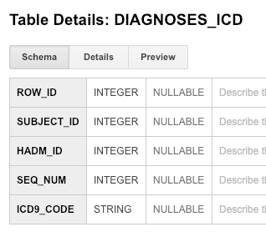
Use these screen captures (and next slide) to select one or more MIMIC tables that contain data for OMOP CONDITION_OCCURRENCE table
Notes:
Paste into one or more slides, the key table or tables from MIMIC that hold data that can be used to fill in the OMOP CONDITION_OCCURRENCE table.
Choose the MIMIC table screenshots from this slide to indicate which MIMIC table or tables would be used in the ETL process. Delete the MIMIC tables that you will not use.

Slide 8
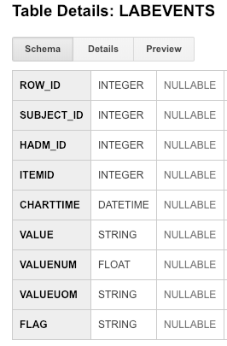
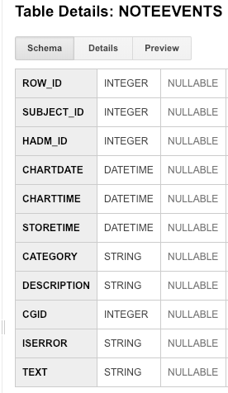
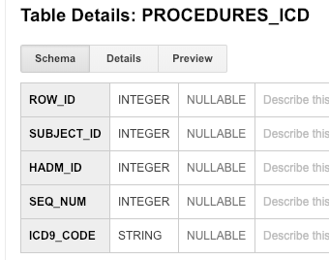
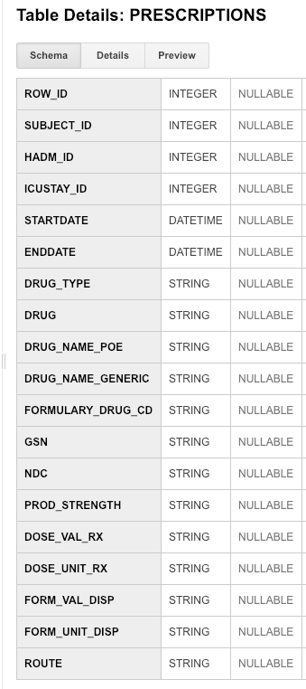
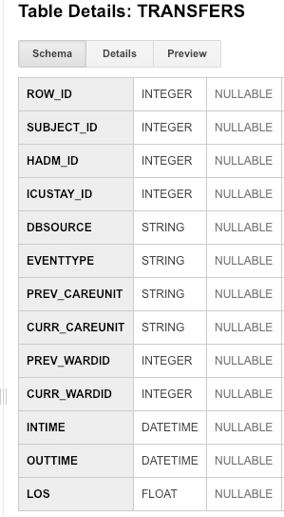
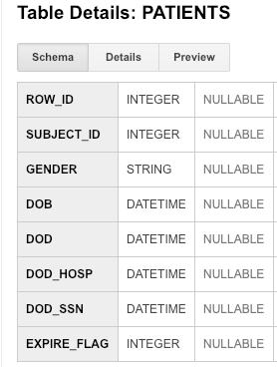
Use these screen captures (and previous slide) to select one or more MIMIC tables that contain data for OMOP CONDITION_OCCURRENCE table
Notes:
Paste into one or more slides, the key table or tables from MIMIC that hold data that can be used to fill in the OMOP CONDITION_OCCURRENCE table.
Choose the MIMIC table screenshots from this slide to indicate which MIMIC table or tables would be used in the ETL process. Delete the MIMIC tables that you will not use.

Slide 9
Step 1: Understand source/target data models
The MIMIC tables that we are going
to use and their descriptions are on the
next 2 slides.
Paste one or more MIMIC table(s) from the previous two slides that contain data for ETL into OMOP CONDITION_OCCURRENCE here!
Notes:
Paste into one or more slides, the key table or tables from MIMIC that hold data that can be used to fill in the OMOP CONDITION_OCCURRENCE table.
Choose the MIMIC table screenshots from this slide to indicate which MIMIC table or tables would be used in the ETL process. Delete the MIMIC tables that you will not use.

Slide 10
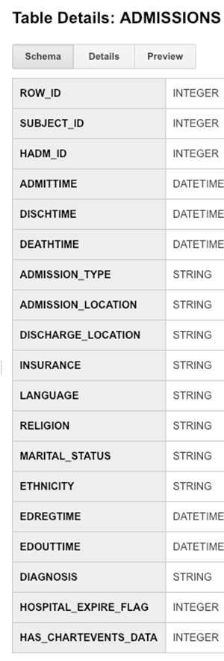
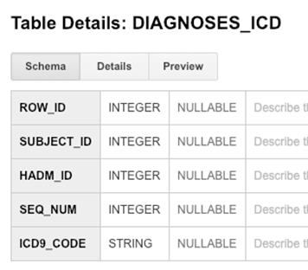
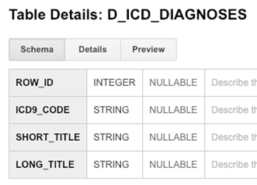
We choose the ADMISSIONS, DIAGNOSES_ICD, and D_ICD_DIAGNOSES MIMIC tables from the previous two slides
that contain data for the ETL mapping into the OMOP CONDITION_OCCURRENCE table. Note we do not really need
the D_ICD_DIAGNOSES table, but if we join this table to the DIAGNOSES_ICD table using the ICD9_code values
we can obtain a text description (SHORT_TITLE) for the ICD9_code.
1.) A few sample rows with a few of the columns are shown below for the ADMISSIONS table:
ADMISSIONS TABLE
Row row_id subject_id hadm_id admission_type diagnosis
1 12293 10043 168674 EMERGENCY RESPIRATORY DISTRESS
2 12345 10094 168074 EMERGENCY HYPOTENSION;TELEMETRY
3 12346 10094 122928 EMERGENCY SEPSIS;TELEMETRY
4 12317 10067 160442 EMERGENCY S/P MOTORCYCLE ACCIDENT
5 12349 10098 180685 EMERGENCY STATUS POST MOTOR VEHICLE ACCIDENT WITH INJURIES
6 12265 10013 165520 EMERGENCY SEPSIS
2.) From https://mimic.physionet.org/mimictables/admissions/ we obtain a description of this table:
Each row of this table contains a unique HADM_ID, which represents a single patient’s admission to the hospital.
It is possible for this table to have duplicate SUBJECT_ID, indicating that a single patient had multiple admissions to the hospital.
The DIAGNOSIS column provides a preliminary, free text diagnosis for the patient on hospital admission.
The diagnoses can be very informative (e.g. chronic kidney failure) or quite vague (e.g. weakness).
Final diagnoses for a patient’s hospital stay are coded on discharge and can be found in the DIAGNOSES_ICD table.
While this field can provide information about the status of a patient on hospital admission,
it is not recommended to use it to stratify patients.
From the above statements we conclude that we should ignore the diagnosis column in the ADMISSION table
and join the ADMISSION table to the DIAGNOSES_ICD table on the hadm_id values to obtain the diagnoses.

Slide 11
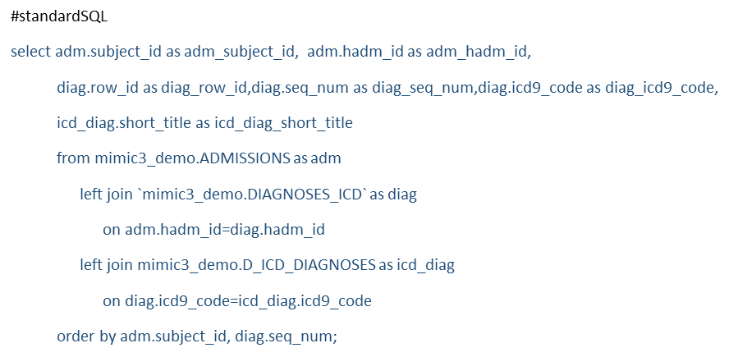
Row adm_subject_id adm_hadm_id diag_row_id diag_seq_num diag_icd9_code icd_diag_short_title
1 10006 142345 112344 1 99591 Sepsis
2 10006 142345 112345 2 99662 React-oth vasc dev/graft
3 10006 142345 112346 3 5672 null
4 10006 142345 112347 4 40391 Hyp kid NOS w cr kid V
5 10006 142345 112348 5 42731 Atrial fibrillation
6 10006 142345 112349 6 4280 CHF NOS
7 10006 142345 112350 7 4241 Aortic valve disorder
8 10006 142345 112351 8 4240 Mitral valve disorder
9 10006 142345 112352 9 2874 null
10 10006 142345 112353 10 03819 Staphylcocc septicem NEC
11 10006 142345 112354 11 7850 Tachycardia NOS
12 10006 142345 112355 12 E8791 Abn react-renal dialysis
13 1110006 142345 112356 13 V090 Inf mcrg rstn pncllins
14 10006 142345 112357 14 56211 Dvrtcli colon w/o hmrhg
15 10006 142345 112358 15 28529 Anemia-other chronic dis
16 10006 142345 112359 16 25000 DMII wo cmp nt st uncntr
17 10006 142345 112360 17 V5867 Long-term use of insulin
18 10006 142345 112361 18 E9342 Adv eff anticoagulants
19 10006 142345 112362 19 41401 Crnry athrscl natve vssl
20 10006 142345 112363 20 2749 Gout NOS
21 10006 142345 112364 21 3051 Tobacco use disorder
22 10011 105331 112394 1 570 Acute necrosis of liver
23 10011 105331 112395 2 07030 Hpt B acte wo cm wo dlta
24 10011 105331 112396 3 07054 Chrnc hpt C wo hpat coma
25 10011 105331 112397 4 30401 Opioid dependence-contin
26 10011 105331 112398 5 2875 Thrombocytopenia NOS
DISCUSSION
Note by using the above SQL query we have joined those 3 MIMIC tables and can map this table to the OMOP CONDITION_OCCURRENCE table.
We joined the ADMISSION table to the DIAGNOSES_ICD table based on the hadm_id. We joined the DIAGNOSES_ICD table to the D_ICD_DIAGNOSES table based on the icd9_code.
For a single subject_id and a single hadm_id, we can have multiple diagnoses which can be found from the seq_num column in the DIAGNOSES_ICD table (also shown here in the diag_seq_num column).

Slide 12
Step 2: Profile source table or tables
Using the White Rabbit profiling data from the 100 patient MIMIC database provided in the Assessment to comment on the distribution of the SUBJECT_ID field from one of the MIMIC tables selected in Step 1
MIMIC TableName
See rubric for the types of topics to include here
See the next slide for the discussion.
Notes:
Use the White Rabbit data profiling Excel spreadsheet that is linked to the assignment to describe key profiling findings from the table or tables you identified in ETL Step 1. See rubric for the types of topics to include here.

Slide 13
Using the White Rabbit profiling data
ADMISSIONS
The data for the ADMISSIONS table indicates that unique individuals will appear more than once (in multiple rows) in the table.
This implies that an individual will have multiple visits to the hospital.
I believe the data is ordered by Frequency descending.
DIAGNOSES_ICD
We see that a unique individual in the DIAGNOSES_ICD table can appear multiple times. This means that an individual can have multiple diagnoses
coming from 1 or more visits.
The Frequency of HADM_ID 153826 is 37. The HADM_ID refers to 1 individual for 1 visit. Since this HADM_ID occurs 37 times in the table
this implies that 1 individual for 1 visit can have multiple (in fact many) diagnoses. You can also see this from frequency of SEQ_NUM 8 which is 111.

Slide 14
Step 3: Create ETL mappings
MIMIC TableName
Field 1
Field 2
Field 3
Field 4
Field 5
Field 6
Field 7
Field 8
The explanation is on the next slide.
Notes:
For each MIMIC table or tables (one table per slide) from Step 1, paste the screenshot of the MIMIC table on left side. Show field mappings from the MIMIC table to the OMOP CONDITION_OCCURRENCE table using arrows. Only provide mappings to the OMOP person_id, visit_occurrence_id, and condition_source_value. One MIMIC table may provide a mapping to all three OMOP tables as shown here.
Provide an explanation for each mapping why the MIMIC field relates to the OMOP field you selected on the slide

Slide 15

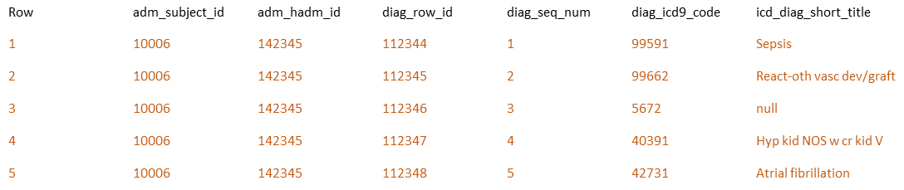
ETL mappings
By using our work from slide 11, we can see how we are going to map the MIMIC data
to the CONDITION_OCCURRENCE table in OMOP for the 3 fields.
The mapping is as follows:
The subject_id from the ADMISSIONS table in MIMIC is mapped to the person_id field in the CONDITION_OCCURRENCE table in OMOP.
The hadm_id from the ADMISSIONS table in MIMIC is mapped to the visit_occurrence_id field in the CONDITION_OCCURRENCE table in OMOP.
The icd9_code from the DIAGNOSES_ICD in MIMIC is mapped to the condition_source_value in the CONDITION_OCCURRENCE table in OMOP.
Basically each row in the table created above (that includes only the columns adm_subject_id, adm_hadm_id, and diag_icd9_code)
will map to a row in the CONDITION_OCCURRENCE table.
Notes:
Each row in the MIMIC ADMISSIONS table represents 1 person and 1 visit. A single person can appear in multiple rows because that person can have multiple unique visits.
Even though 1 row in the MIMIC ADMISSIONS table represents 1 person and 1 visit, that 1 visit can have multiple diagnoses.
We obtain this by joining the ADMISSIONS table to the DIAGNOSES_ICD table by the hadm_id.
This now gives us multiple rows with the same person and visit, but each row has a different diagnosis.

Slide 16
Step 4: Write transformation code
WITH person1 as (select distinct mp.subject_id as person_id,
mp.subject_id as person_source_value from mimic3_demo.PATIENTS mp),
person2 as (select distinct p1.person_id, p1.person_source_value
,mp.GENDER as gender_source_value
,CASE mp.GENDER
WHEN 'F' then 8532
WHEN 'M' then 8507
ELSE 0 END as gender_concept_id
from person1 p1 join mimic3_demo.PATIENTS mp on p1.person_id = mp.subject_id),
person3 as (select distinct p2.person_id, p2.person_source_value
,p2.gender_source_value, p2.gender_concept_id
,extract(year from mp.dob) as year_of_birth
,extract(month from mp.dob) as month_of_birth
,extract(day from mp.dob) as day_of_birth
,dob as birth_datetime
from person2 p2 join mimic3_demo.PATIENTS mp on p2.person_id = mp.subject_id),
person4 as (select distinct p3.person_id, p3.person_source_value
,p3.gender_source_value,p3.gender_concept_id
,p3.year_of_birth, p3.month_of_birth, p3.day_of_birth, p3.birth_datetime
,ma.ethnicity as race_source_value
,case ma.ethnicity
when 'WHITE' then 8527
when 'BLACK/AFRICAN AMERICAN' then 8516
when 'ASIAN' then 8515
when 'HISPANIC/LATINO-PUERTO RICAN' then 44814653
when 'HISPANIC OR LATINO' then 44814653
when 'UNKNOWN/NOT SPECIFIED' then 44814653
when 'OTHER' then 44814653
when 'AMERICAN INDIAN/ALASKA NATIVE FEDERALLY RECOGNIZED TRIBE' then 8657
when 'UNABLE TO OBTAIN' then 44814650
else 0 end as race_concept_id
from person3 p3 join mimic3_demo.ADMISSIONS ma on p3.person_id = ma.subject_id),
person as (select distinct p4.person_id, p4.person_source_value
,p4.gender_source_value,p4.gender_concept_id
,p4.year_of_birth, p4.month_of_birth, p4.day_of_birth, p4.birth_datetime
,p4.race_source_value, p4.race_concept_id
,ethnicity as ethnicity_source_value
,case ma.ethnicity
when 'WHITE' then 38003564
when 'BLACK/AFRICAN AMERICAN' then 38003564
when 'ASIAN' then 38003564
when 'HISPANIC/LATINO-PUERTO RICAN' then 38003563
when 'HISPANIC OR LATINO' then 38003563
when 'UNKNOWN/NOT SPECIFIED' then 44814653
when 'OTHER' then 38003564
when 'AMERICAN INDIAN/ALASKA NATIVE FEDERALLY RECOGNIZED TRIBE' then 38003564
when 'UNABLE TO OBTAIN' then 44814650
else 0 end as ethnicity_concept_id
from person4 p4 join mimic3_demo.ADMISSIONS ma on p4.person_id = ma.subject_id)
select * from person
Paste the SQL statements that transform data from one or more MIMIC tables into the three OMOP CONDITION_OCCURRENCE fields (patient-id, visit_occurrence_id, condition_source_value) into the Coursera Submission Site
Transformation code shown here is from the Course 2 videos showing transformation of MIMIC PATIENTS to OMOP PERSON
Notes:
Paste the SQL statements that transform data in one or more MIMIC tables to the correct column or columns in OMOP CONDITION_OCCURRENCE into the Coursera Submission Site.

Slide 17
Transformation code
#standardSQL
WITH CONDITION_OCCURRENCE1 as (select adm.subject_id as person_id, adm.hadm_id as visit_occurrence_id
from mimic3_demo.ADMISSIONS adm),
CONDITION_OCCURRENCE as (select oc1.person_id, oc1.visit_occurrence_id, diag.icd9_code as condition_source_value
from CONDITION_OCCURRENCE1 as oc1
join mimic3_demo.DIAGNOSES_ICD as diag
on oc1.visit_occurrence_id = diag.hadm_id)
select * from CONDITION_OCCURRENCE as oc
order by oc.person_id, oc.visit_occurrence_id;
Example output:
Row person_id visit_occurrence_id condition_source_value
1 10006 142345 40391
2 10006 142345 7850
3 10006 142345 25000
4 10006 142345 56211
5 10006 142345 4240
6 10006 142345 E8791
7 10006 142345 5672
8 10006 142345 4241
9 10006 142345 03819
10 10006 142345 V5867

Slide 18
Step 5: Execute transformation code
Execute the ETL code from Step 4 but do not submit the output table.
Use the output table for Step 6.
There is no submission for this Step.
Notes:
Execute the ETL code from Step 4 but do not submit output table. Use output table for Step 6.
There is no submission for this Step.

Slide 19
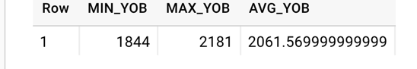
Step 6: Perform data quality assessment
Define, implement, execute one or more data quality measures.
Submit final DQ measure and an explanation why you created your measure(s).
Example output table from the Course 2 videos showing transformation of MIMIC PATIENTS to OMOP PERSON
OK to paste link to a GoogleDoc instead.
Notes:
Paste the output from your data quality SQL executed on the OMOP CONDITION_OCCURRENCE table generated in Step 5 into this slide.
OK to paste link to a GoogleDoc instead.

Slide 20
Data Quality Assessment
The number of rows in the MIMIC ADMISSIONS table (where each row represents a unique visit which is represented by a unique hadm_id) should equal the
number of unique values for visit_occurrence_id in our new OMOP CONDITION_OCCURRENCE table (We are assuming there was no other data present in the table before our work.).
select count(distinct oc.visit_occurrence_id) as number_unique_visits from CONDITION_OCCURRENCE as oc;
Row number_unique_visits
1 129
select count(*) as row_admissions from mimic3_demo.ADMISSIONS adm;
Row row_admissions
1 129
The number of distinct subject_ids in the MIMIC ADMISSIONS table should equal the number of distinct person_ids in our new OMOP CONDITION_OCCURRENCE table
(We are assuming there was no other data present in the table before our work.).
select count(distinct oc.person_id) as number_unique_persons from CONDITION_OCCURRENCE as oc;
Row number_unique_persons
1 100
select count(distinct adm.subject_id) as num_unique_subjects from mimic3_demo.ADMISSIONS adm;
Row num_unique_subjects
1 100
The number of distinct condition_source_values in our new OMOP CONDITION_OCCURRENCE table should <= the number of distinct icd9_code values in the
MIMIC DIAGNOSES_ICD table (We are assuming there was no other data present in the table before our work.).
select count(distinct oc.condition_source_value) as number_unique_conditions from CONDITION_OCCURRENCE as oc;
Row number_unique_conditions
1 581
select count(distinct diag.icd9_code) as num_unique_icd9codes from mimic3_demo.DIAGNOSES_ICD diag;
Row num_unique_icd9codes
1 581

Slide 21
Step 7: Package documentation
Congratulations! The materials in the previous slides constitute a complete ETL package.
There is no submission for this Step.

