Slide 1

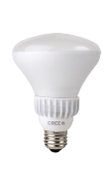
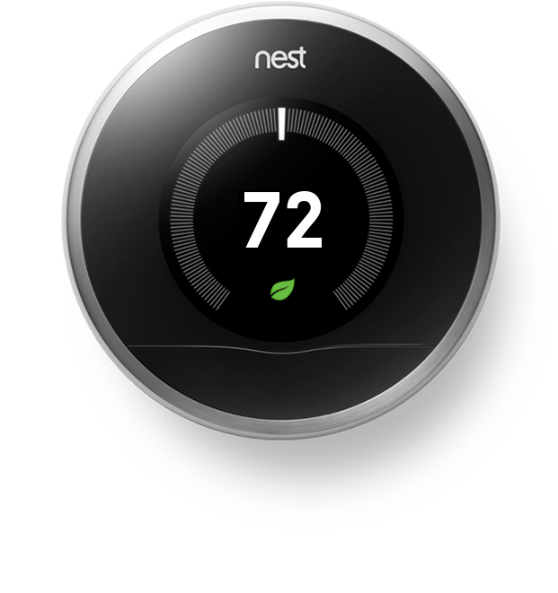

The home re-imagined.
Design
Connected Home
SMART
Warranty
We design our homes to be more efficient, more intuitive, more functional than anything we had seen before. To do that we had to throw out traditional limitations and build something truly beautiful, something important.
Design
Our design is immediately recognizable. When re-imagining what a home should look like we set no boundaries. We literally flipped the roof upside down.
8’
You notice the detail the moment you interact with your home. Solid core 8’ doors are not just for exteriors. We have used solid core doors throughout the house and its stunning.
Stay Energized.
Stay Connected.
Welcome to the future. Each Fields Residential home includes Smart Energy. Never change a light bulb again. Throw in our Smart Entry system and throw away your keys. Control it all from anywhere in the world.
Smart Energy
last
Each home includes LED bulbs with an incredible 22 year life span. These amazing LED arrays use 83 percent less energy and burn at a cool 3 btu/hr compared to a hot 85 btu/hr of traditional bulbs.
25x
longer
uses
83
%
We believe sustainability is vital. That’s why we also include a Nest thermostat to help reduce our energy impact and save money. Nest also puts you in control from anywhere in the world.
less energy
20
%
energy savings
Smart Entry
Throw away your keys and clicker. The future is here and you can access your home from your smartphone. One tap to open the garage or front door. Can’t remember if you closed the garage door? Check your app and see, if you did not, close it from anywhere. Need to let your friend from out of town into the house and you are stuck in traffic? Just tap the button and voila!
connected
entry
garage
lights
1 2 3
4 5 6
7 8 9
Construction
2 x 6 Exterior Walls
57
Stronger, stiffer, quieter, cooler, warmer, energy-saving. Thicker walls leave more room for insulation, reducing energy usage, saving money, and helping the planet.
3.5”
insulation
% more
insulation
5.5”
16”
16”
Stronger
Stiffer
Quieter
Cooler
30 Year Composition Shingle Roof
Warmer
You notice the detail the moment you interact with your home. Solid core 8’ doors are not just for exteriors. We have used solid core doors throughout the house and its stunning.
30
year
Masonry and Steel Façade
100
%
All Fields Residential homes are finished with a 100% masonry and steel façade. High quality materials lead to iconic residences.
Masonry
& Steel
95
%

Slide 2
Design
Connected Home
SMART
Warranty
Fields Residential Warranty
Fields Residential stands by each home it builds. Fields Residential supplies full support for their homes and works hard to resolve any issues that may arise. To further guarantee quality and peace of mind each Fields Residential home comes with a StrucSure 1-2-10 home warranty.
1
yr
Workmanship and Materials: Covers every part of the home from appliances to the structure.
2
yr
Builder Surety: Covers all building related issues such as wiring, piping, ductwork, electrical, HVAC, and mechanical systems.
10
yr
Structural: Covers items such as the foundation, floor framing, roof framing, beams, headers and other structural elements.
Brochure Link:
https://www.strucsure.com/Builders/1_2_10_warranty
95
%

