Slide 1
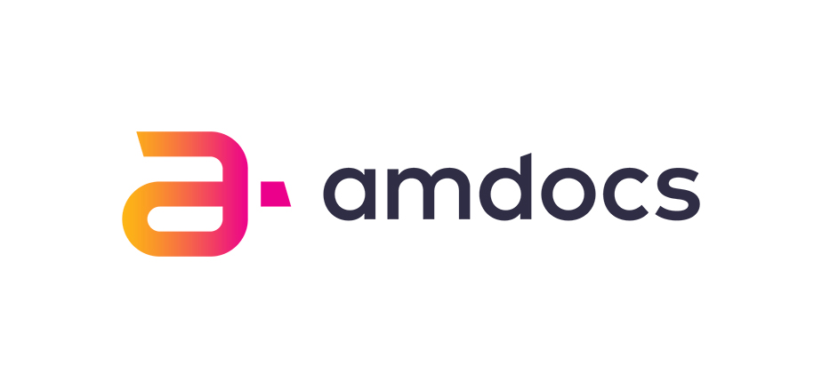
Kubernetes (K8s)
Infrastructure Overview

Slide 2
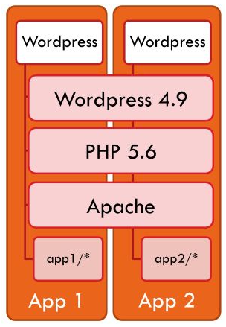
Different environments, runtime and versions
More and more expensive is a change
A lot of rework when we have an update
Update are great! But it can be so terrifying (evolving is important!)
Testing
Release
Maintenance

Slide 3
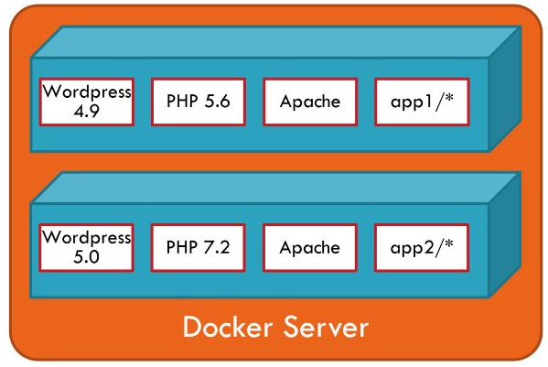
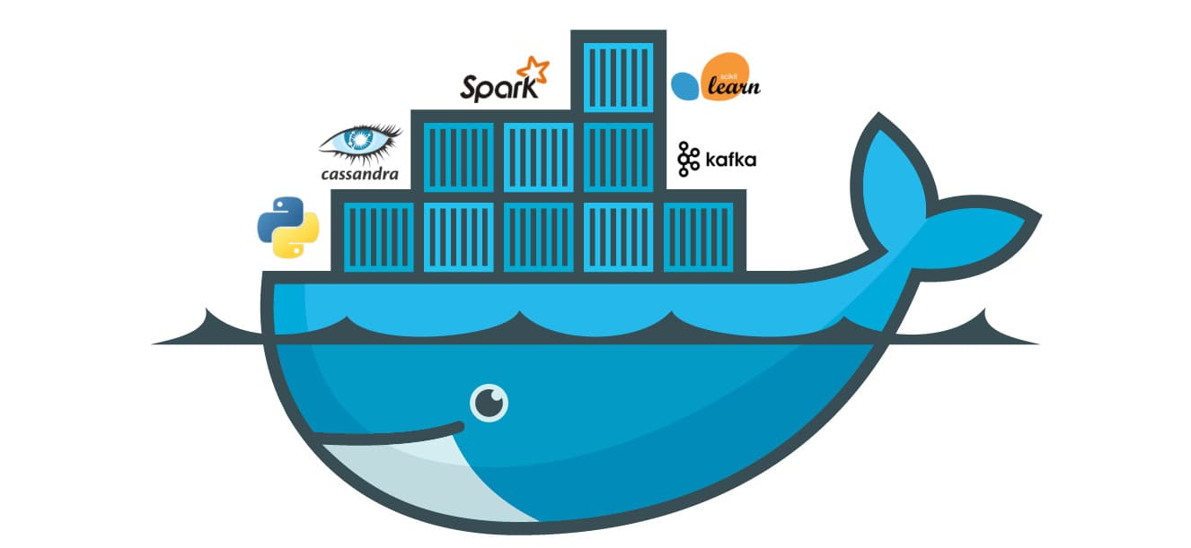
A solution for documenting and making software reproductible
Who has never spent days trying to configure software that was supposed to be available for use?
Instead of using conventional virtual machines, we can use Docker
Dockerizing applications
https://github.com/californi/playground_kubernetes/tree/master/DockerizingOurApplication

Slide 4
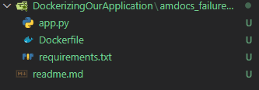
Dockerizing an Application
https://github.com/californi/playground_kubernetes/tree/master/DockerizingOurApplication
Dockerfile
Images and TAGS
Registry and DockerHub
OSs, Runtimes, Dependencies
# Building and deploying in docker hub
docker build -t amdocs_failuremanager .
docker tag amdocs_failuremanager californibrs/amdocs_failuremanager
docker push californibrs/amdocs_failuremanager
docker run -d --name amdocs_failuremanager -p 8000:5002 californibrs/amdocs_failuremanager
# testing
get http://localhost:8000/docs

Slide 5
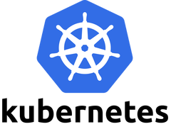
Demands and Advances in Cloud Computing
K8s as Infrastructure, our containers can have\be:
High availability
High scalability
High elasticity
Levels of fidelity
Fault tolerance
A magic word
Stateless objects

Slide 6
Developing and Deploying applications (to learn)
Docker Desktop
https://www.docker.com/products/docker-desktop
Kubernetes
kubectl - CLI (all OSs)
PaaS/IaaS: GKE (Google), AKS (Azure)
Local: Minikube and Kind (for all OSs)
A tool for editing your codes
e.g. VSCode

Slide 7
Creating a cluster K8S (using Minikube)
minikube start --cpus=6 --vm-driver hyperv --hyperv-virtual-switch "Primary Virtual Switch" --kubernetes-version=v1.16.10
minikube addons enable ingress
kubectl get all --all-namespaces

Slide 8
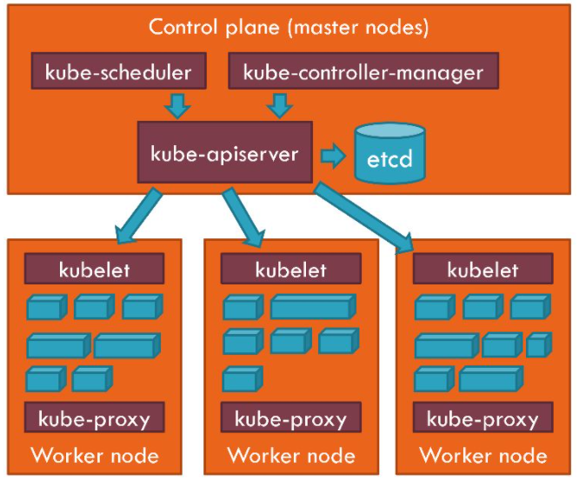
Some Kubernetes objects
Pods (CPU/Memory/IP) and containers
kube-scheduler: create pods
kube-controller-manager: compare states
etcd (knowledge - desired state)
Nodes | Machines
Master (manage workers)
Workers (run pods)
Simplifying: Nodes supply CPU, Memory and IPs for the PODs

Slide 9
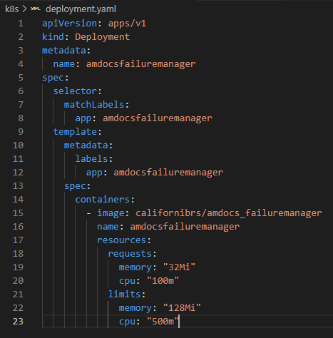
Some Kubernetes objects
Imperative and declarative definition of objects
PODs are instances of the Deployment objects
Characteristics of a Deployment
e.g. containers, limits and requests
https://github.com/californi/playground_kubernetes/blob/master/k8s/amdocsFailureManager/deployment.yaml
describe command (e.g. pods)
kubectl port-forward

Slide 10
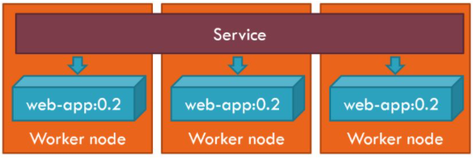
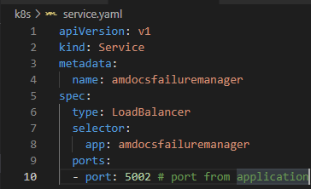
Some Kubernetes objects
PODs are ephemeral. So, what happen when they die?
Or and if multiple PODs need to communicate between themselves?
You’d need a “port-forward” for each pod that has been created.
The Service object
Importance of Labels
https://github.com/californi/playground_kubernetes/blob/master/k8s/amdocsFailureManager/service.yaml

Slide 11
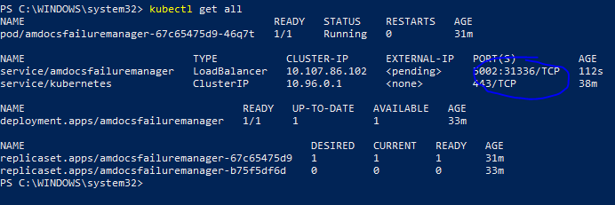
Some Kubernetes objects
Cluster IP: internal
LoadBalancer: external
kubectl get all
External address in Minikube is its own IP
minikube ip
External GET http://<minikube ip>:31336
e.g. http://192.168.0.49:31336/docs
DNS: Internal GET (between pods) http://amdocsfailuremanager:5002

Slide 12
Some Kubernetes objects
The Service object
There are other types of services, once that we can have different configuration in a production environment (e.g. different clusters and nodes, different places geographically, and so on).

Slide 13
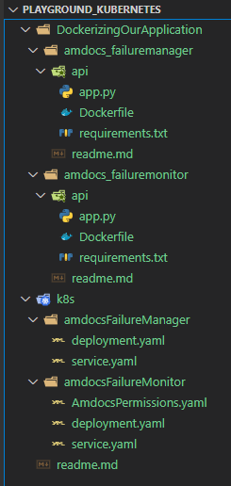
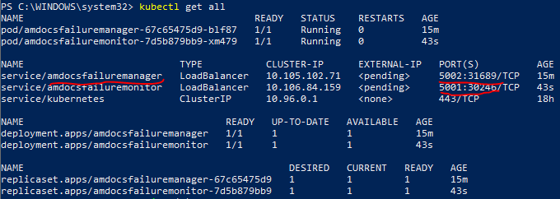
Communication POD to POD
Two microservices with communication between themselves
from amdocsfailuremonitor to amdocsfailuremanager
target DNS: http://amdocsfailuremanager:5002/<paths>
Permissions: a hot topic for later

Slide 14
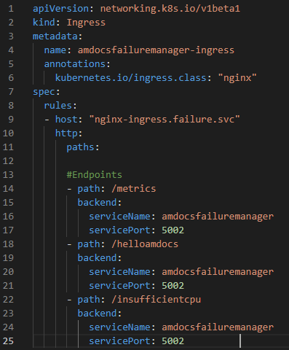
Ingress: internal routes for services and paths
https://github.com/californi/playground_kubernetes/blob/master/k8s/amdocsFailureManager/ingress.yaml
Centralize and define routes for hosts
For external access for the hosts, we should verify how the clusters are availables
Metrics: another hot topic for later

Slide 15
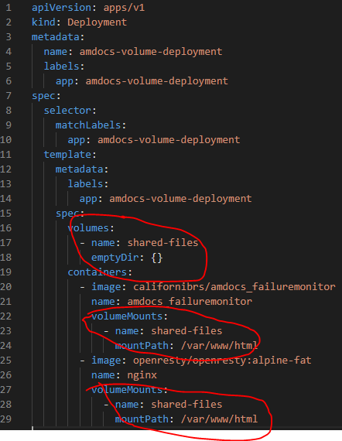
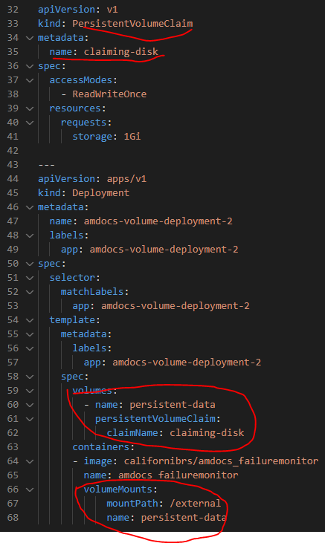
Volumes
To keep stateless objects and to persist data between containers and PODs
Short-lived storage
PersistentVolumeClaim
https://github.com/californi/playground_kubernetes/blob/master/k8s/ConceptsExamples/volumeDeployment.yaml

Slide 16
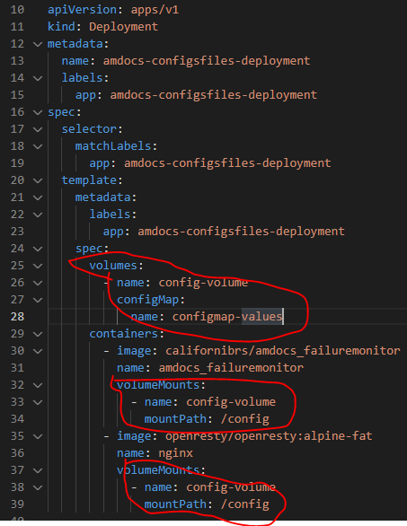
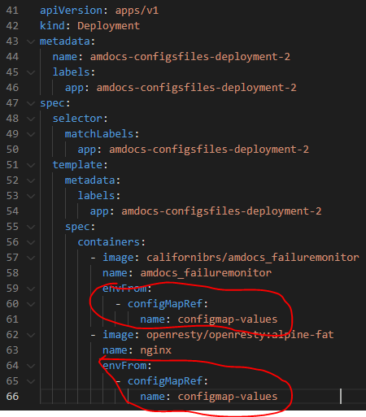
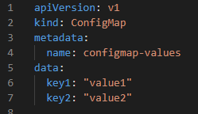
Configurations (runtime parameters)
ConfigMaps (files and environment variables)
https://github.com/californi/playground_kubernetes/blob/master/k8s/ConceptsExamples/configurations.yaml
Secret: alternative to sensitive data

Slide 17
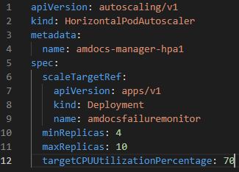
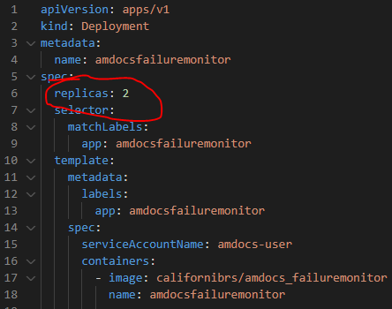
Updating and Scaling
Static replicas and HPA (e.g. overloaded LoadBalancer)
https://github.com/californi/playground_kubernetes/blob/master/k8s/ConceptsExamples/hpa.yaml

Slide 18
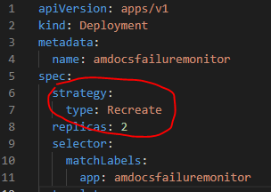
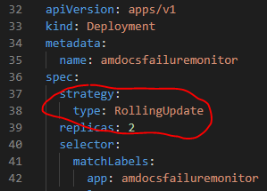
Update strategies
Each deployment is related to a ReplicaSet (to manage updating in versions)
When we change a version in the deployment
Recreate strategy: waiting all POD being killed to start the new ones
Rolling Update strategy (default): old PODs are killed and new ones are created gradually.
https://github.com/californi/playground_kubernetes/blob/master/k8s/ConceptsExamples/updateStrategies.yaml
There are other update strategies that could be used according to the organization goals.

Slide 19
Kubernetes API (libraries)
Customising the Kubernetes management
https://kubernetes.io/docs/reference/using-api/client-libraries/
Example in Python: https://github.com/californi/playground_kubernetes/tree/master/k8s_ApiClient
Kubow: https://github.com/ppgia-unifor/kubow

Slide 20
References
Some concept figures: Learn Kubernetes by Arnaud Weil
Kubow: An Architecture-Based Self-Adaptation Service for Cloud Native Applications by Carlos Mendes

