Slide 1
<Company Name>
User Journey Template for Integrating with UAE PASS Authentication
version 1.1

Slide 2
Instructions
This template document will guide you through creating your new user journey with UAE PASS.
Please use this template to show how you are integrating UAE PASS within your digital channel.
Please add English and Arabic version of each scenario
Do submit your user journey in PDF format. Submissions that are not in this format will not be processed.

Slide 3
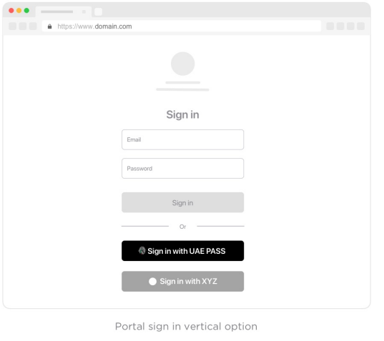
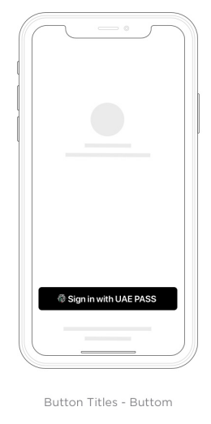
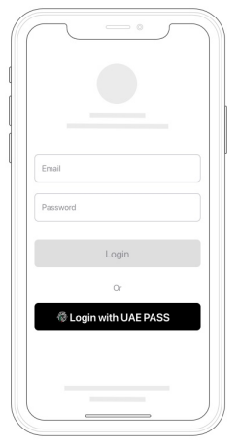
Sign-in with UAE PASS
Please add your prototype into this placeholder

Slide 4
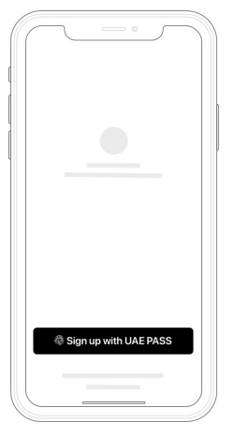
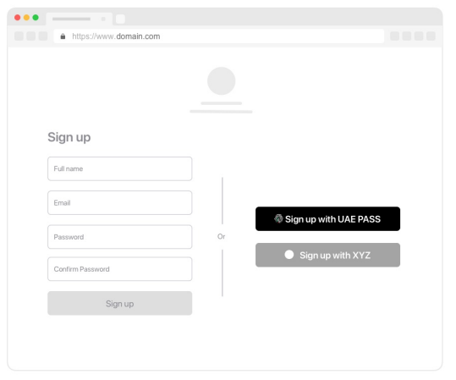
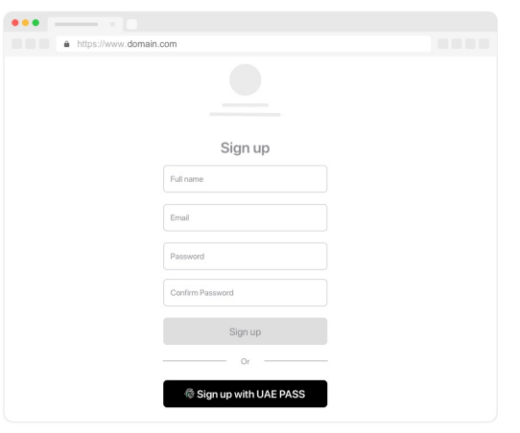
Sign up with UAE PASS (Authentication) If applicable
Please add your prototype into this placeholder

Slide 5
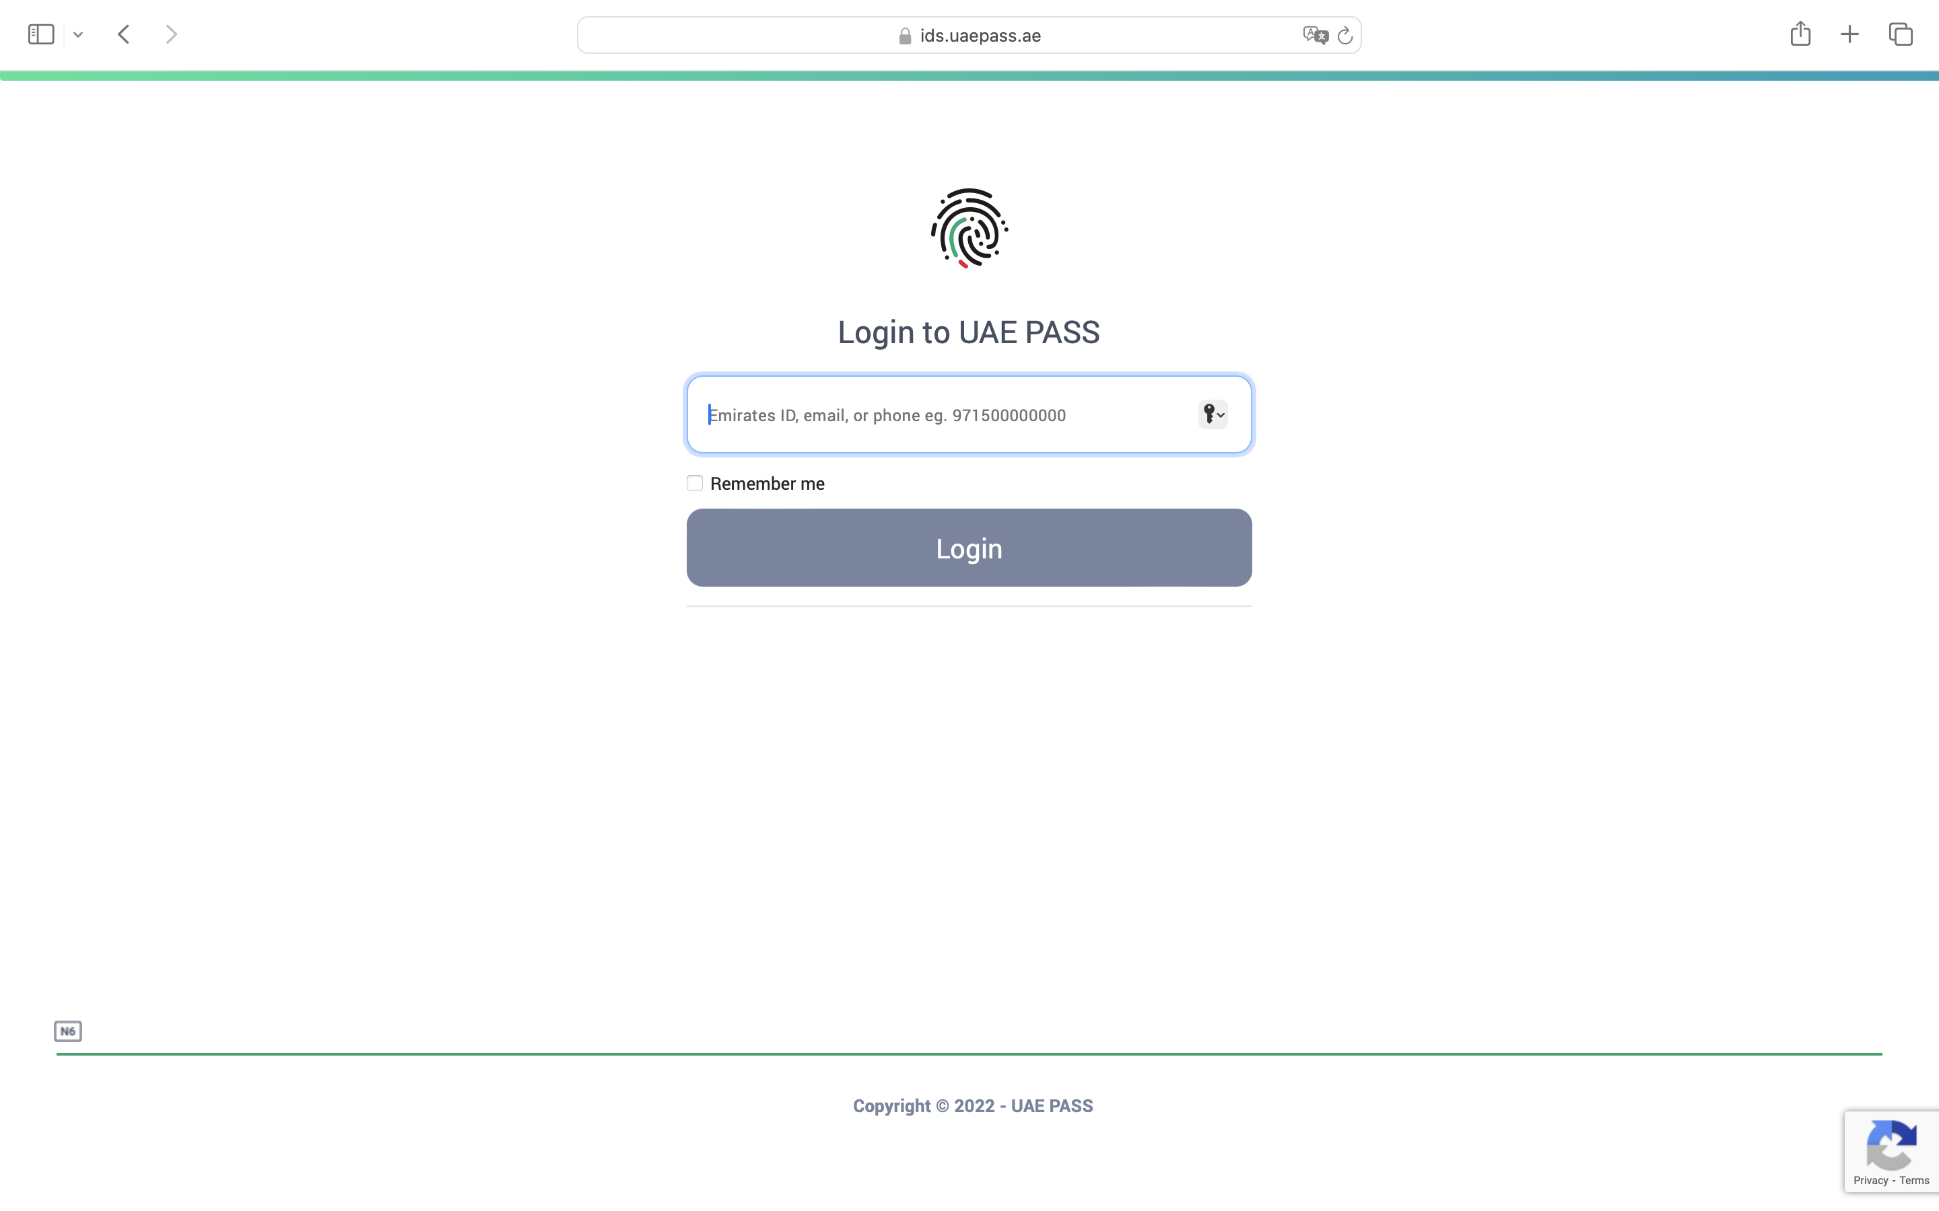
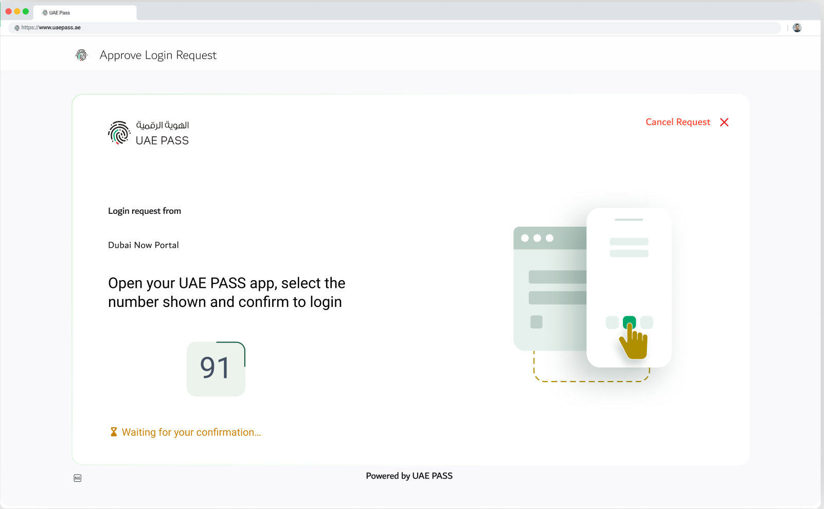
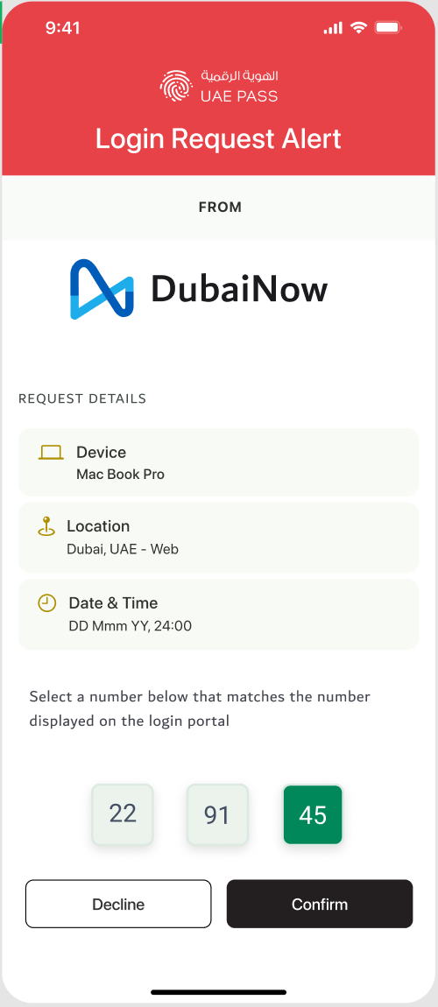
Redirection to UAE PASS Login page (WEB)

Slide 6
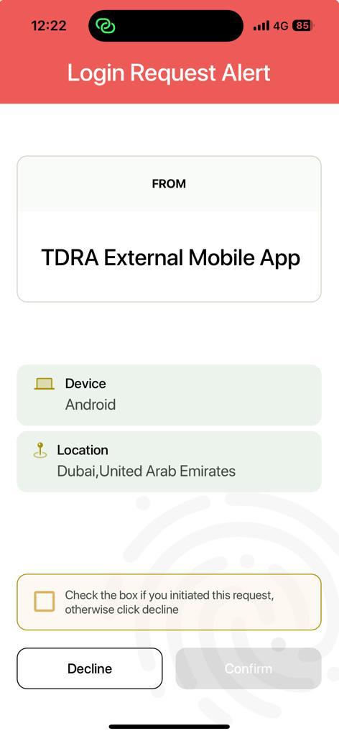
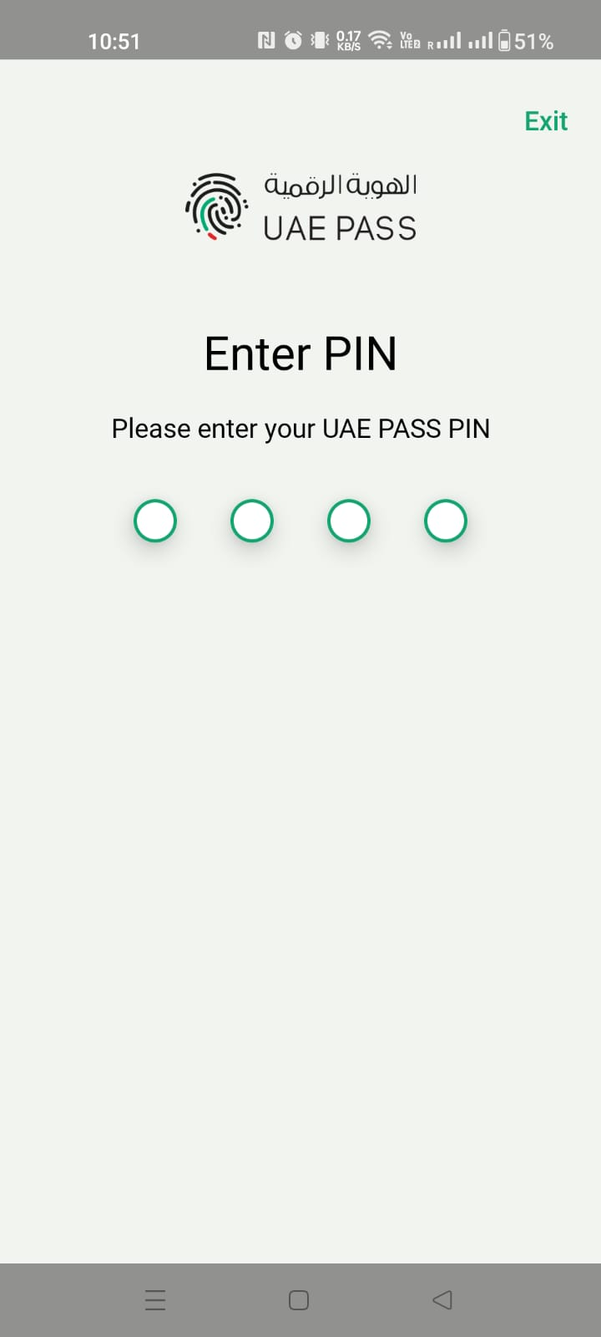
OR Redirection to UAE PASS Login page (App)

Slide 7
SOP1 scenario (If applicable)
Please add your prototype into this placeholder

Slide 8
SOP2 scenario (If applicable)
Please add your prototype into this placeholder

Slide 9
SOP3 scenario
Please add your prototype into this placeholder

Slide 10
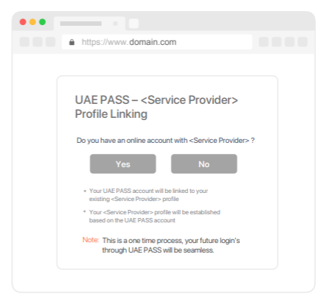
Manual linking page (if applicable)
Please add your prototype into this placeholder

Slide 11
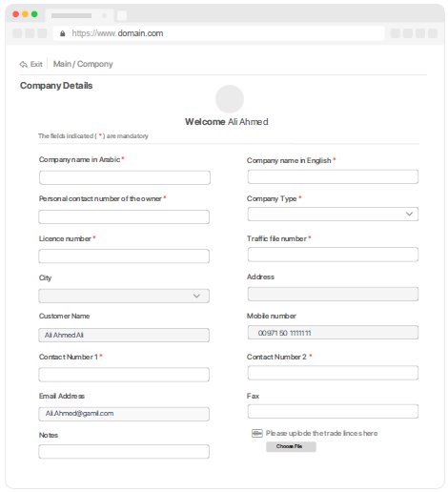
Manual linking (NO) scenario (if applicable)
Please add your prototype into this placeholder

Slide 12
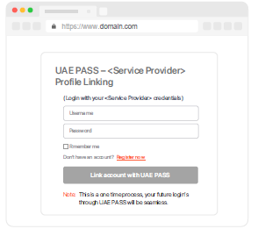
Manual linking (YES) scenario (if applicable)
Please add your prototype into this placeholder

Slide 13
Only registration/Sign up Scenario (If applicable)
Please add your prototype into this placeholder

Slide 14
Error Handling Only existing users error message
This service is only for registered users, please contact <SP Name> in order to access the services
Please add your prototype into this placeholder
هذه الخدمة مخصصة فقط للمستخدمين المسجلين، يرجى التواصل مع <اسم الجهة> لتتمكن من الوصول إلى الخدمات

Slide 15
Error Handling Unverified user restriction
You are not eligible to access this service. Your account is either not upgraded or you have a visitor account. Please contact <SP Name> to access the services.
Please add your prototype into this placeholder
أنت غير مؤهل للوصول إلى هذه الخدمة. إما أن حسابك لم تتم ترقيته أو لديك حساب زائر. يرجى الاتصال بـ <اسم الجهة> لتتمكن من الوصول إلى الخدمة.

Slide 16
Error Handling Something went wrong during the login
Something went wrong during the login, please try again later!
Please add your prototype into this placeholder
حدث خطأ ما أثناء تسجيل الدخول، يرجى المحاولة مرة أخرى لاحقًا!

Slide 17
Error Handling User cancel scenario
User cancelled the login
قام المستخدم بإلغاء تسجيل الدخول
Please add your prototype into this placeholder

Slide 18
Logout scenario
Please add your prototype into this placeholder

Slide 19
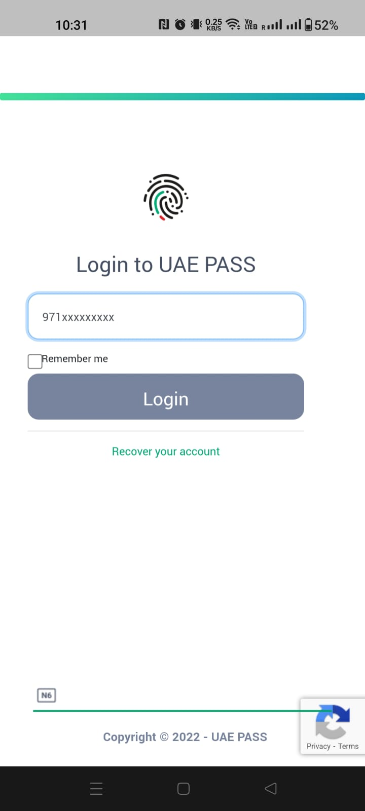
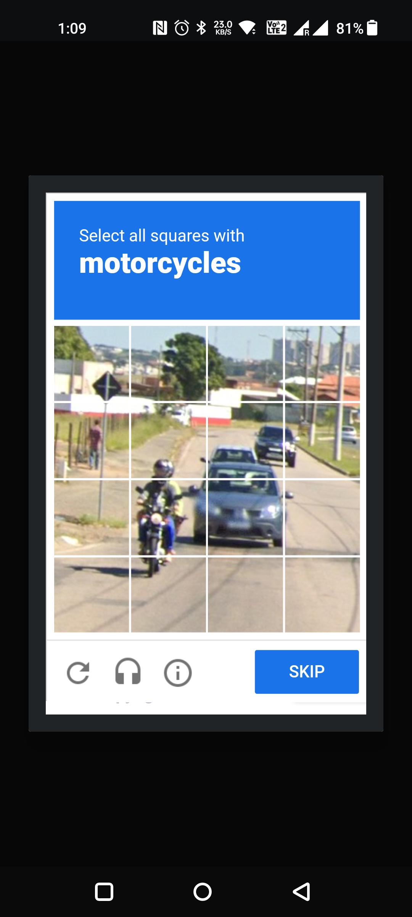
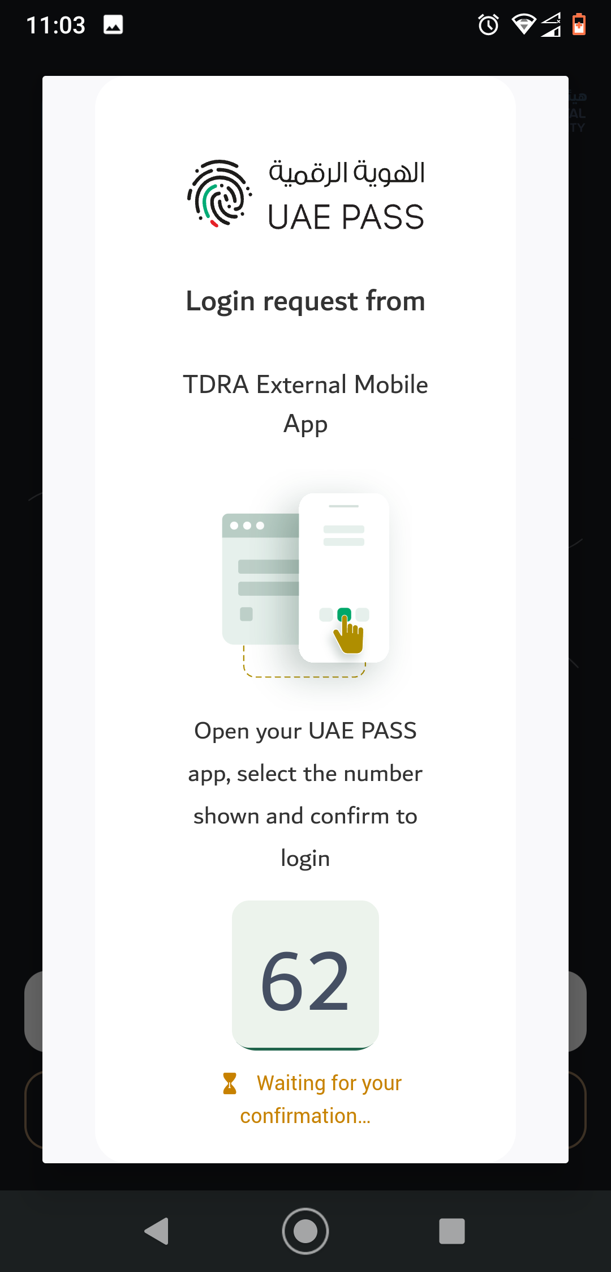
APP to WEB scenario (if mobile integration)
Please add your prototype into this placeholder

