Slide 1
MySilah.ae
User Journey Template for Integrating with UAE PASS Authentication
version 1.1

Slide 2
Instructions
This template document will guide you through creating your new user journey with UAE PASS.
Please use this template to show how you are integrating UAE PASS within your digital channel.
Please add English and Arabic version of each scenario
Do submit your user journey in PDF format. Submissions that are not in this format will not be processed.

Slide 3
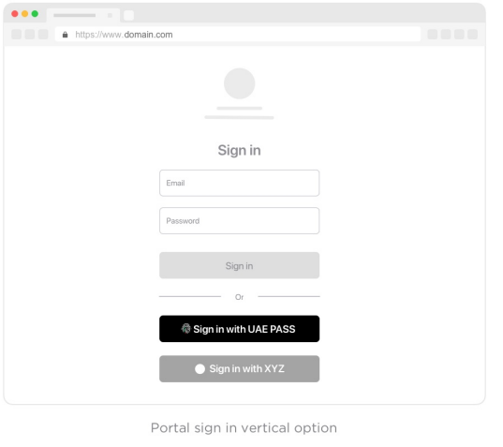
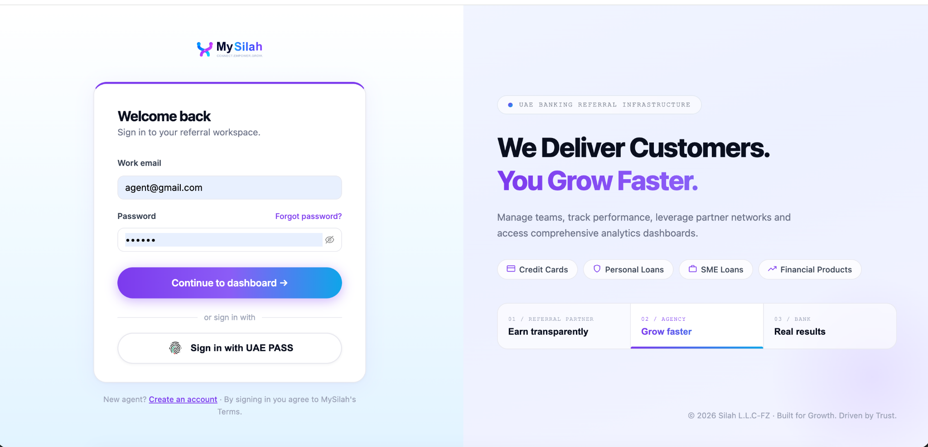
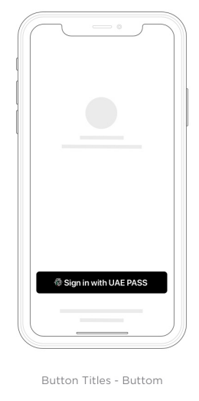
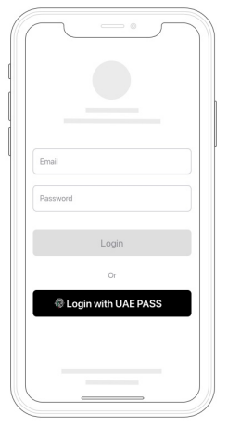
Sign-in with UAE PASS
EN: User visits app.mysilah.ae/login. Clicks "Sign in with UAE PASS" button to initiate UAE PASS OIDC authentication flow.

Slide 4
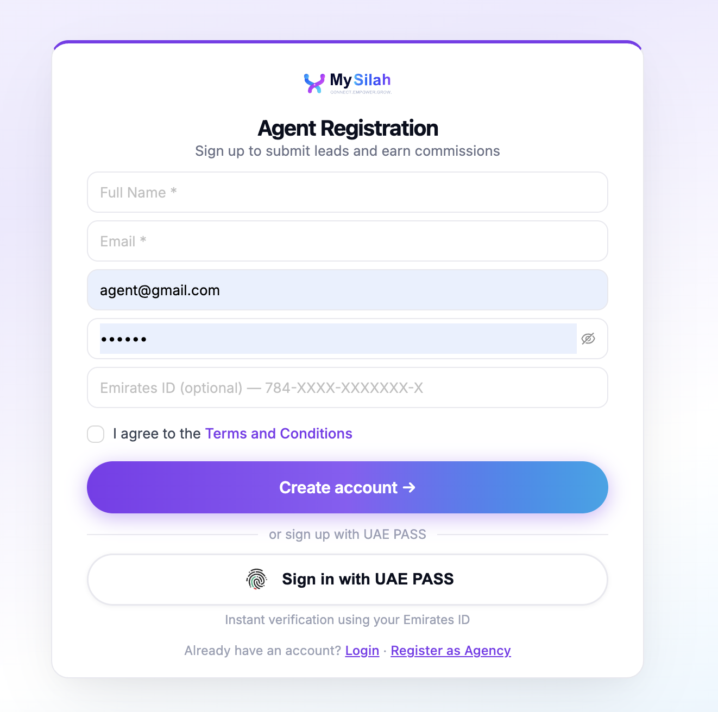
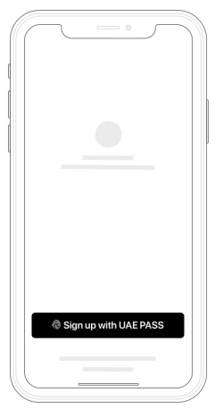
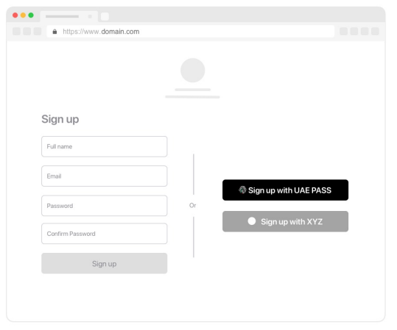
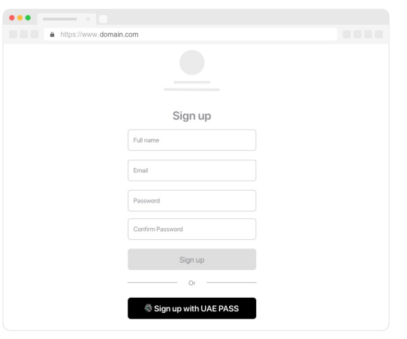
Sign up with UAE PASS (Authentication) If applicable
EN: New user visits app.mysilah.ae/register. Clicks "Sign in with UAE PASS" for instant verification via Emirates ID. MySilah auto-creates the Agent account upon successful verification.

Slide 5
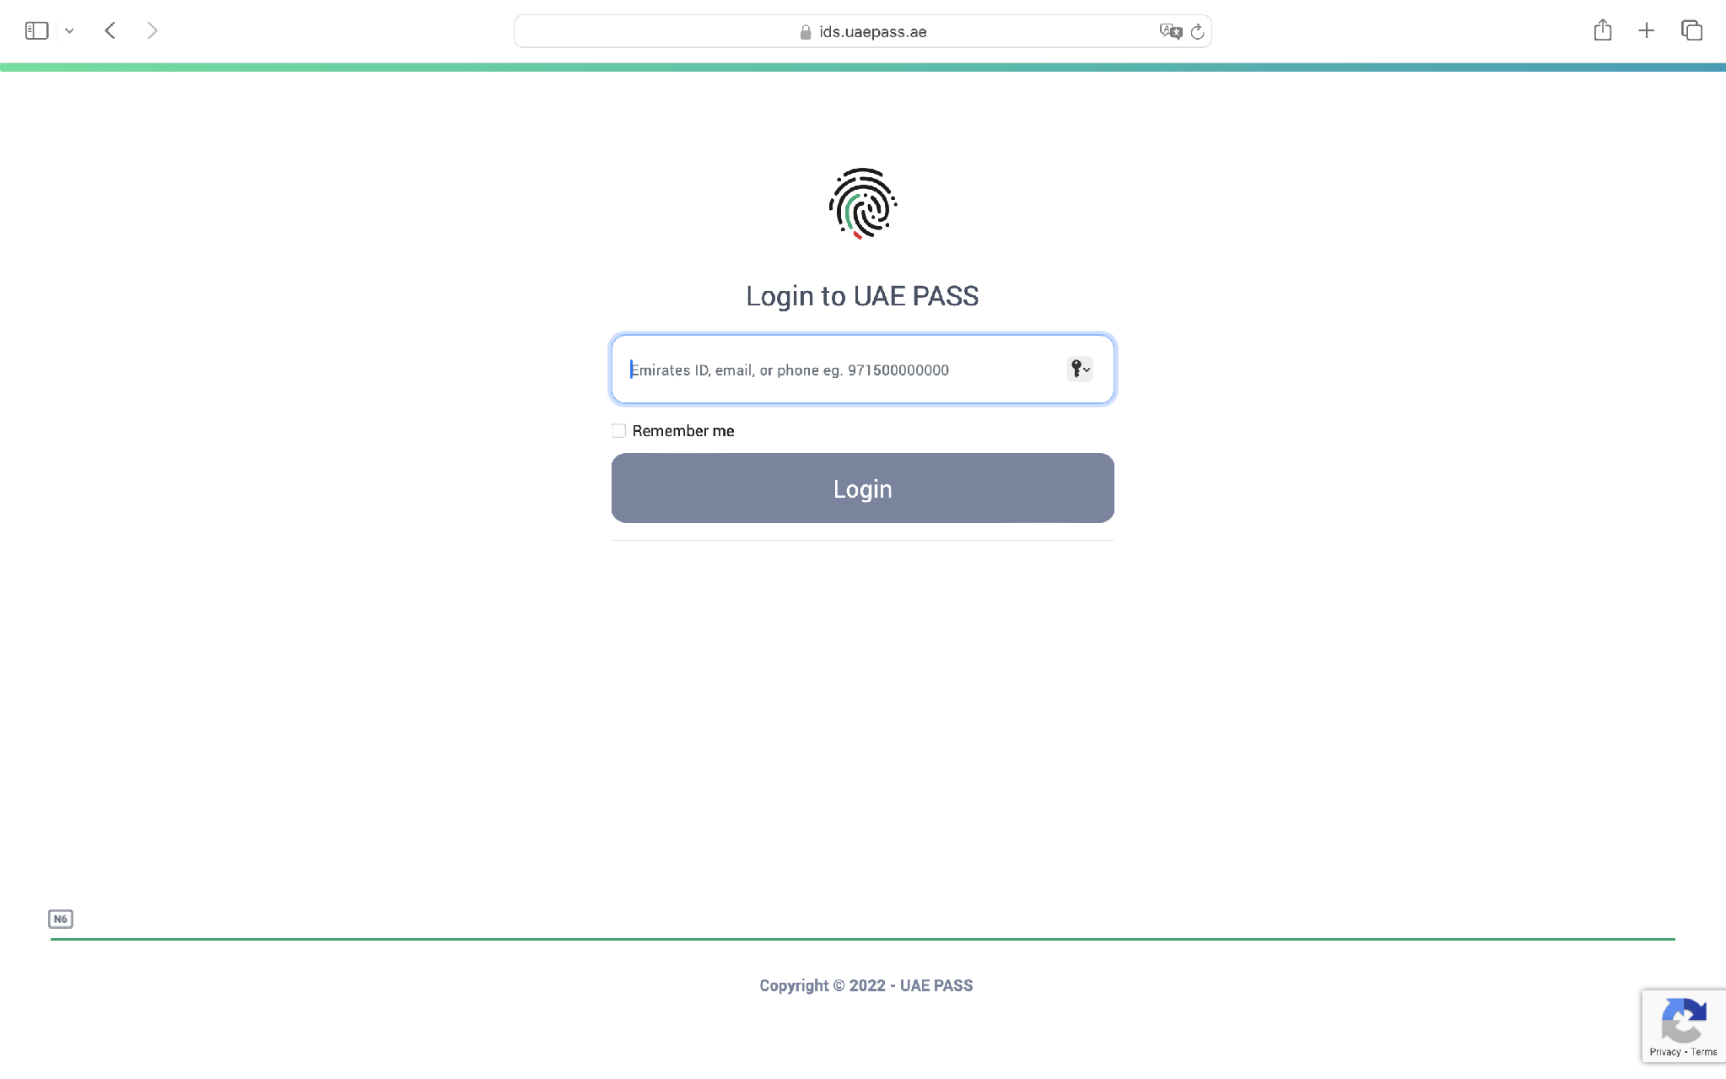
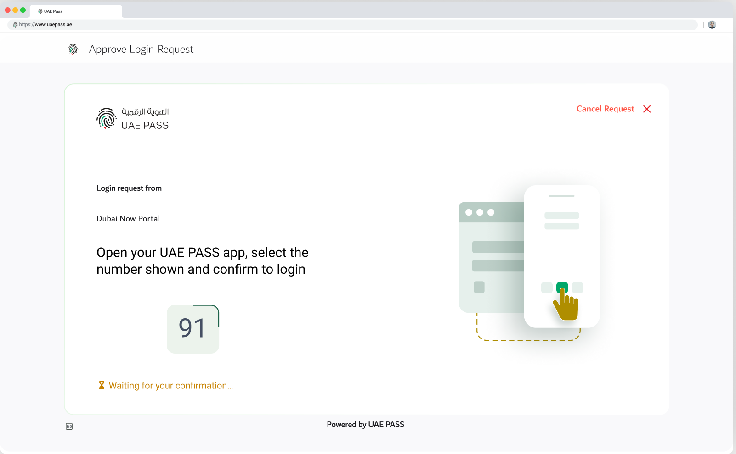
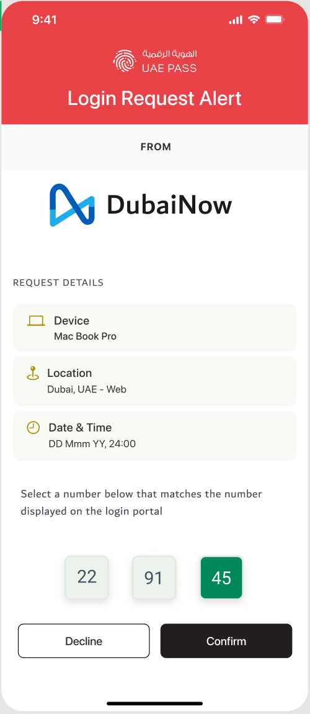
Redirection to UAE PASS Login page (WEB)
Step 1: Enter credentials (mobile / Emirates ID / email) | Step 2: Browser shows number code — wait for app | Step 3: Select matching number in UAE PASS app + confirm PIN/Face ID
EN: User enters UAE PASS credentials on the web portal. Browser displays a polling page with a number code. User receives a push notification on UAE PASS mobile app, selects the matching number, and confirms with PIN or Face ID.

Slide 6
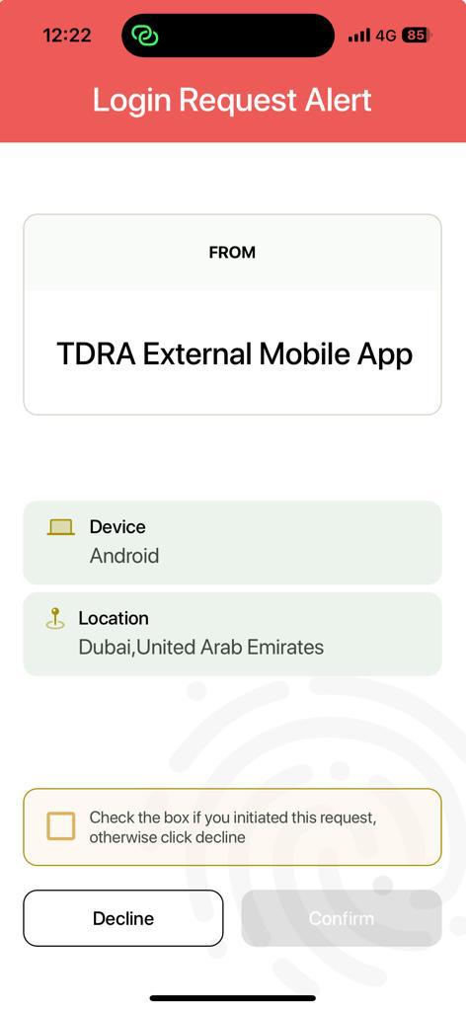
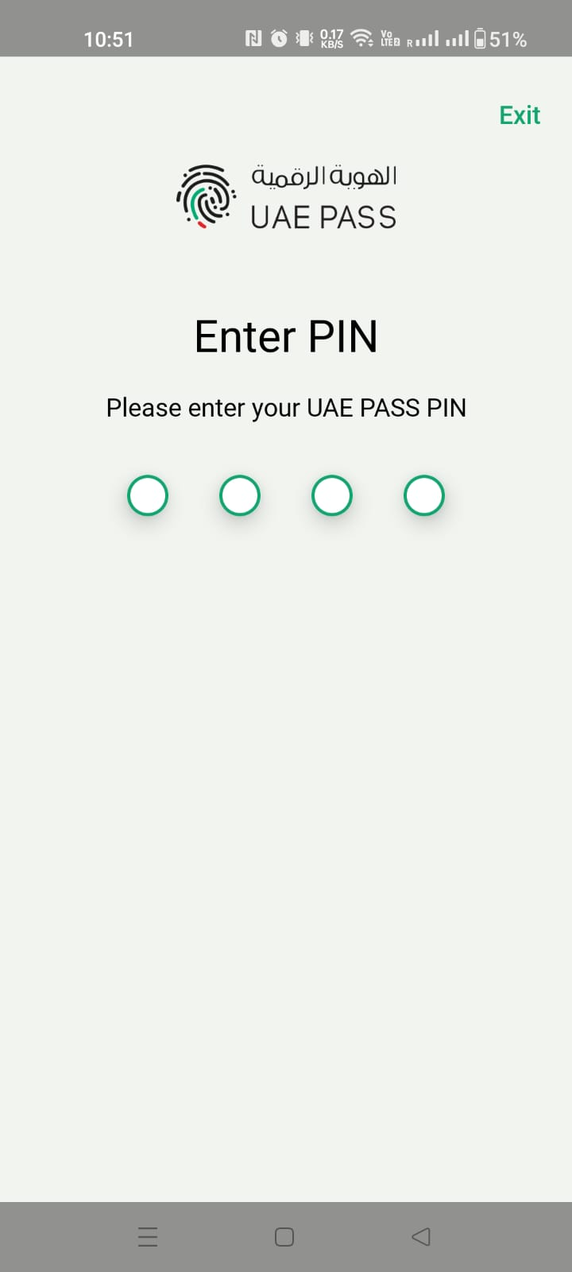
OR Redirection to UAE PASS Login page (App)
Not Applicable MySilah is a web-only platform. No native mobile application exists.

Slide 7
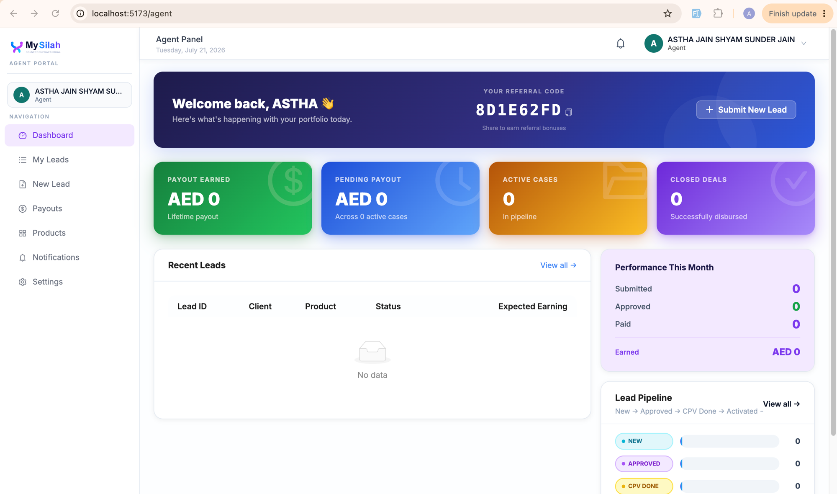
SOP1 scenario (If applicable)
EN: New user clicks "Sign in with UAE PASS" on registration page → UAE PASS verifies identity → MySilah auto-creates Agent account using verified data → User lands on Agent Dashboard.

Slide 8
SOP2 scenario (If applicable)
EN: Existing MySilah user clicks “Sign in with UAE PASS” on login page → UAE PASS authenticates at SOP2 or SOP3 level → System recognises linked account by UAE PASS UUID → User logged in directly to Agent Dashboard. MySilah accepts both SOP2 (verified residents) and SOP3 (UAE nationals with verified Emirates ID).

Slide 9
SOP3 scenario
EN: MySilah supports SOP3 authentication (UAE nationals with verified Emirates ID). Upon SOP3 authentication, additional verified attributes are received including the user’s title (titleEN/titleAR), which is displayed alongside their name on the Agent Dashboard. SOP3 users have full access to all MySilah Agent services at the highest verification level.

Slide 10
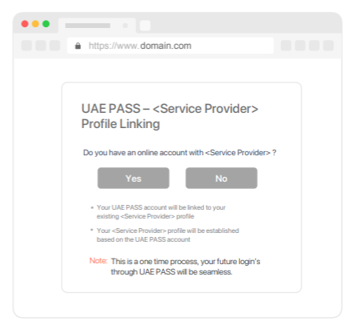
Manual linking page (if applicable)
Not Applicable MySilah automatically links user accounts via UAE PASS UUID on first authentication. No manual linking step is presented

Slide 11
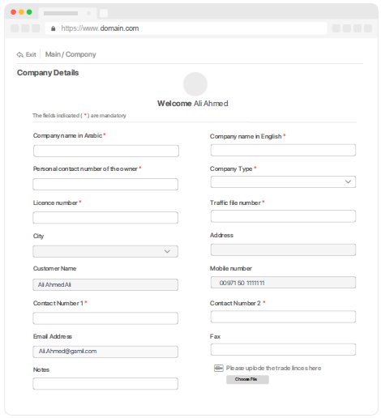
Manual linking (NO) scenario (if applicable)
Not Applicable MySilah automatically links user accounts via UAE PASS UUID on first authentication. No manual linking step is presented.

Slide 12
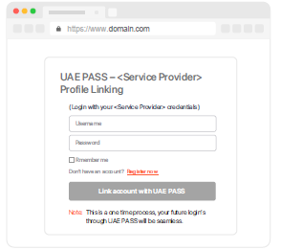
Manual linking (YES) scenario (if applicable)
Not Applicable MySilah automatically links user accounts via UAE PASS UUID on first authentication. No manual linking step is presented.

Slide 13
Only registration/Sign up Scenario (If applicable)
EN: Users without a MySilah account register via app.mysilah.ae/register using UAE PASS. Verified identity data auto-populates the registration. No prior MySilah account required.

Slide 14
Error Handling Only existing users error message
This Service is only for registered users, please contact MySilah in order to access the services
Not Applicable MySilah allows new user registration via UAE PASS. Access is not restricted to pre-existing users only.

Slide 15
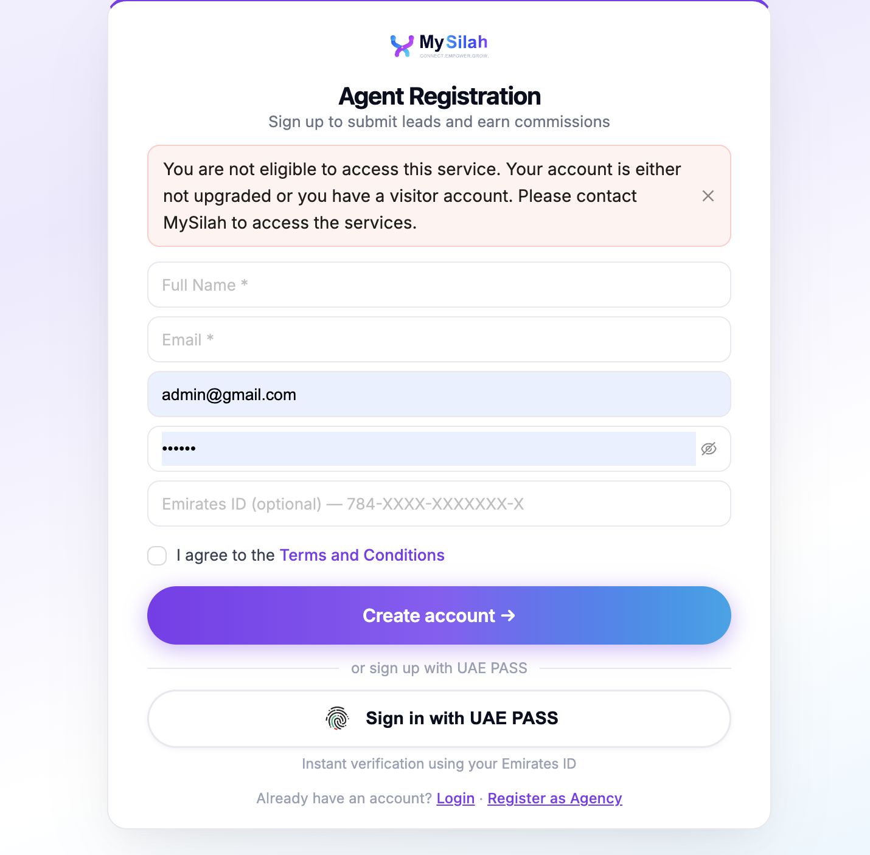
Error Handling Unverified user restriction
You are not eligible to access this service. Your account is either not upgraded or you have a visitor account. Please contact MySilah to access the services.
EN: If user authenticates with a Basic (unverified) UAE PASS account, MySilah restricts access and displays: "Your UAE PASS account is not fully verified. Please upgrade your account to access MySilah services."

Slide 16
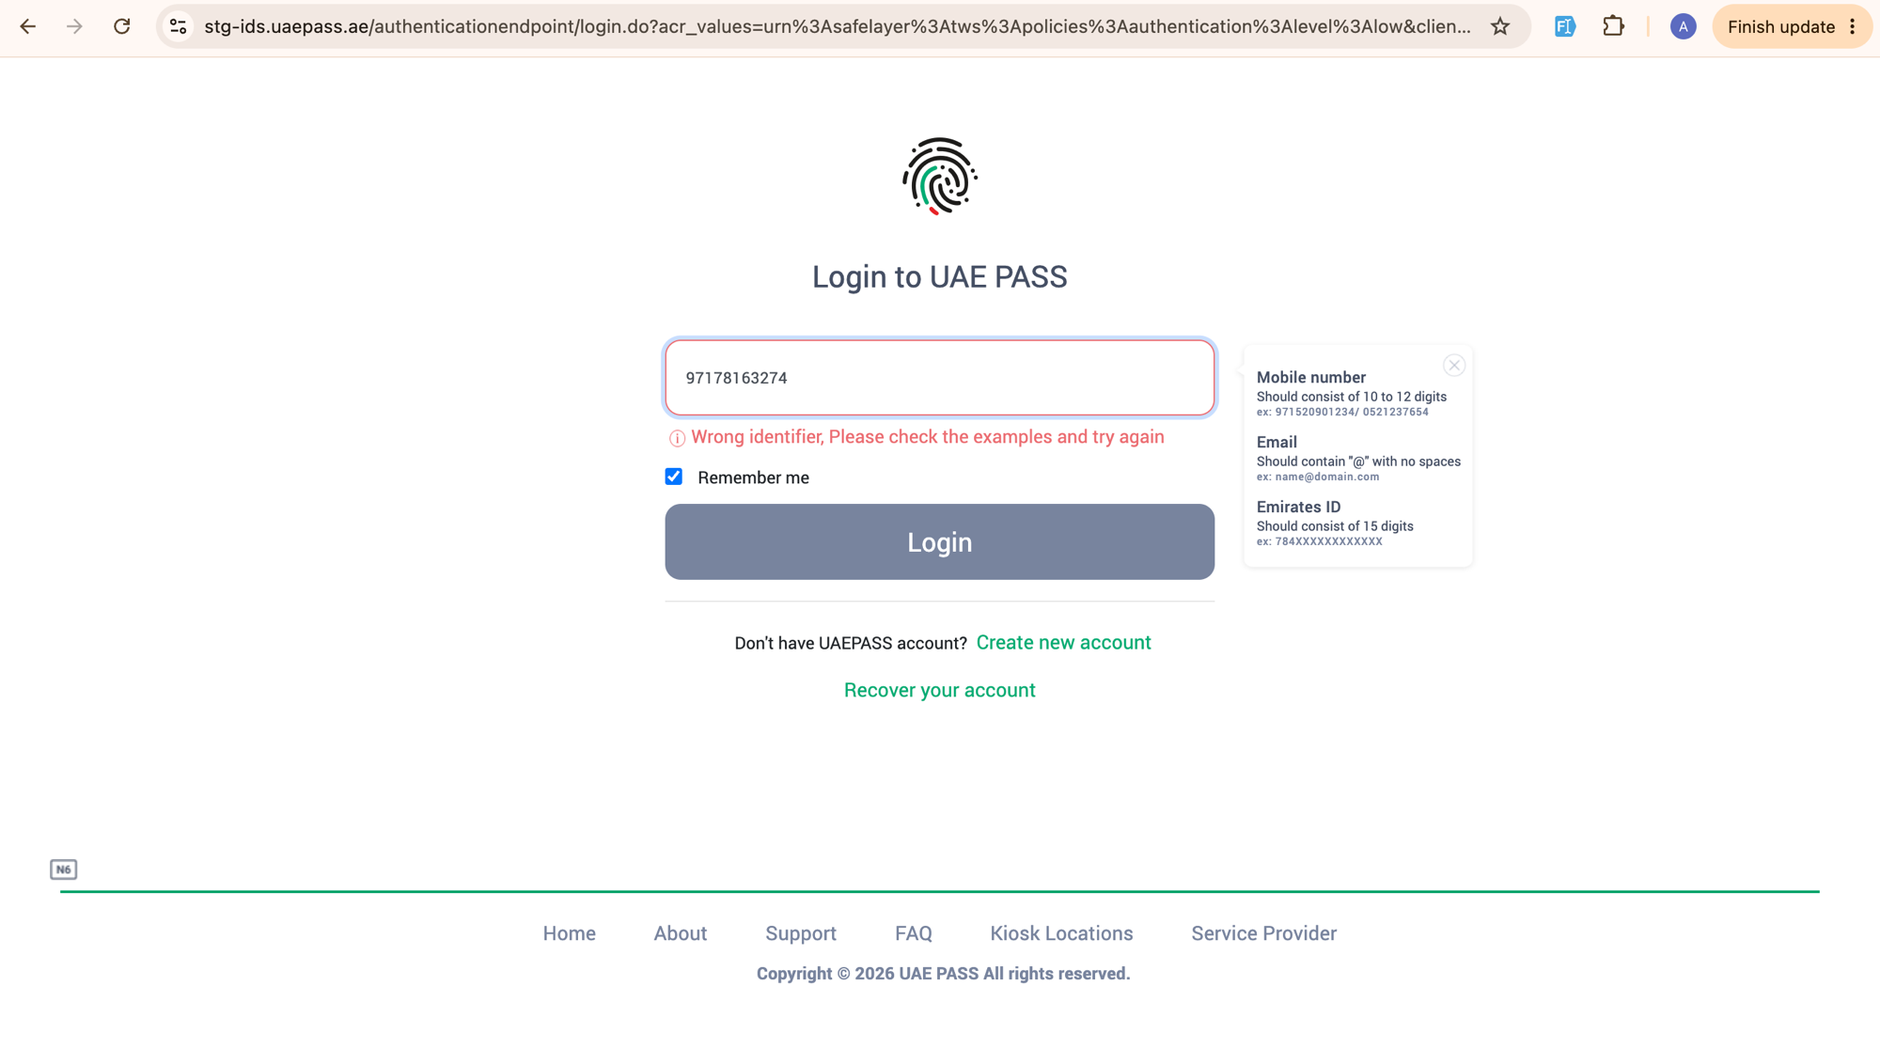
Error Handling Something went wrong during the login
Something went wrong during the login, please try again later!
EN: UAE PASS displays an error for invalid credentials. If the OAuth callback fails, user is redirected to app.mysilah.ae/login with: "Something went wrong during the login, please try again later!"

Slide 17
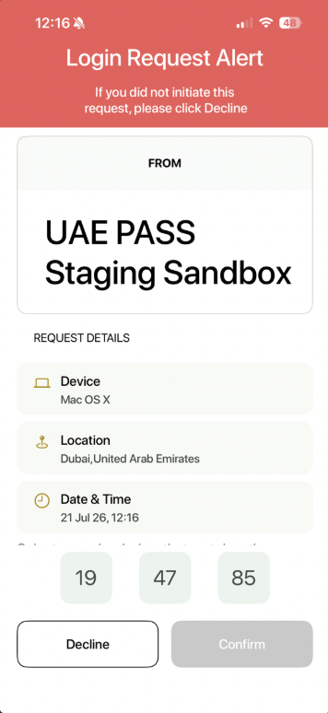
Error Handling User cancel scenario
User cancelled the login.
EN: User taps "Decline" on the UAE PASS Login Request Alert (or clicks "Cancel Request" on the browser polling page). Authentication is cancelled and user is redirected to app.mysilah.ae/login.

Slide 18
Logout scenario
EN: User clicks their name/avatar in the top-right of the MySilah Agent Dashboard and selects "Logout". Session is terminated and user is redirected to app.mysilah.ae/login.

Slide 19
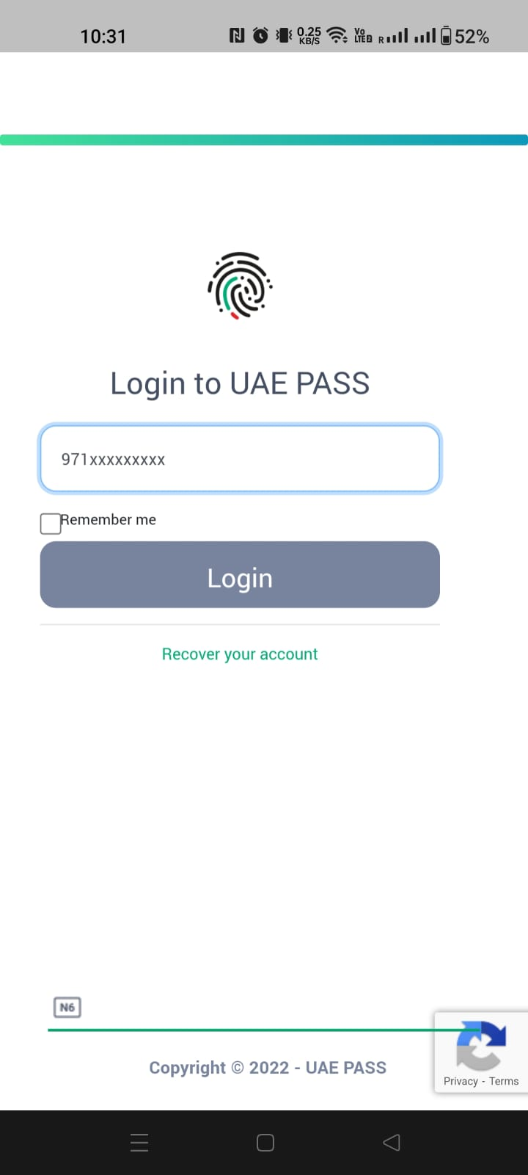
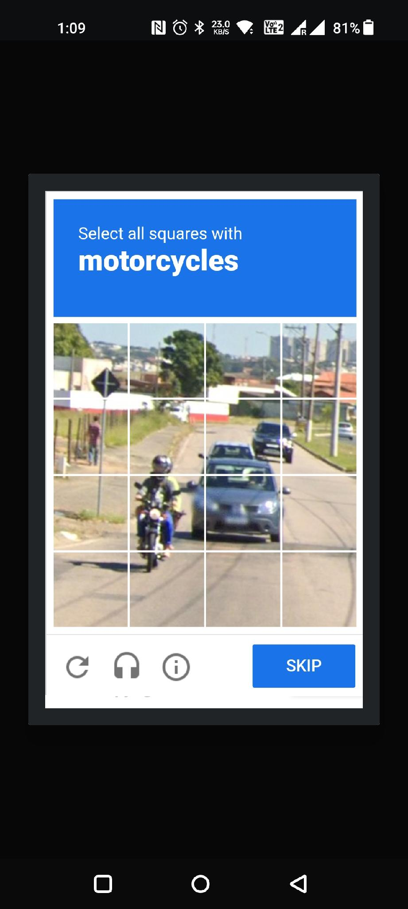
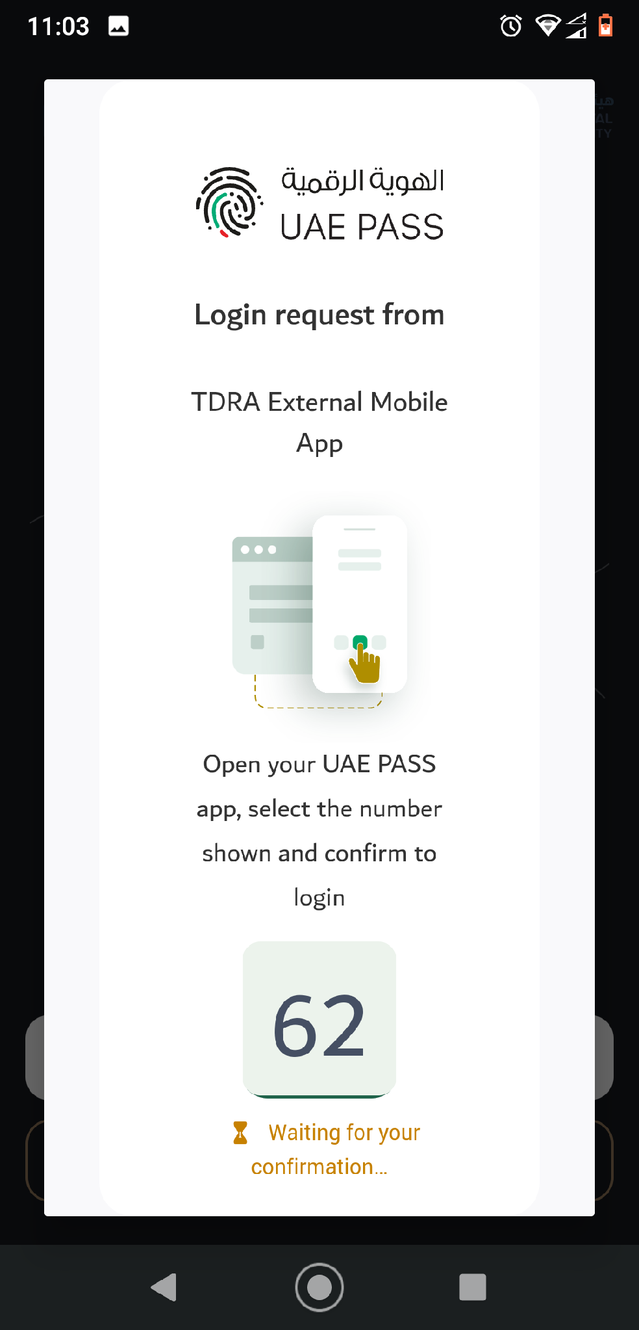
APP to WEB scenario (if mobile integration)
Not Applicable MySilah is a web-only platform. No native mobile application exists.

