Slide 1

Ping Pong game with Music
Nourine Mahmoud, Andres Ruiz, Javier Eguia Chaire, Zaid Omar

Slide 2

Requirements
LEDS
Seven Segment Display
Switches and Buttons
Two of the following protocols
UART, VGA, PWM, XADC

Slide 3
What we decided to do
VGA to display Ping Pong game
UART as an input to control Ping Pong game
Reset
Seven Segment Display to provide user info

Slide 4

VGA Implementation
Controlled by three different modules
VGA_controller
Pong_text
Pong_graph

Slide 5
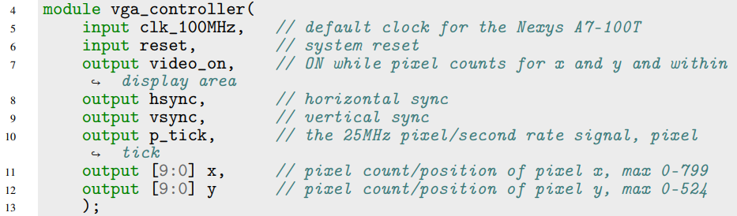
VGA_controller Module
Takes care of the VGA refresh rate and provides an output to the VGA XDC
Input of 100Mhz clock with a 25MHz refresh period for the hsync and vsync
640x840 resolution
Reset button stops screen from refreshing

Slide 6



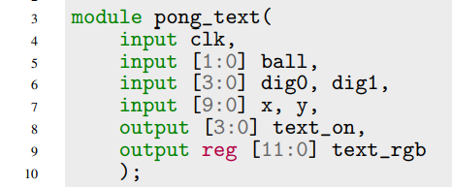
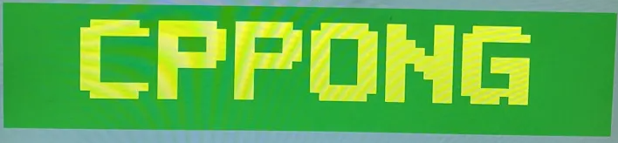
Pong_text Module
The pong_text module serves as a text-based graphics controller for a Pong game, responsible for displaying various textual elements on the screen.
Utilizes ASCII Codes to provide characters to the different text sections of the game
Four regions are used in the game, activated based on the courser position:
score region, logo region, rule region, and game over.

Slide 7
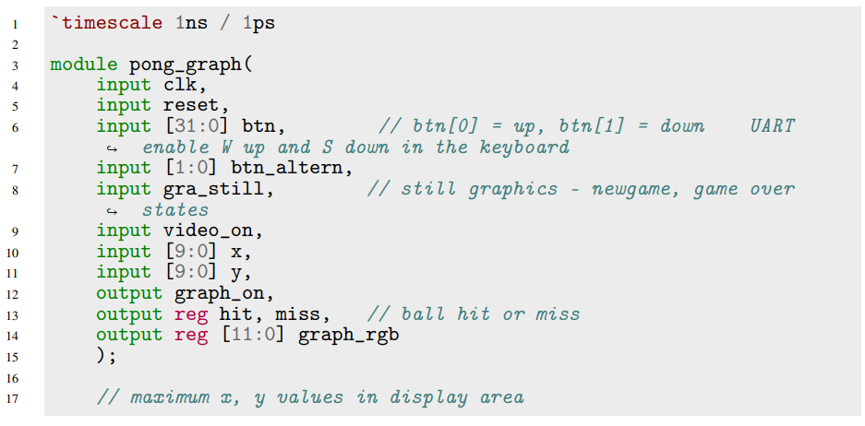
Pong_graph Module
The pong_graph module functions as a graphics controller for a Pong game, determining the positions and interactions of various graphical elements such as walls, paddles, and the ball within the display area.
These objects are closed within a display area and are giving coordinates within this display area
The paddle's position is controlled by the up and down keys of a keyboard
The ball's position is controlled by velocity parameters that recognize when the ball crashes with any other objects and responds respectively
These objects include ROMs to represent the object to place on screen

Slide 8
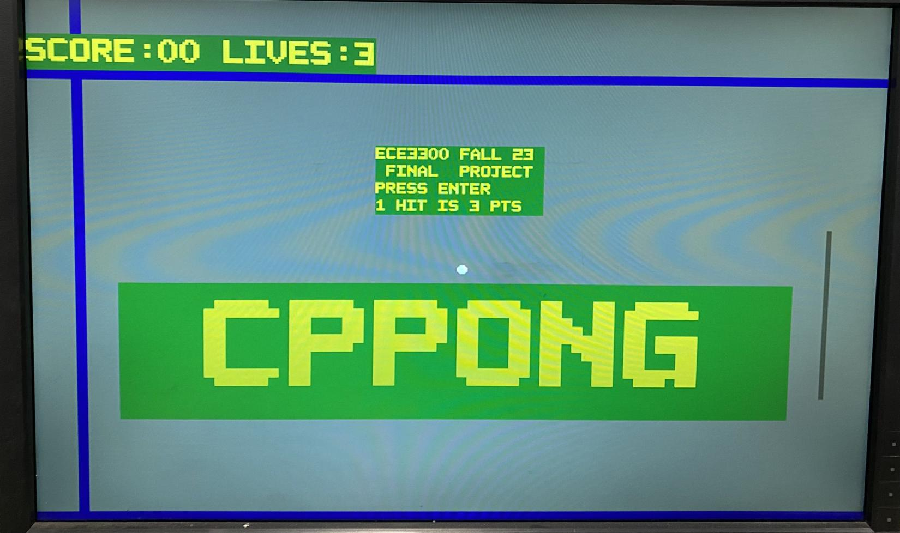
Initial Screen

Slide 9
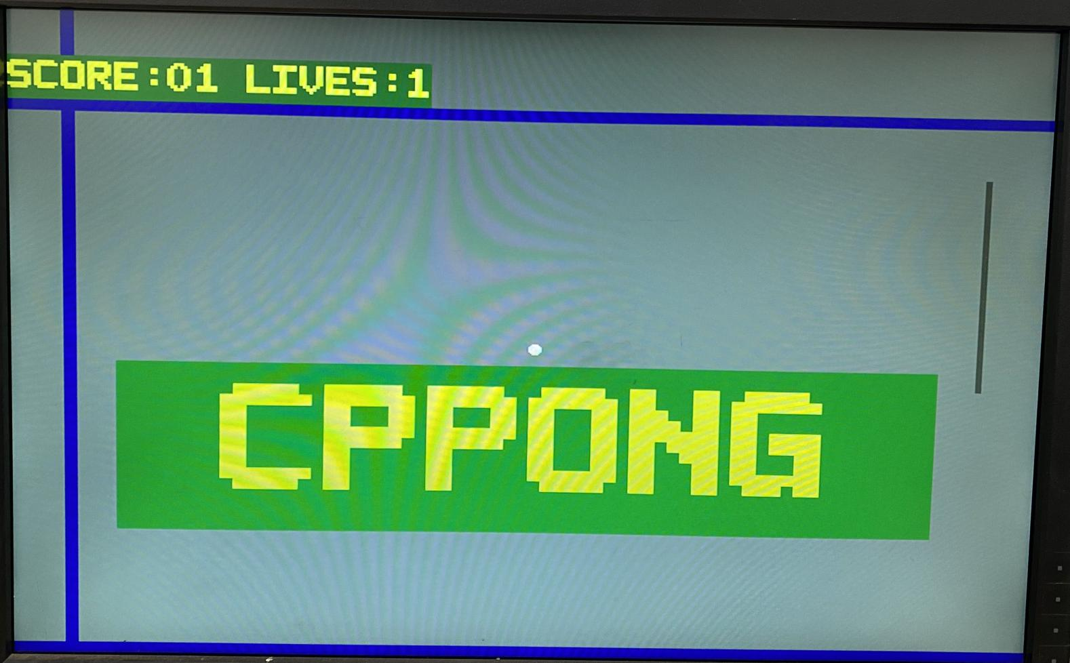
Gameplay Screen

Slide 10
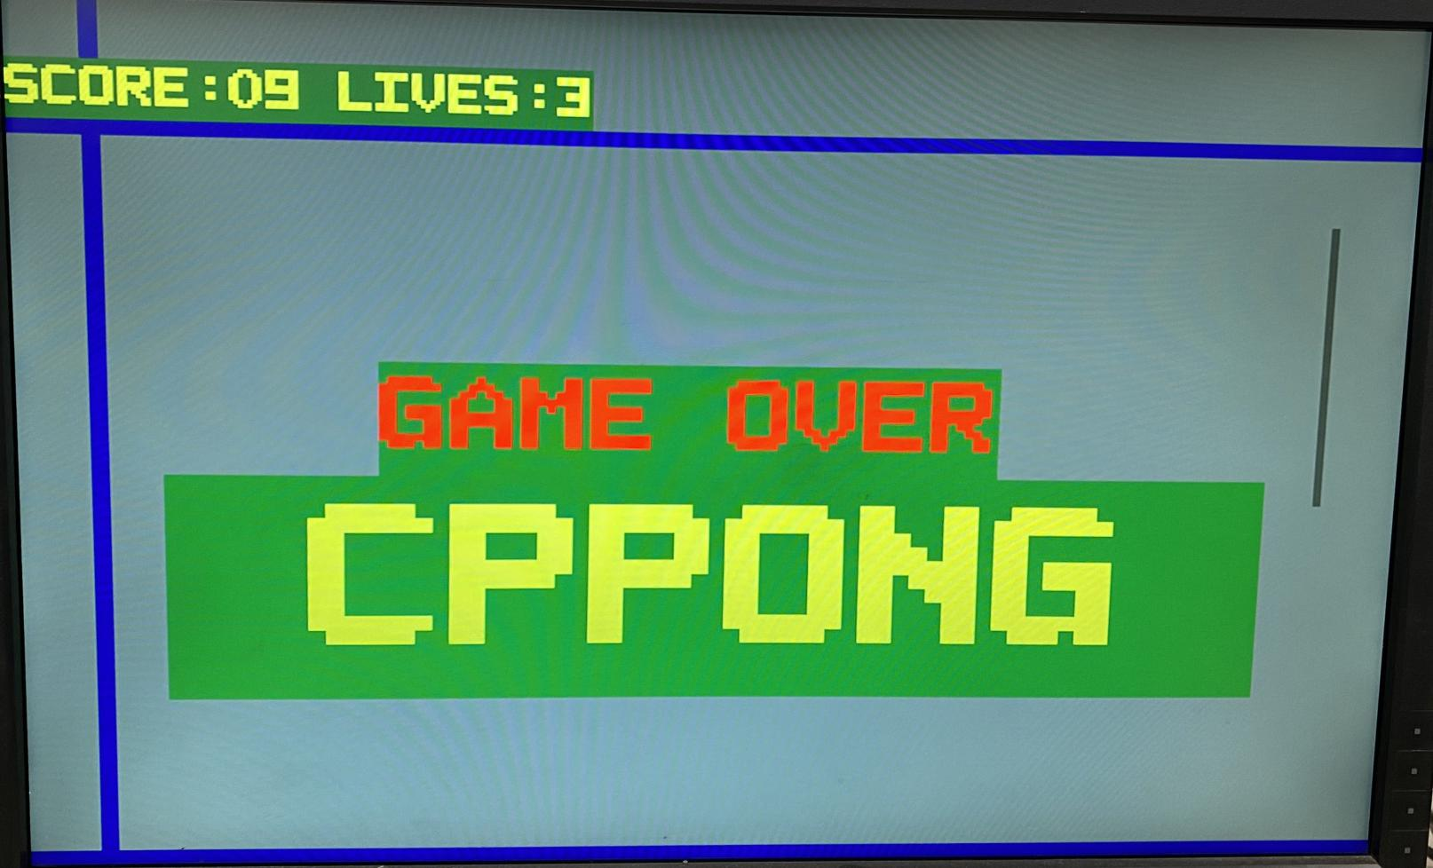
Game Over Screen

Slide 11
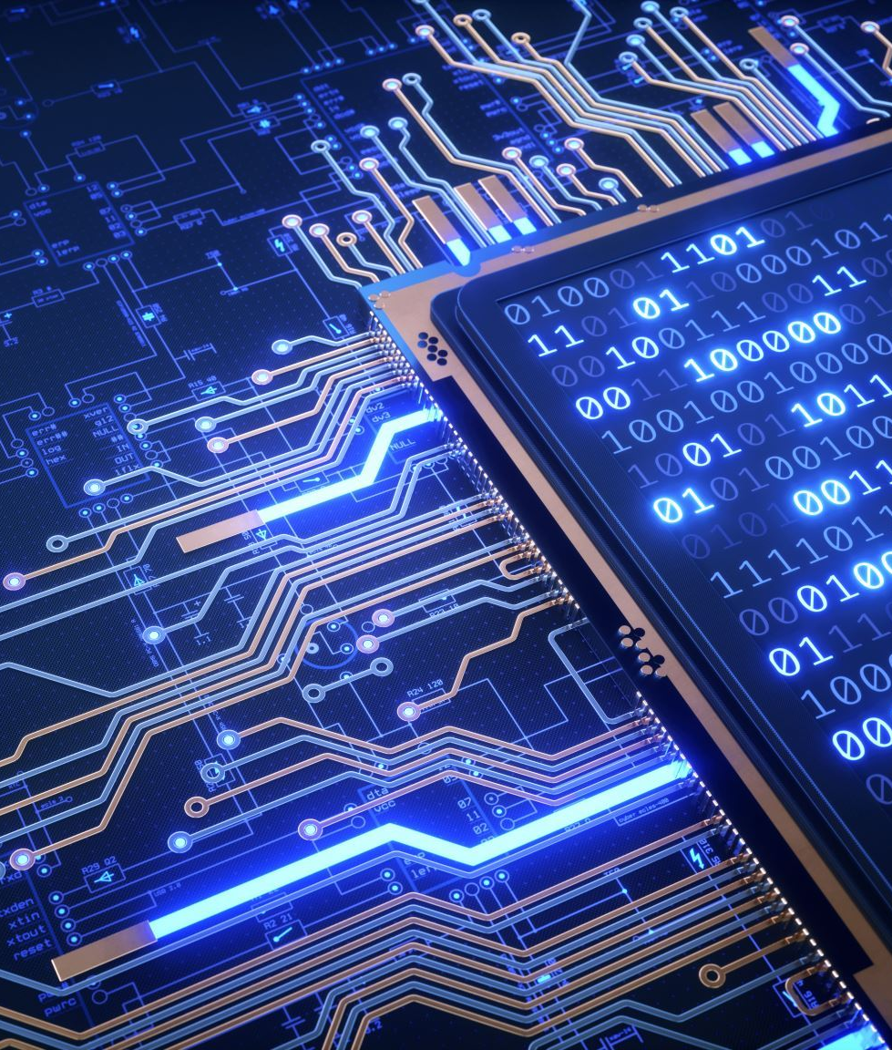
UART Implementation
Controlled by five different modules
Debouncer
PS2 Receiver
UART_transmitter
UART_Buffer_Control
Binary_to_ASCII

Slide 12
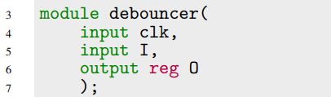
Debouncer Module
The module takes input from a potentially noisy source, such as a button press, and produces a clean and stable output.
Operating on a clock signal, the module compares the current input state (I) with its previous state (Iv). If the states match, it increments an internal counter (count). When this counter reaches a predefined maximum count (COUNT_MAX), the output (O) is updated to reflect the stable input state.

Slide 13
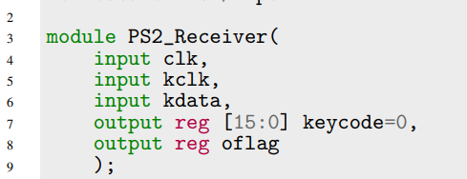
PS2_Receiver Module
The PS2_Receiver module is responsible for decoding signals from a PS/2 keyboard into keycodes.
It interfaces with the keyboard through clock (kclk) and data (kdata) lines, utilizing debouncing mechanisms (db_clk and db_data) to filter out noise and ensure the stability of input signals.

Slide 14
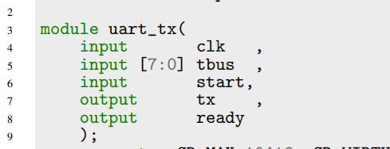
UART_tx module
The uart_tx module serves as the transmitter, enabling the FPGA to receive input from an external source, such as a keyboard.
Follows proper UART TX protocol

Slide 15
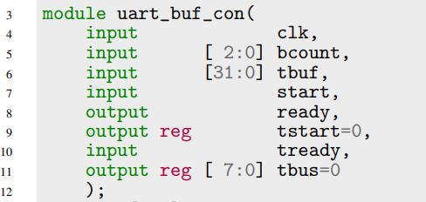
UART_buffer Implementation
This module manages the transmission of data (tbuf) from the UART buffer to the internal system based on control signals such as clk, bcount, and start. Additionally, it handles the formatting of data for proper display.

Slide 16

Binary to ASCII Module
The module converts binary data into ASCII format, facilitating the display of relevant information on the seven-segment displays. With a parameterized number of bytes (NBYTES), this module efficiently transforms binary input data (I) into a corresponding ASCII representation (O).
This is used in conjuction with the text module.

Slide 17
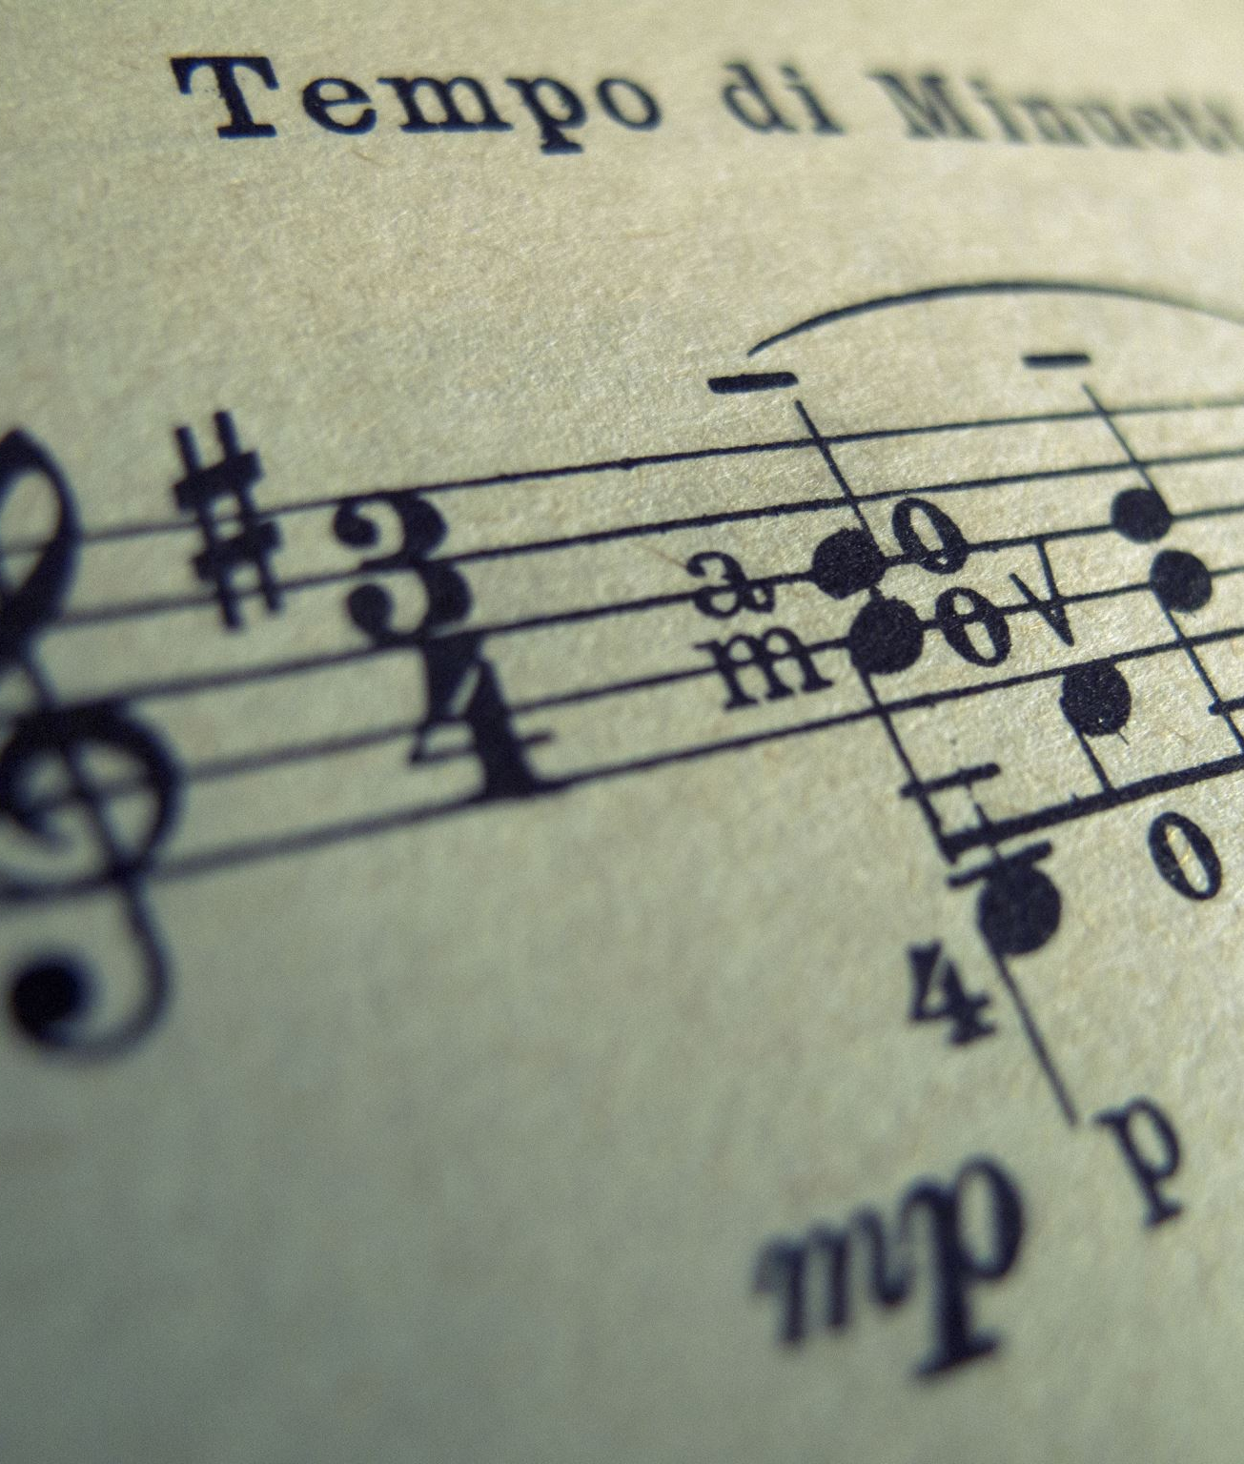
Music Implementation
The music module orchestrates this process by employing several interconnected modules. The music_ROM module fetches the full note values based on a continuously increasing tone counter. These full notes are then dissected into octave and note components using the divide_by12 module.
This implementation showcases the intricate integration of mathematical computations, sequential logic, and real-time control to achieve accurate and dynamic audio synthesis within the FPGA environment.

Slide 18
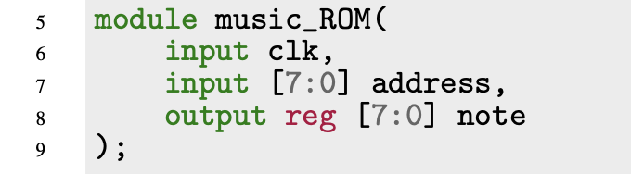
Music ROM
The music_ROM module serves as a crucial component in the CPPONG project, functioning as a lookup table for musical notes based on specific memory ad- dresses.
This implementation showcases the FPGA’s capability to handle sequential data and highlights the efficient use of memory resources for musical synthesis.

Slide 19
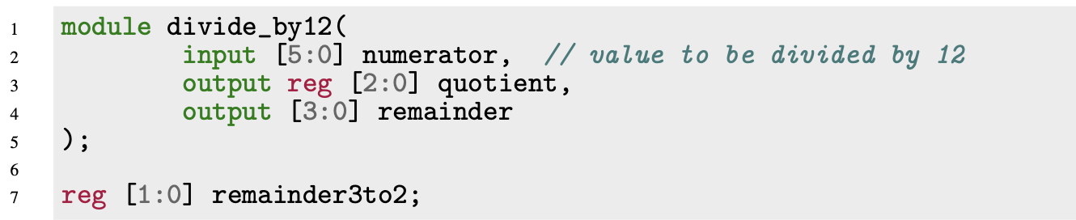
Tone Divider
The divide_by12 module is designed to efficiently divide a given 6-bit input (‘numerator‘) by 12.
The module employs a case statement based on the four most significant bits of the input to determine both the quotient (‘quotient‘) and the remainder (‘remainder‘).

Slide 20


Music Audio Generator
The music module in the CPPONG project serves as a crucial component for generating musical tones and controlling the speaker output. It employs a combination of modules to manage the frequency and duration of musical notes.

Slide 21
Top Implementation
The pong_top module employs a Finite State Machine (FSM) to manage different game states, including "newgame," "play," "newball," and "over."
The module interfaces with peripherals such as a PS2 receiver for keyboard input processing and a UART transmitter for serial communication. It integrates a clock divider for deriving timing signals and employs timer and counter modules to manage game timing.

Slide 22
Key Components of pong_top Module
Finite State Machine (FSM)
Peripheral Interfaces
Clock and Timing
Audio
Display
Text and Graphics
Input Handling
Scorekeeping Timing
User Interface
Modularity and Organization

Slide 23
Simulation
The Verilog testbench includes modules for testing various aspects of the design, such as the VGA controller, Pong game logic, music generation, and keyboard input processing.
The testbench begins by declaring signals and modules necessary for testing, including clock signals (clk and kclk), buttons (reset_btn, btn_controller, enter_btn), switches (clk_factor, music_enable_sw), and internal signals for music testing (tone, fullnote, octave, note).

Slide 24
Conclusion
In conclusion, the development and simulation of the Pong game and its associated components have yielded a functional and enjoyable gaming experience. The successful integration of the VGA controller, Pong text, Pong graph, keyboard input processing, and music generation modules showcases the design’s robustness and versatility. The testbench has effectively validated the system’s responsiveness to user input.
Future enhancements may explore additional features, optimizations, or expansions of the game logic. This project has not only provided valuable insights into Verilog hardware design and simulation but also offers a solid foundation for the development of more complex and feature-rich games or interactive applications.

