Slide 1
The RC6™ Block Cipher
Group 4
Joseph Popoviciu
Sami Elias
Nash Russak

Slide 2
Task Assignment
Joseph Popoviciu- Key Member
Sami Elias- Hardware and Coding
Nash Russak- Coding

Slide 3
The RC6™ Block Cipher
Created in 1998, the RC6 Block Cipher is used to encrypt and decrypt large amounts of data
Submitted to the National Institute of Standards and Technology for consideration as the new Advanced Encryption Standard
Designed to replace the RC5 due to the cipher not using all of the bits in its registers which could lead to a security breach.
Considerations when designing the RC6 were its security, simplicity, and performance
Differs from RC5 due to using integer multiplication and using 2 additional registers totaling 4
Designed to be flexible as the computer industry continues innovate and improve

Slide 4
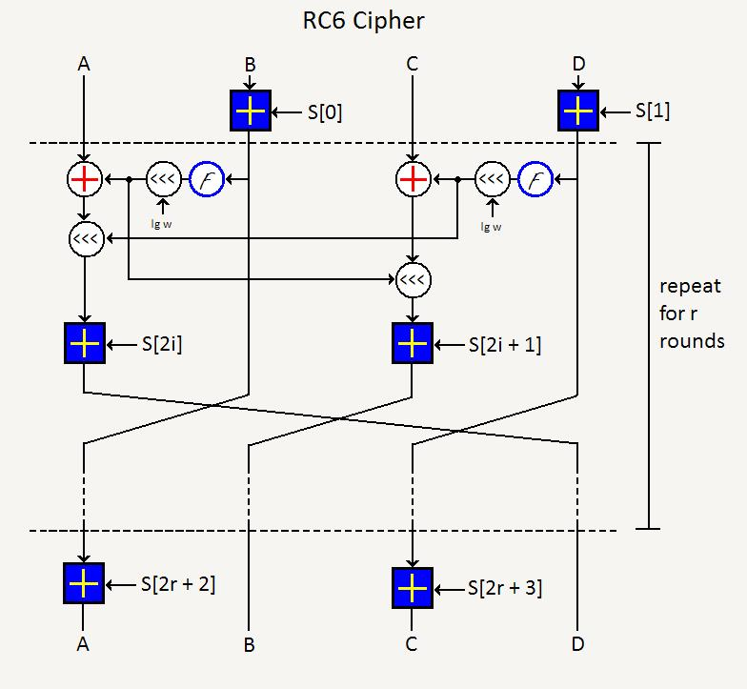

Slide 5
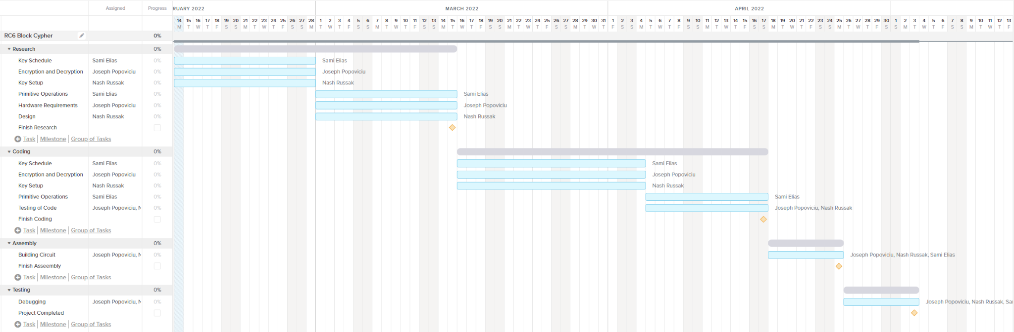
Gantt Chart

