Slide 1
Tic-Tac-Toe Simulation
ECE 3300.02 Digital Circuit Design using Verilog
By: Joseph Popoviciu, Sami Elias, Nash Russak

Slide 2
Introduction
The features of the board that will be used include the switches, buttons, LEDs, RGBs, and seven-segment display. Our simulation will work by outputting the display onto a monitor through the VGA port found on the board. Furthermore, the device will also be able to be controlled with a keyboard using UART connections. The final product will be a tic-tac-toe simulation that will allow the user to place the marker of “X” or “O” onto a specific spot until three in a row of either marker is achieved, the game will then be repeated once that requirement has been met.

Slide 3
Introduction
The core code for this project was originally created by Arthur Brown. We were able to modify and fix portions of the code to expand the user inputs to allow a user to play using a keyboard. We also added more functionality that takes advantage of the FPGAs seven segment display, RGB led, LED’s, and switches.

Slide 4
Game Operation
We can use the buttons on the board to control the player position.
We can also flip a switch that allows us to use the arrow keys on the keyboard
RGB is green for ongoing game. Red for X winning, and blue for O winning
The 7 segment display will count down from 9 to show how many games are left. The game also resets when the counter reaches 0 and displays the scores.
The score is also displayed on the seven segment displays.
In order to reset the game, we hit the reset button and it resets the score, game, and game count

Slide 5
Modules
Clk_manager - Slows down the clock for the rgb_pwm module
KeyBoard_PS/2 - UART for keyboard input
PS/2Receiver - Receiver for the keyboard being input through the PS/2 port
Debouncer_keyboard - prevents the board from registering more than 1 input for each button press
Btn_cntrl - Converts the signals from the keyboard UART to the up/down/left/right arrow keys and enter button
Btn_flsm - Handles user inputs from the keyboard or FPGA buttons
Debouncer - prevents the board from registering more than 1 input for each button press
Pulser - pulses the output on the rising edge of the input, so that the signal is only high for one clock cycle
Reg_array- Stores the game state
Go_encode - obtains the state of the game, whether it is over, and who won

Slide 6
Modules
VGA_AB - Controls the VGA output of the board
Counter - counter that controls the vertical and horizontal counts
Vga_color_sel - controls the colors being output on the display
Go_decode - causes the winning tiles to be green
Lut - Loads the hex file for the games display
Shift_divider - determines which row or column of cells the vga is looking at, and where in that row or column the pixel is located
Fsm_counter - Finite State Machine that counts the players scores up to 9.
Seg7_driver - Display for the scores, and rounds remaining
Rgb_pwm - Activates the RGB LED based on state of the game and which player won the round
Counter - counter to control the pwm cycle

Slide 7
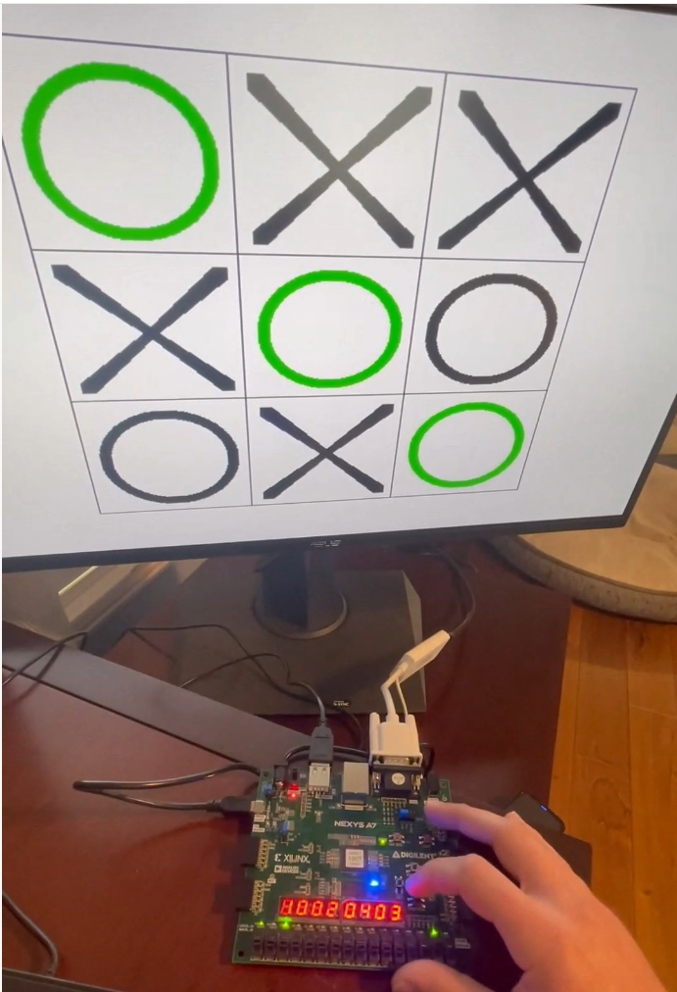
Results
The result of our work has produced an functioning tic-tac-toe simulation game which can be played by two players
The input devices that can be used are the keyboard and buttons located on the board
Up to 9 games can be played to determine the winner before resetting

Slide 8
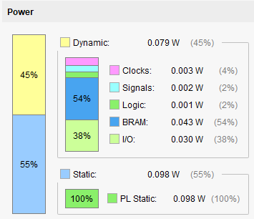
Power Consumption

Slide 9
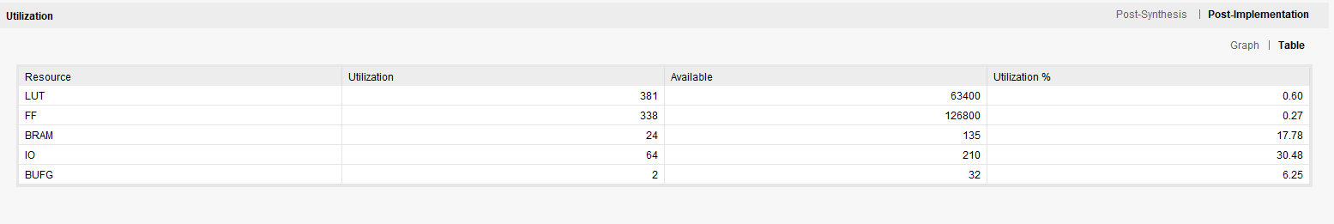
Resource Utilization

Slide 10
References
Arpadi, Sergiu. “Nexys Video PS/2 Keyboard Demo.” Nexys Video PS/2 Keyboard Demo-Digilent Reference, https://digilent.com/reference/learn/programmable-logic/tutorials/nexys-video-axi-ps2-keyboard/start.
Artvvb. “TicTacToe/SRC/HDL at Master · Artvvb/Tictactoe.” GitHub, https://github.com/artvvb/TicTacToe/tree/master/src/hdl.
Aseddin. “Ece_3300/fsm_counter.V At Main · ASEDDIN/ece_3300.” GitHub, 26 Mar. 2021, https://github.com/aseddin/ece_3300/blob/main/8%20FSMs/Source/fsm_counter.v.
Brown, Arthur. “Nexys A7 Reference Manual.” Nexys A7 Reference Manual - Digilent Reference, https://digilent.com/reference/programmable-logic/nexys-a7/reference-manual.
Digilent. “Digilent/Nexys-A7-100T-Keyboard.” GitHub, https://github.com/Digilent/Nexys-A7-100T-Keyboard.
“Tic Tac Toe Game in Verilog and LogiSim.” FPGA Projects, Verilog Projects, VHDL Projects - FPGA4student.Com, https://www.fpga4student.com/2017/06/tic-tac-toe-game-in-verilog-and-logisim.html.
“UART, Serial Port, RS-232 Interface.” UART in VHDL and Verilog for an FPGA, https://www.nandland.com/vhdl/modules/module-uart-serial-port-rs232.html.

