Slide 1

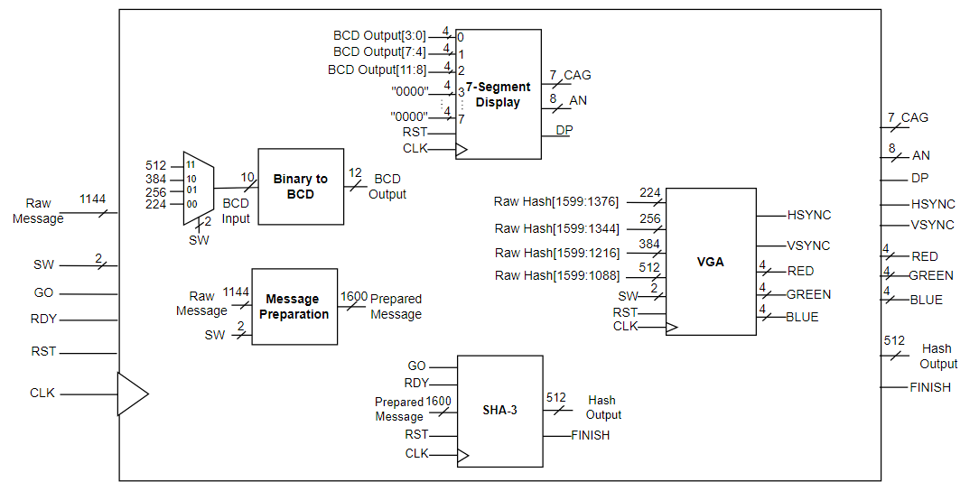
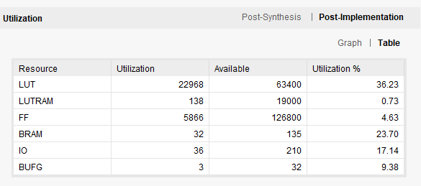
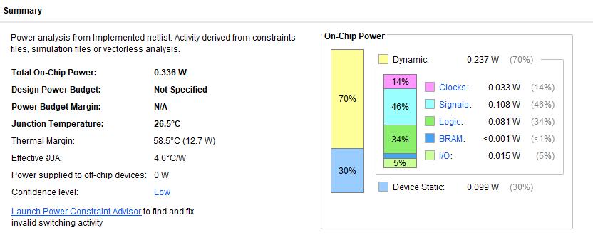
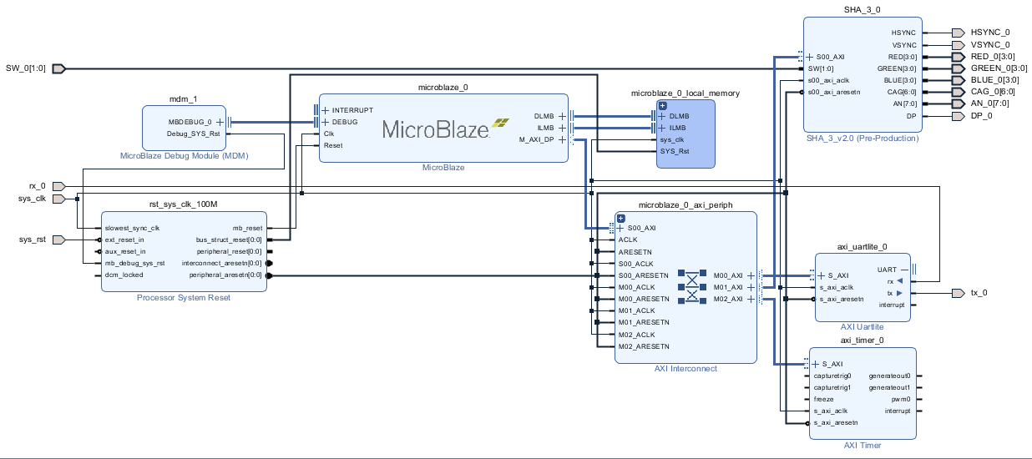
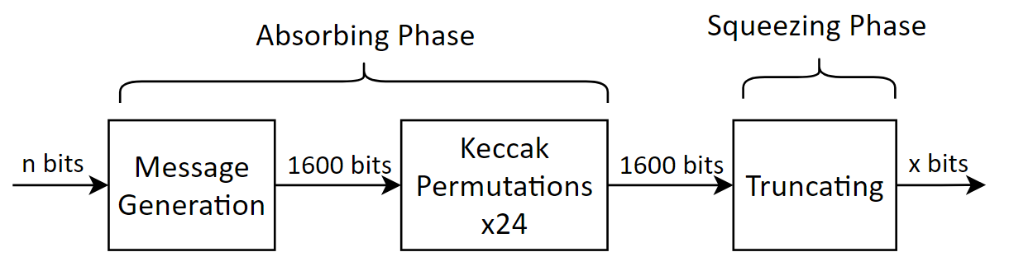
SHA3-FPGA: SECURE HASH ALGORITHM 3 IMPLEMENTATION ON AN FPGA WITH MICROBLAZE MICROPROCESSOR
Yuta Akiya, Kyle Thomas Le, Megan Luong, Dr. Mohamed El-Hadedy ECE Department at Cal Poly Pomona Contact: yakiya@cpp.edu, kylethomasle@cpp.edu, mmluong@cpp.edu, mealy@cpp.edu
Abstract
With the increase in a global presence in software and hardware devices, the need for security has as well. Cryptographic solutions aim to provide an efficient and secure way of protecting and securing devices in an ever-growing field. One important cryptographical tool is hashing. However, hashing algorithms, which perform the hashing, are often outdated, and become vulnerable to cyber-attacks over time. In the last decade, the world transitioned from using Secure Hash Algorithm 1 (SHA-1) to Secure Hash Algorithm 2 (SHA-2) due to the flaws in SHA-1. However, its replacement, SHA-2, still uses a similar internal structure which has the same flaws. Since then, a new hash algorithm, SHA-3 has been introduced which does not share the same flaws as its other family members. However, the transition to SHA-3 has not been completely due to the lack of support for SHA-3 in software and hardware as well as issues with performance. This performance limitation, however, is only present in software implementations. This project aims to measure the performance metrics of an FPGA implementation of SHA-3 to introduce a realistic, hardware method of implementing SHA-3 to contribute to a potential global implementation to a more secure hashing algorithm standard.
Introduction
Design
Results
SHA-3 is the latest encryption standard in the hashing family, aiming to provide a faster and more robust implementation in hardware. This performance is important for a hashing algorithm since a faster hash allows for more time for other operations. Field-programmable gate arrays (FPGAs) are devices providing re-programmable hardware that are extensively efficient in processing time and precising timing. The aim of this project is to design and implement the SHA-3 algorithm onto an FPGA system and analyze its performance metrics. This can then be compared to traditional and other related systems to see if the performance benefit of an FPGA is able to provide a boost to the SHA-3 algorithm.
The top module of the implementation design contains 5 main modules: Binary to BCD, seven-segment display, message preparation, SHA-3, and VGA. The final implementation takes in user message inputs through U-ART and displays the hash through VGA.
The SHA-3 implementation was successful, with the system being able to properly hash an input message in either SHA-3 224-, 256-, 384-, or 512-bit mode. The message is inputted through the UART system on the MicroBlaze microprocessor, which is then passed to the SHA-3 IP containing the SHA-3 calculation and other systems. The message was then displayed onto the VGA system and the SHA-3 mode displayed on the 7-segment display and controlled by the switches. Our overall throughput was 1.04 Gbps.
Algorithm
SHA-3 features a sponge construction which has two phases: absorbing and squeezing. During the absorbing phase, the input message is padded to 1600 bits. The input message is divided into two sections: the rate and capacity. The size of both sections depend on the output size. The rate is filled in with the input data and formatted. The capacity is unaffected by the input and is placed to hide the message’s data from attackers.
The padded message, known as the state, is then permutated for 24 rounds by the Keccak hash function. Keccak features 5 permutation stages: Theta, Rho, Pi, Chi, and Iota. Each permutation stage XORs, rotates, or shifts around the state’s bits in order to get the output hash. The resulting output hash is truncated to x-bits, depending on the SHA-3 version. Available output sizes for SHA-3 are 224, 256, 384, and 512 bits.
Top module design of the SHA-3 implementation
Implementation
Resource utilization of the complete SHA-3 system
With the design of the SHA-3 module, it could be implemented and wrapped with AXI in order to communicate with the MicroBlaze microprocessor. To do this, a custom intellectual property (IP) was made, which allowed our SHA-3 with AXI module to connect to the MicroBlaze microprocessor via block diagram.
Power usage of the complete SHA-3 system
Conclusion
The performance of the SHA-3 implementation onto the Nexys A7 FPGA with the MicroBlaze microprocessor proved successful. When viewing the performance metrics of other implementations and their hardware capabilities, it is clear that SHA-3 on the FPGA is comparable, if not better. The hardware acceleration of the FPGA allows for a tremendous improvement in system performance of the execution time of the algorithm. Ultimately, servers and systems that aim to potentially increase the performance of hashing using SHA-3 could look towards FPGA acceleration cores.
Flow chart of the SHA-3 Algorithm Design
Block design of the MicroBlaze system

