Slide 1
Custom Claims Provider API

Slide 2
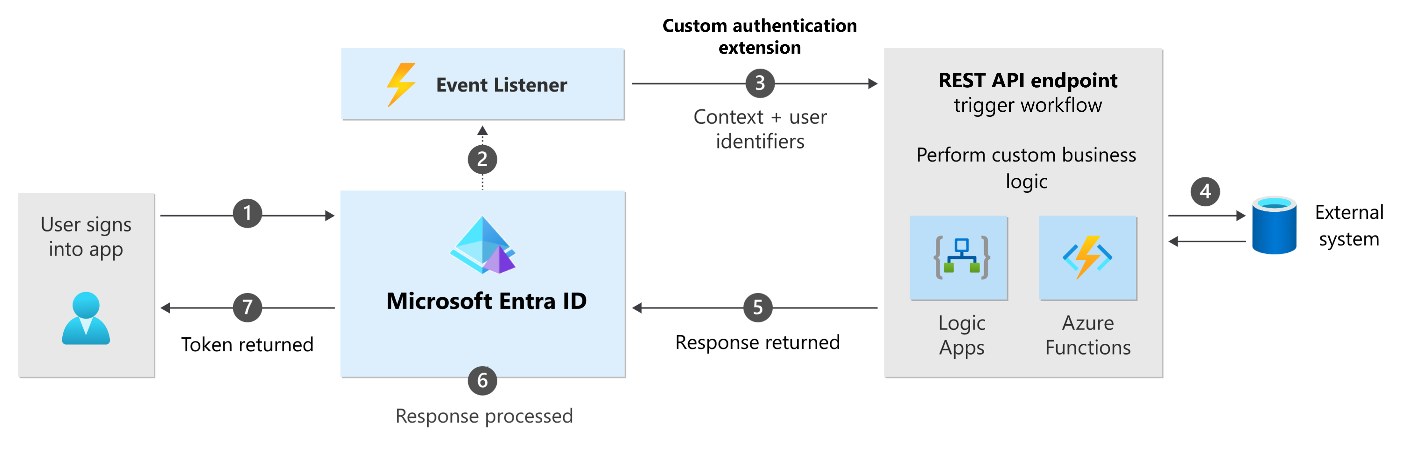
Custom Authentication Extension
A custom authentication extension is essentially an event listener that, when activated, makes an HTTP call to a REST API endpoint where you've defined a workflow action. You could use a custom claims provider to add external user data to the token before it's issued.
Notes:
Custom authentication extensions overview - Microsoft identity platform | Microsoft Learn:
https://learn.microsoft.com/en-us/entra/identity-platform/custom-extension-overview
Custom extensions in a customer tenant - Microsoft Entra External ID | Microsoft Learn:
https://learn.microsoft.com/en-us/entra/external-id/customers/concept-custom-extensions

Slide 3
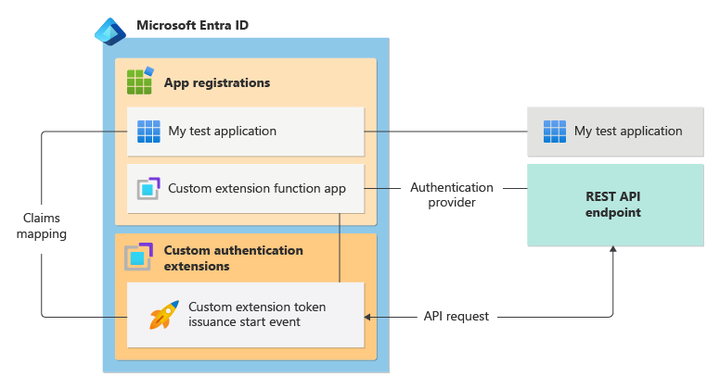
Custom Claims Provider
The custom claims provider token issuance start event allows you to enrich or customize application tokens with information from external systems.
This information that can't be stored as part of the user profile in Microsoft Entra directory.
Notes:
Introduction to Microsoft Entra ID Custom claims providers (part one) (youtube.com): https://www.youtube.com/watch?v=1tPA7B9ztz0&list=PL3ZTgFEc7Lythpts59O9KOVuEDLWJLLmA&index=6
Configure Microsoft Entra ID Custom claims provider (part two) (youtube.com): https://www.youtube.com/watch?v=fxQGVIwX8_4&list=PL3ZTgFEc7Lythpts59O9KOVuEDLWJLLmA&index=7
Custom claims provider overview - Microsoft identity platform | Microsoft Learn: https://learn.microsoft.com/en-us/entra/identity-platform/custom-claims-provider-overview#token-issuance-start-event-listener
Custom claims provider: Configure a token issuance event - Microsoft identity platform | Microsoft Learn: https://learn.microsoft.com/en-us/entra/identity-platform/custom-extension-tokenissuancestart-configuration?tabs=azure-portal%2Cworkforce-tenant
Custom claims provider reference - Microsoft identity platform | Microsoft Learn: https://learn.microsoft.com/en-us/entra/identity-platform/custom-claims-provider-reference

Slide 4

Best Practices and Common Pitfalls
Use custom claims provider sparingly and only when necessary.
Choose the appropriate data source for your custom claims provider.
Avoid performance and scalability issues by caching and optimizing your custom claims provider.
Ensure that your custom claims provider is secure and does not expose sensitive information.
Test your custom claims provider thoroughly before deploying it to production.
Notes:
Troubleshoot a custom claims provider - Microsoft identity platform | Microsoft Learn:
https://learn.microsoft.com/en-us/entra/identity-platform/custom-extension-troubleshoot?tabs=obtain-an-access-token#common-performance-improvements

Slide 5
Sample Architecture
Request a token by calling https://login.microsoftonline.com/<tenantid>/oath2...
Custom Authentication Extension triggers an OnTokenIssuanceStart event.
Custom claims API calls sql db to retrieve the custom claims.
Return response to Entra ID within 2 seconds timeout limit or authentication fails.
Redirect to jwt.ms with the token provided.

Slide 6
Sample application
https://github.com/caligaris/EntraCustomAuthenticationExtensionAPI

