Slide 1
Custom Claims Provider API

Slide 2
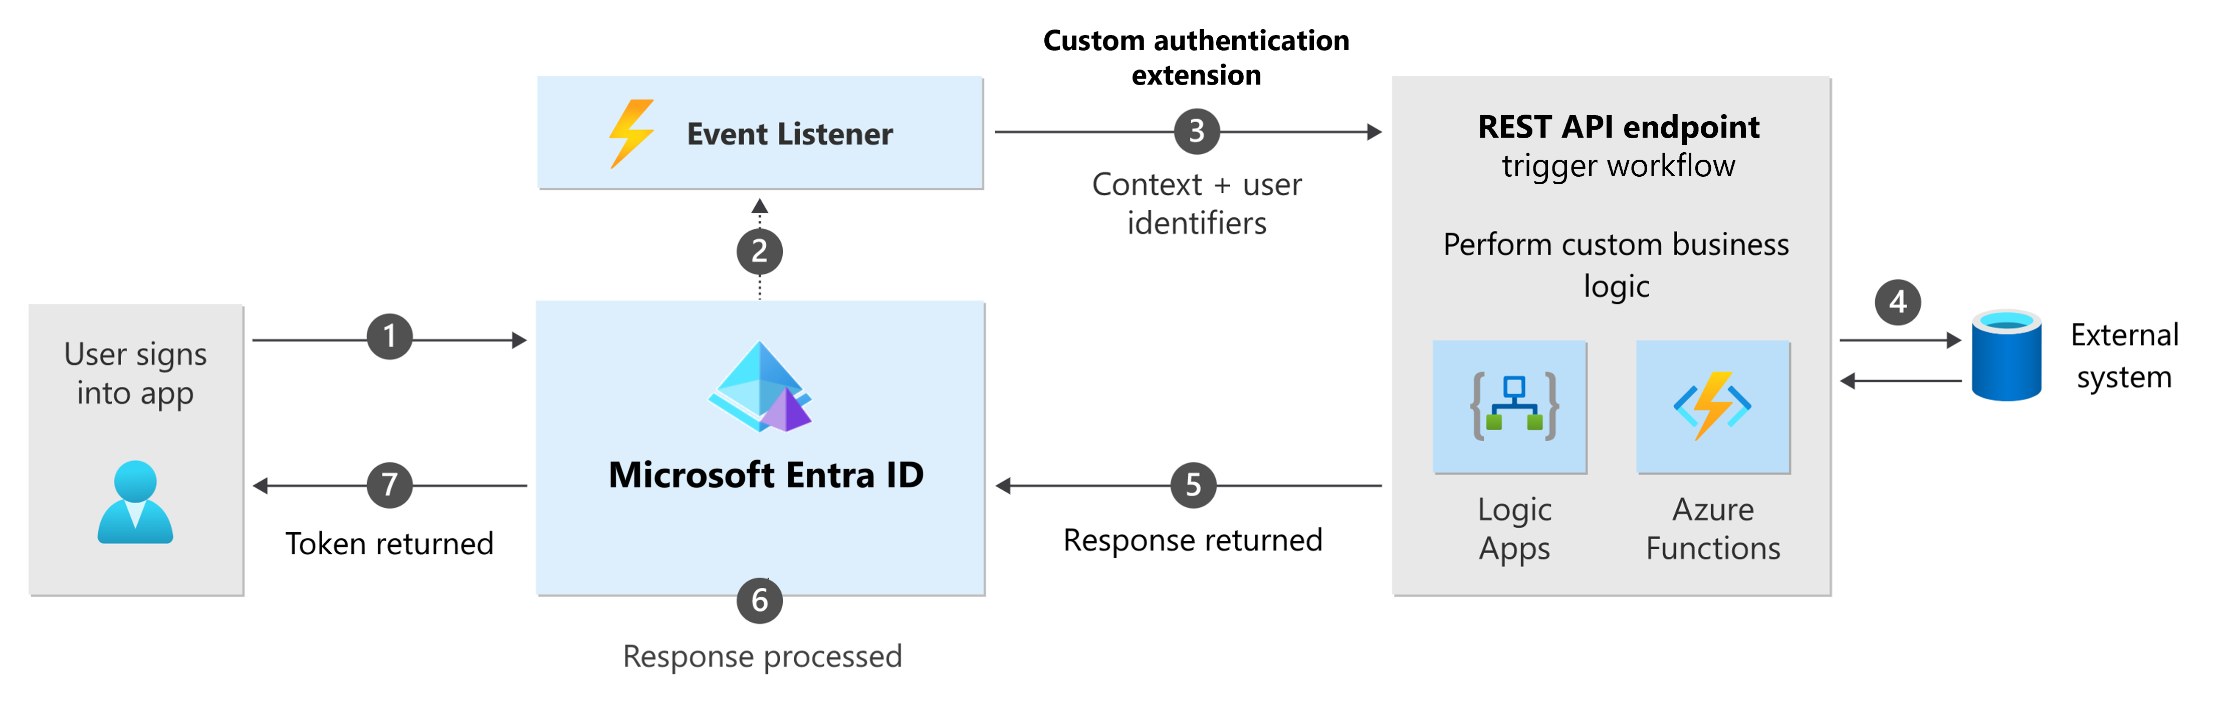
Custom Authentication Extension
A custom authentication extension is essentially an event listener that, when activated, makes an HTTP call to a REST API endpoint where you've defined a workflow action. You could use a custom claims provider to add external user data to the token before it's issued.
Notes:
https://learn.microsoft.com/en-us/entra/identity-platform/custom-extension-overview
https://learn.microsoft.com/en-us/entra/external-id/customers/concept-custom-extensions

Slide 3
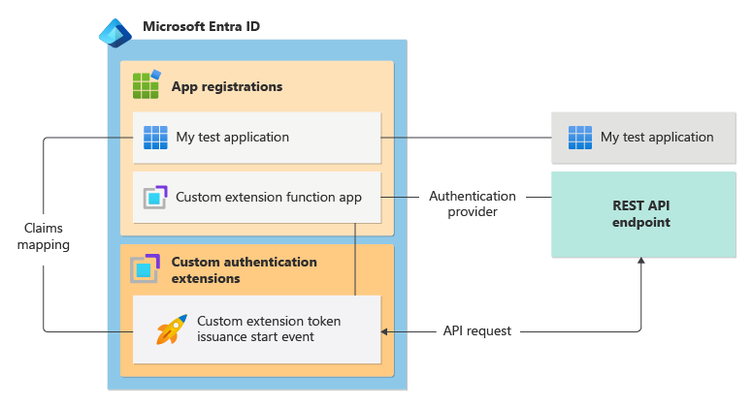
Custom Claims Provider
The custom claims provider token issuance start event allows you to enrich or customize application tokens with information from external systems.
This information that can't be stored as part of the user profile in Microsoft Entra directory.
Notes:
https://www.youtube.com/watch?v=fxQGVIwX8_4&list=PL3ZTgFEc7Lythpts59O9KOVuEDLWJLLmA&index=7

Slide 4

Best Practices and Common Pitfalls
Use custom claims provider sparingly and only when necessary.
Choose the appropriate data source for your custom claims provider.
Avoid performance and scalability issues by caching and optimizing your custom claims provider.
Ensure that your custom claims provider is secure and does not expose sensitive information.
Test your custom claims provider thoroughly before deploying it to production.

Slide 5
Sample Architecture
Entra Custom Authentication Extension.
Custom Claims API listens for the OnTokeIssuanceStart event.
Get user claims from SQL
Transaction needs to be completed in 2 seconds or the Authentication fails.

Slide 6
Sample application
https://github.com/caligaris/EntraCustomAuthenticationExtensionAPI

