Slide 1
Luma & Thread
Interested Buyer Automation
A working buyer intake flow for fashion and lifestyle sales teams.
Form
n8n
Sheets
Gmail
Follow-up
01

Slide 2
Sales intake problem
Fashion inquiries arrive through messages, comments, product links, and quick forms. The sales team needs the buyer context before the buyer cools off.
Capture
Segment
Save
Alert
The workflow keeps four things visible:
Product interest
Outcome
Budget and size
A shopper record, sales alert, and follow-up path appear from one submission.
Intent level
Recommended next action
02

Slide 3
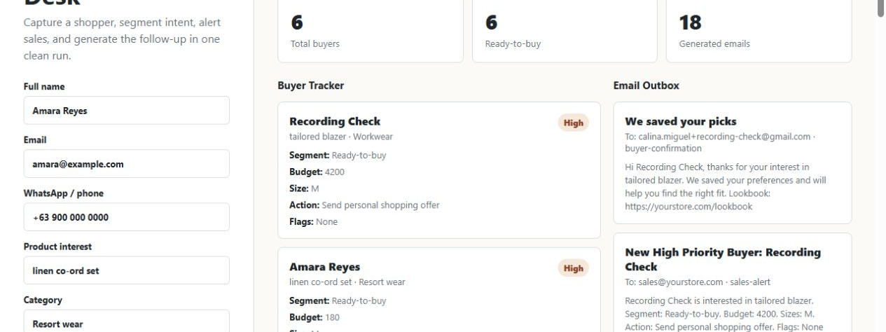
Buyer desk
The form captures product, budget, size, style preference, urgency, and source.
Local desk forwards to the published n8n webhook.
03

Slide 4
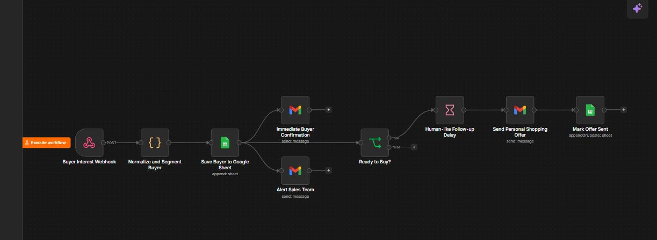
n8n workflow backbone
The workflow records the buyer first, sends the confirmation and sales alert, then routes high-intent shoppers to the personal shopping path.
04

Slide 5
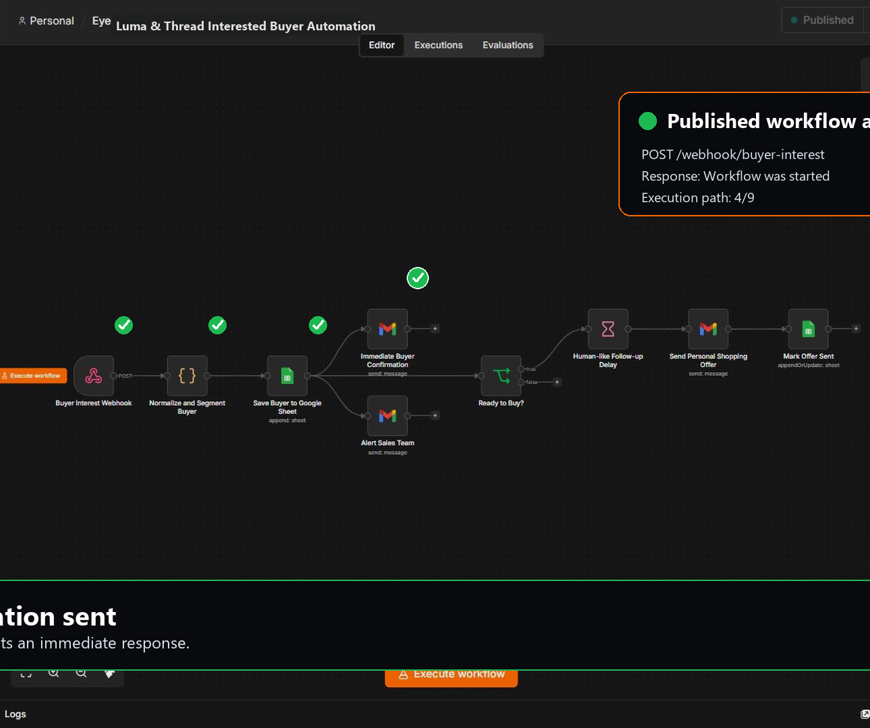
Run evidence
The published webhook accepted the buyer submission and returned a started workflow response.
POST /webhook/buyer-interest
{"message":"Workflow was started"}
Buyer
Tracker
Email
Offer
Video asset shows the node path with executed checks.
05

Slide 6
Presentation links
Open the live page, play the workflow video, or download this deck from the repository.
Live page
https://calina-miguel.github.io/fashion-buyer-automation/
Repository
https://github.com/calina-miguel/fashion-buyer-automation
Workflow
https://devtones.app.n8n.cloud/workflow/anSd0GnuD9zYGiLD
06

