Slide 1
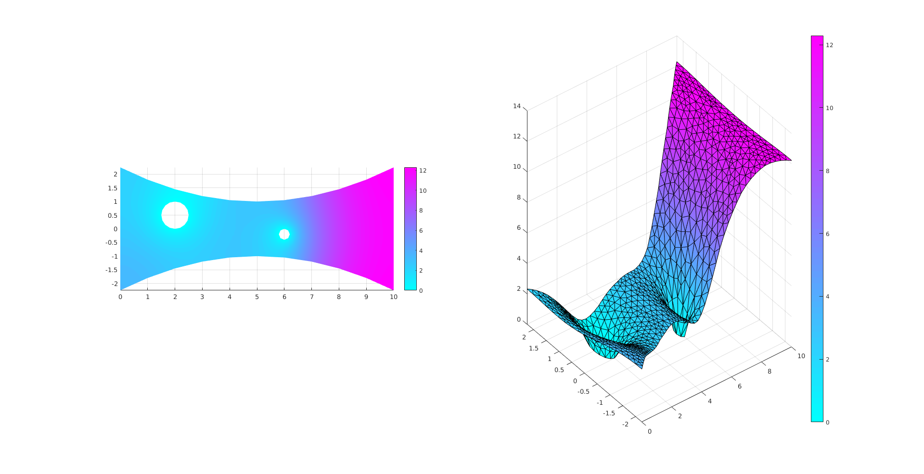
(-) Advection-reaction diffusion (in Matlab) with 3 different boundary conditions:
Dirichlet, no flux, and Robin. The code uses a first-order finite difference scheme.

Slide 2
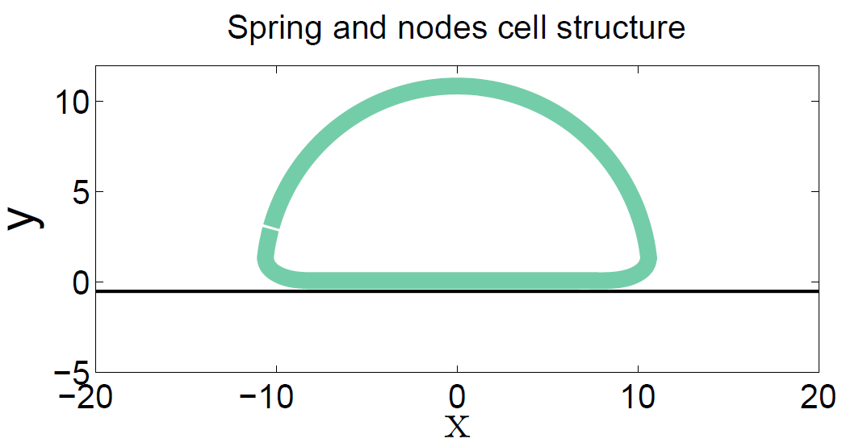
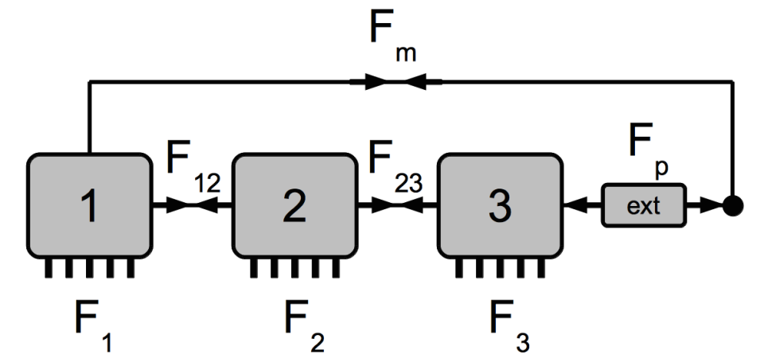
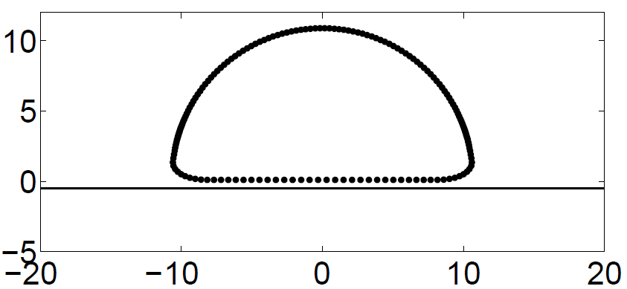
(-) Springs and nodes cell representation with elastic springs cell-surface binding (in C)

Slide 3
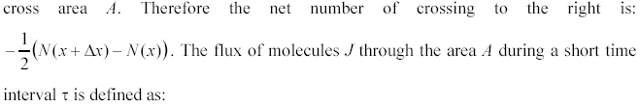
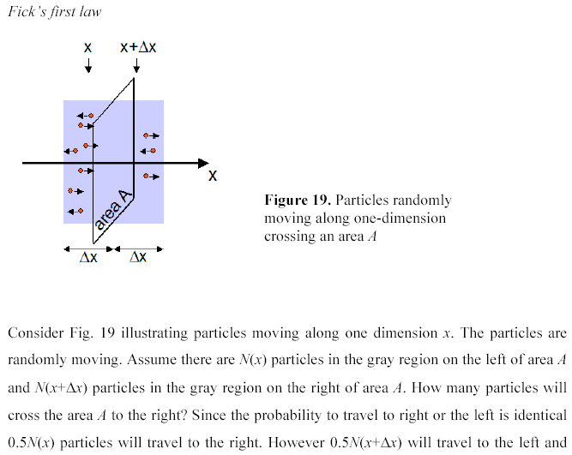
A bit about diffusion:

Slide 4
concentration
gradient
flux
(read SolDifEq.bmp from the class web site)
>> x=(-5:0.1:5);t1=1;t2=3;t3=5;c1=exp(-x.^2./t1)./sqrt(t1);
>> c2=exp(-x.^2./t2)./sqrt(t2);c3=exp(-x.^2./t3)./sqrt(t3);
>> plot(x,c1,x,c2,x,c3)

Slide 5
Drift, reaction-drift, diffusion-drift, and reaction-diffusion-drift equations in cell biology
Remember the 1st Fick’s law (conservation of the number of particles)?:
Before, we considered the diffusive flux: Now, let us consider particles
drifting to the right with velocity V(x). Then:
Where (particles from a box of length V*tau
can cross the boundary at x), so:
- drift flux
Remember that minus corresponds to the
right direction. If V(x) = const, then:
- drift equation
Solution to is

Slide 6
Other possible cases: diffusion-drift
No flux at the boundaries:
L – scale of length
L/V – scale of time
Arbitrary S – scale
of concentration
How much faster diffusion is than drift
The transients die out in L/V or in L^2/D, whichever is longer;
Number of motors is conserved (integrate and check). In the steady state, flux is
zero everywhere. Integrate the steady state equation once:
Can estimate either D or V if either V or D is known and log(C)/X is measured

Slide 7

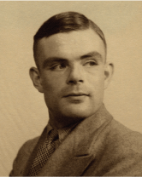
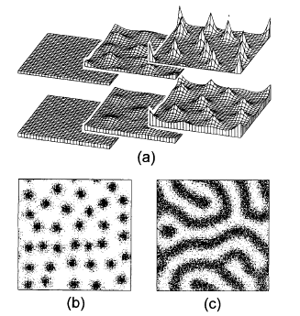
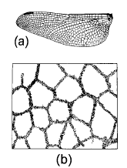
Turing Instability
activator-inhibitor system
Turing machine, algorithm,
computer, Bletchley park,
Enigma, AI – Turing test;
RD eqs – morphogenesis
A. M. Turing (1952).
The Chemical Basis of Morphogenesis.
Phil Trans Royal Soc London,
volume B 237, pages 37-72.

Slide 8
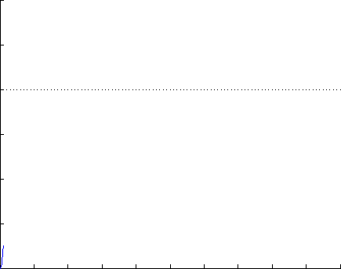
Any chemical reaction is stochastic.
deterministic equation
k/d
protein number (P)
Choose 1/d as the scale of time;
K=k/d as the scale of the # of molecules;
But in this case do not rescale the
# of molecules; t=kt’:
0
time (sec)

Slide 9
Why are chemical reactions stochastic?
1. Reactants diffuse to find each other in solution.
2. They must overcome the energy barrier of the reaction.
Both events are randomly affected by thermal fluctuations:
collisions with other (solvent) molecules

Slide 10
When are chemical reactions significantly stochastic?
As reaction only increases or decreases the number
of molecules by one or two, it is only when numbers of
molecules are small that random timing of individual
reactions will matter.

Slide 11
Noise depends on low numbers.
mean 40
mean 10,000
protein number
noise = 0.16
noise = 0.01
time (sec)
time (sec)

Slide 12
Stochastic model for this simple chemical reaction:
The rate of production is K, so over time dt we expect K*dt new molecules. If
K*dt << 1, then most likely no new molecules will appear, or at most one, and
most certainly not 2,3,… One new molecule will appear with probability Pr+ = K*dt.
2) The rate of degradation is P, so over time dt we expect P*dt existing
molecules to disappear. If P*dt << 1, then most likely no molecules disappear,
or at most one, and most certainly not 2,3,… One new molecule will disappear
with probability Pr- = P*dt.
Direct Monte Carlo method:
If the current number of molecules is P, (a) generate a random number equal to 1 with
probability Pr+ = K*dt and to 0 with probability (1 - Pr+), and add this number to P;
(b) generate a random number equal to 1 with probability Pr- = P*dt and to 0 with
probability (1 – Pr-), and subtract this number from P; (c) repeat this step for a few
time units.
How to generate a random number r equal to 1 with given probability Pr and to zero
otherwise?
In Matlab: rand r = 0.5*(1+sign(Pr – rand));
0 Pr 1
probability to be here is Pr

Slide 13
K=100; dt=0.001; tend=8;
t=(0:dt:tend); P=zeros(size(t));
for s=1:(tend/dt)
P(s+1)=P(s)+0.5*(1+sign(K*dt-rand))-0.5*(1+sign(P(s)*dt-rand));
end
plot(t,P)
hist(P,30)
Start with K
>> mean(P)
ans =
99.5100
>> std(P)
ans =
9.2659
Gaussian with average 100 and std~10

Slide 14
K
std
So, we expect:
Try simulating K=900 with dt=0.001 and see what your mean and std is. Think about it!
Note about dt: K*dt and P(s)*dt << 1; otherwise, one of the main assumptions is violated.
But this means that during most of the steps nothing happens so we waste a lot of computer
time generating random numbers and computing during ‘empty’ steps.
Another way to simulate this chemical reaction (without decay for now) stochastically:

Slide 15
Let us prove that if we generate the random waiting time
then its probability distribution will be as that for the
reaction event:
Gillespie algorithm

Slide 16
Gillespie algorithm
Algorithm: if you have a stochastic
process happening with rate K,
then you generate an exponentially
distributed time (average time 1/K),
and increase the number of molecules
at this time.
K=1; T=50; n=10;
time=zeros(size(T)); nn=n*ones(size(T));
for t=1:T % number of events
tt=-(1/K)*log(rand); time(t+1)=time(t)+tt;
% time for an event, time is updated
nn(t+1)=nn(t)+1; % molecule number is updated
end
stairs(time,nn,'r')
The method is exact; it also saves you
time when you have to make intermittent
small and large time steps. The downside
(there’s always one) is difficult code writing
if there are too many simultaneous reactions
we made 50 steps
Direct Monte Carlo
K=1; dt=0.1; T=50; n=10;
time=(0:dt:T); nn=n*ones(size(time));
for t=1:length(time) % number of steps
r = 0.5*(1+sign(K*dt - rand));
% random increment for molecule number
nn(t+1)=nn(t)+r; % molecule number is updated
end
plot(time,nn,'m')
we made 500 steps

Slide 17
How do we simulate a little bit more complex reaction (include degradation):
Algorithm: if you have 2 possible processes happening with rates r1 and r2, then an event
(any of the two processes) take place with the rate (r1 + r2). So, we first generate an
exponentially distributed time (average time 1/(r1+r2)), and then with probability r1/(r1+r2)
make the first event happen at this time, and with probability r2/(r1+r2) make the second
event happen at this time:
r1 = K and r2 = molecule #
K=1; T=50; n=10;
time=zeros(size(T)); nn=n*ones(size(T));
for t=1:T % number of events
T=-(1/(K+nn(t)))*log(rand); time(t+1)=time(t)+T;
% time for an event, time is updated
r=rand; if r<K/(K+nn(t)) n=n+1; % production
else n=n-1; end % degradation
nn(t+1)=n; % length is updated
end
stairs(time,nn,'r')

