Slide 1
cfDNA as a diagnostic tool for early cancer detection
Hack Students: Aamna Al-Shehhi, Calina Copos, Madhav Kothari, Revanz Ahmed, Seth Hilliard
Hack Investigators: Alejandro Balbin, Rebecca Leary, Markus Riester, Ben Gustafson, Katie Daco
Notes:
Thank Hack organizers, etc
Expertise of team (multi-disciplinary)

Slide 2
‹#›
Notes:
(Something motivating about earlier cancer detection)

Slide 3
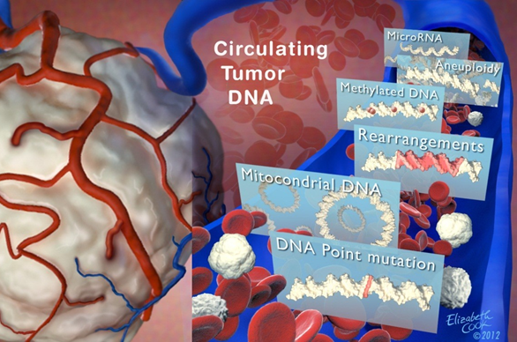
What can be detected in the circulation?

Slide 4
What can be detected in the circulation?

Slide 5
Where is Novartis looking today?
Notes:
What if no known mutations are found? Can we determine ctDNA more accurately?

Slide 6
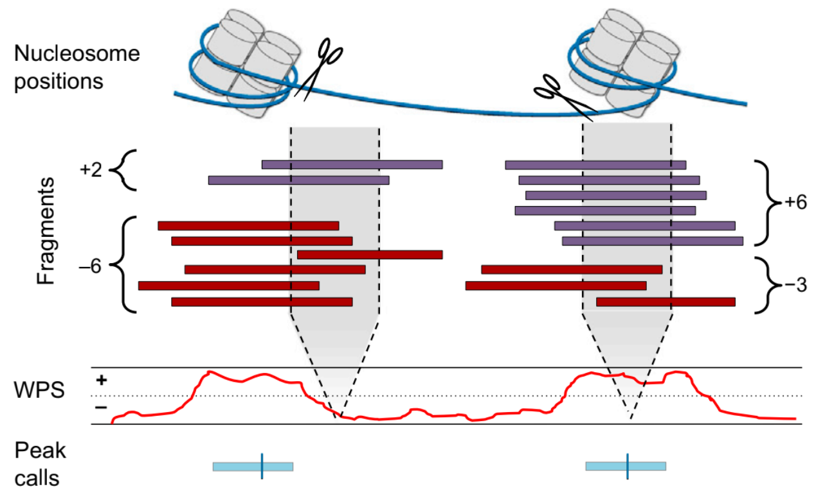
Once upon a time last Thursday
Window protection score
What data is important?
What resolution is important?
How can data be used in ML model?

Slide 7
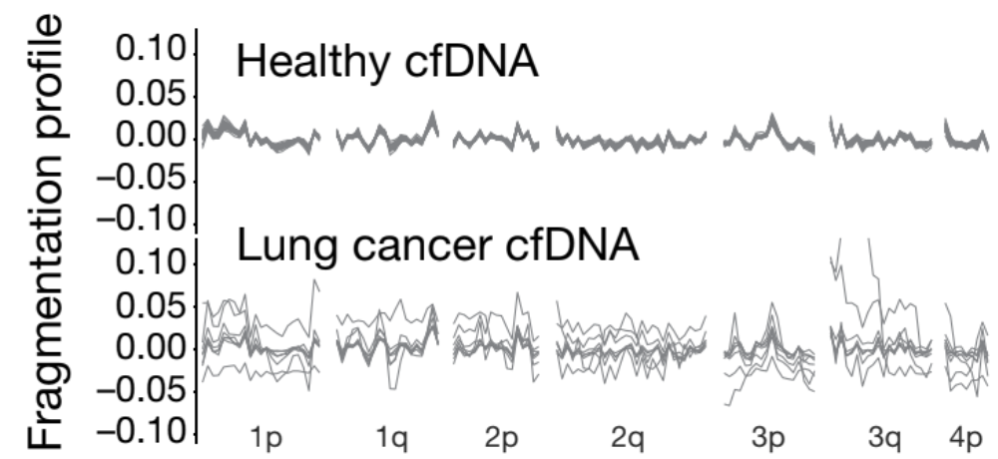
Feature Engineering
Mean
Amplitude
AUC
Variance
Power
Peak frequency from FFT
Nan Percentile
Is variance or range of WPS more important than average WPS itself?
Notes:
We had a WPS for each base pair of an exon, and to use ML we needed one entry per element
create the following features, per exon, per gene, and per chromosome

Slide 8
Results

Slide 9
Future Directions (BAM File, other assays, etc)

