Slide 1
Autofac & Nhibernate

Slide 2
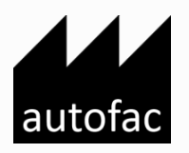
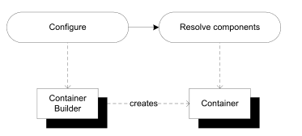
Autofac
- Dependency Injection is a set of software design principles and pat-
terns that enable us to develop loosely coupled code.
- With Autofac, we first create and configure
a ContainerBuilder instance. When we’re done configuring the ContainerBuilder , we use it to
create a Container that we can subsequently use to resolve components.
A ContainerBuilder can’t resolve
components, and we can’t configure a Container .

Slide 3

Nhibernate
- Object-relational mapping (ORM) in computer science is a programming technique for converting data between incompatible type systems using object-oriented programming languages. This creates, a "virtual object database" that can be used from within the programming language.

Slide 4
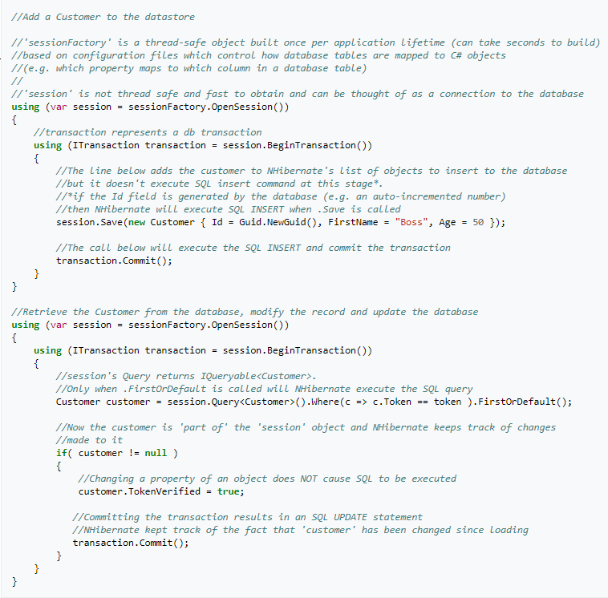

Slide 5
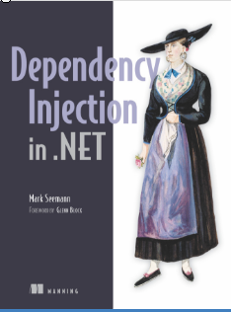

Resources
https://autofaccn.readthedocs.io/en/latest/index.html
https://nhibernate.info/doc/nh/en/index.html

