Slide 1




LEFT RECURSIVE
Group 7:
Divasetya Pratama Putri (2110631170009)
Annisa Intan Nuraini (2110631170052)
Calista Salsabila C. P. W. (2110631170058)
Notes:
Aturan produksi rekursif
Tahapan reduksi rekursif kiri (siapin algoritmanya)

Slide 2

TABLE OF CONTENTS
INTRODUCTION TO RECURSIVE
1
RECURSIVE PRODUCTION RULE
2
LEFT RECURSIVE REDUCTION STEPS
3
What’s recursive in production rule? What’s left recursive? And is there right recursive?
It’s actually what we explain in introduction yet here in advance
How to remove left recursive?

Slide 3


HELLO!
Please stay focus and enjoy! May you learn something new today

Slide 4


1
INTRODUCTION TO RECURSIVE PRODUCTION RULES

Slide 5
INTRODUCTION
In production rule, we’ve known a writing of variable product and production symbol, can be written as follows:
S → aB
B → ca | aB
If we input the string aaca
From that we can make an inheritance tree as below :
(next page)

Slide 6
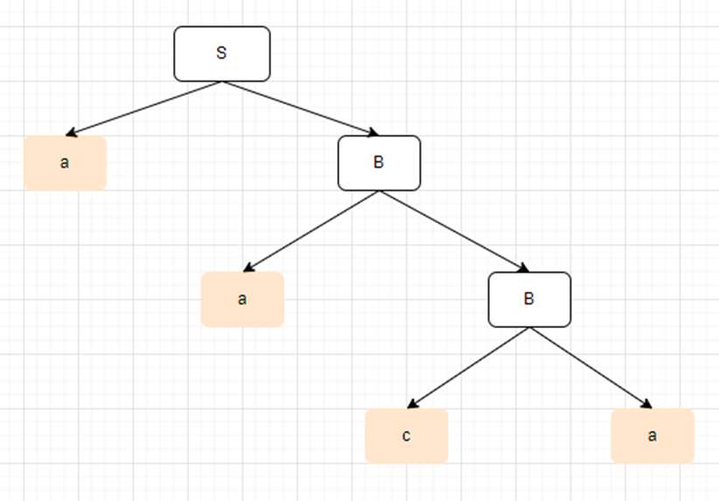
INTRODUCTION
S → aB
B → ca | aB

Slide 7
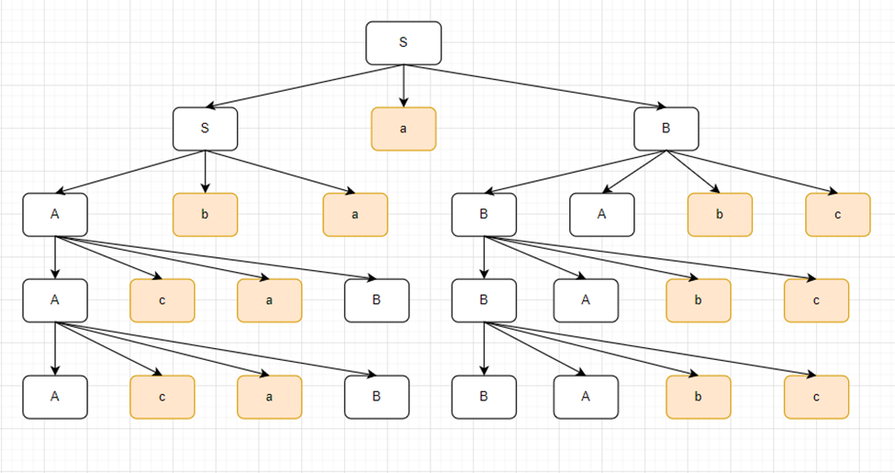
INTRODUCTION
But how if there are a production rule which contains :
S → SaB | ABa
A → AcaB
B → BAbc
It’ll be an endless looping

Slide 8
2
RECURSIVE PRODUCTION RULE

Slide 9
RECURSIVE PRODUCTION RULE
A recursive production rule has right side (production result) that includes variable symbol in left side.
The production rule in the form of:
𝛢→𝛽𝛢
Is production rule of the right side:
𝛽(V∪T)* or a collection of symbols, variables and terminals
Where 𝛽 is terminal symbol or variable symbol which is not equal to 𝛢
Example of production rule that’s right recursive:
S→dS
B→adB

Slide 10
RECURSIVE PRODUCTION RULE
Production in form of:
𝛢→𝛢𝛽
Is production rule that is left recursive, for example:
S→Sd
B→Bad
Right-hand recursive production causes the decline tree to grow to the right, whereas left-recursive production causes the decline tree to grow to the left.

Slide 11
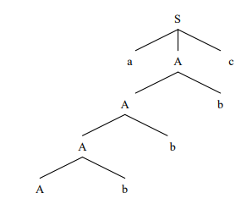
RECURSIVE PRODUCTION RULE
Look at this derivation tree context-free grammar with production rule:
S→aAc
A→Ab|𝜀

Slide 12
RECURSIVE PRODUCTION RULE
In so many implementation of grammar, left recursive is unwanted. To avoid derivation that could cause loop we must to remove left recursive as well.

Slide 13
3
LEFT RECURSIVE REDUCTION STEPS

Slide 14
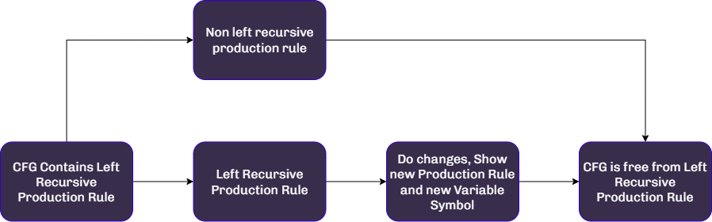
LEFT RECURSIVE REDUCTION STEPS

Slide 15

To avoid deriving that could result in a loop, remove the left recursive property of the production rule.

Slide 16
LEFT RECURSIVE REDUCTION
Example :
We have production rule as follow
S → Sab | Sbb | bAbb
A → AbS | aabb
B → b | bab | BbaA

Slide 17
LEFT RECURSIVE REDUCTION
Separate production rule which contain left recursive and right recursive!
Right recursive :
S → bAbb
A → aabb
B → b | bab
Left recursive :
S → Sab | Sbb
A → AbS
B → BbaA

Slide 18
LEFT RECURSIVE REDUCTION
For right recursive, give symbol for every product from the rule as 𝛽n
Right recursive :
S → bAbb
𝛽1 = bAbb
A → aabb
𝛽2 = aabb
B → b | bab
𝛽3 = b
𝛽4 = bab

Slide 19
LEFT RECURSIVE REDUCTION
For left recursive, give variable and terminal in front of first variable by symbol αn
Left recursive :
S → Sab | Sbb
S → Sα1 | Sα2
A → AbS
A → Aα3
B → BbaA
B → Bα4

Slide 20
LEFT RECURSIVE REDUCTION
Rebuild new production rule which followed step as :
S → 𝛽1Z1 | 𝛽2Z1 | … | 𝛽nZ1
Z1 → α1 | α2 | … | αn
Z1 → α1Z1 | α2Z1 | … | αnZ1
So from the production rule before, we get new production rule :
S → bAbb | bAbbZ1
A → aabb | aabbZ2
B → b | bab | bZ3 | babZ3
Z1 → ab | bb | abZ1 | bbZ1
Z2 → bS | bSZ2
Z3 → baA | baAZ3

Slide 21
THANKS!
Does anyone have any questions?
Please keep this slide for attribution

Slide 22

Exercise
Production rule:
S → Sa | aAc | c | 𝜀
A → Ab | ba
Do left recursive reduction

Slide 23
Exercise

