Slide 1
Outline
Research Background
Research Methods
Research Results
Conclusions & Future Work
Notes:
[Sources]
- Huang et al., ACS Applied Materials & Interfaces 2025, 17, 5078-5085. DOI: 10.1021/acsami.4c18435

Slide 2
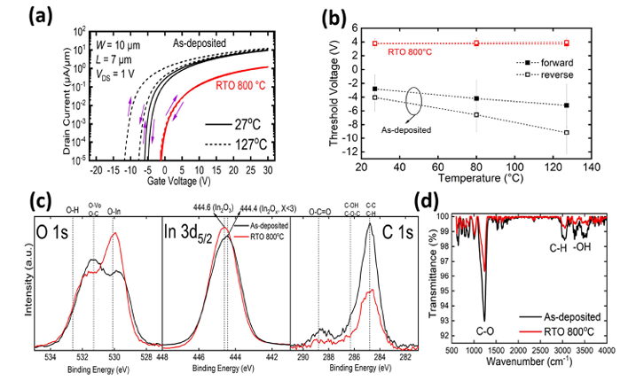
Why Thermal Stability Limits Ultrathin In₂O₃ FETs
ALD / carbon defects
Metal + heat create Vₒ
Thermal drift
High mobility and BEOL compatibility are offset by negative VTH shift, hysteresis, and SS degradation at elevated temperature.
Notes:
[Sources]
- Huang et al., ACS Applied Materials & Interfaces 2025, 17, 5078-5085. DOI: 10.1021/acsami.4c18435
- Figure 3 supplied by the user.

Slide 3
Outline
Research Background
Research Methods
Research Results
Conclusions & Future Work
Notes:
[Sources]
- Huang et al., ACS Applied Materials & Interfaces 2025, 17, 5078-5085. DOI: 10.1021/acsami.4c18435

Slide 4
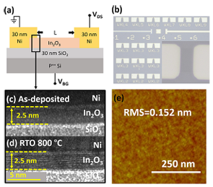
Device Fabrication and Stability Tests
ALD 225 °C
RTO 800 °C
Ni S/D
Thermal / PBS / forming-gas tests
2.5 nm In₂O₃ on 30 nm SiO₂/p⁺⁺ Si; RTO: O₂, 800 °C, 1 min before 30 nm Ni deposition.
Notes:
[Sources]
- Huang et al., ACS Applied Materials & Interfaces 2025, 17, 5078-5085. DOI: 10.1021/acsami.4c18435
- Figure 1 supplied by the user; Methods section of the paper.

Slide 5
Outline
Research Background
Research Methods
Research Results
Conclusions & Future Work
Notes:
[Sources]
- Huang et al., ACS Applied Materials & Interfaces 2025, 17, 5078-5085. DOI: 10.1021/acsami.4c18435

Slide 6
RTO Crystallizes In₂O₃ in One Minute
As-deposited
Crystalline RTO
1 min
RTO converts the 2.5 nm channel from amorphous to crystalline and limits 1000 s PBS drift from −1.6 to −0.4 V.
Notes:
[Sources]
- Huang et al., ACS Applied Materials & Interfaces 2025, 17, 5078-5085. DOI: 10.1021/acsami.4c18435
- Figure 1 supplied by the user; PBS values from the paper and Supporting Figure S5.

Slide 7
RTO Removes Carbon and Donor Defects
Fewer defects
XPS and FTIR show stronger stable In–O bonding and fewer Vₒ, C–O, C–H, and OH-related defects after RTO.
Notes:
[Sources]
- Huang et al., ACS Applied Materials & Interfaces 2025, 17, 5078-5085. DOI: 10.1021/acsami.4c18435
- Figure 3 supplied by the user.

Slide 8
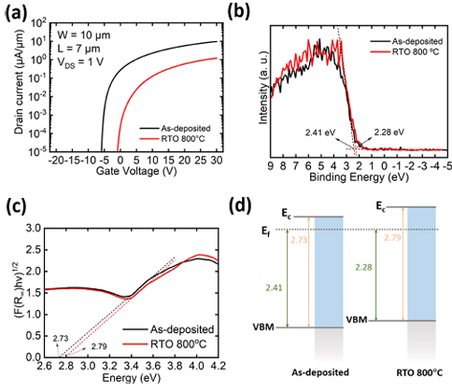
Crystallinity Trades Mobility for Stability
Eg: 2.73 → 2.79 eV
RTO shifts VTH from −4.7 ± 2 to 4.0 ± 0.7 V and lowers μFE from 26 ± 5 to 5 ± 3 cm²/V·s.
Notes:
[Sources]
- Huang et al., ACS Applied Materials & Interfaces 2025, 17, 5078-5085. DOI: 10.1021/acsami.4c18435
- Figure 2 supplied by the user.

Slide 9
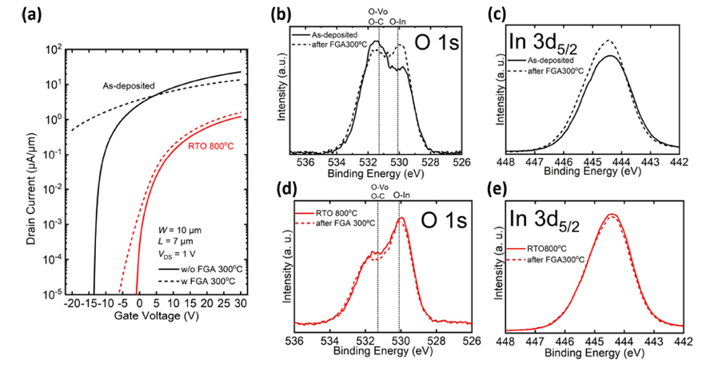
Crystalline In₂O₃ Resists Hydrogen Damage
Hydrogen immunity
After 300 °C forming-gas annealing, as-deposited transfer curves degrade strongly; RTO 800 °C devices change only slightly.
Notes:
[Sources]
- Huang et al., ACS Applied Materials & Interfaces 2025, 17, 5078-5085. DOI: 10.1021/acsami.4c18435
- Figure 4 supplied by the user.

Slide 10
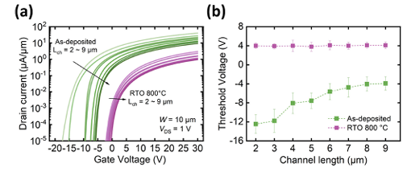
RTO Stabilizes Temperature and Channel Scaling
27 → 127 °C
9 → 2 μm
At 127 °C, RTO shifts only 0.05/0.15 V. From Lch 9→2 μm, VTH remains ~4 V instead of falling to −11.76 V.
Notes:
[Sources]
- Huang et al., ACS Applied Materials & Interfaces 2025, 17, 5078-5085. DOI: 10.1021/acsami.4c18435
- Figures 3 and 5 supplied by the user.

Slide 11
Outline
Research Background
Research Methods
Research Results
Conclusions & Future Work
Notes:
[Sources]
- Huang et al., ACS Applied Materials & Interfaces 2025, 17, 5078-5085. DOI: 10.1021/acsami.4c18435

Slide 12
Conclusions and Future Work
800 °C O₂ RTO
Higher crystallinity
Stable VTH + H₂ immunity
Next: top-gate, GAA, and monolithic 3D integration
Enhancing crystallinity both passivates existing defects and suppresses new metal- and heat-induced defects, enabling stable In₂O₃ for complex 3D devices.
Notes:
[Sources]
- Huang et al., ACS Applied Materials & Interfaces 2025, 17, 5078-5085. DOI: 10.1021/acsami.4c18435
- Conclusions section of the paper.

