Slide 1

웹개발
시니어 코딩

Slide 2
웹개발
1
웹, 인터넷이란?

Slide 3
Web
World Wide Web (WWW, W3)
# Wikipedia 인터넷에 연결된 컴퓨터들을 통해 사람들이 정보를 공유할 수 있는 전 세계적인 정보 공간을 말한다. 인터넷과 동의어로 쓰이는 경우가 많으나 엄격히 말해 서로 다른 개념이다. 웹은 전자 메일과 같이 인터넷 상에서 동작하는 하나의 서비스일 뿐이다. 그러나 1993년 이래로 웹은 인터넷 구조의 절대적 위치를 차지하고 있다.
1969 ~ 1990 ARPAnet 1981 CSNET (NFS, 미국 국립 과학 재단) 1982 TCP/IP 표준정립 1986 ~ 1995 NFSnet 1996 ~ ISP

Slide 4
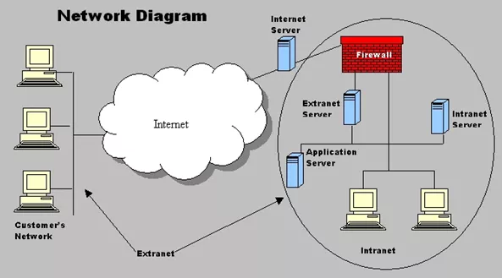
Internet
Intranet : Private
Extranet : Private
Internet : Global, Public
Web is a part of Internet.
출처: http://www.conceptsimplified.com/compare/difference-between-internet-intranet-and-extranet/

Slide 5
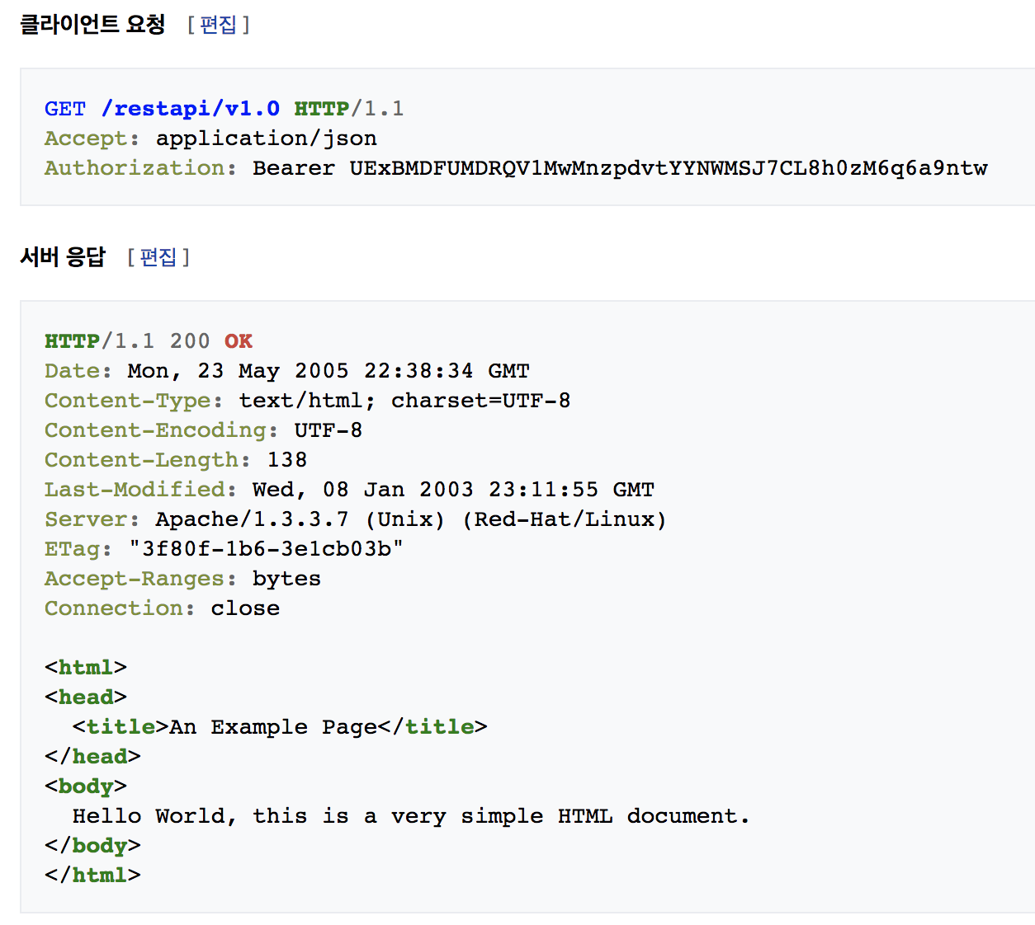
HTTP
cf. Protocols
TCP Transmission Control UDP Universal Datagram FTP File Transfer DHCP Dynamic Host Config IMAP Inter Message Access POP Post Office NNTP Network News Transfer NTP Network Time SMTP Simple Mail Transfer SNMP Simple Network Manage
HyperText Transfer Protocol (Web Protocol)
1996 HTTP 1.0 1999 HTTP 1.1 2015 HTTP 2
Request, Response Authentication Session, Cookie Foward, Redirect Cache, Compression Header, UserAgent

Slide 6
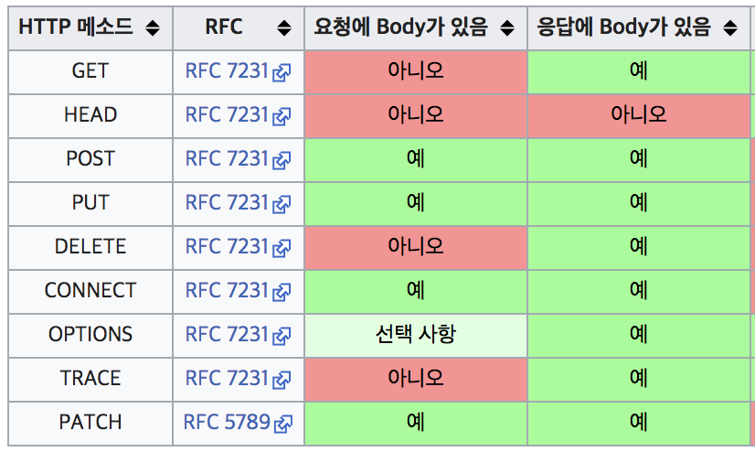
HTTP (Cont'd)
# Request, Response, Body
# HTTP Request Method
# Response Code
200 OK 202 Accepted
304 Not Modified
400 Bad Request 401 UnAuthorized 403 Fobidden 404 Not Found 405 Method NotAllowed
50X Error

Slide 7
Web Development (웹개발 시작하기)
https://developer.mozilla.org/ko/docs/Learn/Getting_started_with_the_web

Slide 8
웹개발
2
HTML

Slide 9
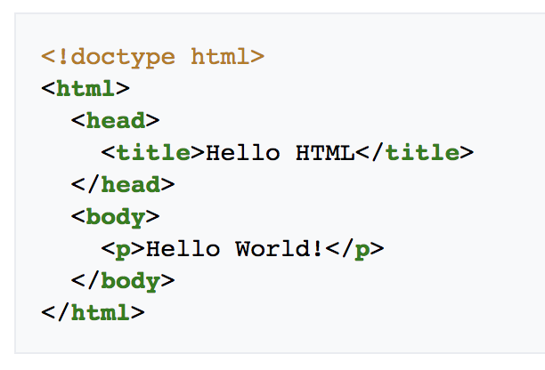
HTML (HyperText Markup Language)
1991 HTML 1996 XML 2000 XHTML 2004 HTML5
Tag, Element, Attribute, Namespace
# HTML Tutorial https://developer.mozilla.org/ko/docs/Learn/HTML/Introduction_to_HTML https://www.w3schools.com/html/default.asp

Slide 10
웹개발
3
CSS

Slide 11
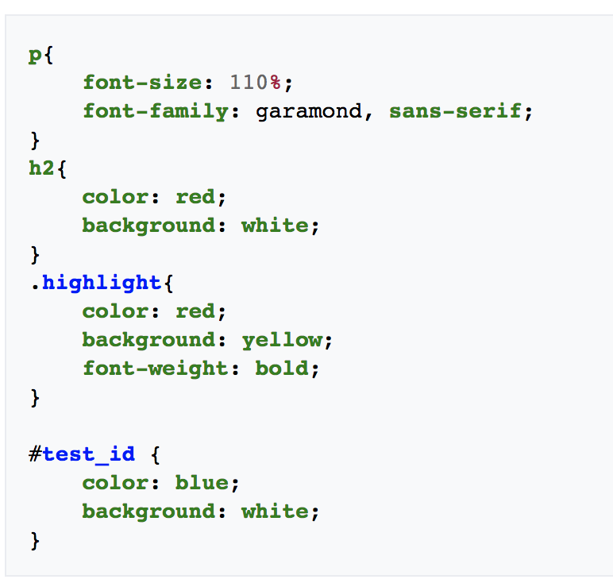
CSS (Cascading Style Sheets)
1994 Suggested 1996 CSS1 (cf. XSLT) 1998 CSS2 2005 CSS3 2012 SASS (Syntactically Awesome StyleSheets) Style, Selector, XPath
# CSS Tutorial https://developer.mozilla.org/ko/docs/Learn/CSS/Introduction_to_CSS https://www.w3schools.com/css/default.asp https://getbootstrap.com/

Slide 12
웹개발
4
JavaScript

Slide 13
JavaScript
# Javascript Tutorial
https://www.w3schools.com/js/default.asp
# jQuery
Download: https://code.jquery.com/ API Doc: https://jquery.com/

Slide 14
웹개발
요청강의
5
jQuery

Slide 15
jQuery
# jQuery Tutorial
https://learn.jquery.com/
# jQuery
Download: https://code.jquery.com/ API Doc: https://jquery.com/

Slide 16
Getting Start
<script src="https://cdnjs.cloudflare.com/ajax/libs/jquery/3.3.1/jquery.js"></script>
<script>
$( window ).on( "load", alert('onload!!') );
$( document ).ready(function() { console.log( "ready!" ); $('#err').hide(); });
</script>

Slide 17
AJAX (Asynchronous JavaScript and XML)
var URL= "http://berryservice.net:8080/Berry/g/tests/"; $.get(URL).then( function(json) { var content = JSON.stringify(json, null, " "); $("<h1>").text(json.test.length).appendTo("body"); $("<pre class=\"content\">").html(content).appendTo("body"); }, function(err) { console.error("Sorry, there was a problem!", err.status, err); });
// 비동기I/O == Non-Blocking I/O == Asyncronized (cf. 동기 == Synchronized)

Slide 18
AJAX (Asynchronous JavaScript and XML)
var URL = "http://berryservice.net:8080/Berry/g/tests/"; $.get(URL).done( function( json ) { var content = JSON.stringify(json, null, " "); $("<h1>").text(json.areagroup.length).appendTo("body"); $("<pre class=\"content\">").html(content).appendTo("body"); }).fail( function( xhr, status, errorThrown ) { console.error("Sorry, there was a problem!", xhr, status, errorThrown); console.error(">>", xhr.responseJSON); }).always(function( xhr, status ) { console.log( "The request is complete!" ); });

Slide 19
AJAX (Asynchronous JavaScript and XML)
var URL = "http://berryservice.net:8080/Berry/g/tests/"; $.ajax({ url: URL, type: "GET", dataType : "json" }).done(function( json ) { var content = JSON.stringify(json, null, " "); $("<pre class=\"content\">").html(content).appendTo("body"); }).fail(function( xhr, status, errorThrown ) { console.error("Error>>", xhr.responseJSON); var $err = $('#err'); $err.text(xhr.responseJSON.message); $err.show(); }).always(function( xhr, status ) { console.log( "The request is complete!" ); });

Slide 20
AJAX (Asynchronous JavaScript and XML) : Parameter
var URL = "http://berryservice.net:8080/Berry/g/tests/", p = { cmd: "test-by-icode", icode: 3 }; $.ajax({ url: URL, type: "GET", data: p, dataType : "json" }).done(function( json ) { var content = JSON.stringify(json, null, " "); $("<pre class=\"content\">").html(content).appendTo("body"); }).fail(function( xhr, status, errorThrown ) { console.error("Sorry, there was a problem!", status); }).always(function( xhr, status ) { console.log( "The request is complete!", URL + '?' + $.param(p)); });

Slide 21
AJAX (Asynchronous JavaScript and XML) : POST
var URL = "http://berryservice.net:8080/Berry/g/tests/"; $.ajax({ url: URL, data: { name: "test333-1", icode: 3 }, type: "POST", dataType : "json" }).done(function( json ) { var content = JSON.stringify(json, null, " "); $("<pre class=\"content\">").html(content).appendTo("body"); }).fail(function( xhr, status, errorThrown ) { console.error("Sorry, there was a problem!", status); }).always(function( xhr, status ) { console.log( "The request is complete!" ); });

Slide 22
AJAX (Asynchronous JavaScript and XML) : DELETE
var test28_url = "http://berryservice.net:8080/Berry/g/tests/28"; $.ajax({ url: test28_url, type: "DELETE" }).done(function( json ) { var content = JSON.stringify(json, null, " "); $("<pre class=\"content\">").html(content).appendTo("body"); }).fail(function( xhr, status, errorThrown ) { console.error("Sorry, there was a problem!", status); }).always(function( xhr, status ) { console.log( "The request is complete!" ); });

Slide 23
웹개발
요청강의
6
Handlebars

Slide 24
Handlebars.js : client side Template Engine
http://handlebarsjs.com/
cf. CSS Template
https://getbootstrap.com
https://mdbootstrap.com
https://fontawesome.com/v4.7.0/icons/

