Slide 1
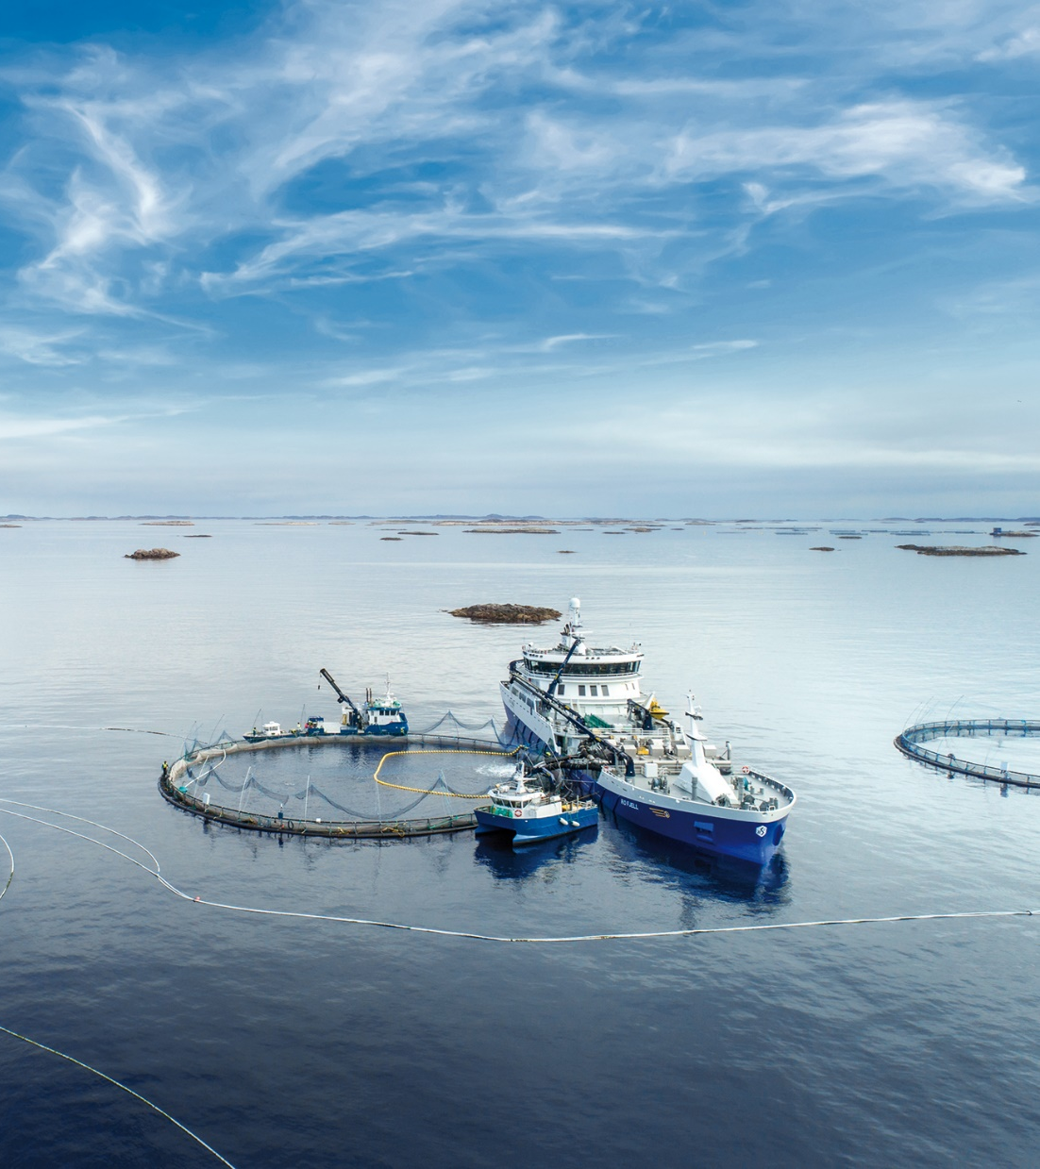
PF Slewing motor

Slide 2
PF Kran

Slide 3
PF Crane
Slewing Motor Requirements

Slide 4
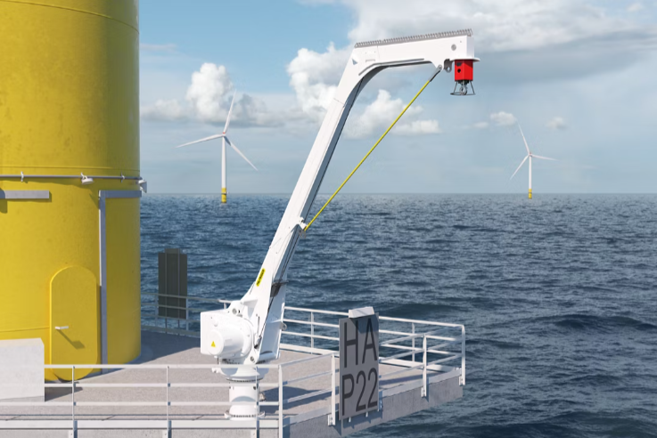
Crane Application - Offshore Davit

Slide 5
Crane & Slewing Requirements
PARAMETER | VALUE | WHY REQUIRED
Crane Type | Offshore Davit Crane | Defines application environment
Lifetime | 30 years | Long-term reliability requirement
Operating Hours | 500 h | Low-duty lifetime usage
Load Cycles | 5222 | Structural fatigue design
Operating Temperature | -20C to +45C | Offshore environmental range
Motor Duty | S3 >= 25% | Required intermittent crane operation
PARAMETER | VALUE | WHY REQUIRED
Slewing Speed | 0.2 - 1.0 rpm | Controlled crane rotation
Slewing Type | Electric + manual backup | Emergency operation
Slew Gear Ratio | ~110 - 150 | High torque generation
Motor Interface | IEC 90 B5 (O165 mm) | Compatibility with geared motor

Slide 6
Slewing Drive Parameters - BE702-2B-Z18.7-LM
PARAMETER | VALUE | PURPOSE
Gear Ratio | 121 : 1 | High torque multiplication
Efficiency | 40% | Torque transfer through worm gear
Self-Locking | Yes | Prevents back-driving
Backlash | <0.15 degrees | Accurate positioning
Maximum Torque | 41,190 Nm | Drive mechanical limit
Nominal Torque | 15,360 Nm | Continuous operation
STRUCTURAL LOAD CAPACITY | VALUE | APPLICATION
Axial Dynamic Load | 1200 kN | Vertical crane loads
Radial Dynamic Load | 400 kN | Horizontal forces
Axial Static Load | 4000 kN | Static load capacity
Radial Static Load | 1600 kN | Structure stability
Tilting Moment | 540 kNm | Crane overturning load
Holding Torque | 100 kNm | Hold position without motion

Slide 7
Current Slewing Motor - EP2557M
MECHANICAL PARAMETER | VALUE | PURPOSE
Motor Type | Helical Bevel Geared Motor | Compact high-torque drive
Motor Power | 0.75 - 1.1 kW | Required torque generation
Gear Ratio | 27.82 | Speed reduction
Rated Motor Speed | 1410 - 1365 rpm | Standard induction motor speed
Output Speed | ~51 rpm | Correct slewing speed
Output Torque | 141 Nm | Input torque for slew drive
Pull-up Torque | ~295 Nm | Starting torque
ELECTRICAL PARAMETER | VALUE
Voltage 50 Hz | 400 / 690 V
Voltage 60 Hz | 400 / 480 / 690 V
Frequency | 50 / 60 Hz
Insulation Class | Class H
Duty Cycle | S2 - 12 min

Slide 8
Environmental & System Requirements
PARAMETER | VALUE | REQUIREMENT
Protection Class | IP66 | Protection against water & dust
Ambient Temperature | -20C to +45C | Offshore climate conditions
Heater | 24 V DC, ~25 W | Prevent internal moisture
Coating | C5H (>=300 micrometers) | Offshore corrosion protection
Paint Color | RAL7035 | Standard marine finish
PERFORMANCE TARGET | VALUE
Motor Output Speed | ~50 rpm
Slewing Drive Ratio | 121 : 1
Crane Slewing Speed | 0.2 - 1.0 rpm
All specifications comply with Palfinger offshore marine standards

Slide 9
PF-XXL Slewing Torque Requirement vs Drive Capability
PARAMETER | VALUE | SOURCE
Maximum Slewing Torque | 62 kNm | PF-XXL crane requirement
Holding Torque | 107 kNm | PF-XXL crane requirement
Tilting Moment | 625 kNm | PF-XXL crane requirement
Radial Load | 26 kN | PF-XXL crane requirement
Axial Load | 86 kN | PF-XXL crane requirement
SLEWING DRIVE CHARACTERISTICS | VALUE
Slewing Drive Ratio | ~150 : 1
Drive Efficiency | ~40%
Self-Locking | Yes
Required Motor Torque Calculation
Motor Torque = Slew Torque / (Ratio x Efficiency)
Motor Torque = 62,000 Nm / (150 x 0.40) = 103 Nm
Minimum theoretical: 103 Nm | Proposed: 180 Nm | Margin: 75%

Slide 10
PF-XXL Recommended Slewing Motor Specification
PARAMETER | TARGET VALUE | REASON
Motor Power | ~1.5 kW | Increased torque capability
Output Torque | ~180 Nm | Meets required torque margin
Output Speed | ~50 rpm | Compatible with slew drive
Duty Cycle | S3 >= 25% | Crane requirement
Voltage | 400 / 480 / 690 V | Offshore power supply
Resulting Slewing Performance
Motor Output Speed: ~50 rpm | Slewing Drive Ratio: 150:1
Resulting Slew Speed: ~0.33 rpm (within required 0.2 - 1.0 rpm range)
PF-XXL Motor Concept
Marine execution helical-bevel geared motor
~1.5 kW motor power | ~180 Nm output torque | ~50 rpm speed
IP66 protection | C5H offshore coating | 24 V heater

